Slide 1

OceanGliders
The glider component of the integrated Global Ocean Observing System
www.oceangliders.org

Slide 2
OceanGliders, the glider component of GOOS
The OceanGliders program brings marine scientists deploying gliders from all over the world to observe on the long term physical, biogeochemical, biological ocean processes and phenomena. It allows active coordination and strengthening of the worldwide glider activity.
It contributes to the present international efforts for Ocean Observation for Climate, Ocean Health and Real Time Services
Our goal is to : monitor the global glider activity, share the requirements, efforts and scientific knowledge needed for gliders data collection and support the dissemination of glider data in global databases, in real-time and delayed mode.

Slide 3
OceanGliders recommend to :
1. develop a global operational program of underwater gliders to address key ocean observing challenges.
2. develop a global data management system to ensure the effective sharing and use of data from underwater gliders.
3. consider three key areas of ocean observation: Ocean Boundary Currents, Storms, and Water Transformation.
4. develop an implementation plan for a sustained Boundary Ocean Observing Network to meet the societal needs of improving ocean observation.

Slide 4
OceanGliders, data management
The OceanGliders addresses a limited number of scientific issues that need a coordinated effort around appropriate EOVs (Essential Ocean Variables) with existing national and regional glider data centers to harmonize data management on a global scale.
The OceanGliders Data Management Task Team (OGDMTT) develops a strategy and implementation plan for international coordination and governance. We build a strong interoperability of ocean glider data and metadata regardless of the location of data center or model of glider used.
  Merge near real time (NRT) and delayed mode (DM) data streams,
  Harmonize quality assurance and control (QA and QC)
  Address biogeochemical data handling (aligned with BGC-Argo)
  Standardize formats and protocols, web services - API.
Significant efforts have already been made in national and regional data centers, such as Ocean Gliders Canada , Australian National Facility for Ocean Gliders (ANFOG), US National Glider Network (NGN), IOOS National Glider Data Assembly Center, and Everyone’s Gliding Observatory (EGO).

Slide 5
OceanGlider Task Team ongoing activity
Propose unified data format to facilitate sharing and collaboration
Harmonize three existing standards (US, EU, AU) with minimum impact for historical data, but flexible and stable enough for long-term usability.
Match as closely as possible BGC-Argo floats and OceanSITES moorings data management
Join us on
https://github.com/OceanGlidersCommunity/OG-format-user-manual

Slide 6
OceanGlider Task Team ongoing activity
EGO contribution for a common NetCDF-CF file format to manage glider metadata and observations, organized by deployment
EGO gliders NetCDF format reference manual version 1.5 http://doi.org/10.13155/34980
EGO gliders Quality Control on time series and profiles data
http://doi.org/10.13155/51485
EGO gliders data processing chain
http://doi.org/10.17882/45402
EGO gliders NetCDF file format checker
http://doi.org/10.17882/45538

Slide 7

DAC glider real-time data processing
DAC : data assembly centre
Glider metadata
JSON from OceanOPS
Data processing
Matlab code
Glider deployment NetCDF trajectory file
data, metadata, QC flags
Glider data
Iridium messages

Slide 8
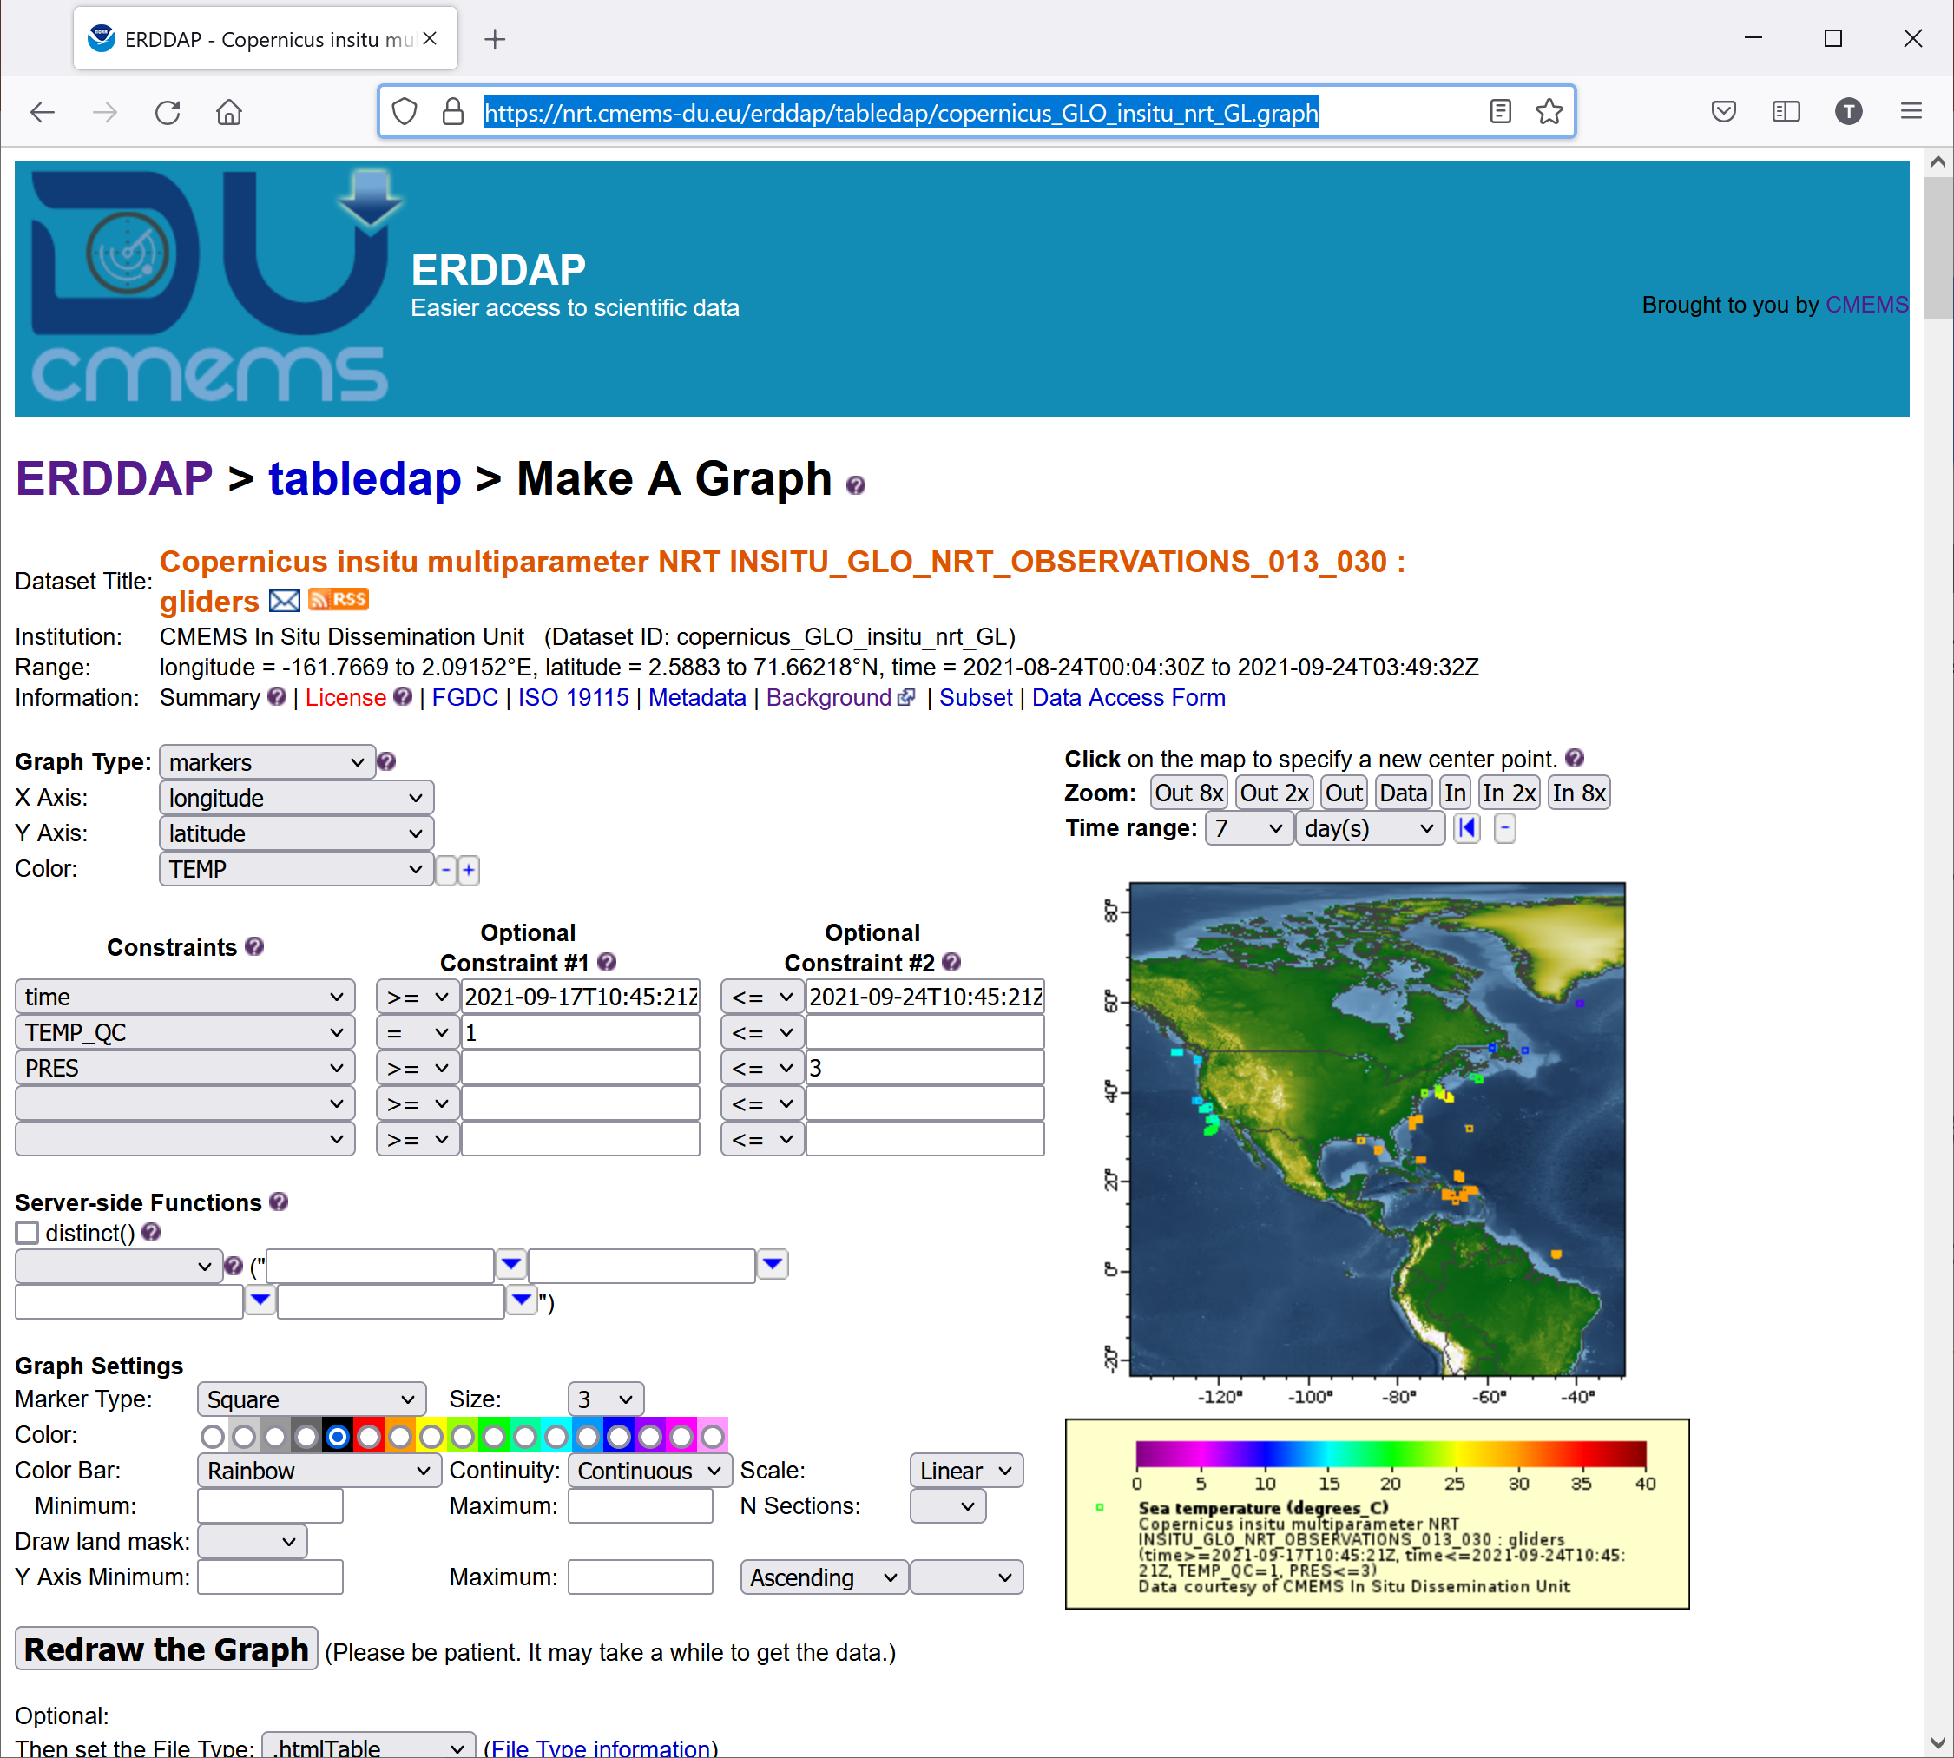
OceanGliders GDAC prototype
A prototype for OceanGliders GDAC
(Global Data Assembly Centre) available at:
  https://nrt.cmems-du.eu/erddap
  http://www.ifremer.fr/co/ego/ego/v2
A directory per glider, a sub-directory per deployment
Each deployment contains
  The NetCDF trajectory data and metadata file
  The deployment JSON file (used for data processing)
  A directory of all vertical profiles
    One NetCDF file per profile, extracted from NetCDF data file (descending and ascending phases)

Slide 9
Data citation, credit to scientists
Work underway within OceanGliders
  Assign a DOI for each deployment
  Manage DOIs of DOIs to group a series of deployments
    Network level
    Science process
  Use ORCID to give credit to PIs and contributors
Examples
  Tintin in Greenland http://doi.org/10.17882/51473
  Tintin & Moose http://doi.org/10.17882/51472

Slide 10
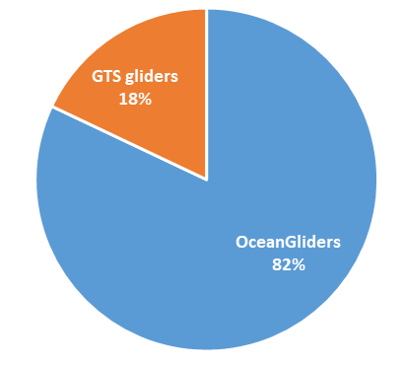
Copernicus Marine glider profiles (from OceanGliders and GTS)
EU Copernicus Marine service aggregates vertical profiles from OceanGliders and WMO GTS
Today : 2,3 million ocean vertical profiles from 423 gliders (82% from OceanGliders)

Slide 11
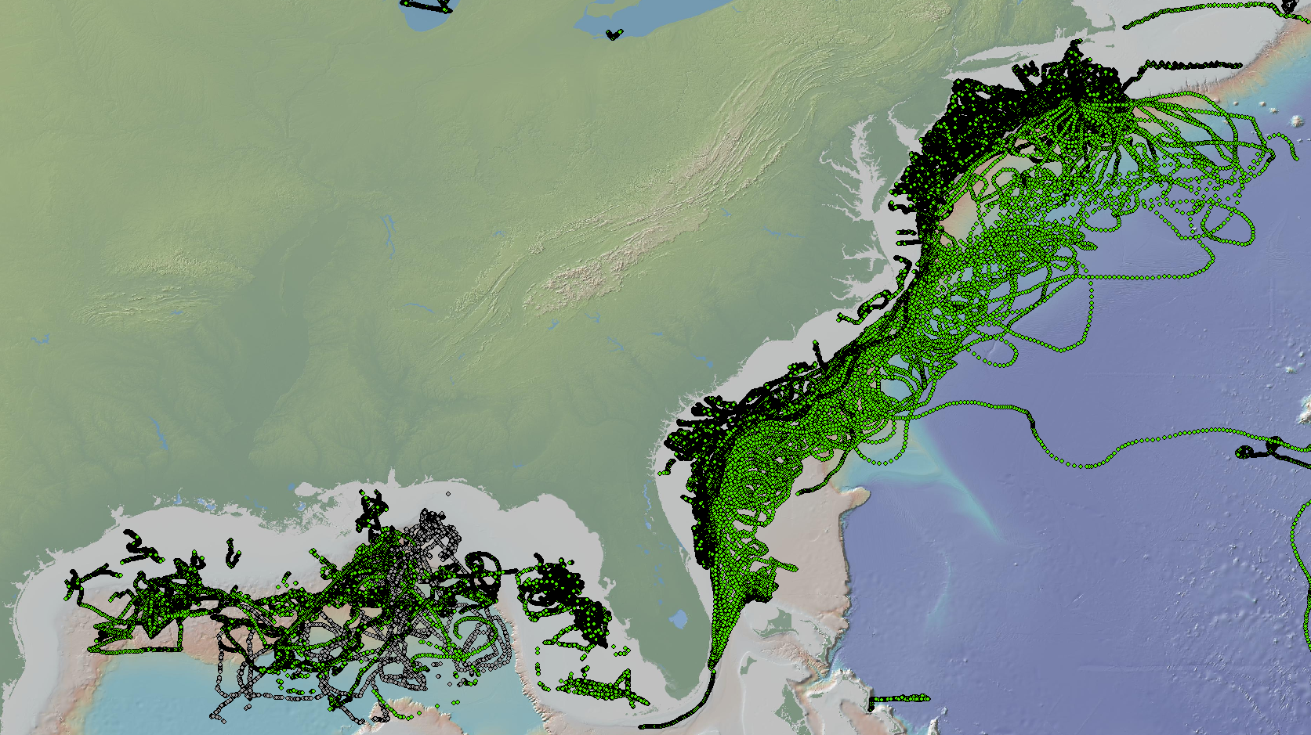
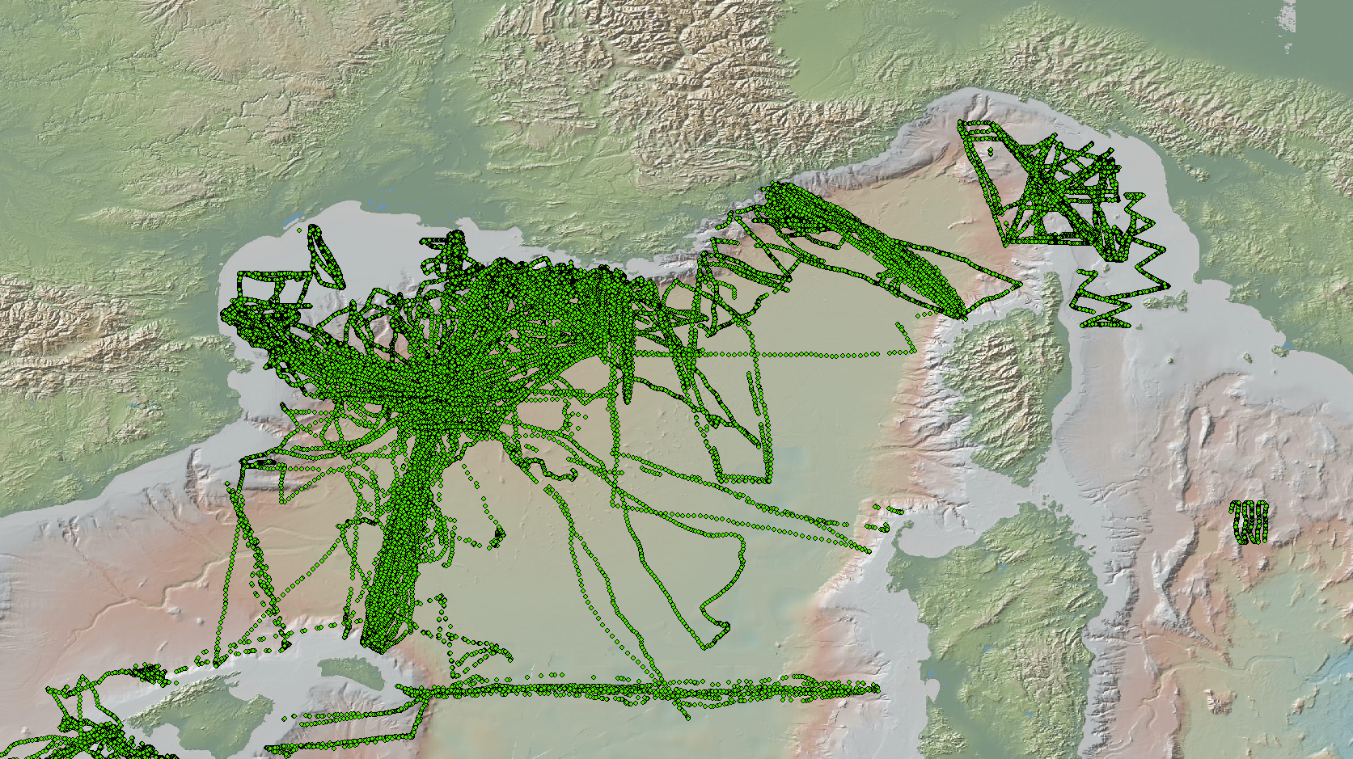
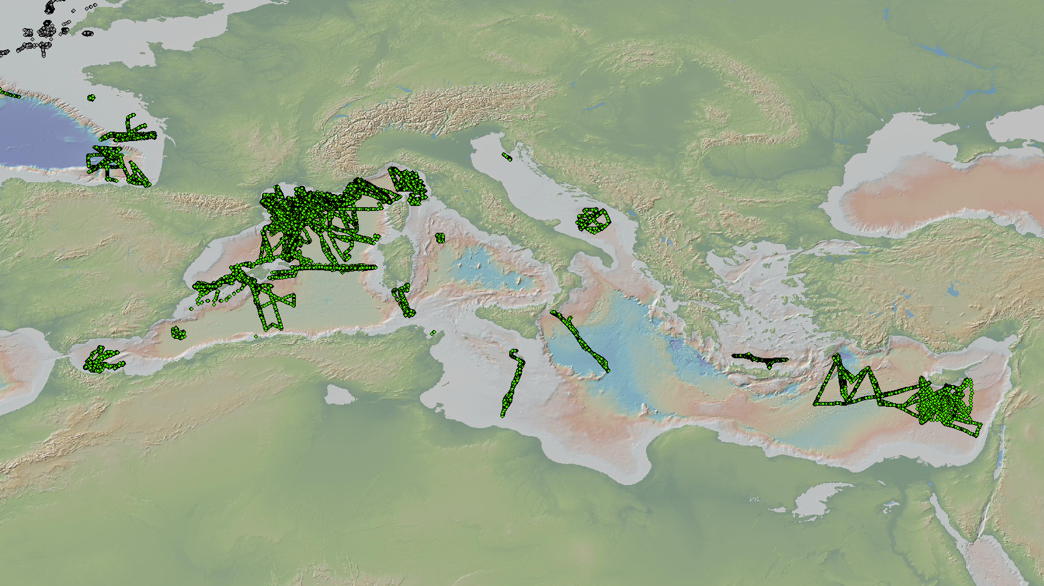
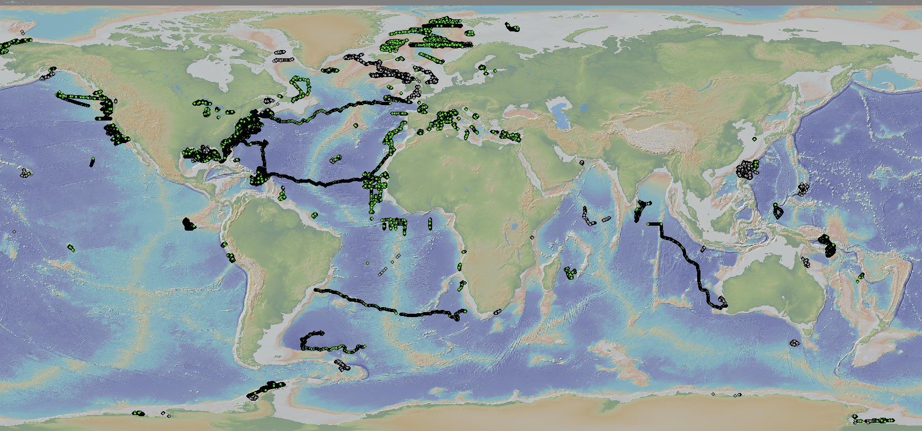
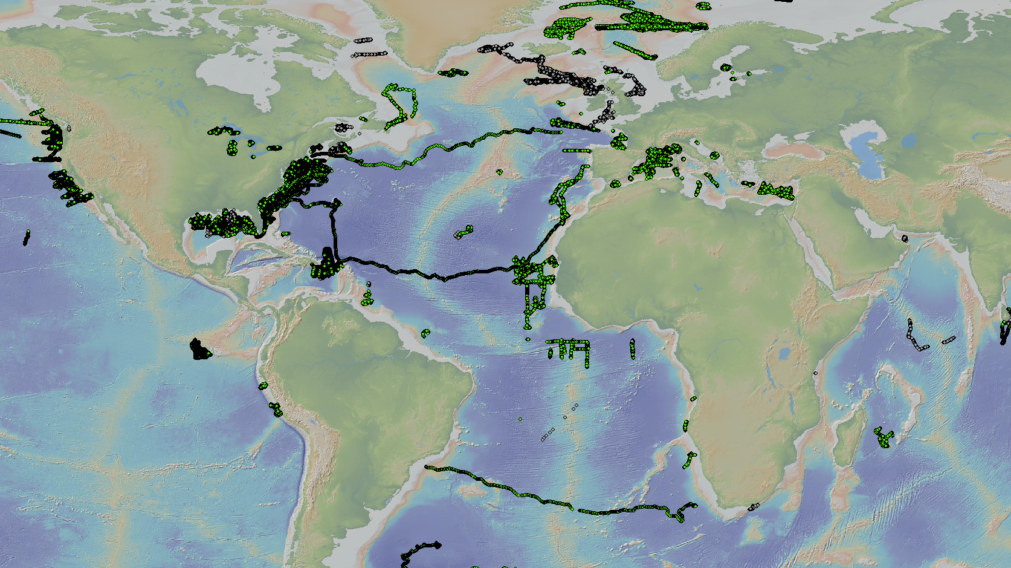
A few maps : 2 million profiles from 400 gliders in September 2021 (OceanGlider, GTS)
Source: Copernicus Marine service

