Slide 1
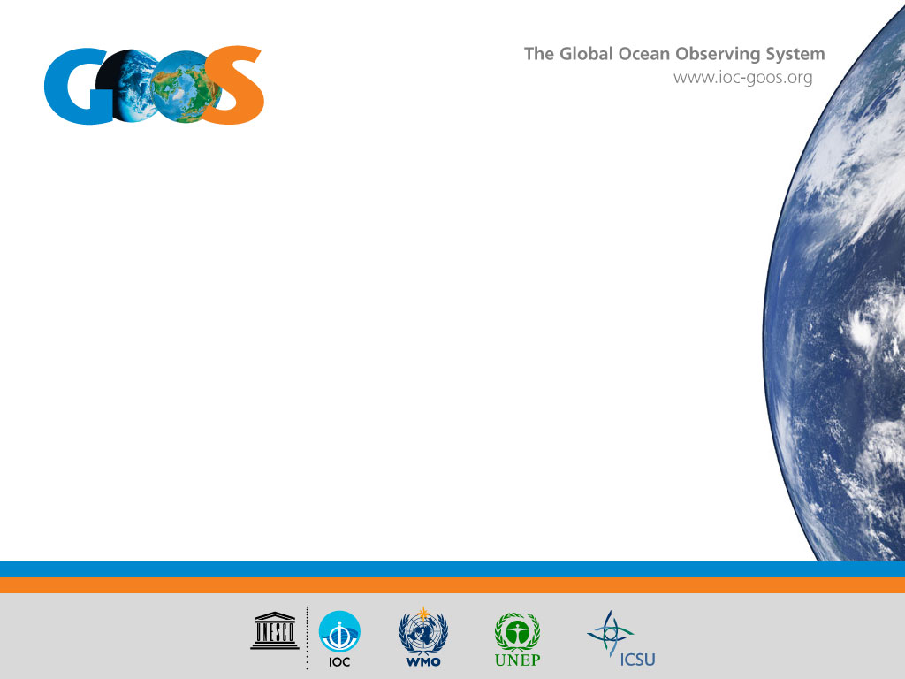
GRA Background Report
U.S. IOOS
Carl Gouldman
Director, U.S. IOOS
Carl.Gouldman@noaa.gov
GOOS Regional Forum-10

Slide 2
General information
Type: National Program
Funding characterization: Program funded
GRA leadership (Chair/coordinator) and contact:
  Carl Gouldman, Director, Carl.Gouldman@noaa.gov
Secretariat:
  Laura Gewain, Laura.Gewain@noaa.gov
Website: https://ioos.noaa.gov/
Terms of Reference: https://ioos.noaa.gov/about/governance-and-management/
Meetings: Twice a year with RAs, Bi-monthly with IOOC, 2-3 times a year with Advisory Committee, Annually with Data Managers
Membership | Advisory Bodies
17 Federal agencies 11 U.S. IOOS Regional Associations (RAs) Coastal and Ocean Modeling Testbed | Integrated Ocean Observation Committee (IOOC): www.iooc.us U.S. IOOS Advisory Committee: https://ioos.noaa.gov/community/u-s-ioos-advisory-committee IOOS Association: www.ioosassociation.org

Slide 3

United States Integrated Ocean
Observing System (U.S. IOOS)

Slide 4
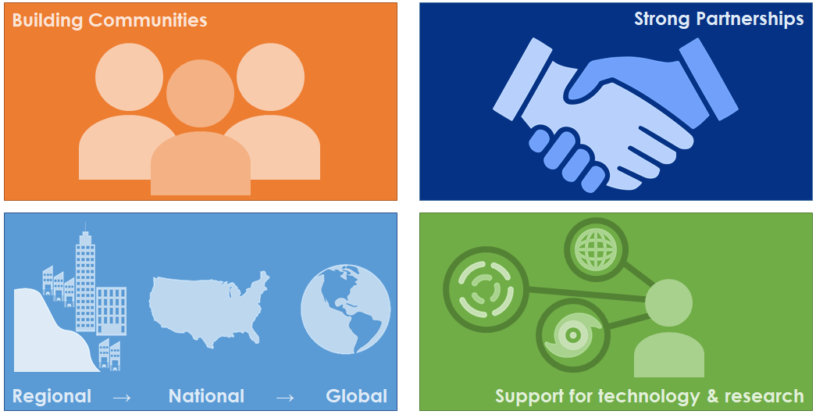
How we work

Slide 5
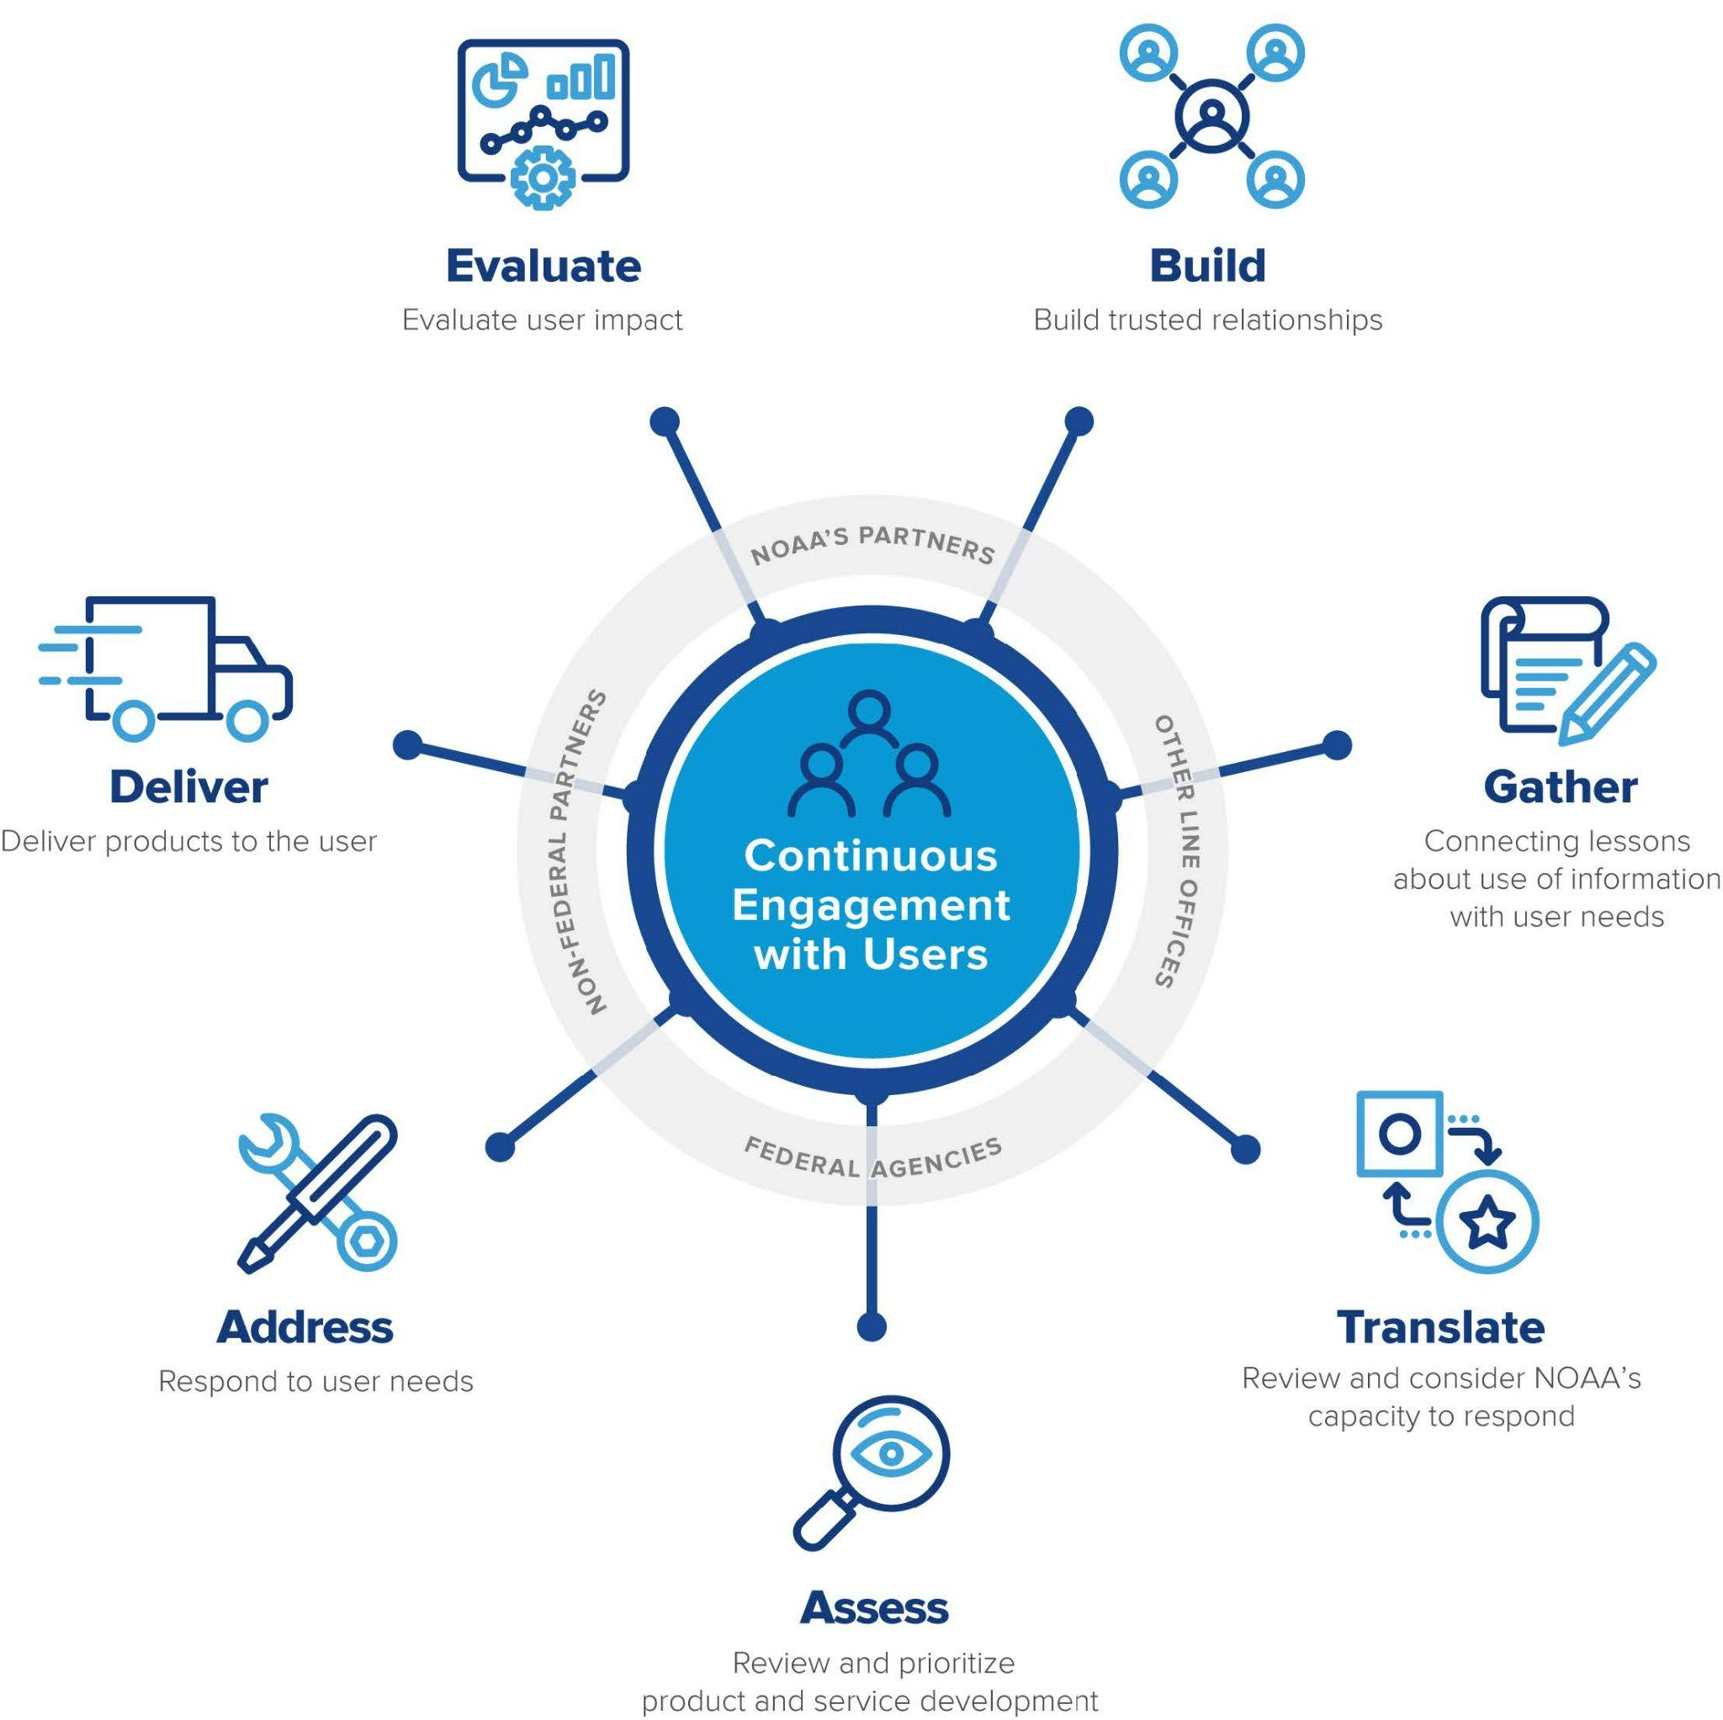
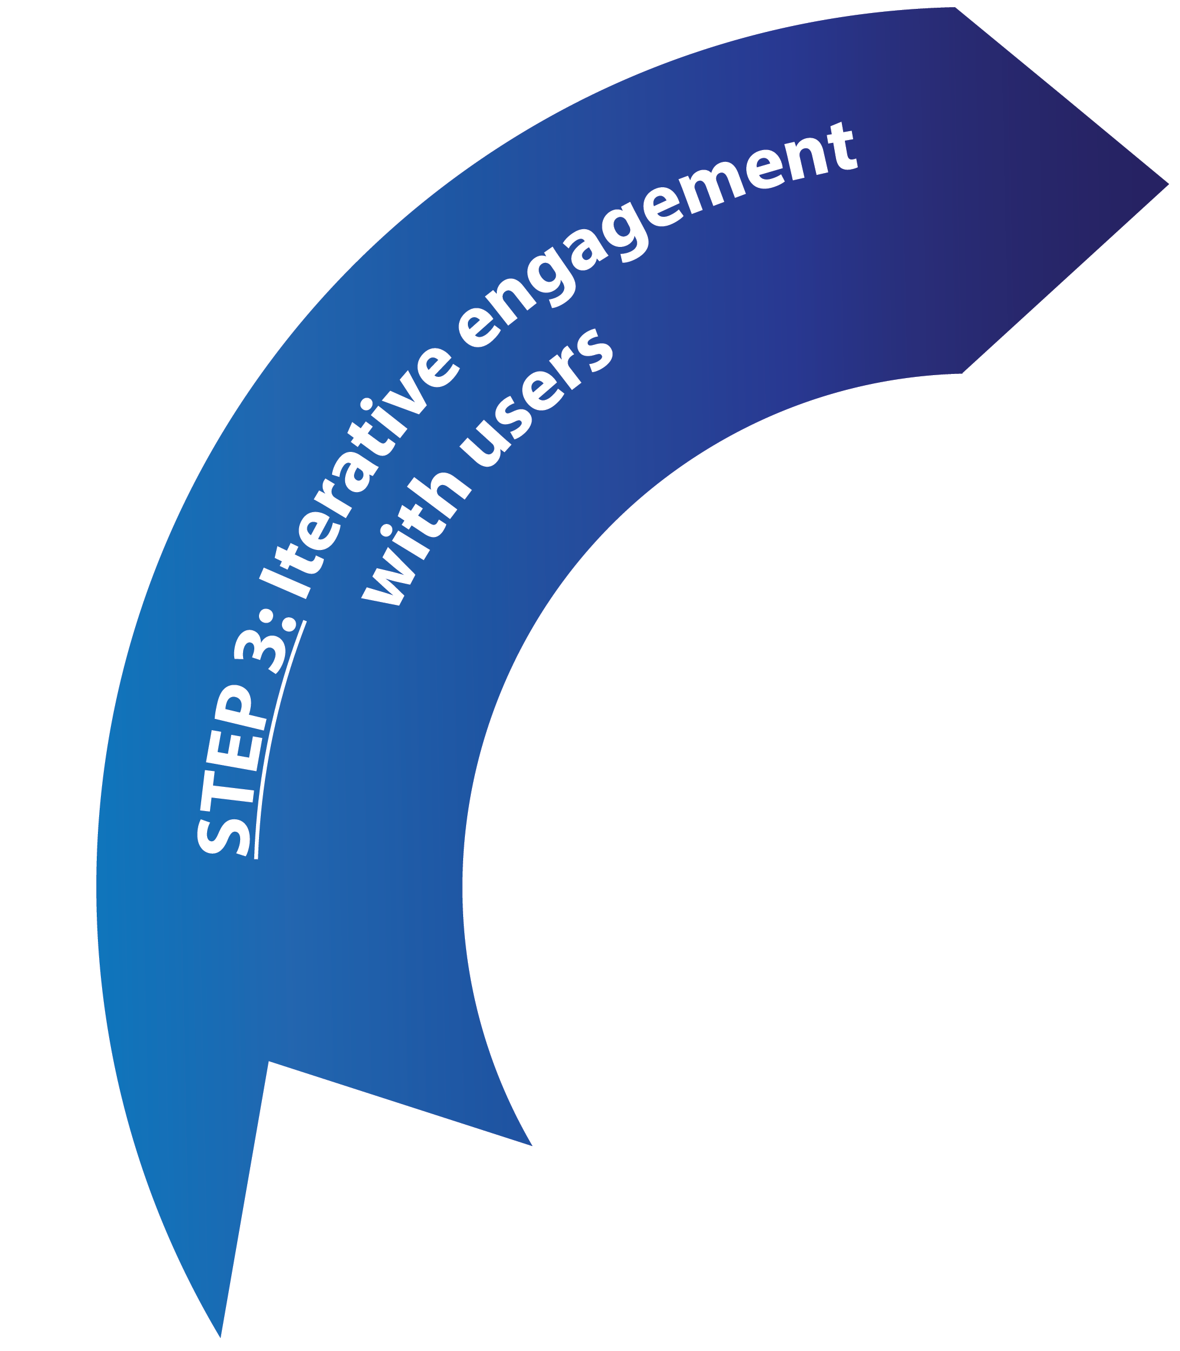
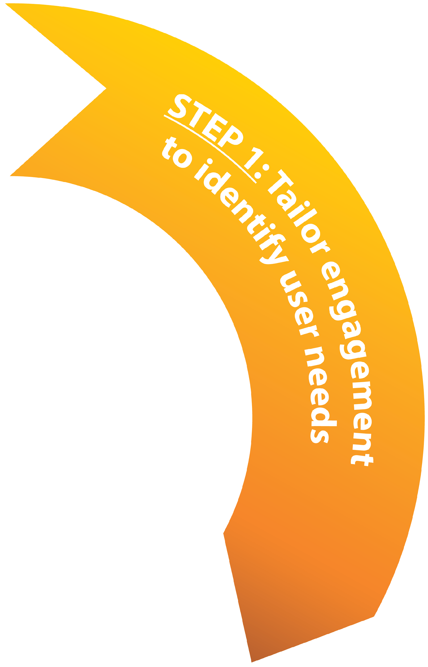
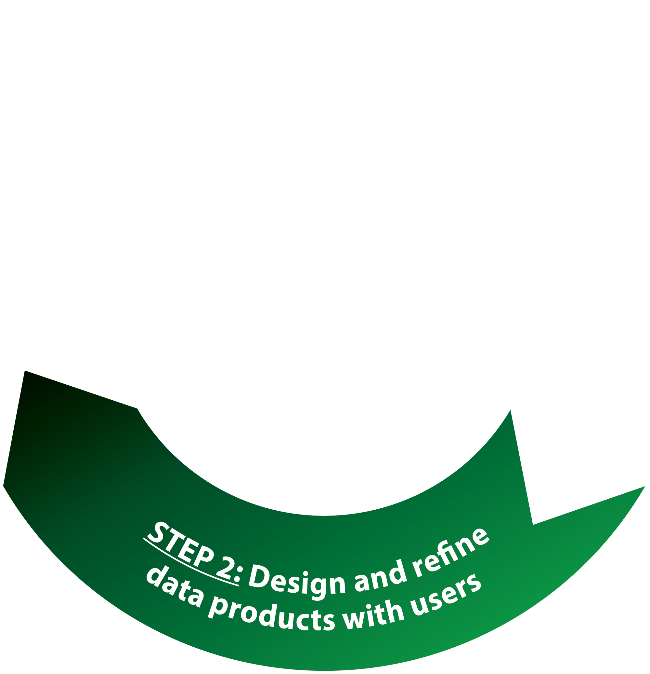
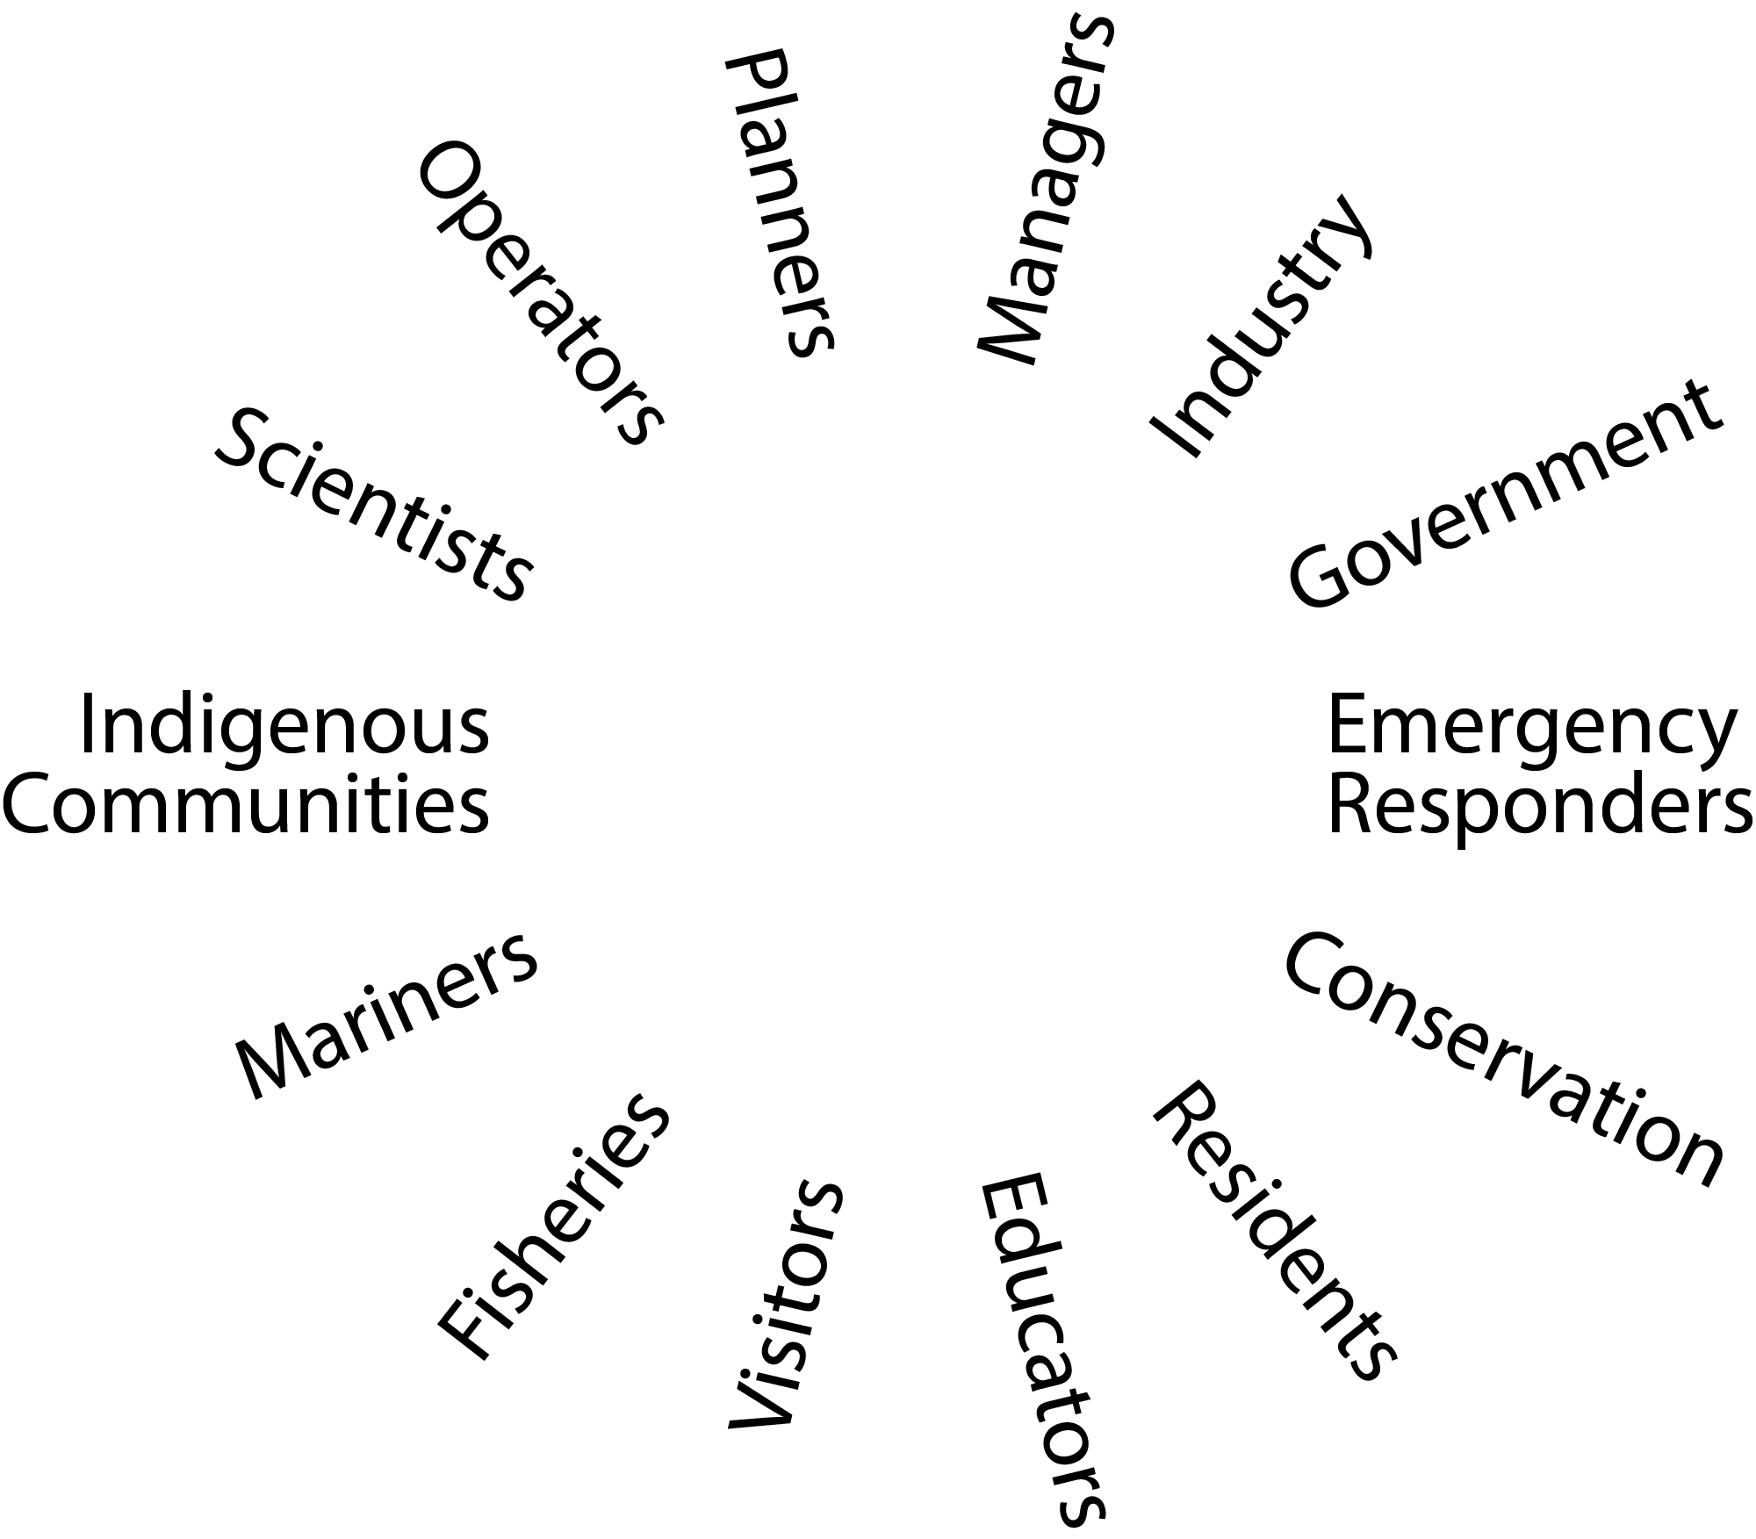

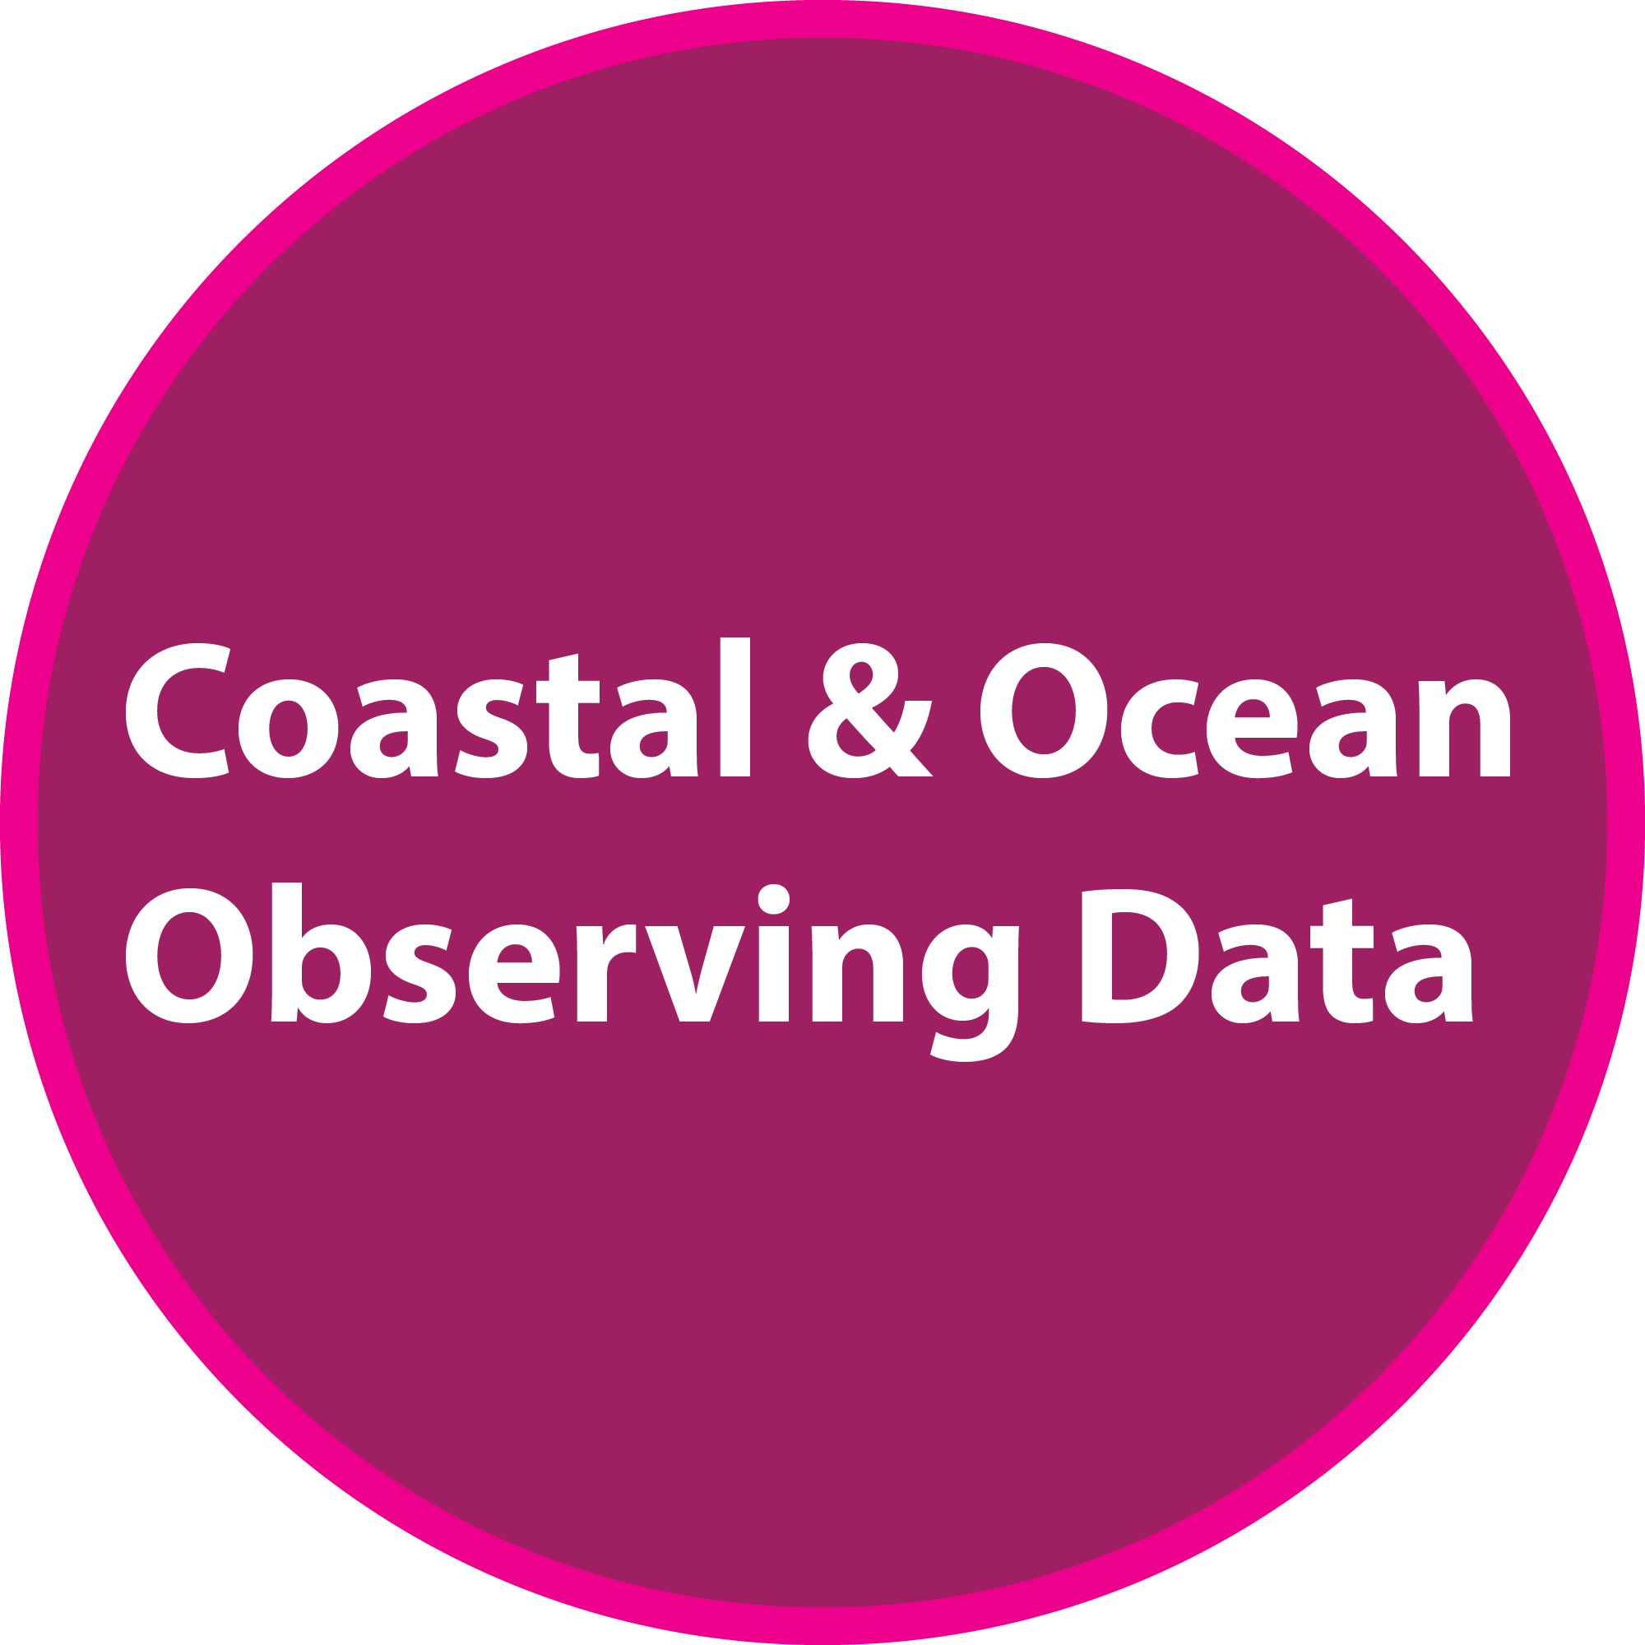
How We Work
Stakeholder Outreach
Data Management

Slide 6
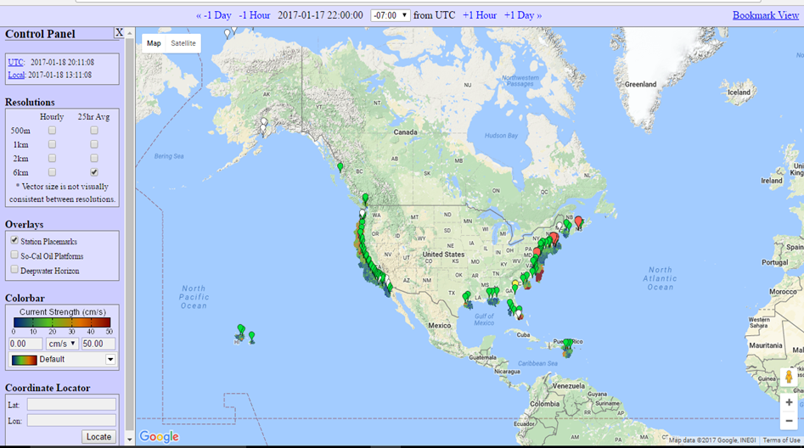
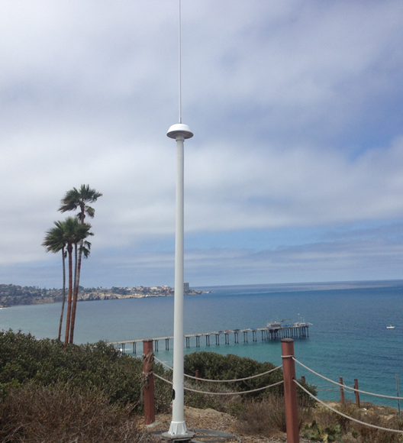
High-Frequency Radar (HFR)
Project: HFR Network and Global HFR Network
Users: Search & Rescue; Oil Spill Response; Marine Navigation; AWIPS; Coastal Monitoring; Tsunami Detection; Hydrodynamic Modeling
Process: $5M budget; ~160 radars, operated by non-federal partners
Outcomes:
30+ HFRs installed in the last 4–5 years.
Plans for 25–40 more HFRs to “fill the gaps”.
Wind turbine radar interference mitigation (WTRIM) software for SeaSonde® HFRs under development; version 1 anticipated FY 2022.
http://global-hfradar.org/
Example end-use success: Water quality - Contaminated runoff from the Tijuana River creates hazardous water conditions forcing beach closures and the Navy to halt SEAL Training. HFR data enables tracking and forecasting of pollution plumes to inform Navy and local officials to close beaches before recruits and civilians are exposed to dangerous water.

Slide 7
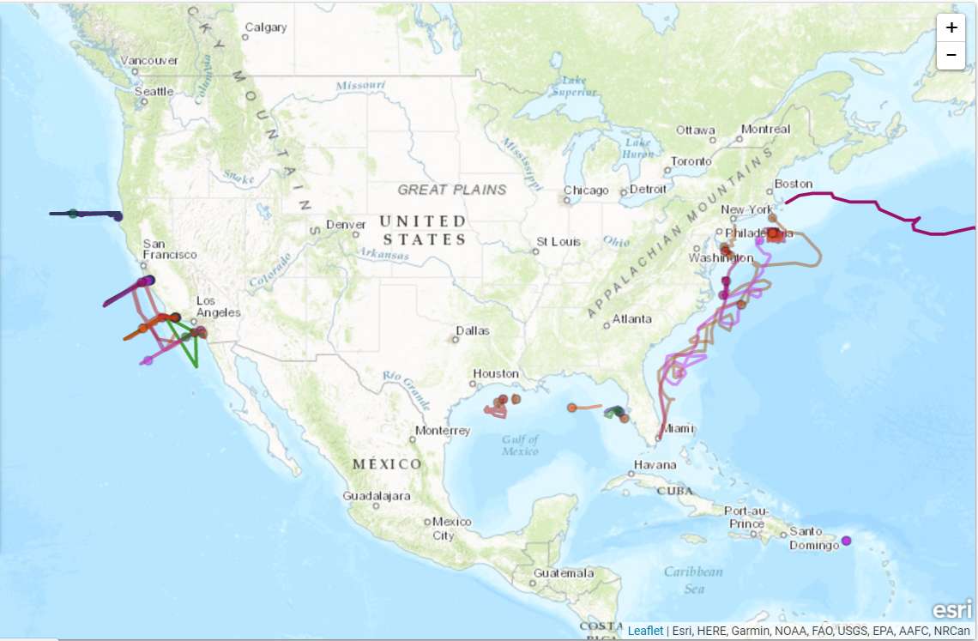
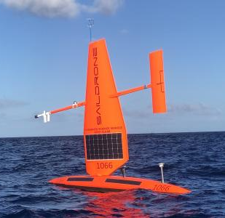
U.S. IOOS Supports Underwater Profiling Gliders
Project: Supports Glider Community through glider Data Assembly Center (DAC) and interagency team
Users: Federal, non-federal/regional
Process: Use interagency and regional team to develop recommendations for glider best practices
Outcomes:
Measuring ocean features and detecting climate signal
Hurricane Gliders - partnership with Navy and NOAA to collect ocean data using gliders to improve hurricane intensity forecasting
Saildrone missions:
  Arctic missions to improve sea ice prediction, collect bathymetry data, and inform fisheries assessments
  Tropical Atlantic and Pacific missions to collect high quality oceanic and atmospheric observations
U.S. Underwater Glider User Group
Glider DAC: gliders.ioos.us

Slide 8
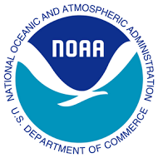
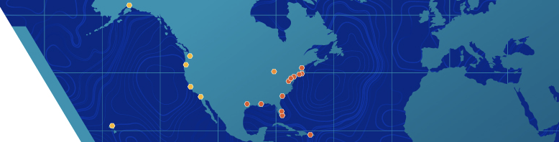
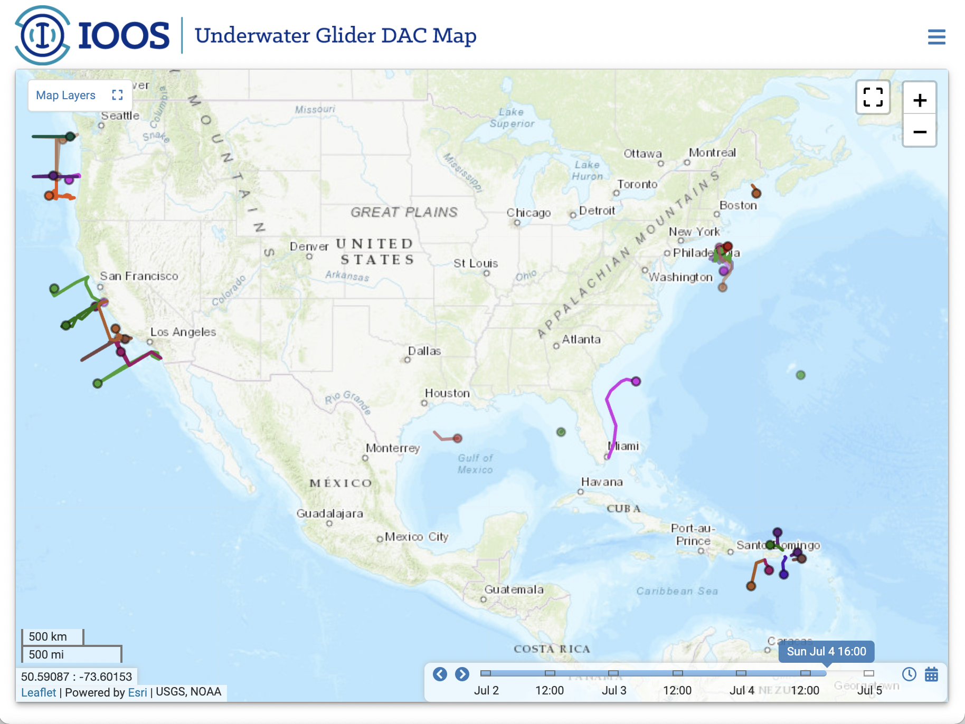
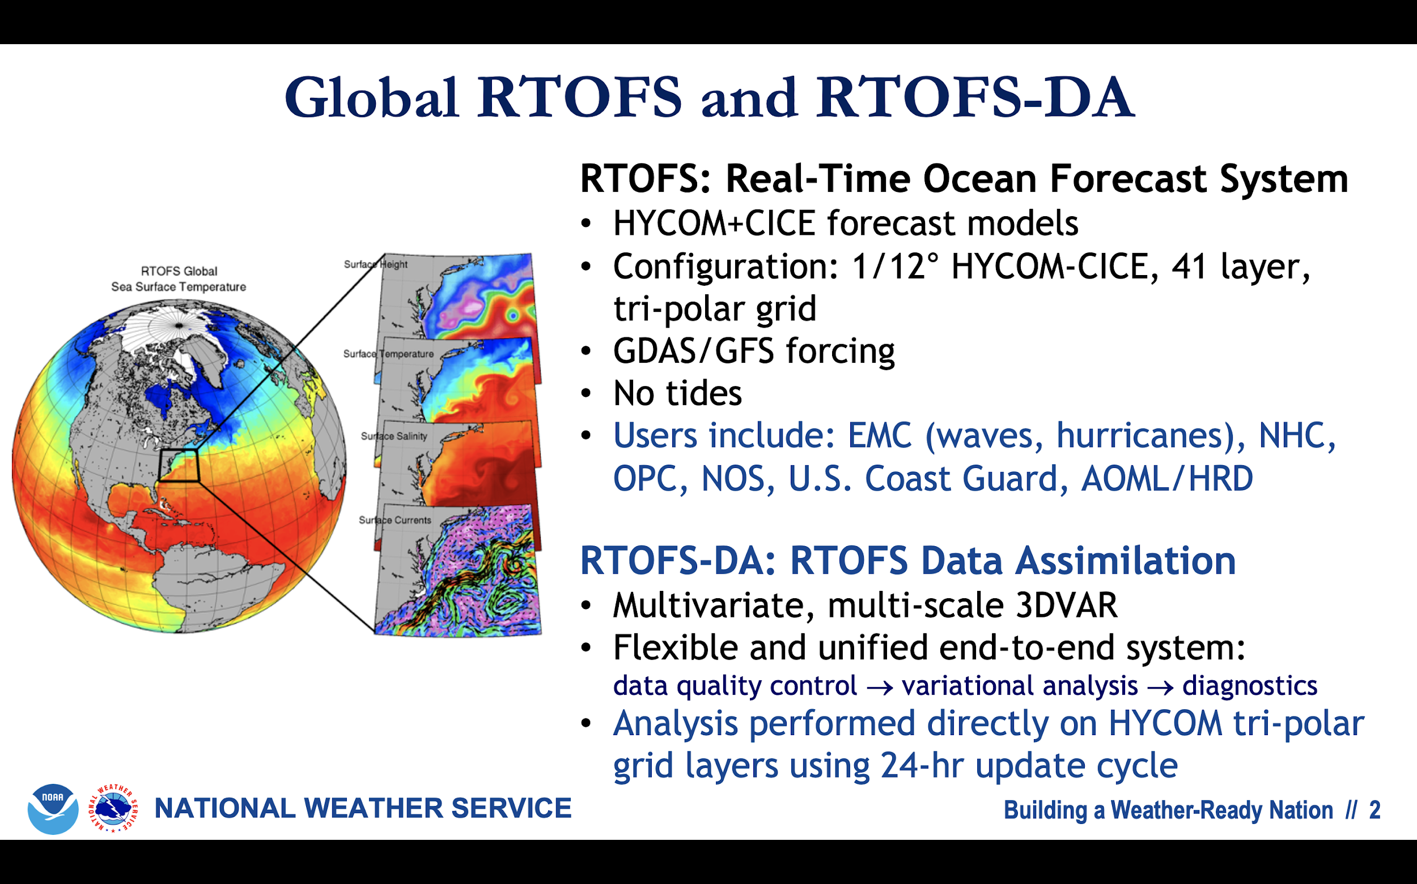


Innovations in
Data Flow & Assimilation
New for 2021
NDBC > GTS
EMC
Regional-Scale Coupled Ocean-Atm Hurricane Forecast Models:
HWRF & HMON
IOOS Glider Data Assembly Center (DAC) aggregates and quality controls glider profile data for harvesting by the NDBC
Real Time Ocean Forecast System (RTOFS) pulls ocean data from the GTS for assimilation in the global model
Any glider operating anywhere in the global ocean can contribute to better hurricane forecasts simply by contributing their data to the IOOS Glider DAC!

Slide 9
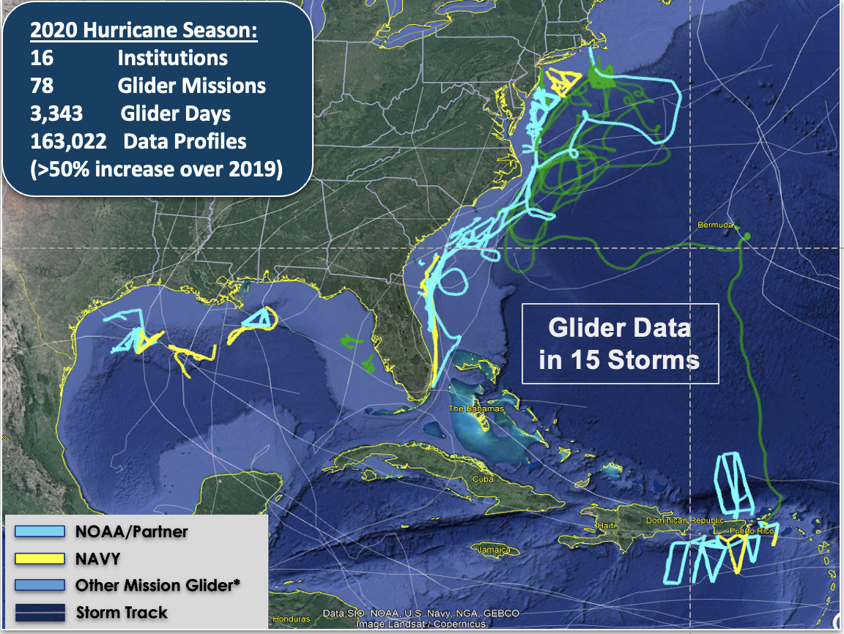
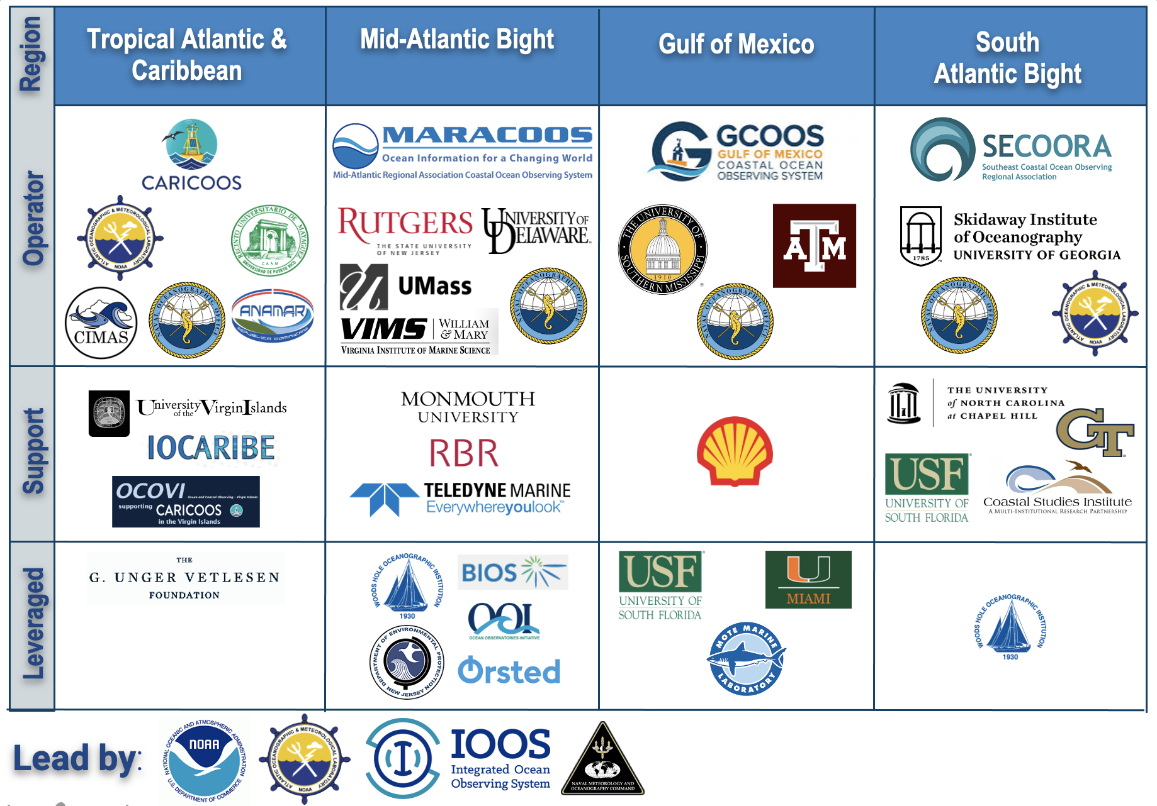
Innovative Transitions
to Distributed Operations
A team of over 30 institutions helped to operate and support Glider Data for the 2020 hurricane season.

Slide 10
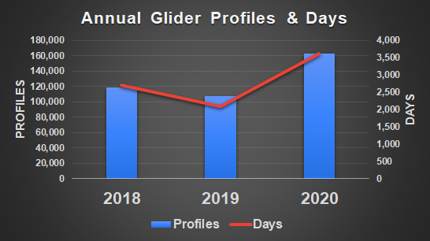
Innovative Transitions
to Distributed Operations

Slide 11
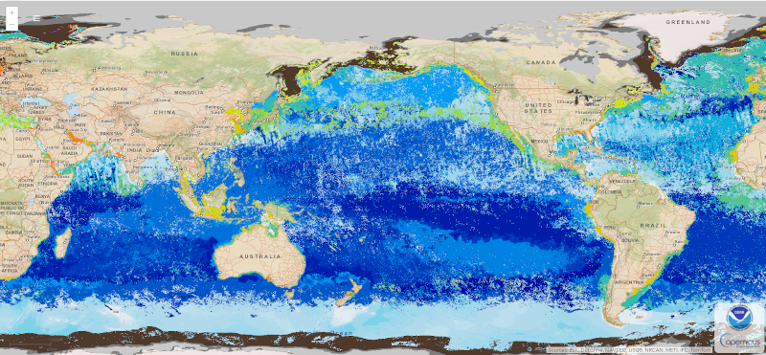




Marine Biodiversity Observation Network (MBON)
2021
Marine Life 2030 UN Decade Programme endorsed (US IOOS, US MBON co-leads)
IOOS soliciting new joint US MBON-ATN projects
MBON Oceanography special issue due out soon
2020
US and global remote sensing-based Seascapes produced on NOAA CoastWatch
IOOS-ACT workshop on eDNA sampling and sample processing
2019
IOOS Code Sprint launched two working groups (USG and ESIP) on standardizing biological data
11

Slide 12
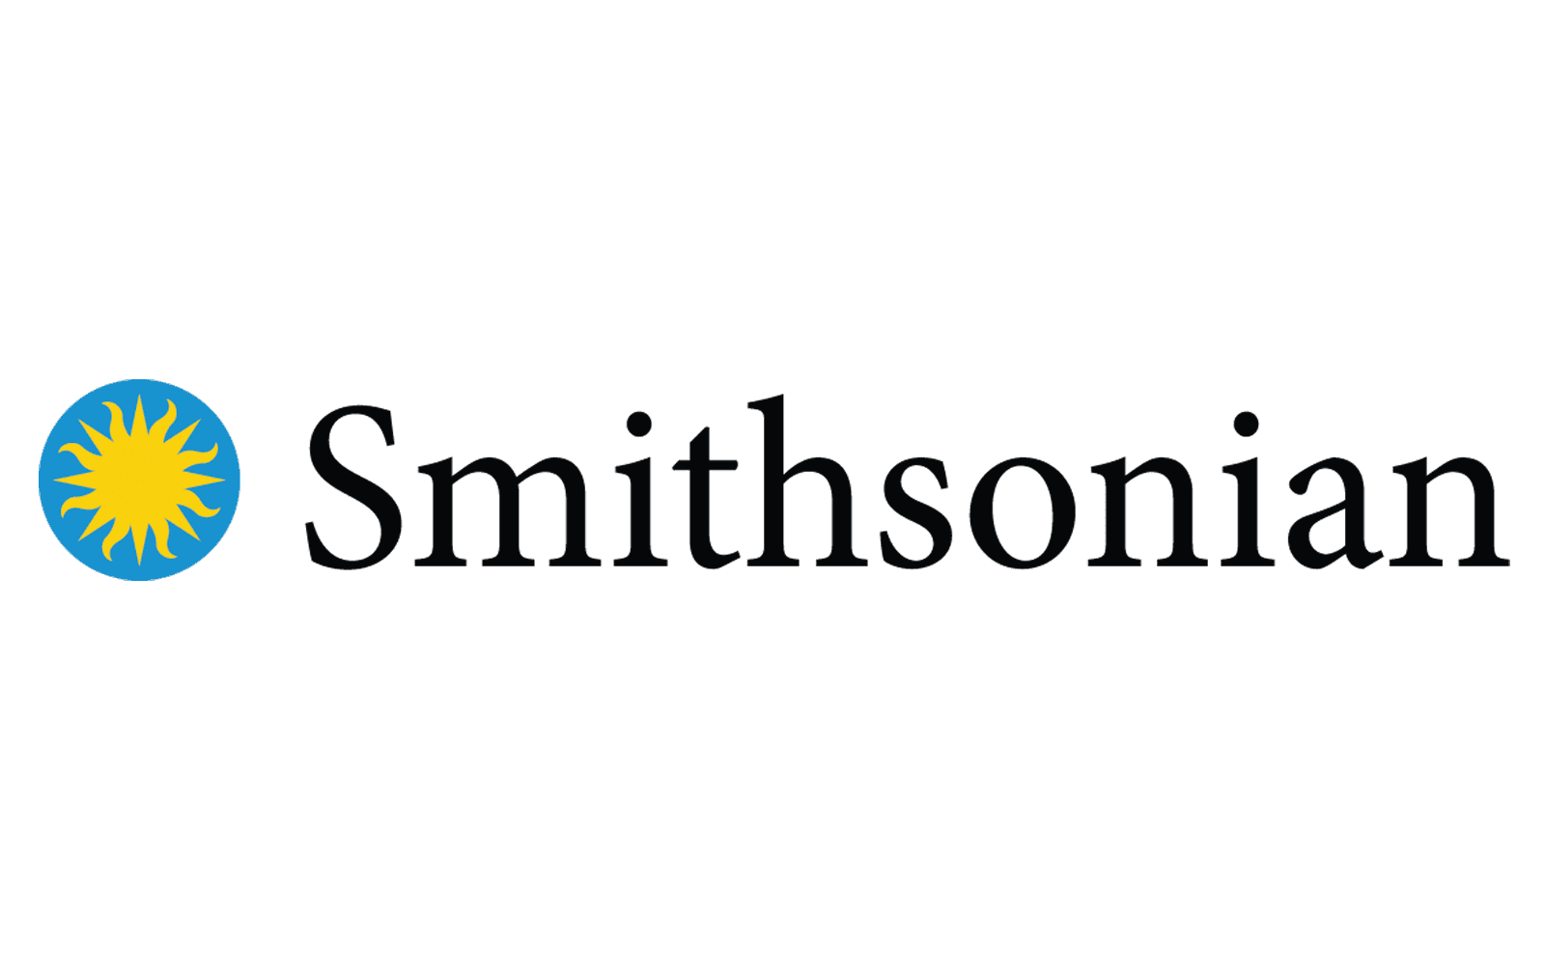
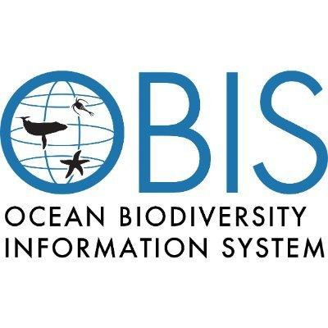



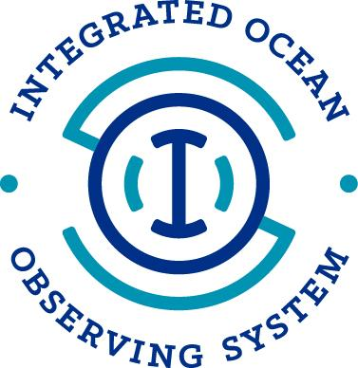

Marine Life 2030: Building global knowledge of marine life for local action
Endorsed UN Ocean Decade programme
US IOOS co-lead with Smithsonian, MBON
Focus on implementing BioEco EOVs, ensuring interoperability of data, advancing new technologies and observing networks
New partnerships invited; 2021 focus on convening stakeholders to inform programme co-design
Marine Life 2030 Program

Slide 13
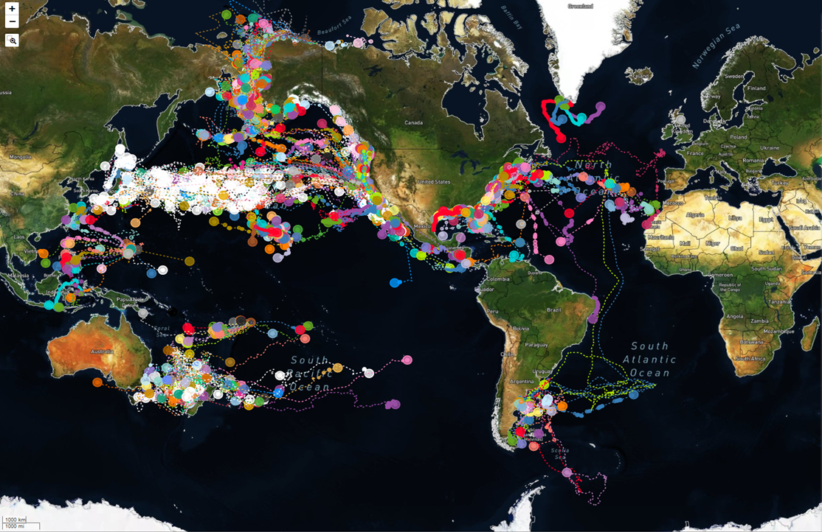
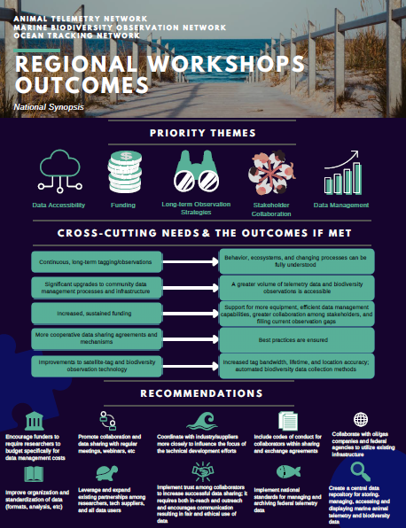
Animal Telemetry Network (ATN) & AniBOS
Data Volume in ATN DAC has expanded to 149 Projects, 61 Species, 3676 Tags
Keeping U.S. beaches safe with R/T shark detection buoys and text alerts
Integrated U.S./Canadian Atlantic Coast acoustic telemetry tracking - single point access for PIs to thousands of rcvrs
MBON/ATN “BioTrack” established to integrate biodiversity and animal movement data
7 Regional ATN-MBON stakeholder workshops completed
Summary Report now available: https://ioos.noaa.gov/project/atn/

Slide 14
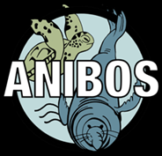
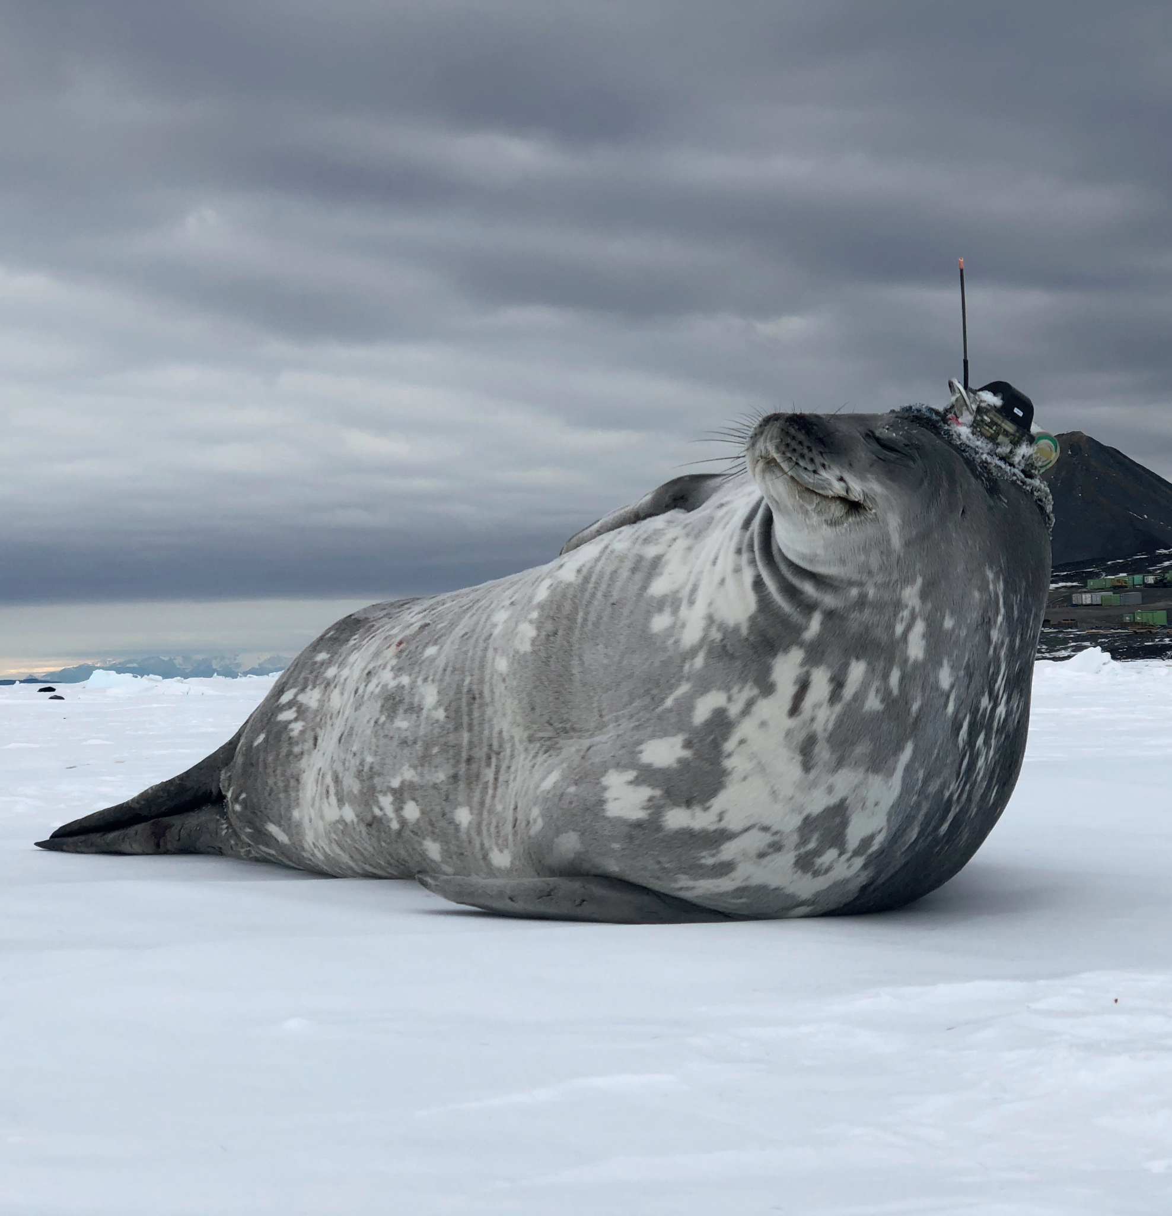
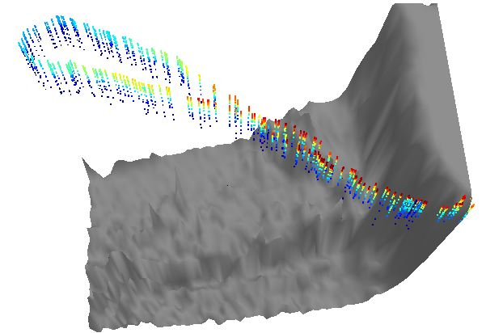
Animal Telemetry Network (ATN) & AniBOS
AniBOS is formally approved by OCG as an emerging GOOS Network
ATN Network Coordinator on Steering Committee
ATN DAC Manager on Data Sub-committee
ATN is leading the development and implementation of the AniBOS real-time data management strategy and approach
R/T operational capability is now in the ATN DAC to auto-ingest and QC animal borne ocean profiles and insert them onto the WMO GTS

Slide 15
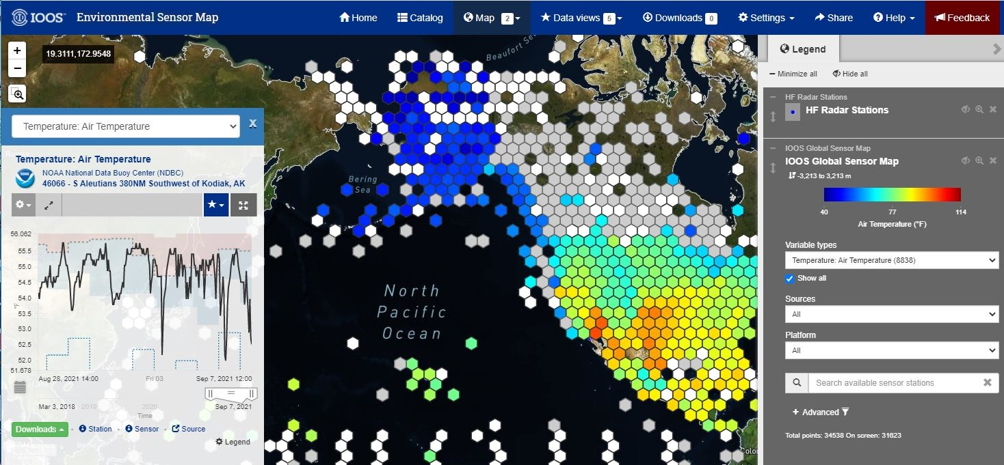
Environmental Sensor Map
Includes both historic
and real-time stations,
across the entire globe.
https://sensors.ioos.us
45,718 stations
137 data sources across 337 affiliates
312 unique parameters
Approximately 65,000 sensors with observations in the past week
Approximately 42,826,000 sensor observations per week

Slide 16
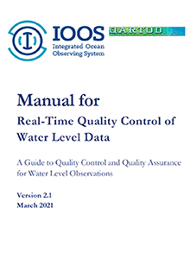
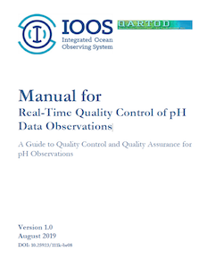
QARTOD
Published QARTOD manuals
Manual for Real-Time Quality Control of pH Data Observations (August 2019)
Updated Manual for Real-Time Quality Control of Water Level Data (March 2021)
Other accomplishments:
New Paper Released (September 2020) -
QARTOD - Prospects for Real-Time Quality Control
Manuals, How to Create Them, and a Vision for
Advanced Implementation
QARTOD 2022-2026 work plan under development
All manuals are included in the Ocean Best Practices repository.
https://ioos.noaa.gov/project/qartod/
16

Slide 17
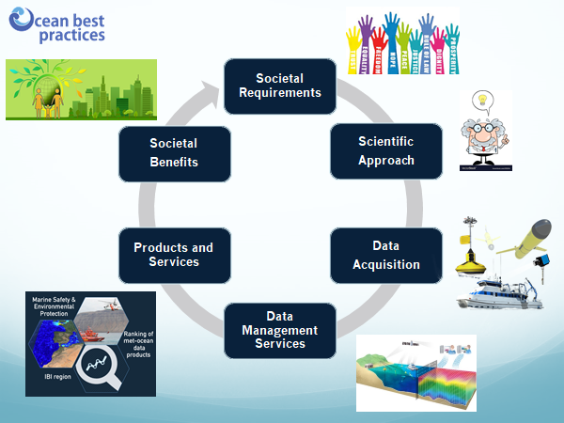



Ocean Best Practices System: a global resource to facilitate harmonization of practices for ocean observations
Repository: https://www.oceanbestpractices.org
“Ocean Practices for the Decade” one of 60 new programmes endorsed under the UN Ocean Decade
OBPS is enhancing its repository discovery capabilities by improving both metadata input fields and search options. Suggestions invited at https://www.oceanbestpractices.org/contact

Slide 18
Challenges
Very strong support for ocean observing in current Administration/Government of U.S.
  New funding in FY22 President’s Budget for advancing R&D toward operations, yet highly uncertain. ‘Marine Life program’ with ATN and MBON support pending.
  System age and O&M costs are weighing on core capabilities
  “New funding” without infrastructure boost is a risk.
Improving alignment of model (prediction) skill and (R2O) development for operational oceanography. Still have a complex set of participants and need for better community approaches to model improvements.
UN Decade of Ocean Science for Sustainable Development - is so big and important but hard to decipher how to “play”

Slide 19
In what areas would the GRA like to be more active: Core GRA Activity?
Value chain element | What resource would be needed?
Observations implementation | U.S. IOOS is currently active in all areas. Willing to exchange information as other GRAs prioritize or seek to expand into new activities. Plans for improved capabilities in priority areas are highlighted in the “Challenges” section of this report. Willing to work on capacity development with members as plans coalesce under the “Decade”.
Data management
Forecasting
Service / information delivery
Capacity development of members
Outreach / ocean literacy

Slide 20
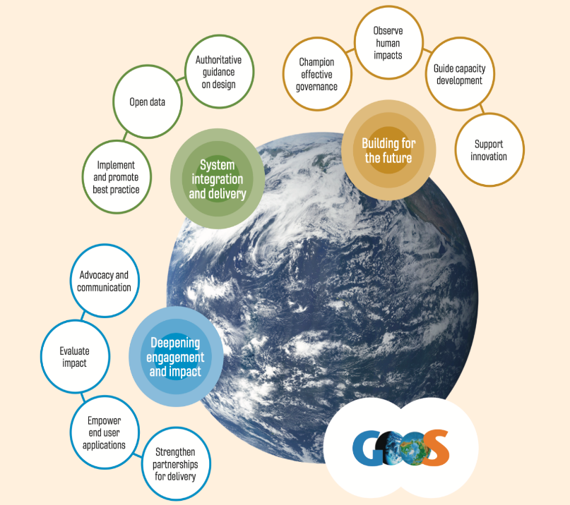
Opportunities Across GOOS
Strategic Objectives
To be elaborated on 10 Sep meeting
Deepening Engagement and Impact
System Integration and Delivery
Building for the Future

Slide 21
Opportunities Across GOOS
Proposed Decade Programmes
To be elaborated on 10 Sep meeting
Observing Together
Keep working with EOVs, EBVs, etc.
Ocean Observing Co-Design
Develop Use cases (BOOC) - best practices and partner across programs to share
CoastPredict
Coordinate on global to coastal modeling and integrating predictions at all timescales

Slide 22
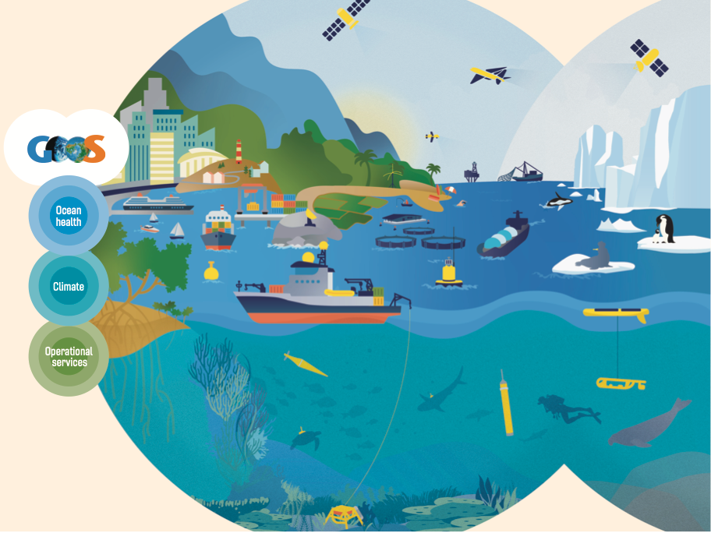
END

