Slide 1
Role of Media in India
Dr. P. Manas Krishnakant
Deputy Director, Press Information Bureau (PIB)
&
Ms. Laxmi
Correspondent, All India Radio (AIR)
Hyderabad, India
Regional Standard Operating Procedure Workshop
for Broadcasting Media in the Tsunami Warning Chain
7-9 September 2021

Slide 2
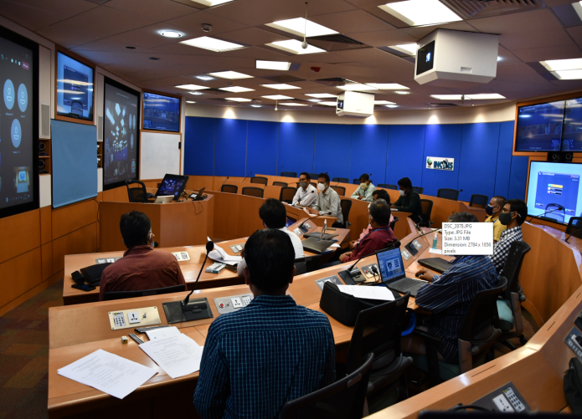
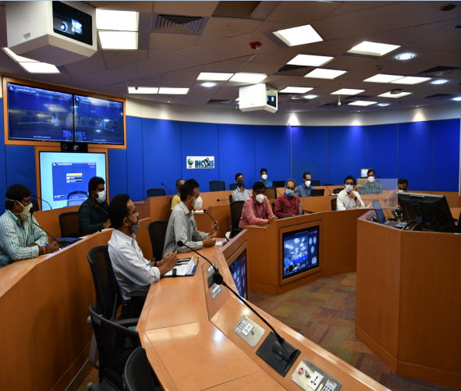
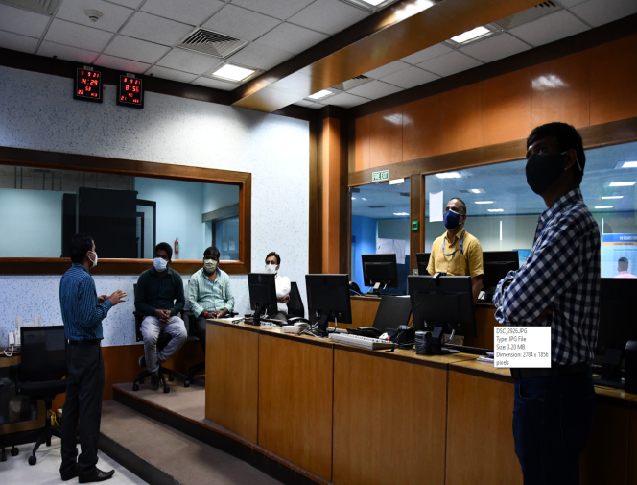
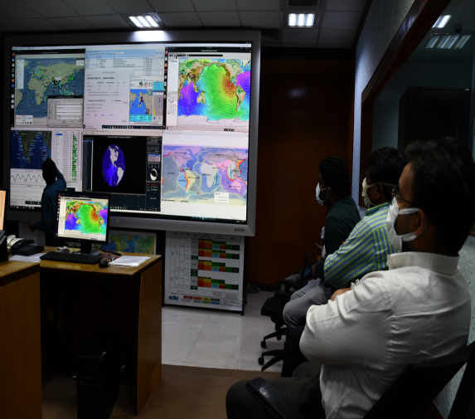
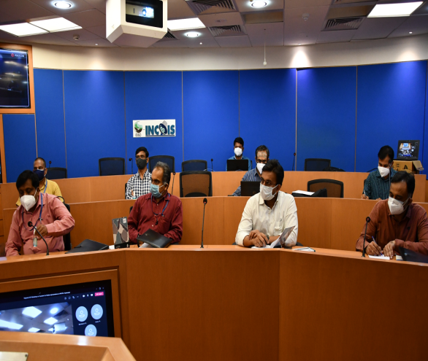
Visit to National Tsunami Warning Centre, INCOIS
Sensitized the activities of INCOIS
Learned about Indian Tsunami Early warning Centre, Standard Operating Procedure, Products, types of bulletins, dissemination process
Understanding the national tsunami warning chains and the NTWC and DMO procedures
Understanding the role of Disaster Management Organisations and Media in Tsunami warnings
Visited Indian Tsunami Early Warning Centre
Discussed on Strengthening the engagement of the media in the tsunami early warning processes, requirements for Media SOPs to facilitate timely and accurate dissemination of advice from the authorities, etc.

Slide 3
Pre-event
Sensitization of all the stakeholders
Information generators
Decision makers
Disseminators
Receivers (at the grassroots level)
Specific modules for sensitization of each of the above should be fabricated.
Sensitization includes understanding the gravity of the event (well in advance of the occurrence of the actual event).

Slide 4
Pre-event
Popularizing the nomenclature associated with tsunami and associated events.(mass media and popular media plays a major role, even broadcast media can broadcast time to time special stories related to it in local media of vulnerable regions)
Introduction of disaster management as a mandatory topic in the syllabi of schools of coastal states.
Developing the terminology in sign languages and other relevant methods of communication which are suitable for differently abled. (which is one of the main aims of SDGs).

Slide 5
During the event
Only the national broadcaster is allowed to release the first warning received from NTWC or NDMA, to maintain the authenticity and reduce panic or fake news generation.
Words/phrases used for communication should be non-confusing and easily understandable by layman also.
Message should be crisp and clear should not generate any speculation or controversy.
Only facts should be aired. No opinion or analysis is allowed until the last warning message is given.
Avoiding politicization of the event until the final safety message is given.
Broadcast media should give real time and location specific directions to facilitate the movement of people and property.
Local FMs which are known for providing real time traffic updates can be of great use by providing the same during crisis.
On the ground - they can be helpful by announcing the names of missing family members which can help locating each other.

Slide 6
Post-event
Responsible broadcasting includes sympathizing with the aggrieved.
Help locating the lost family or property
Sensitizing the international citizenry/organizations by projecting the ground scenario sympathetically which further garners the financial or any other aid which is required.
Giving publicity to the people who need aid and assistance.

Slide 7
Limitations
Infrastructure, manpower availability with the national broadcaster.
Lack of linear chain of command
Lack of proper specialized crisis communication training to the media personnel.
Chaos causing social media handles (which generate fake news).

Slide 8
Suggestions
National Broadcaster/spokesperson should have a representative in the decision making body of DMO.
Crisis communication wing should be incorporated into national broadcasting agencies in the most vulnerable countries.

Slide 9
SOP for Media could be(during the event)
only one Information provider (INCOIS)
only one decision maker (NDMA) SDMAs
only one intial disseminator (DD/AIR/PIB) all local media

Slide 10
Cont..
Maintaining one point information generator, decision maker and initial disseminator -
gives authenticity to the message
Prevents data leaks, fake news generation
Seamless flow of message
SDMAs may be limited to disaster management.
Media management maybe left to the official spokespersons, who are professionally well equipped to handle crises.
Centralized media management in times of crisis reduces the information chaos.

Slide 11
India’s Emergency Response Plan
Information flow in case of natural disaster
Electronic and Print Media (TV, Radio, Press etc.) for public information
Tsunami Early Warning Centre, INCOIS, Hyderabad
MHA (NEOC), MoES , NDMA and Andaman & Nicobar Admin.
SEOC/ RC & Secretary, DM
All concerned line departments
DEOC/ DDMA
All concerned line departments
Sub-Divisional Officer/ SDM
Block Development Officer/ Tehsildar
Public
Reference: SOP for responding to Natural Disasters, Published by MHA, 2010

Slide 12
Thank you

