Slide 1





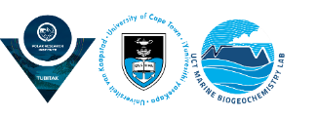

The Southern Ocean Observing System
Alyce Hancock, SOOS Executive Officer
Eileen Hofmann & Mike Williams, Co-Chairs
Sian Henley & Sebastien Moreau, Vice Chairs

Slide 2
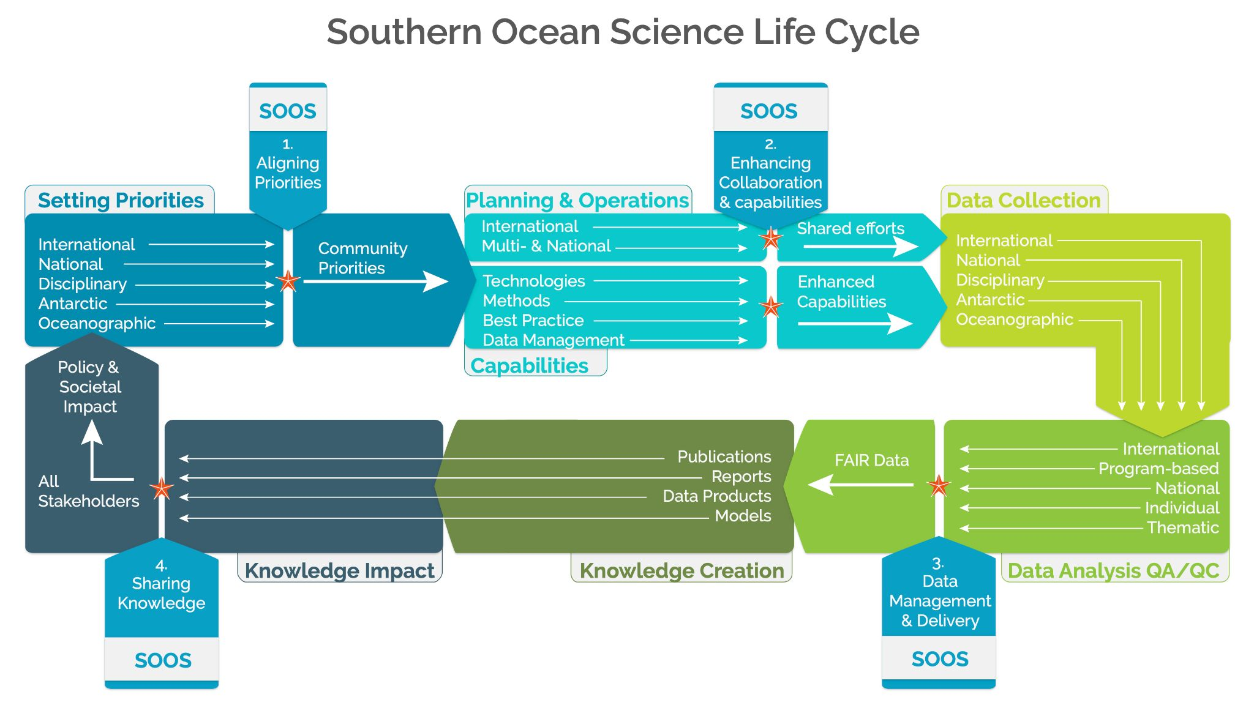
SOOS mission is to facilitate the sustained collection and delivery of essential observations of the Southern Ocean to all stakeholders, through the design, advocacy, and implementation of cost-effective observing and data delivery systems

Slide 3
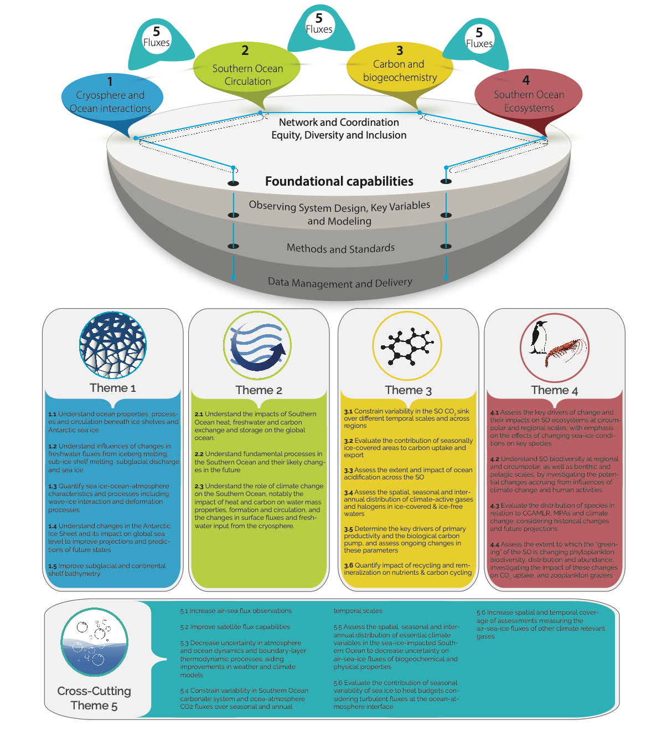
New SOOS Science and Implementation Plan (2021-2025)
New 5-year (2021-2025) Science and Implementation Plan developed
  Reviews just received by SCAR and SCOR
Five Community-agreed Science Themes

Slide 4
SOOS SIP -
Key science challenges in each theme
CRYOSPHERE-OCEAN INTERACTIONS
SOUTHERN OCEAN CIRCULATION
CARBON AND BIOGEOCHEMISTRY
ECOSYSTEMS AND BIODIVERSITY
AIR-SEA-ICE FLUXES

Slide 5
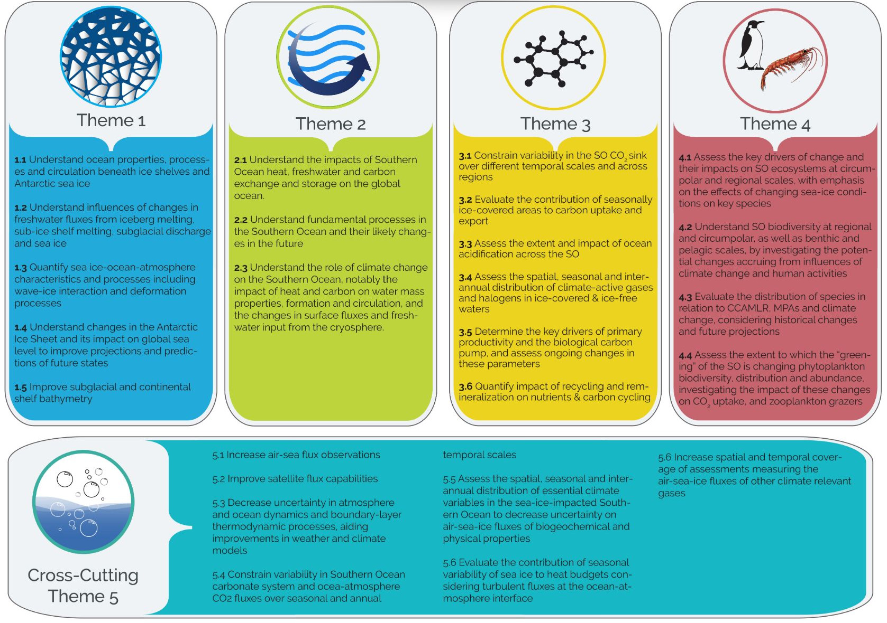
SOOS SIP -
Key science challenges in each theme
CRYOSPHERE-OCEAN INTERACTIONS
SOUTHERN OCEAN CIRCULATION
CARBON AND BIOGEOCHEMISTRY
ECOSYSTEMS AND BIODIVERSITY
1.2: Understand influences of changes in freshwater fluxes from iceberg melting, sub-ice shelf melting, subglacial discharge and sea ice.
2.1: Understand the impacts of Southern Ocean heat, freshwater and carbon exchange and storage on the global ocean.
3.5: Determine the key drivers of primary productivity and the biological carbon pump and assess ongoing changes in these parameters
4.3: Evaluate the distribution of species in relation to CCAMLR, MPAs and climate change, considering historical changes and future projections
Enhance the collection and delivery of the required data
Addressing Challenges
  SOOS working groups
  Complement ongoing SCAR and SCOR activities
5.3: Decrease uncertainty in atmosphere and ocean dynamics and boundary-layer thermodynamic processes, aiding improvements in weather and climate models.
5.4: Constrain variability in Southern Ocean carbonate system and ocean-atmosphere CO₂ fluxes over seasonal and annual temporal scales.
AIR-SEA-ICE FLUXES

Slide 6
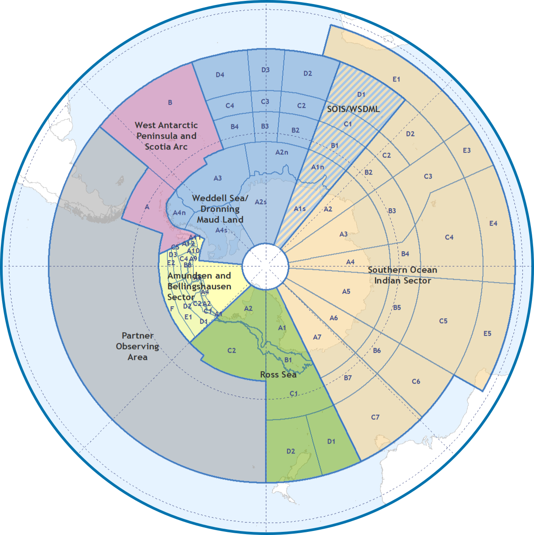
Knowledge delivery to address challenges
SOOS implementation working groups, community efforts
Regional Working Groups (RWGs):
Southern Ocean Indian Sector (SOIS)
Ross Sea
Weddell Sea and Dronning Maud Land (WSDML)
West Antarctic Peninsula and Scotia Arc (WAPSA)
Amundsen/Bellingshausen Sea (ABS)
Capability Working Groups (CWGs):
Censusing Animal Populations from Space (CAPS)
Southern Ocean Flux (SOFLUX)
Observing System Design (OSD)
Task Teams:
Ecosystem Essential Ocean Variables (eEOVs)
Autonomous Underwater Vehicles (AUVs)
Polar Data Discovery (POLDER)
+Future…

Slide 7
SOOS Data Delivery
Data Management Committee
https://www.soosmap.aq/
https://www.soos.aq/activities/duesouth

Slide 8
Ongoing initiative to ensures SOOS acts in accordance with our values in all things
Group to play a strategic implementation and advisory role and make recommendations to the SOOS EXCOM and broader community where appropriate
Make Southern Ocean science more welcoming
Identifying barriers to full participation in SOOS, and acting where possible to circumvent them
SOOS Equity, Diversity and Inclusion Group
Recently established (2020)
Chairs: Sarah Fawcett, Steve Diggs

Slide 9

SOOS & UN Decade
Co-convened Southern Ocean regional workshop (February 2020)
Community input to Decade Implementation Plan
Partner in Southern Ocean Task Force to lead and drive the Southern Ocean regional program
  2nd workshop joint with Polar Data Forum IV to develop Southern Ocean contribution to UN Decade 20-22 September
Active participation in Decade-related webinars/meetings
https://sodecade.org

Slide 10


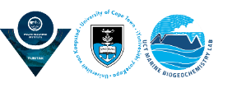


Acknowledgements
Thank You!
www.soos.aq
hancock@soos.aq
This work is a contribution to the Southern Ocean Observing System (SOOS); an international initiative of SCAR and SCOR, funded by the Institute for Marine and Antarctic Studies, University of Tasmania; CSIRO; Tasmanian State Government; Antarctica New Zealand; Swedish Polar Research Secretariat; TUBITAK Marmara Research Center Polar Research Institute; and University of Cape Town Marine Biogeochemistry Lab.
.

