Slide 1



Ocean Information Hub Africa: Database for Training Opportunities
Date 10th June 2021
Abbie Akinyi Allela
a.abbie@unesco.org

Slide 2
Background & Rationale
The Ocean InfoHub Project (OIH)
Funding by Government of Flanders, Kingdom of Belgium
Online IOC sources
Existing repositories and partnerships ~ POGO, SCOR, EMODnet, OTGA, IOC CD, marine training.eu, EurOcean etc.
Pilot regions: Africa, Latin America and the Caribbean & Pacific small island development states
Notes:
.

Slide 3

Inception 2013 (service of the European Marine Biological Resources Centre) & hosted @UGent
UGent ~ centre of academic excellence in education & research
UGent and CLME+ portal development

Slide 4
OIH Africa Database
Lack of single database on marine & coastal training opportunities (Africa)
Purpose is to set up a new database of training opportunities in Africa

Slide 5


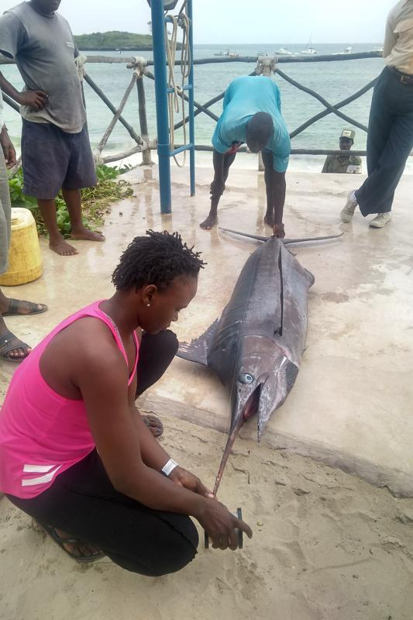
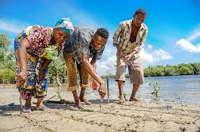
Target Audience:
Priority demographic archetypes
Institutions delivering & seeking training opportunities (Partners)
Managers
Researchers
Early Career Ocean Professionals
Local Communities

Slide 6

Design Process
ODIS specifications (interoperability with existing hubs on training opportunities)
Proof of concept: schema.org
Adoption of ODIS specifications

Slide 7

Coherence: IOC Programmes & International Frameworks
IOC Capacity development Strategy + OTGA
SGGs (4,9,14,17)
Operational strategy for priority Africa (2014-2021)
Agenda 2063:The Africa We Want
The Paris Agreement

Slide 8
Implementation Strategy
No. | Activity | Implementation Partners | Timelines (2021)
1 | Stakeholder Analysis | IOC Africa | April
2 | Contact of focal points for additions | IOC Africa | April
3 | Entry of new institutions and review of websites | IOC Africa | May
4 | Development of front end for portal based on CLME+ template customized for Africa | UGent, marinetraining.eu | May -June
5 | Inco operation of ODIS standards & interoperability with other platforms | UGent, marinetraining.eu | June - July
6 | Training of Users | UGent, marinetraining.eu | July
7 | Data entry | IOC Africa | July - October
8 | Linking to global OIH and IOC Africa websites | IOC Africa, IODE PO | October
9 | Launch (social media, newsletter, webinar) | IOC AFRICA, IODE PO | November

Slide 9

africa.marinetraining.org

Slide 10


Acknowledgements

Slide 11


