Slide 1
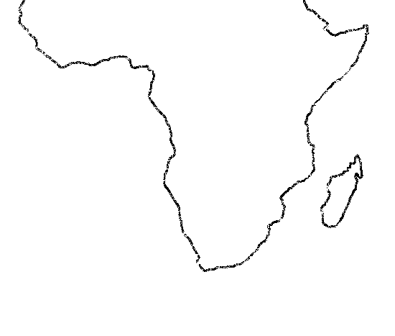
MarCOSouth and OCIMS
Ocean Info Hub

Slide 2
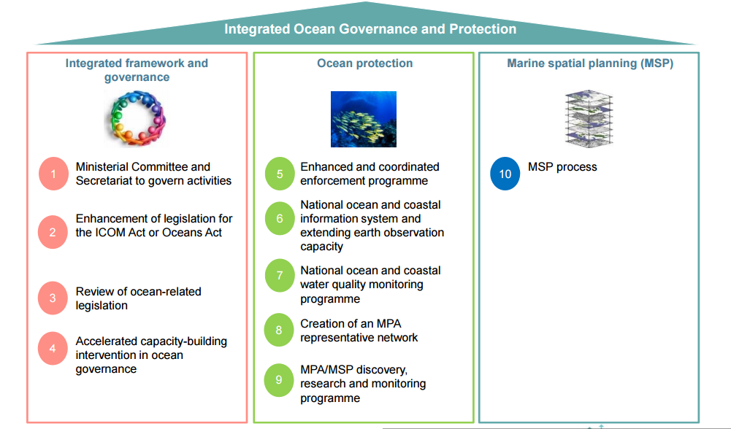
Oceans and Coastal Information Management System
Oceans Economy was identified as part of the Nine Point Plan launched by the presidency in February 2015 with the main aim to grow the South African Economy.
Operation Phakisa Oceans Economy – Fast results
The OCIMS project kicked of in June 2016.

Slide 3
Implementation of the Marine and Coastal Services

Slide 4
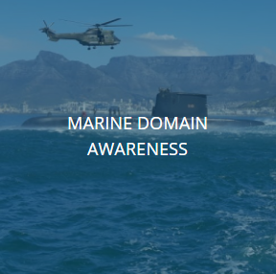
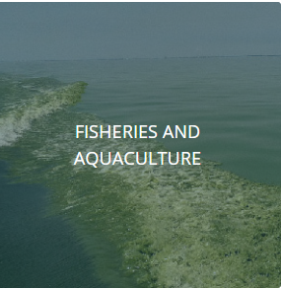
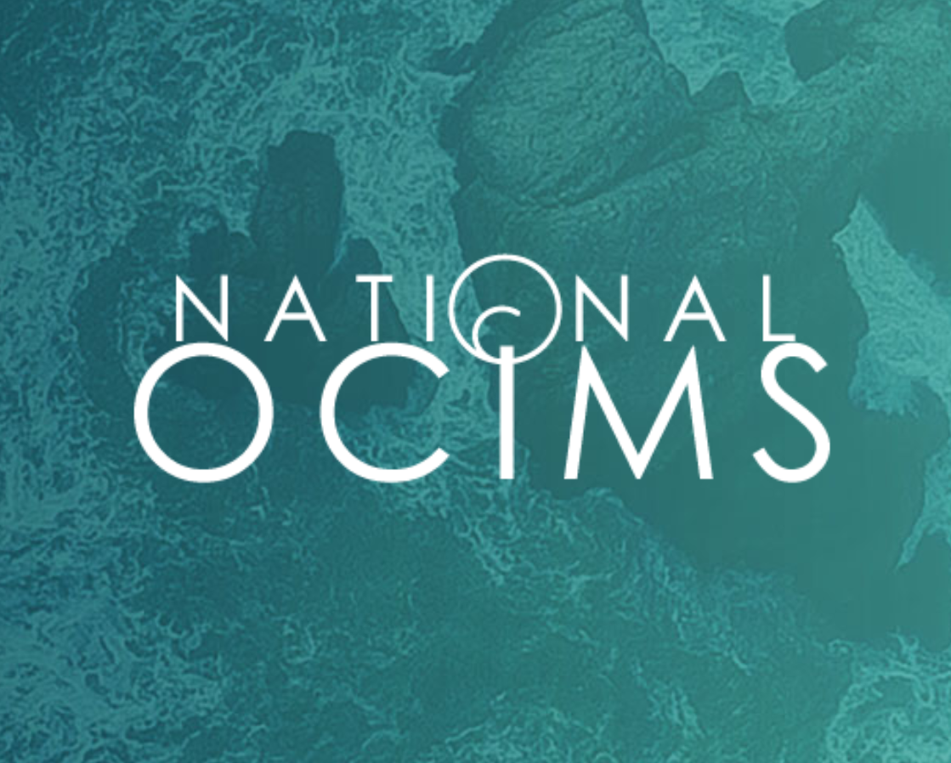
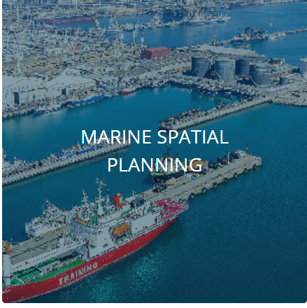
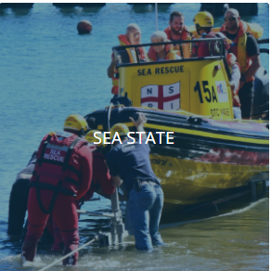
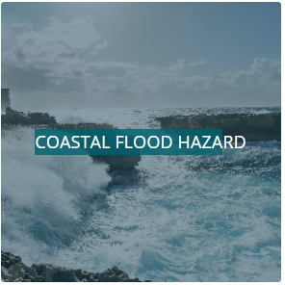
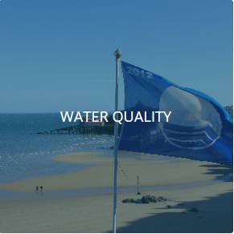
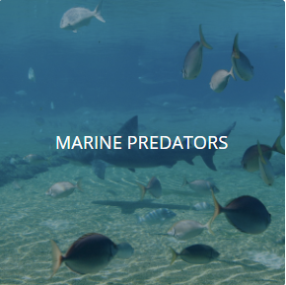
Mature
Decision Support Tools accessible through the OCIMS core
Marine Domain Awareness
OCIMS Core
Fisheries & Aquaculture
Marine Spatial Planning
Implementation through CSIR (service provider) who also runs operations of mode complex DeST.
Sea State
Coastal Flood Hazard
Water Quality
Marine Predator
Concept

Slide 5
Marine and Coastal Operations for Southern Africa
The EU funded Global Monitoring for Environment and Security (GMES) and Africa Program aims to promote more sustainable management of natural resources by improving decision-making through the use of earth observation (EO) data.
The African Union (AU) Commission signed a Cooperation Arrangement with the European Commission (EC) in Brussels on 12 June 2018 to facilitate AU’s access to Earth observation data from the Sentinel satellites of the Copernicus Programme.
In 2017, the CSIR submitted a grant application, as lead of an African Consortium, GMES & Africa Programmes’ Marine and Coastal thematic area in a response to a call by the African Union Commission
The proposal was based on significant technical synergy and co-funding from a current Operation Phakisa Project i.e. Oceans an Coastal Information Management System (OCIMS). The grant was awarded in 2018 and the contract signed in August 2018 and the Marine and Coastal Operations for Southern Africa (MarCOSouth) was initiated.

Slide 6
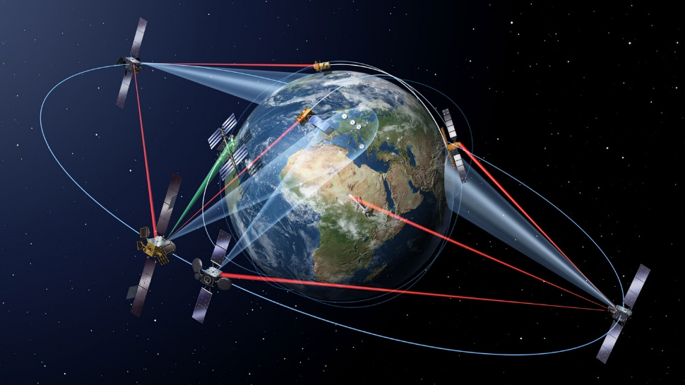
Marine and Coastal Operations for Southern Africa

Slide 7
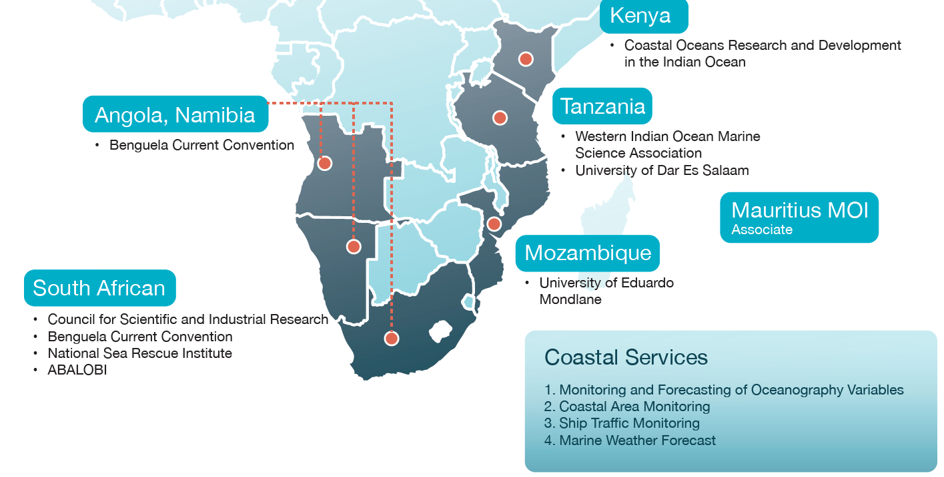

Slide 8
Implementation of the Marine and Coastal Services

Slide 9
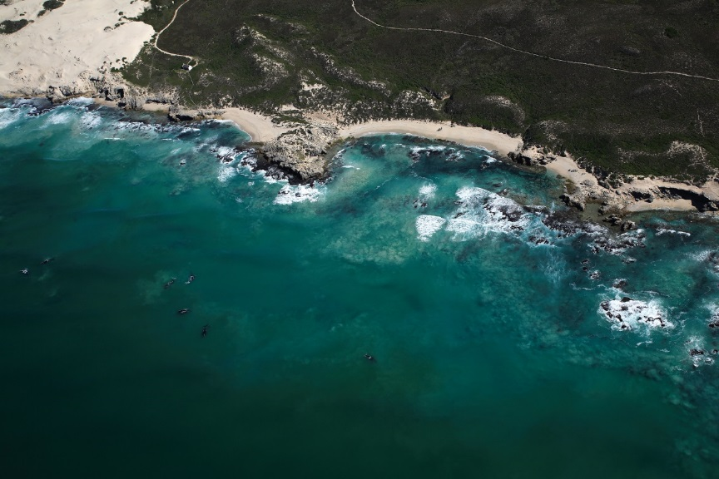
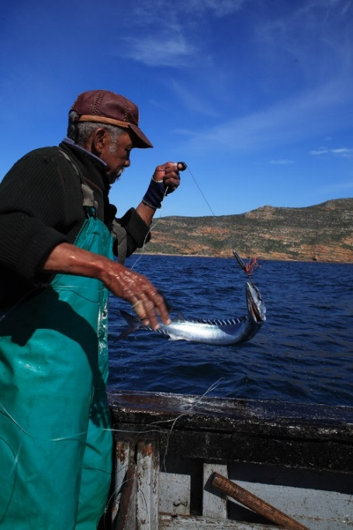
Implementation of the Marine and Coastal Services
3
Marine and Maritime
Ship Traffic Monitoring
Sea Rescue
Aquaculture and Fisheries
Aquaculture support
Abalobi
Coastal Services
Coral Bleaching
Water Quality
Number of Services Developed
Target
Number of Applications Developed
Target
6

Slide 10
Participation in the Ocean Info Hub
Make services, decision support tools and data available to a wider audience and user group
To be part of a wider network of scientists, stakeholders and decision makers
To participate on a international platform wrt Marine/Oceans and coastal forum to the benefit of oceans economy and conservation.
Get access to more services, decision support and data
To collaborate in the development of services, decision support using data to support the economy and to provide support for general conservation of our oceans and coasts.

