Slide 1


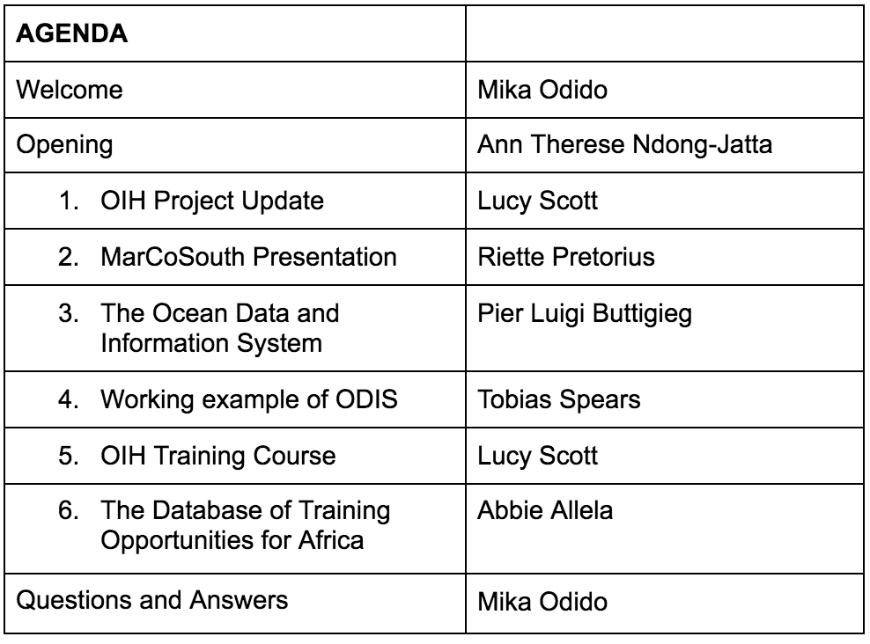






The Ocean InfoHub Project in Africa: Progress and Future Perspectives

