Slide 1


OIH - Pacific Environment Portal Network
Tavita Sua’s
Notes:
Membership – 14, 7 5
Waste , CC, Gov, Bio

Slide 2
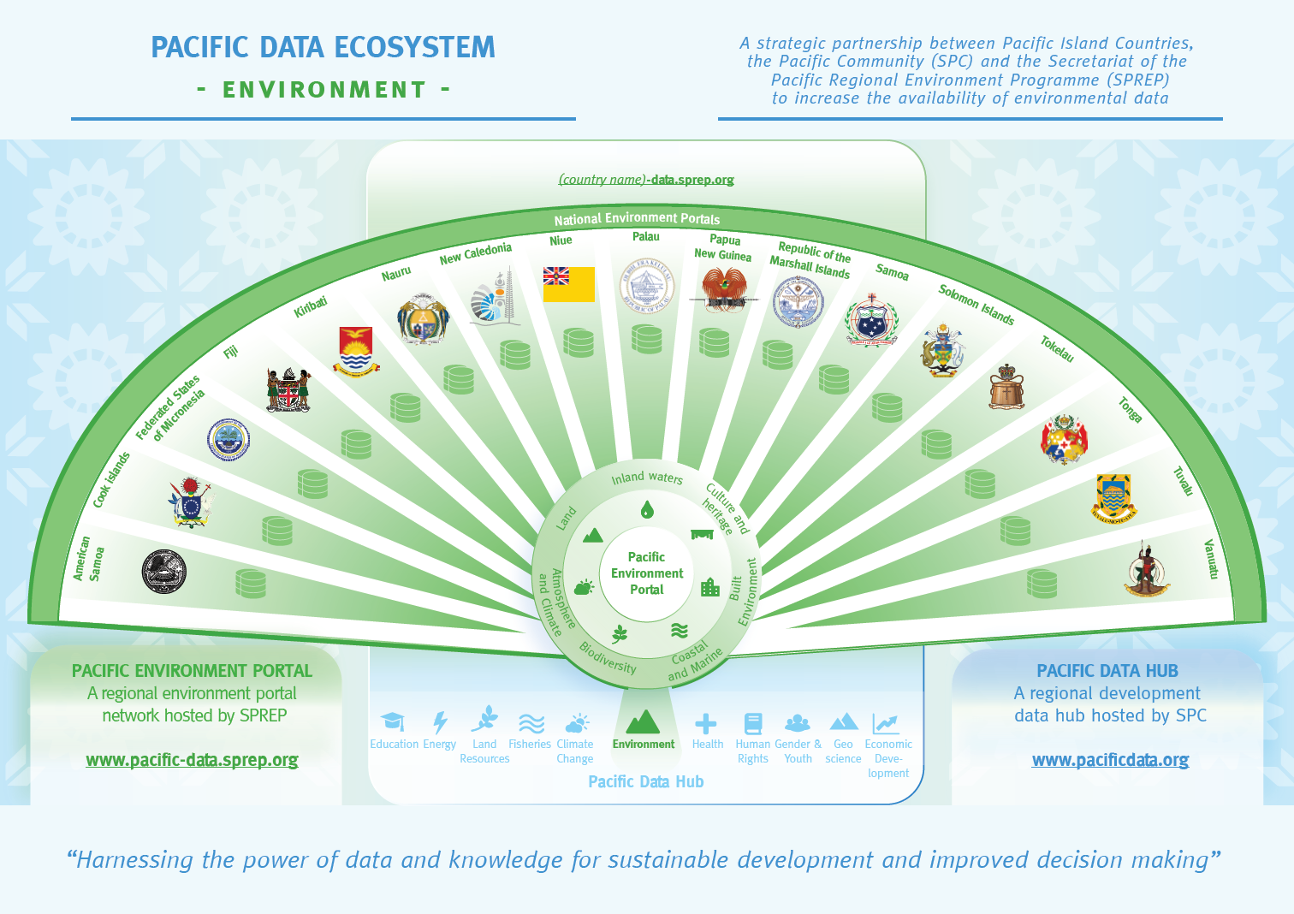

PEP network links to OIH
Notes:
The solution SPREP members through the Inform project have implemented is to ensure the availability and access to good environment data, climate change, and oceans data is a network of national Environment portals Established by SPREP in 2017. This network has grown available datasets from 100s of data sets to well over 9000 – part of this was made possible by forming partnerships with key data holders in the region including SPC as well as SPREPs library called PEIN. Nationally relevant data is harvested by the national portal –as well as published by national data portal users. The Vast majority of information in the data portals is available for download by the public- ie open and available
Provides a conduit to distribute global datasets to PICTs- which is ready now to receive and distribute info as soon as OIH is

Slide 3
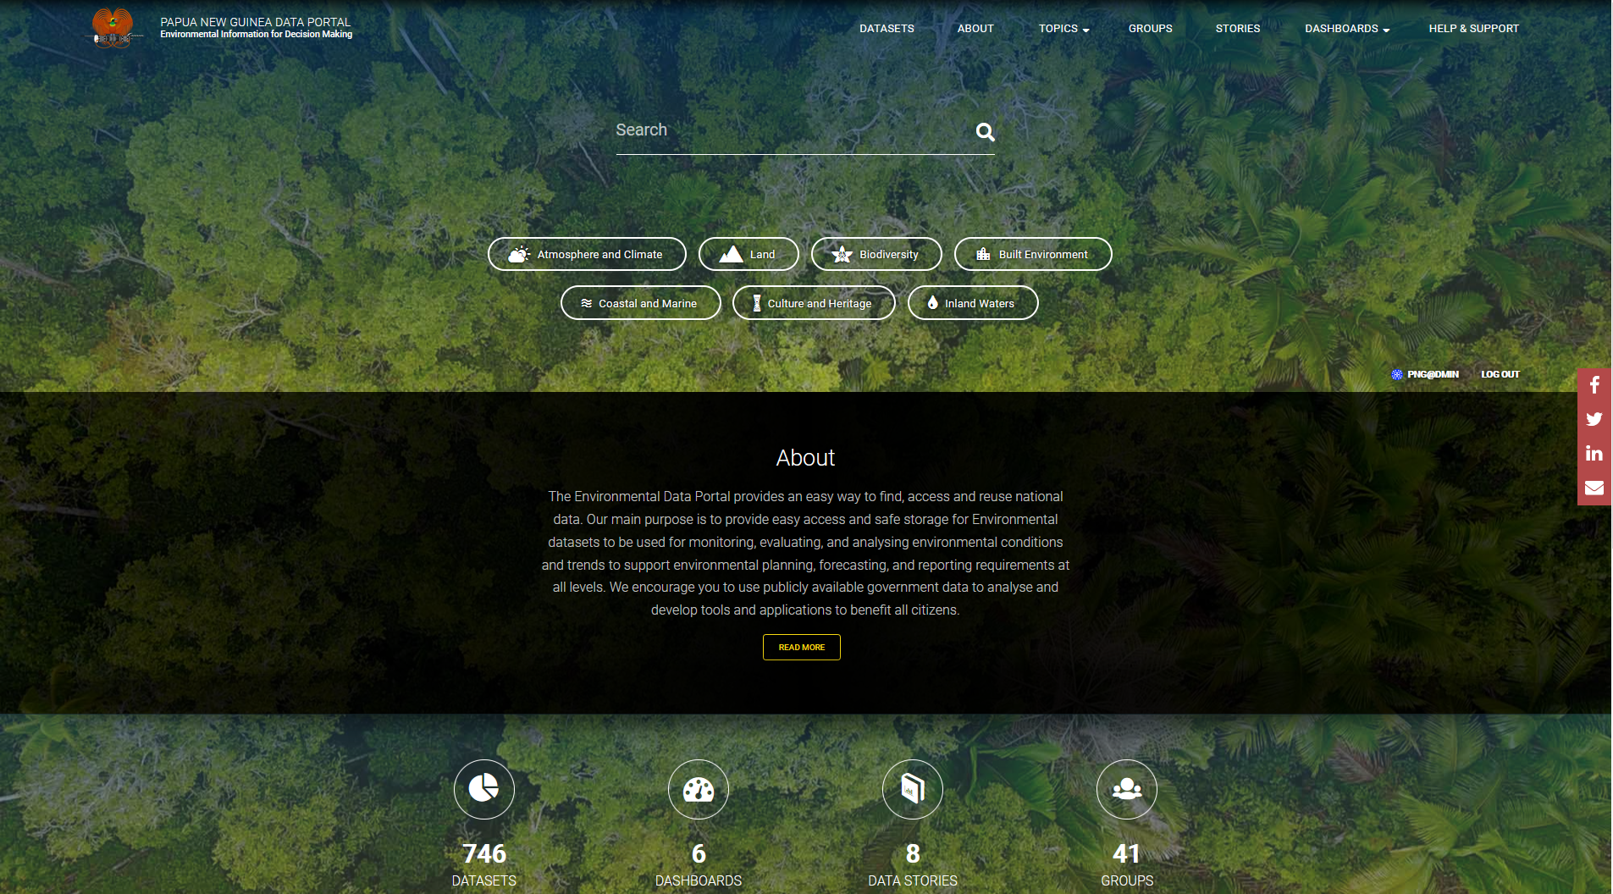
National Data portals
Environment Data Portals
Environment Data Portal
https://png-data.sprep.org
Built on Drupal DKAN Platform
Notes:
Backend upgrade

Slide 4
Pacific Data Ecosystem
SPREP
SPC
Countries
All have open data in a variety of formats
For stakeholders and partners

Slide 5
Looking froward
JOSN-LD – late 2021 rollout for enhances availability of data for OIH

Slide 6
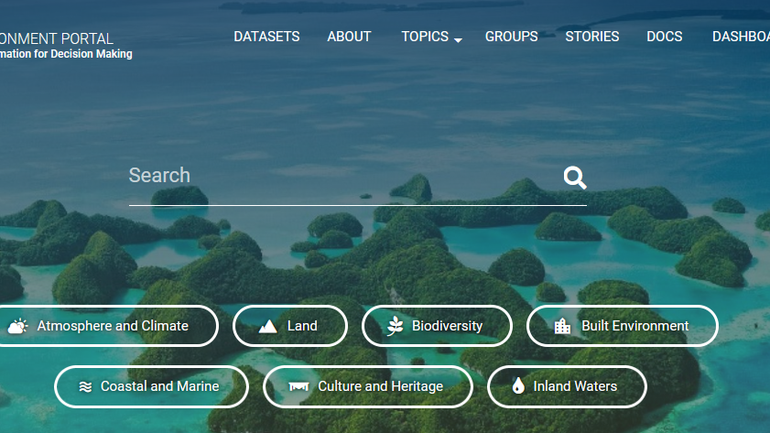
Questions ??

