Slide 1


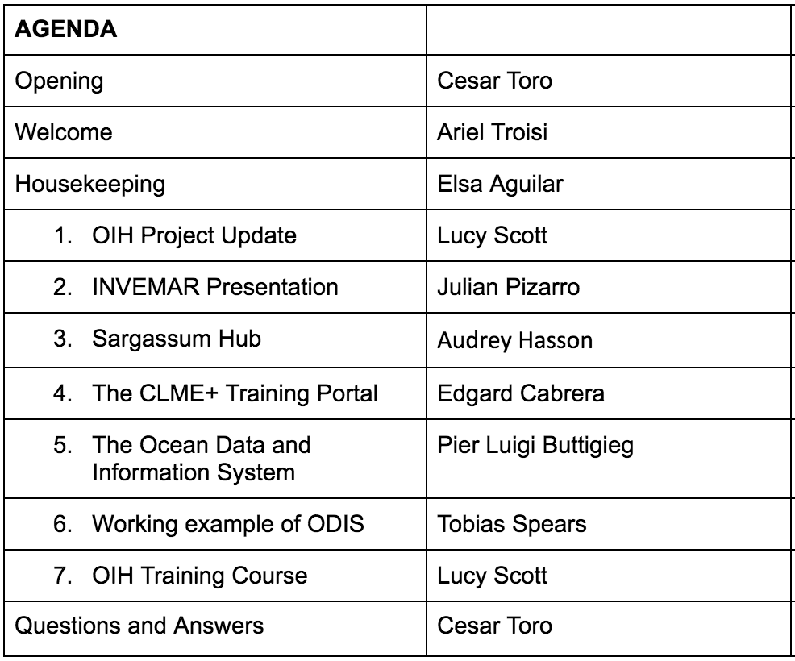


The Ocean InfoHub Project in the Latin America and Caribbean (LAC) region: Progress and Future Perspectives

