Slide 1
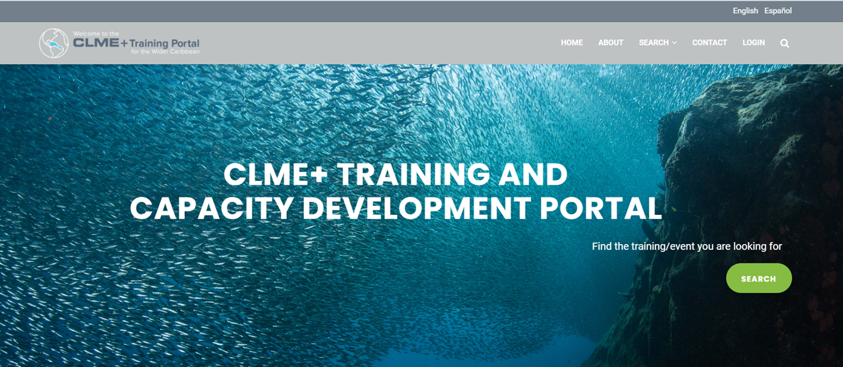
CLME+ Demonstration - 8 June 2021
CLME+ Training and Capacity Development Portal
clmeplus.marinetraining.org/
The Ocean InfoHub Project in the LAC region: Progress and Future Perspectives

Slide 2
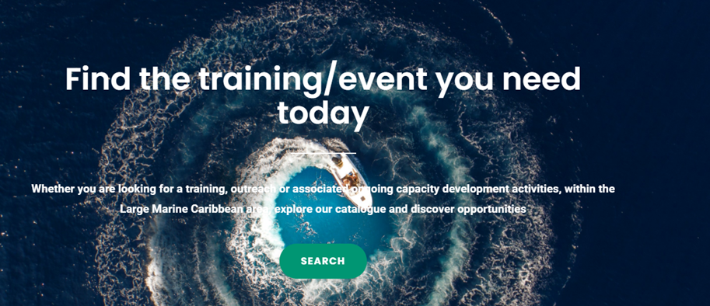
Operational since December, 2020
https://clmeplus.marinetraining.org
The Portal, developed using as basis and core platform “MarineTraining” of the University of Ghent (http://www.marinetraining.eu/), will enhance institutional and stakeholder capacity for sustainable and climate-resilient marine resources management in the wider Caribbean /CLME+ Region at regional, sub-regional, national and local levels, and thus, ultimately contributing to the long-term CLME+ Vision and other ongoing CD initiatives (LAC ocean infoHub-UN Ocean Decade WTA).

Slide 4
Content Management
Academic programmes: B.Sc. M.Sc. and PhD programmes.
Short trainings: courses, webinars, workshops, seminars, and summer schools.
Events: Users will be able to publish and promote work meetings, expert meetings, conferences and webinars.

Slide 5
Services for organizers / providers
Administrative support for organizers of trainings or associated events
Development of training packages linked to specific equipment or tools
Promote and outreach other training or event
User Management
Authenticated user (All providers): User has access to the full list of providers. The publication of the content is subjected to an editor’s revision.
Contributor: the user can publish their own content.
Editor: the user can edit, publish and decline content.
Portal administrator: user and content management

Slide 6
STATUS
The platform is functional and administrated by IOCARIBE of IOC UNESCO
Over 500 trainings and capacity development activities have been entered (programmes, short trainings and events).
Over 190 providers

Slide 7
Future actions
Data entry: future efforts will focus on keeping the training and capacity development information up to date; this increase in data availability will provide an opportunity to gather regional insights on specific training/capacity development needs.
Expected core beneficiaries of the platform include - but are not limited to - professionals at Governmental Departments/Ministries in all countries from the wider Caribbean, at Inter-Governmental Organizations and Non-Governmental Organizations / Civil Society Organizations working on the marine environment.

Slide 8
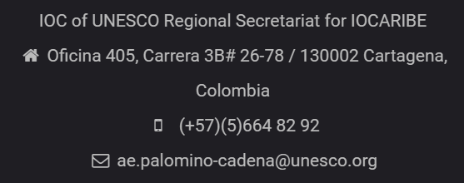
How to contribute:
Register at:
https://clmeplus.marinetraining.org
Contact info:

Slide 9
CLME+ Demonstration - 8 June 2021
Thank You
clmeplus.marinetraining.org
The Ocean InfoHub Project in the LAC region: Progress and Future Perspectives

