Slide 1
Audrey Hasson, Ph.D. GEO Blue Planet Initiative Head of European Office
Sargassum Information Hub
The Ocean InfoHub Project in the Latin America and Caribbean (LAC) region: Progress and Future Perspectives
8 June 2021

Slide 3
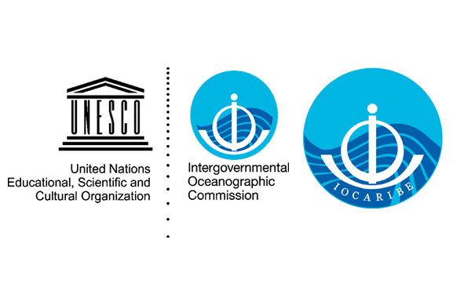
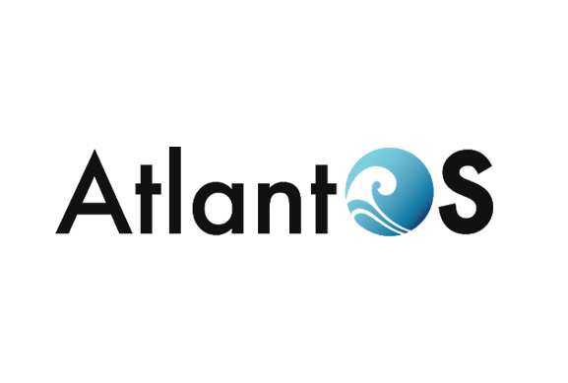
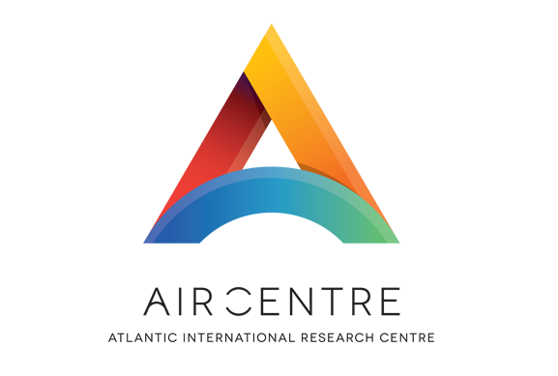
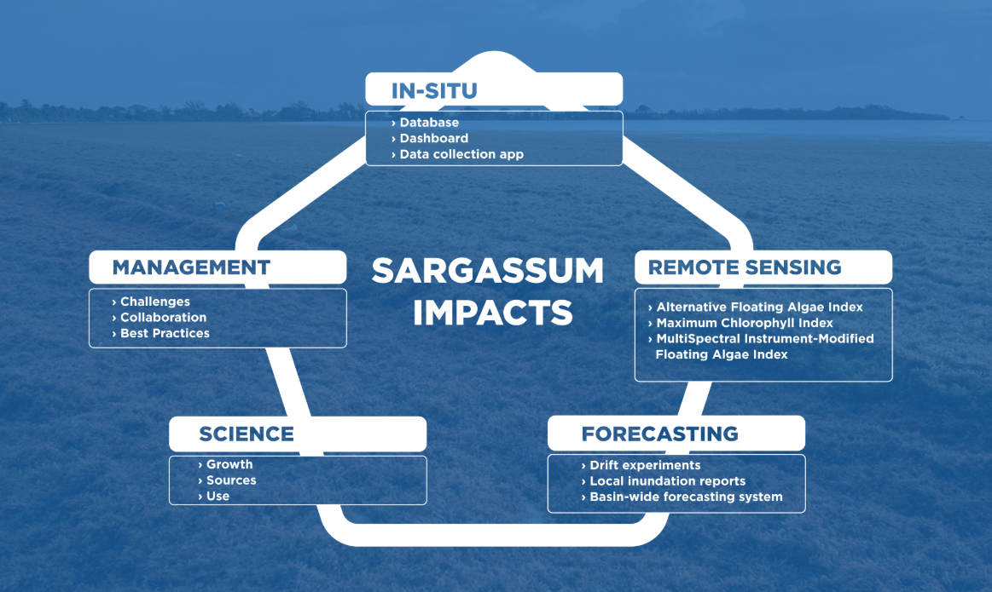
Integrated information
Notes:
We are currently moving forward in collaboration with IOCARIBE, AlantOS the AIR Centre and other partners to support an integrated approach to monitor and forecast concentrations of sargassum for the Atlantic basin. We are doing this based on publicly available data, such as satellite and in-situ data, from countries with open data sharing policies.The project objectives include:

Slide 4
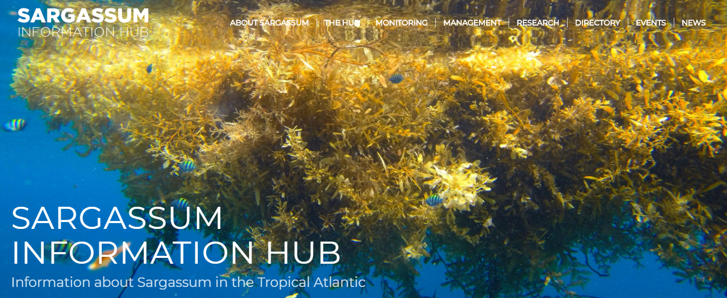
Notes:
To meet this need, GEO Blue Planet, IOCARIBE of IOC-UNESCO, AtlantOS, and the AIR Center developed the Sargassum Information Hub to provide information about sargassum in the Tropical Atlantic. The hub aims to support collaborations, facilitate access to information, and to prevent duplication of effort. GEO Blue Planet led the development of the content in collaboration with IOCARIBE and AtlantOS. The AIR Centre provided the resources for website design by Scite. These four groups are the hub organizers, but we want the community to contribute information to the hub and we welcome feedback and contributions.

Slide 5
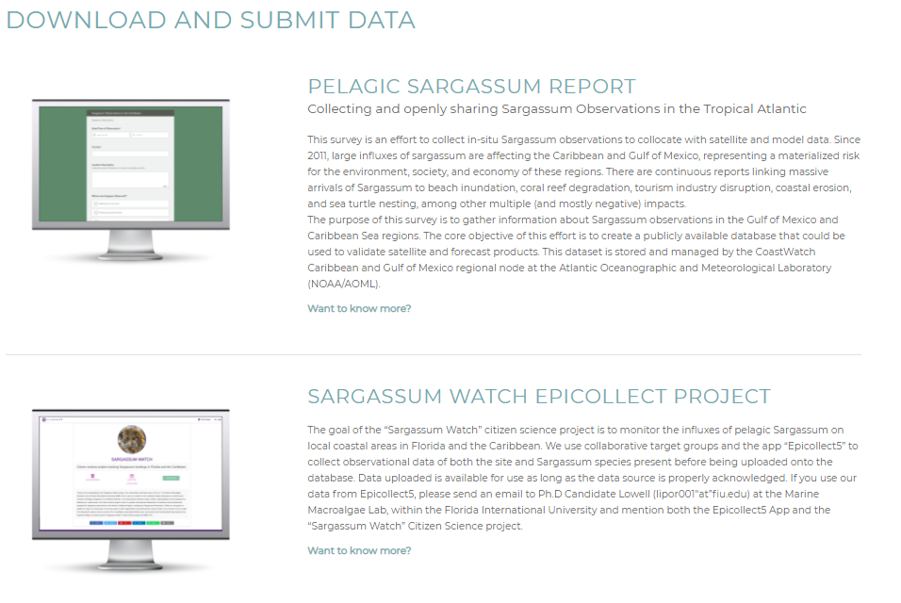
Monitoring information

Slide 6
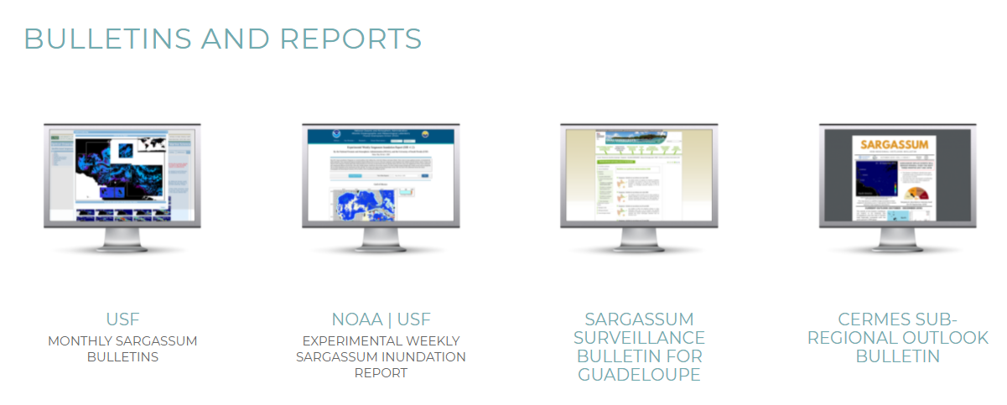
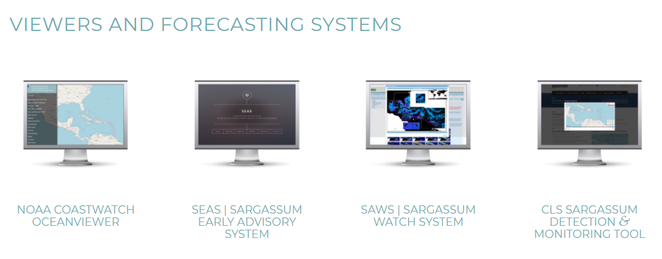
Monitoring Information

Slide 7
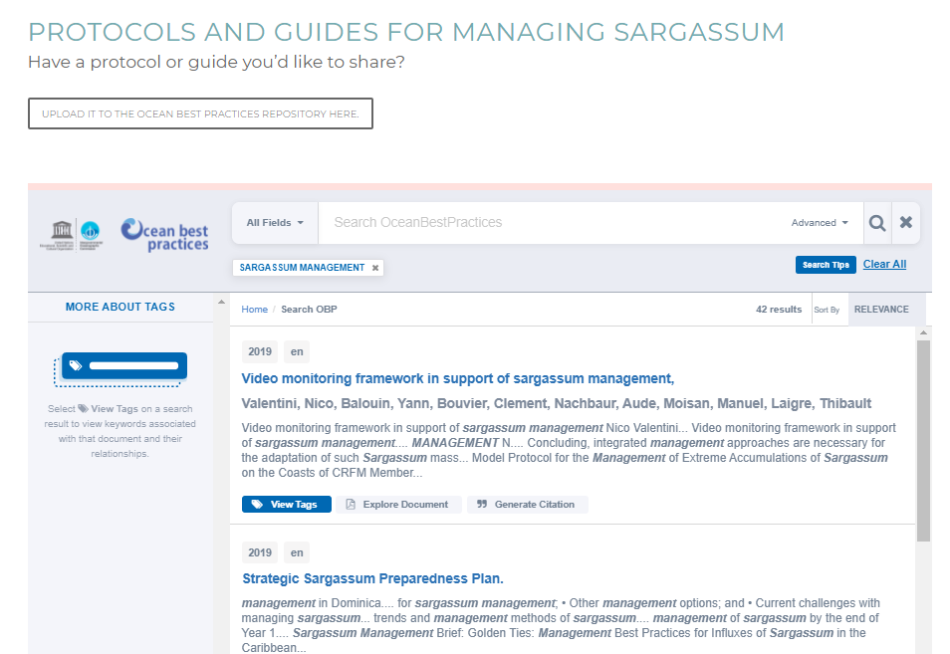
Management

Slide 8
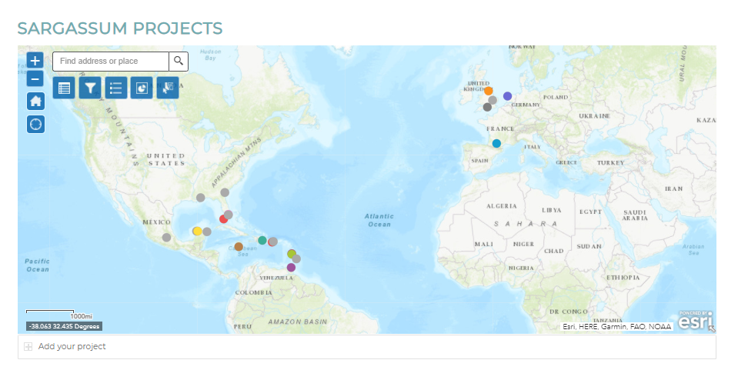
Sargassum Hub Version 2.0
Bringing in additional partners
Updating the directory
Country/regional pages
Integrating freely-available monitoring products
Explore linkages with the Ocean Information Hub

Slide 9
sargassumhub.org info@sargassumhub.org

