Slide 1
Showcase regional working examples of ODIS
CHM-LAC

Slide 2
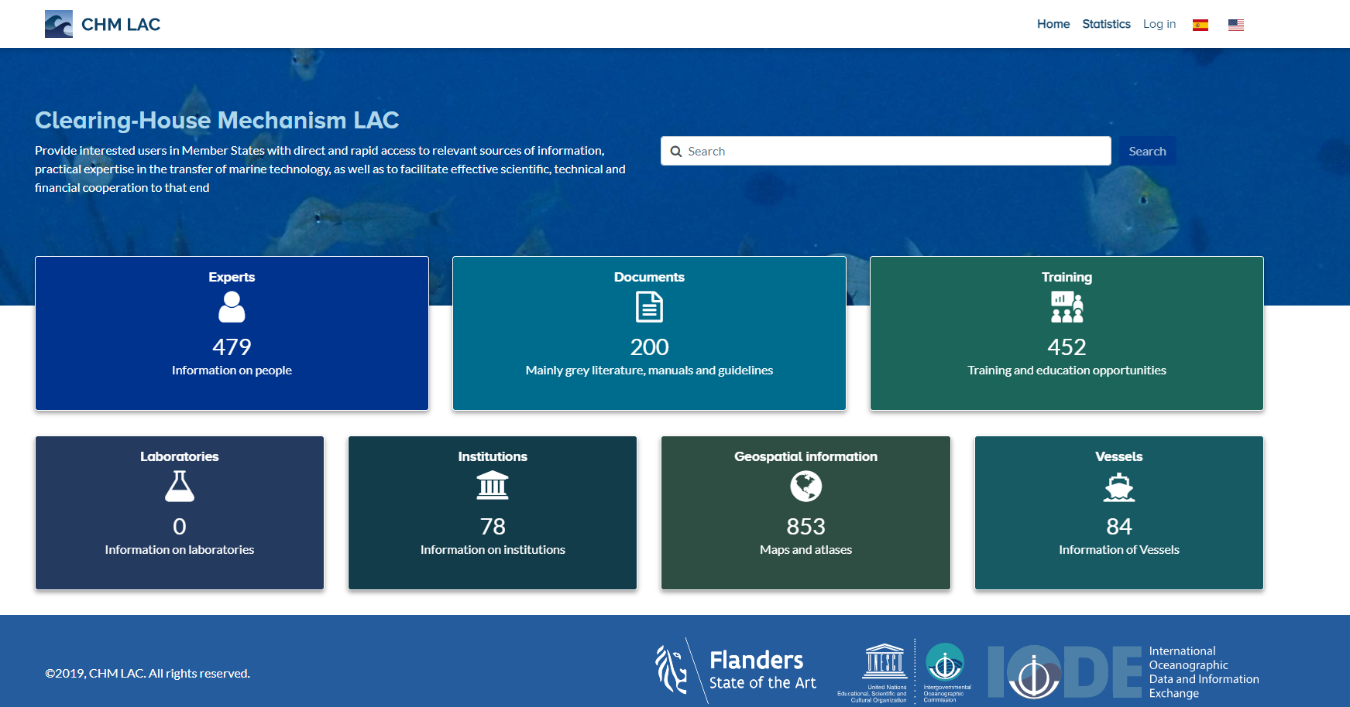
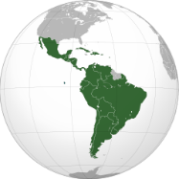
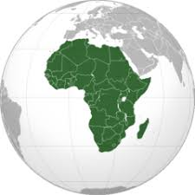
Clearing House Mechanism –CHM for the Latin America and Caribbean region – LAC
Pacific SIDS
CHM – LAC
2019
Notes:
To transfer MT to “developing States, particularly land locked and geographically disadvantaged States as well as other developing States which have not be enable to establish or develop their own capabilities in marine sciences, scientific research, observations of the oceans and coastal areas, and related technology, or to develop the infrastructure needed to achieve such ends”(IOCCGTMT);
“..provide interested users in Members States with direct and rapid access to relevant sources of information, practical expertise in the transfer of marine technology, as well as facilitate effective scientific, technical and financial cooperation to that end (IOCCGTMT)”.
“become the primary information repository to support the international conventions and agreements and at the same time provide a platform to share information, build partnerships and forge collaboration for the growth and transfer of marine technology in developing countries (IOC2017).
“A transparent ocean with open access to data, information and technologies” (Decade of Ocean Science)
CHM to provide information and facilitate technical and scientific cooperation.

Slide 3
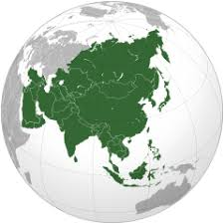
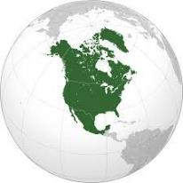
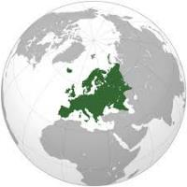
OIH Global
A hybrid model: online central portal integrating the data and information harvested from regional/sectoral portals (need for interoperability)
Training and education
Geospatial information
Document repository as a LAC
Research Vessels
Institution and expert directory as a LAC
OIH-LAC
OIH
(by regions….)
from rest of the world
GOSR
Regional prototype for CHM

Slide 4
Thematic for OIH LAC
OIH LAC
Mainly grey literature
Training and education opportunities database
Manuals and guidelines
Information on people and institutions
Geospatial information
Research vessel database
IOC country profiles
Some data sources identified…
Experts
Documents
Training
Laboratories
Institutions
Geospatial information
Vessels
OceanExpert
OceanDocs
OceanBestPractices
ODISCat
IOCARIBE
Caribbean Marine Atlas
Thematic and some datasources identified
https://oceaninfohub.org/partners/oih-lac/

Slide 5
How is the collection, dissemination and visualization of information and courses?
Platform Workflow
Gets information in different way
Expose web services for interoperability

Slide 6
Features
Thematic search/explorer
Detailed list of information for thematic
Specific filters (facets) for each thematic
Multiple language interface
Gets information in different way
Expose web services for interoperability
Access from mobile and web browser

Slide 7
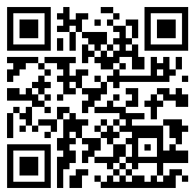
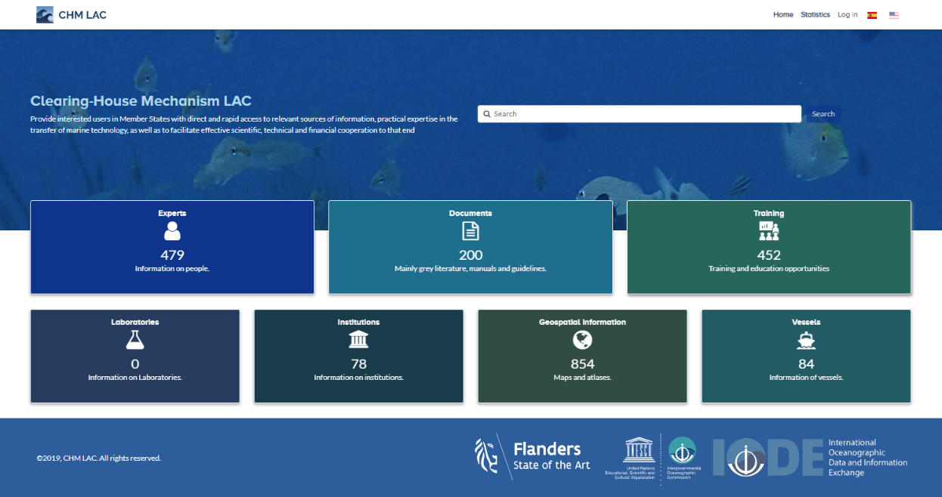
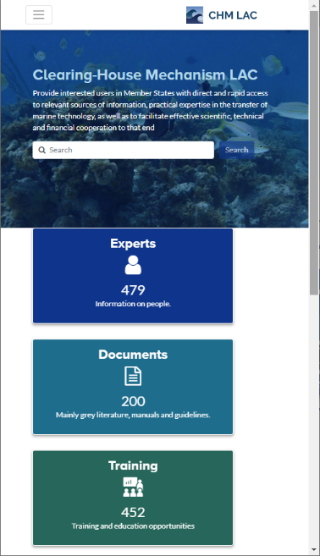
CHM LAC Pilot
http://portete.invemar.org.co/chm

Slide 8
Experts
Datasource

Slide 9
Geospatial information
Datasource

Slide 10
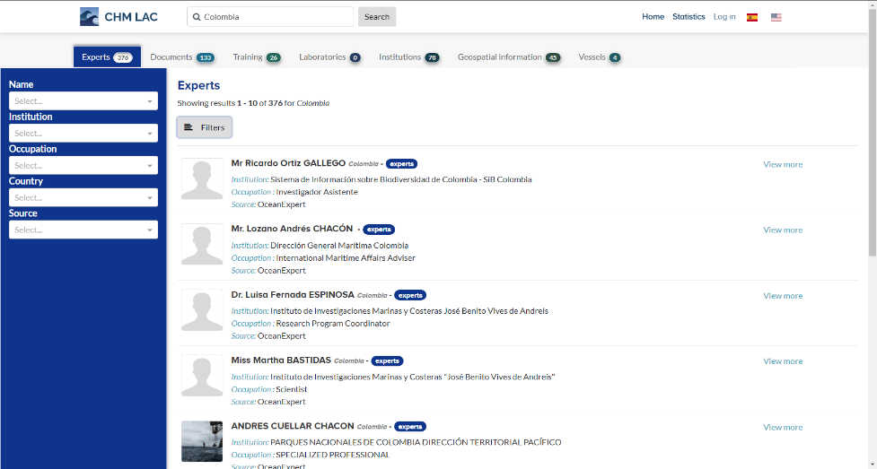
Thematic Search
enter your search term…
…the term is searched in all topics

