Slide 1
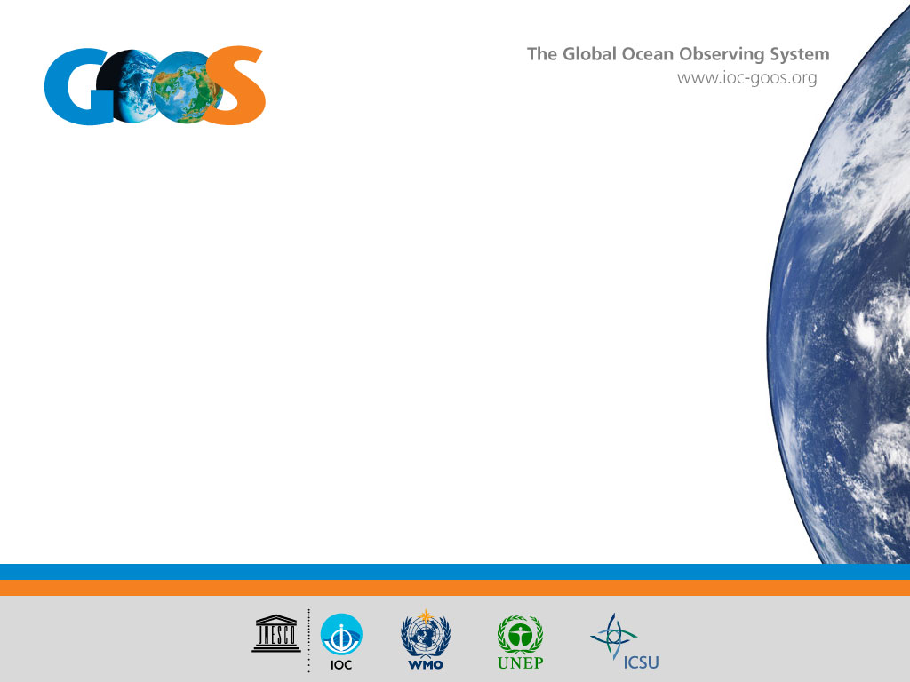
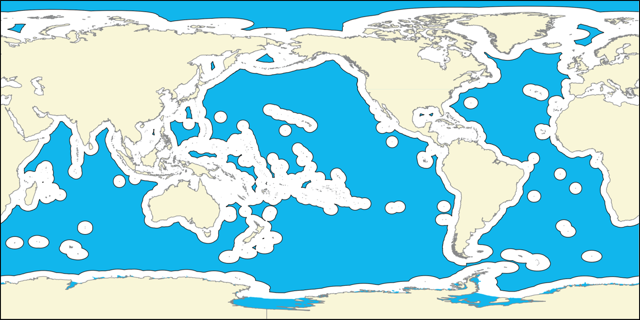

Polycentric ocean governance and GOOS
The Global Ocean Observing System
goosocean.org
Albert Fischer
drawing from work by Robin Mahon
GOOS Regional Forum, 6 August 2019, Tokyo, Japan

Slide 2
GOOS Governance
The situation described in the white paper by Tanhua et al.
Multiple centres of responsibility for GOOS components
Lack of an entity or mechanisms with responsibility for overall for coordination of the system
Associated problems
Not an uncommon situation in governance
Significant work has been done on:
Characteristics of such systems
How to make them effective
This may help with understanding and developing appropriate arrangements for governance of GOOS.
Notes:
The situation of multiple centres of responsibility for GOOS components and the lack of an entity or mechanisms with responsibility for overall for coordination of the system described by Tanhua et al. (2018) is not uncommon in the world of natural resources governance.
There has been a significant amount of work on the characteristics of such systems and how to make them effective, that may be useful in understanding and developing appropriate arrangements for governance of GOOS.

Slide 3
Polycentricity in governance
Early researchers of governance systems noted they were often multicentered, uncoordinated and chaotic
1961 Elinor Ostrom and colleagues, look closer, there is structure
Introduced the term polycentric
Polycentric systems should have:
Overarching rules
Mutual adjustment by components (collaborate and avoid conflict)
Willingness to experiment
Trust among members
Notes:
Governance researchers had been noting than many systems had multiple centers of decisionmaking little coordination and appeared to be totally chaotic In 1961 Elinor Ostrom and colleagues termed such systems as polycentric, defined by the existence of multiple centers of influence or decision-making that address a particular problem area.
Polycentric systems should have:
• overarching rules,
• mutual adjustment of activities to foster collaboration and avoid conflict,
• willingness for experimentation,
• trust,
• local action.

Slide 4
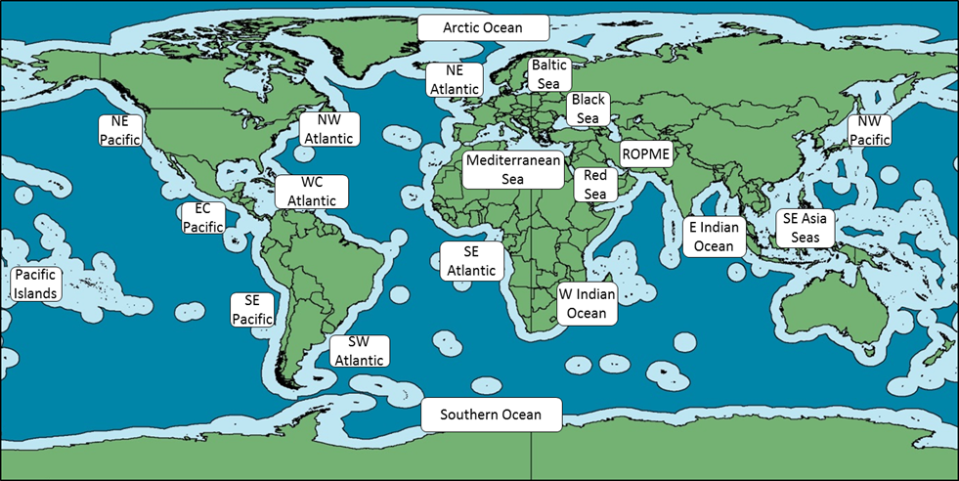
Polycentricity in global ocean environmental governance
Global level – 25+ intergovernmental arrangements
Twenty regions

Slide 5
Multilevel polycentricity
Most of these systems include multiple levels:
Global
Regional
Subregional
National
National regions
Local
Clearly GOOS is polycentric and multilevel with global, regional, subregional, national, and subnational levels.

Slide 6
Pros and cons of polycentricity
Cons
Inefficiency (duplication of effort)
Gaps in coverage
Unpredictable
Pros (may be more ordered than they initially appear)
Multiple mechanisms for mutual monitoring, learning, and adaptation
Subsidiarity, in which problems can be addressed at the most relevant and capable scale;
Decentralised decision-making facilitates the input from relevant stakeholders
Resilience due to redundancy
Notes:
Often self organizes – police example
May not be an option anyway, we can seldom wipe the slate clean and start fresh.

Slide 7
Working with polycentricity
Attending to overall architecture and interactions. Harmonizing principles, rules and mandates. Analysing gaps, overlaps. Establishing cooperation/ conflict management mechanisms. Network development, Applying subsidiarity. Strengthening learning and sharing mechanisms.
Not an option
Centralised authority
Polycentric fragmented
Polycentric bricolage
Polycentric codesigned
Fully functional polycentric
Governance modality spectrum

Slide 8
What are we trying to govern?
Ultimately the investment in ocean observing comes from a national or subnational level – trying to govern the mechanisms that support sustainability/ increase of national investment, and regional and global alignment of those national investments
The activities of GOOS, its components, its partners
The partnership development and implementation planning mechanism(s)
A few prisms to look at what we want to govern:
Framework for Ocean Observing
The 2030 Strategy and Objectives
The intended end use of the observations
The polycentric governance model

Slide 9
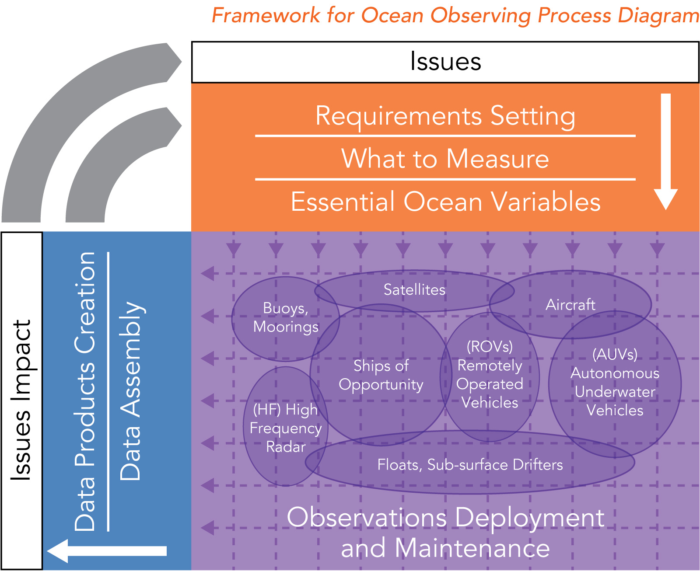
Framework for Ocean Observing
Requirements – global, regional, national priorities
Observations coordination, best practice
Data and information generation
Cycles of evaluation

Slide 10
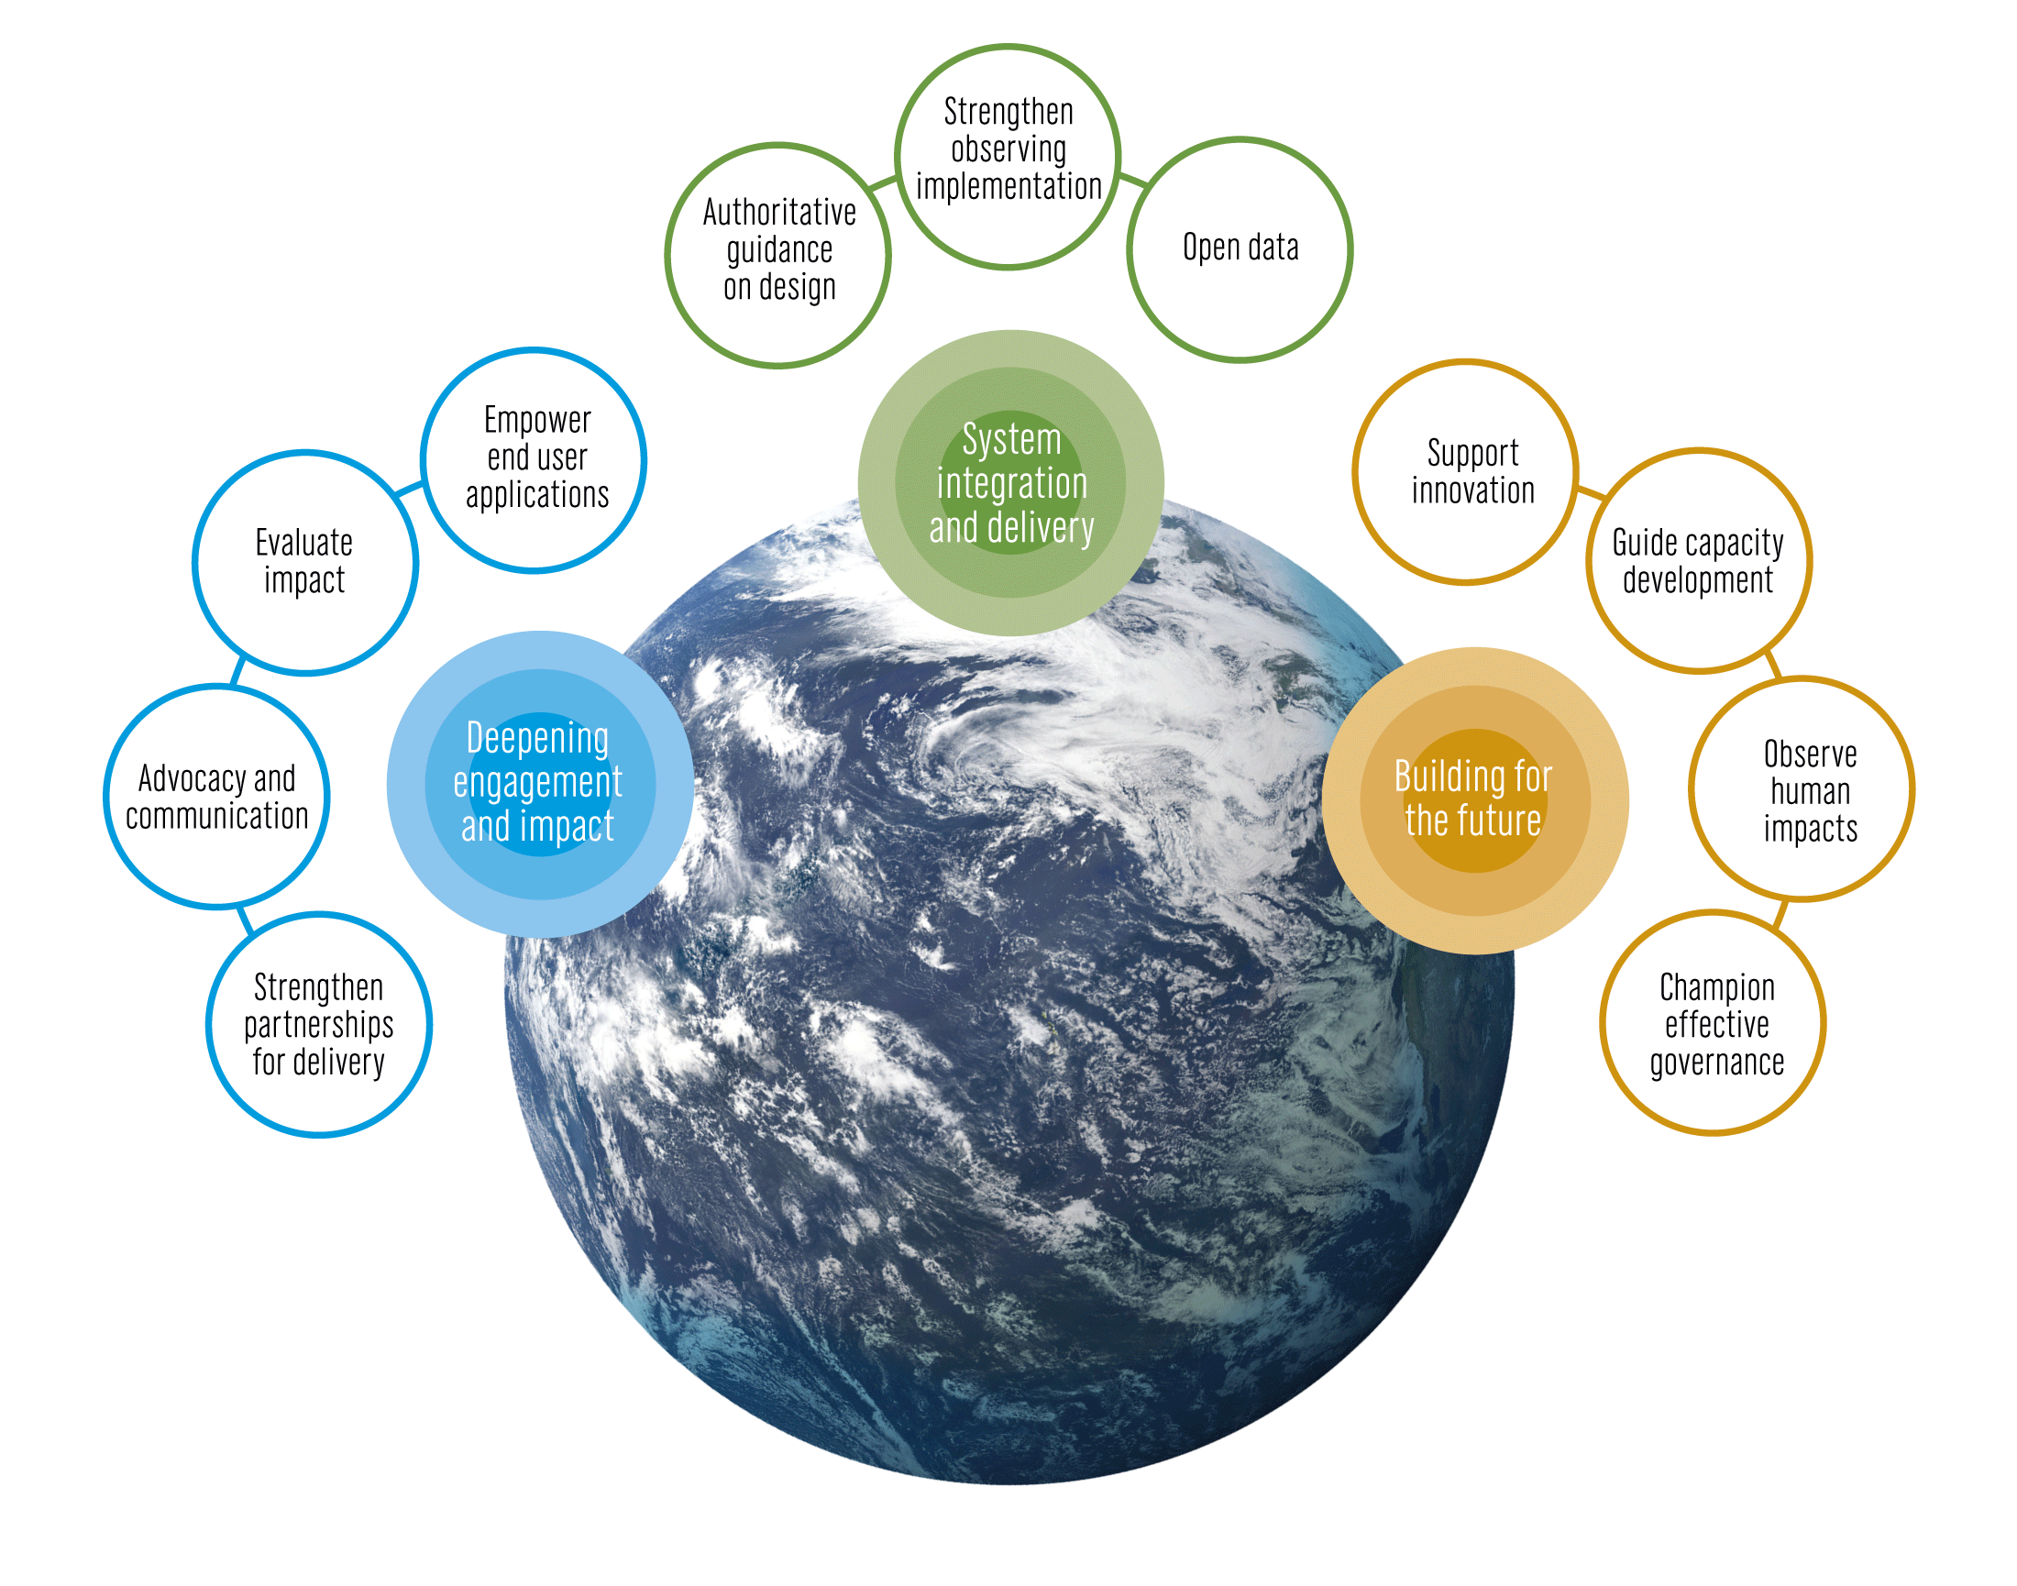
Strategic Objectives
System integration and delivery
Deepening engagement and impact
Building for the future

Slide 11
Working on common objectives Partnerships for delivery
Operational services
Weather &
marine
services
Ocean &
coupled
forecasts
Early warning
systems
Satellite
and
in situ
networks
Global
Regional
National
Real-time
data
systems
Reanalysis
Forecasts
Projections
Research
Climate services
Climate
Archives
Climate
assessments
Models
Research
Scenarios
Indicators
Early warning
systems
Ocean
health
services &
assessments
Ocean health
Observations
Data management
Analysis,
Forecasts,
Models
Applications
Users
Res. & innov.

Slide 12
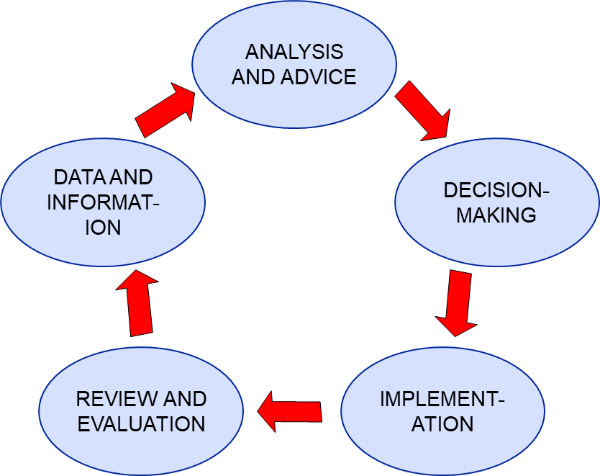
The governance framework
A multi-level policy-cycle based governance framework
Policy cycles must be:
Complete
Linked vertically
Linked laterally
Diversity of policy processes as appropriate
Notes:
12

Slide 13
Framework building interventions
Long-term goal of interventions
‘fully-functional policy cycles at all appropriate levels with the appropriate vertical and lateral linkages’
Interventions can be targeted at various parts of the system to:
Establish or strengthen policy cycles
Build or enhance linkages
In the wider Caribbean: changed the nature of the ocean governance conversation

Slide 14
A more fully polycentric system
Attending to overall architecture and interactions
Harmonizing principles, rules and mandates
Analysing gaps, overlaps
Establishing cooperation/conflict management mechanisms
Network development (networks of people and organizations), Applying subsidiarity
Strengthening learning and sharing mechanisms

Slide 15
Questions for discussion
What activities of ‘GOOS’ are most important in developing national investment in sustained ocean observations?
What activities are most important in influencing national systems to build towards common regional and global systems? (i.e. working towards best practice and standards, sharing data into common systems)
Do these answers give us some indication of priority focus on improving governance?
What are the next steps in this process of improving the governance of GOOS?
Mapping and analysis of the present architecture?
Better learning and sharing mechanisms?
Which mechanisms should be used? GOOS SC? a partners’ forum? how do we engage national systems?

