Slide 1
Cooperation with WMO, disbandment of JCOMM: implications for GOOS
The Global Ocean Observing System
goosocean.org
Albert Fischer
GOOS Regional Forum, 5 August 2019, Tokyo, Japan

Slide 2
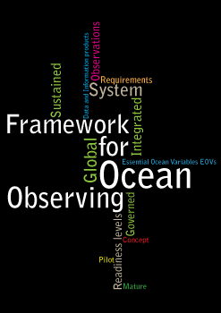
GOOS structure 2019
Sponsors: IOC/UNESCO, WMO, UN Envi, ICS
GOOS Steering Committee
Requirements & Evaluation
GCOS-GOOS-WCRP
Physics & Climate (OOPC)
GOOS
Biogeo-chemical Panel
(IOCCP)
GOOS
Biology & Eco-systems Panel
Observations
Projects
Data & Information
JCOMM Observations Coordination Group
GOOS Regional Alliances
TPOS 2020
DOOS
links to IODE, WMO Information System
AtlantOS
JCOMMOPS
Observing networks
MESCAT
National systems

Slide 3
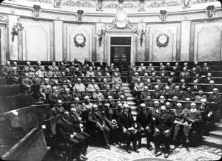
CONSTITUENT BODY REFORM (CBR)
1873
2050
WMO for the 21st Century
From 8 technical commissions (including JCOMM) to two:
Infrastructure, Services; and a Research Board

Slide 4
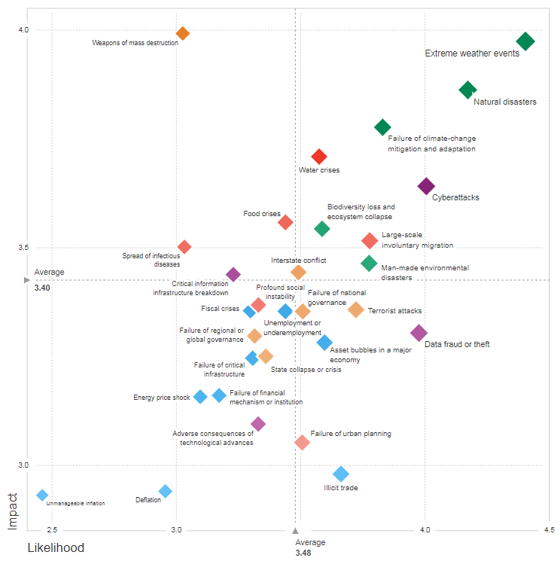
Perspective for the coming decade
Extreme weather events
Natural disasters
Impact
Failure of climate change mitigation and adaptation
Water crises
Cyberattacks
Biodiversity loss and ecosystem collapse
Large-scale involuntary migration
WMO EC-70
Geneva, 20-29 June 2018
Man-made environmental disasters
Likelihood
World Economic Forum Global Risks Landscape

Slide 5
WMO Strategic Plan at a Glance
By 2030, a world where all nations, especially the most vulnerable, are more resilient
to the socioeconomic impact of extreme weather, climate, water and other environmental events,
and empowered to boost their sustainable development
through the best possible services, whether over land, at sea or in the air
Vision 2030
Overarching Priorities
Enhancing preparedness for,
and reducing losses of life
and property from
hydrometeorological extremes
Supporting climate-smart decision making to build resilience and adaptation to climate risk
Enhancing socioeconomic value of weather, climate, hydrological and related environmental services
Core Values
Accountability for Results and Transparency ▪ Collaboration and Partnership ▪ Gender Equality, Inclusiveness and Diversity
Long-Term Goals
Better serve societal needs:
Delivering, authoritative, accessible, user-oriented and fit-for-purpose information and services
Enhance Earth system observations and predictions: Strengthening the technical foundation for the future
Advance targeted research:
Leveraging leadership in science to improve understanding of the Earth system for enhanced services
Close the capacity gap:
Enhancing service delivery capacity of developing countries to ensure availability of essential information and services
Strategic realignment of WMO structure and programmes:
Effective policy- and decision-making and implementation
Strategic Objectives
2020-2023
focus
1.1 Mainstream and strengthen national multi-hazard early warning systems to extend reach and better enable effective decision response to the associated risks
1.2 Broaden the provision of policy- and decision-supporting climate information and services at all levels
1.3 Further develop services in support of sustainable water management
1.4 Enhance and innovate the provision of value-added, decision-supporting weather information and services
2.1 Optimize the acquisition of observation data through the WMO Integrated Global Observing System
2.2 Improve and increase access to, exchange and management of current and past observation data and derived products through the WMO Information System
2.3 Enable access and use of numerical forecasting and prediction products at all temporal and spatial scales from the WMO Global Data Processing and Forecast System
3.1 Advance scientific knowledge of the Earth system
3.2 Enhance the science-to-service value chain ensuring scientific and technological advances improve predictive capabilities
3.3 Advance policy-relevant science
4.1 Address the needs of developing countries to enable them to provide and utilize essential weather, climate, hydrological and marine services
4.2 Develop and sustain core competencies and expertise
4.3 Scale up effective partnerships for investment in sustainable and cost-efficient infrastructure and service delivery
5.1 Optimize WMO constituent body structure for more effective decision-making
5.2 Streamline WMO programmes
5.3 Advance equal and effective participation of women and men in governance, scientific cooperation and decision-making

Slide 6
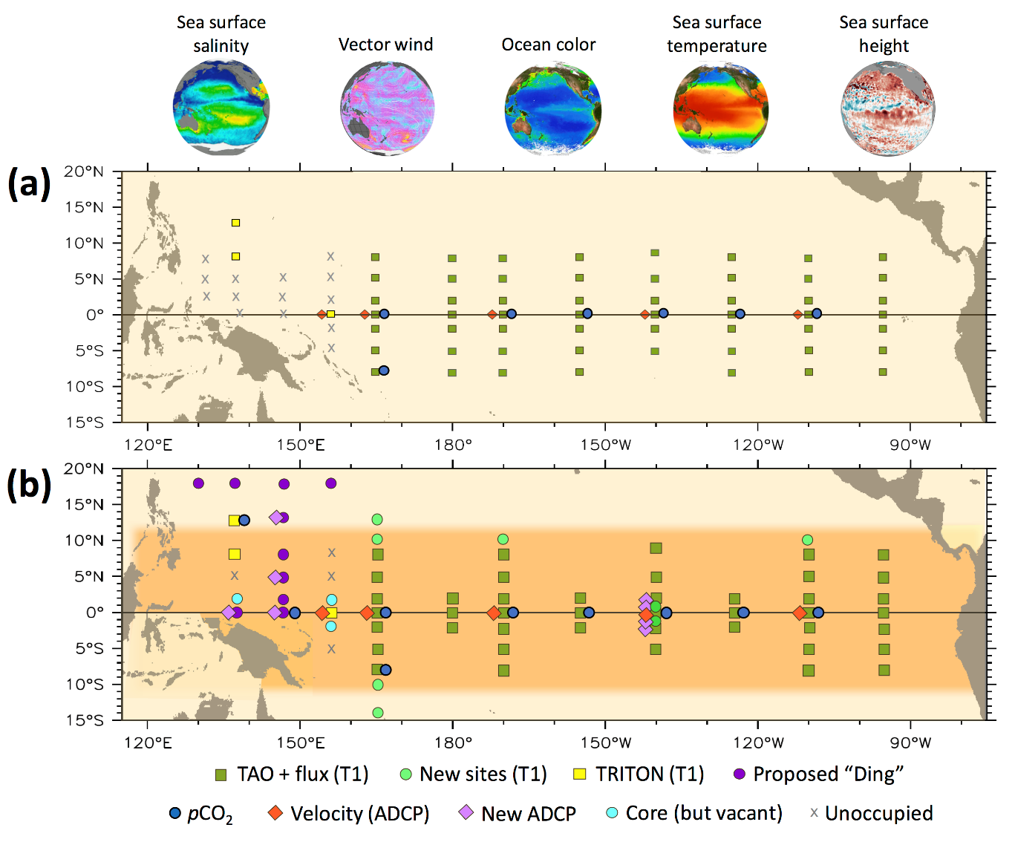
TPOS 2020: proposed backbone, engagement of met services
Integrated in situ and satellite approach
Present system
New regimes with mooring extension lines
Biogeochemical measurements to backbone
Considers unique capabilities and best fits of various observing platforms
Proposed system
Argo:
-double core mission
-add BGC mission
Notes:
Mention new partners establishing their networks, e.g. Ding array in Western Pacific being planned and soon piloted by SOA/Ministry of Natural Resources

Slide 7
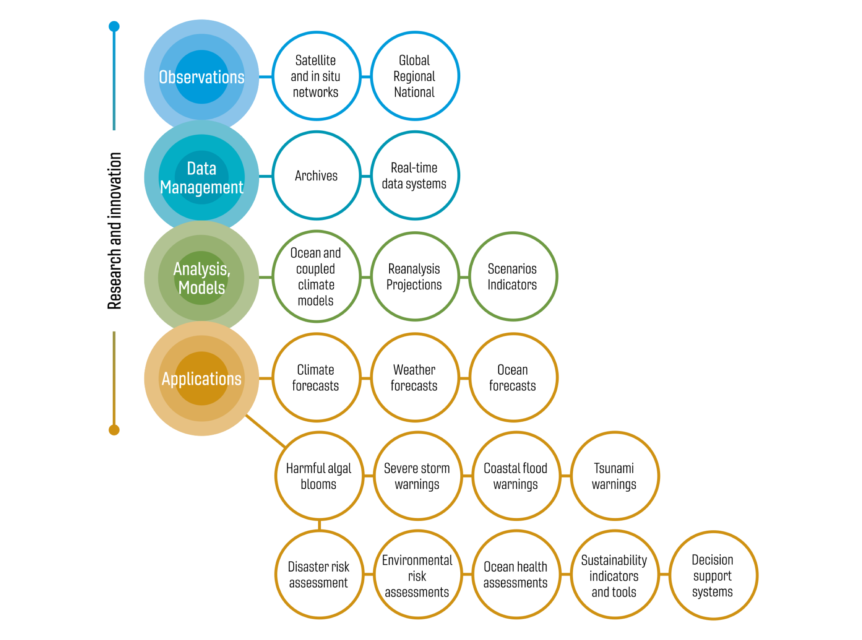
GOOS 2030 Strategy
Value chain includes forecasts and services with met services

Slide 8
Enhanced collaboration with partners
Joint bodies
Working arrangements
Programmes/Projects
More interaction and collaboration with
partners from all relevant areas
Etc., etc., etc …

Slide 9
Forecast Systems
Services
Research
IOC
WMO
Assembly, EC
Assembly and Executive Council
Capacity
development
Cg, EC
Congress and Executive Council
Joint WMO-IOC Collaborative Board
Notional advisory areas
Observations to address ocean, weather, water, and climate applications and services
Assured best practices and quality control in the collection, dissemination, sharing, and archival of ocean and weather observations and model data, for improved services
Enable a fully coupled earth prediction capability for ocean, weather, water, and climate forecasts
Decision support services to save lives, improve health, protect property, and enhance sustainable economic development on the open ocean, in coastal zones, and in high latitudes, as well as over land
Forecast coastal inundation, whether due to hydrological conditions, storm surge, tsunamis, rising sea level, etc.
Safe and efficient ship routing, avoiding hazardous weather conditions at sea
Response to disasters at sea and in coastal zones, minimizing environmental damage
Build partnerships in high latitude observations, predictions, and forecasts of the maritime environment and over land
Identify and address gaps in our knowledge of the interaction among the cryosphere, ocean, and atmosphere impacting to support ocean, weather, water, and climate services
Close the capacity gap in ocean, weather, water, and climate among member states
Observations
Data
Notes:
This slide identifies the opportunities in the chapeau of the Terms of Reference of the Joint WMO-IOC Collaborative Board, and shows it as an additional body that touches on all relevant pieces of WMO and IOC focused on joint delivery

Slide 10
Future landscape
IOC
Forecast
Systems
WMO
Assembly, EC
Assembly and Executive Council
Cg, EC
Congress and Executive Council
co-sponsored
Services
GOOS
Global Ocean Observing System
Observations
COIIS
Commission for Observation, Infrastructure and Information Systems
IOC and WMO scientific and technical bodies and programmes, including co-sponsored entities, immediately after the reform of WMO Constituent Bodies
Value chain of Observations, data, forecast system, and service delivery to users
Underpinning innovation and science-to-policy interfaces with connection to research
Capacity development to ensure wider participation and benefit
Research
GCOS
Global Climate
Observing System
IODE
International Oceanographic Data & Information Exchange
Data
Capacity
development
GOOS
TOWS
Working Group on Tsunamis and Other Hazards Related to Sea-Level Warning and Mitigation Systems
CSA
Commission for Weather, Climate, Water and Related Environmental Services and Applications
Associated
research community
WCRP
Research Board
IOC
CD
WMO
RAs
Notes:
This landscape shows the basic organizational building blocks we will have to work with as a starting point once we have approval from the WMO Congress and IOC Assembly.
This slide introduces the reformed WMO structure, projected onto the value chain connecting observations, data, forecast systems, services and connection to users, and identifies the important role of research and capacity development in improving this connectivity and delivery to society.
It shows the equivalent IOC structures and co-sponsored programmes and their place, along with reminding us of the ultimate decision-making power of the IOC and WMO governing bodies.

Slide 11
IOC
WMO
Notional future home of
JCOMM activities
Assembly, EC
Assembly and Executive Council
Forecast
Systems
Cg, EC
Congress and Executive Council
Joint WMO-IOC Collaborative Board
Services
GOOS
Global Ocean Observing System
Observations
COIIS
Commission for Observation, Infrastructure and Information Systems
JCOMM Observations Programme Area
JCOMM Data Management Programme Area
JCOMM Services and Forecast Systems Programme Area
Joint Collaborative Board creates the opportunity for additional connections and activities
Research
GCOS
Global Climate
Observing System
IODE
International Oceanographic Data & Information Exchange
Data
Capacity
development
GOOS
TOWS
Working Group on Tsunamis and Other Hazards Related to Sea-Level Warning and Mitigation Systems
CSA
Commission for Weather, Climate, Water and Related Environmental Services and Applications
Associated
research community
WCRP
Research Board
IOC
CD
WMO
RAs
Notes:
Preliminary work on mapping notional organizational sponsorship has commenced to address IOC requirements for Member review.
This slide, which will be included with the Co-chairs report, identifies the future notional home of activities presently conducted under JCOMM, with the provision that the WMO Commissions will be setting up their internal structures during a transition period, and that individual teams identified as falling into these Commissions may be recomposed under a different logic
We propose to incorporate appropriate JCOMM functions and activities on observation and operational ocean forecasting systems into the IOC-WMO-UN Environment-ISC Global Ocean Observing System (GOOS), with enhanced connections to the WMO Commission for Observation, Infrastructure and Information Systems;
We propose to incorporate appropriate JCOMM functions and activities on data management and processing into the Commission for Observation, Infrastructure and Information Systems, with a close connection to the work of the IOC International Oceanographic Data and Information Exchange (IODE);
We propose to incorporate appropriate JCOMM functions and activities on data and information management into the International Oceanographic Data and Information Exchange (IODE), with a close connection to the work of the WMO Commission for Observation, Infrastructure and Information Systems;
We propose to incorporate appropriate JCOMM functions and activities on services into the WMO Commission for Services and Applications, with a close connection to relevant IOC activities in early warning and services;

Slide 12
Implications: governance
GOOS takes direct responsibility for
Observations Coordination Group
observing network teams
JCOMMOPS
Expert Team on Operational Ocean Forecast Systems (ETOOFS)
GOOS has responsibility to maintain and create new links to WMO structures as needed, as they evolve
direct functional links between WMO Integrated Global Observing System WIGOS and the Observations Coordination Group
direct functional links between ETOOFS and WMO Global Data Processing and Forecasting System GDPFS
SC-level strategic link between GOOS and WMO’s future bodies: Technical Commission for Infrastructure and Services, Research Board, including through the new Joint Collaborative Board
Opportunities at the regional level

Slide 13
Implications: resources
IOC expected to maintain resources (secretariat and activity funding) formerly assigned to JCOMM OCG, ETOOFS, now under a GOOS label
resources formerly assigned to JCOMM management would be transferred to supporting the new Joint Collaborative Board
WMO expected to resource a node of the distributed GOOS Office in Geneva, maintaining and growing resources formerly assigned to JCOMM OCG
with additional responsibility for developing the partnership between GOOS and WMO
Overall: growth, with additional responsibilities

Slide 14
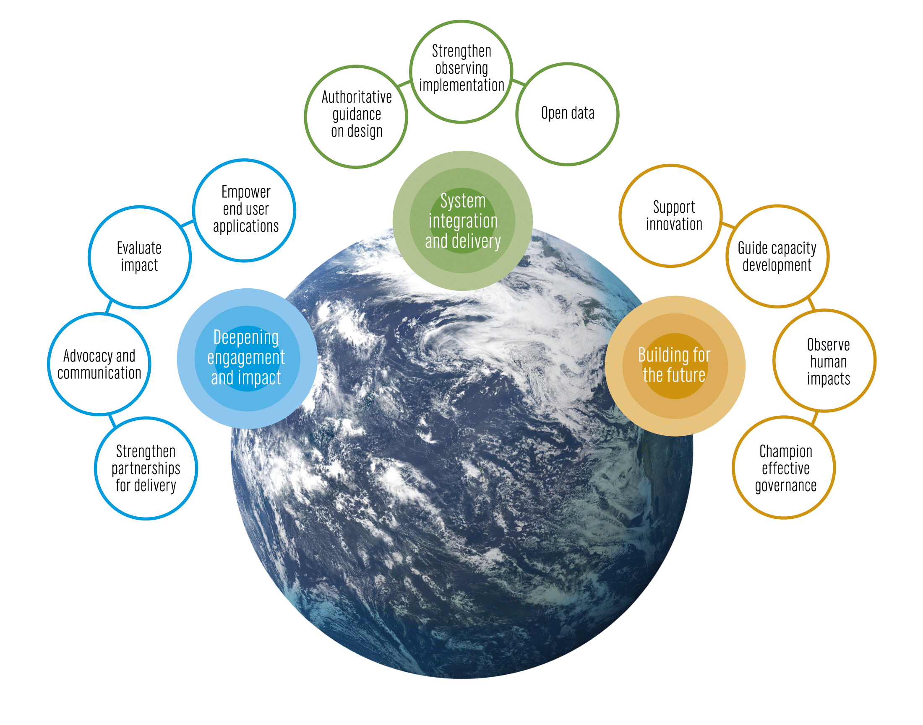
Opportunities
WMO partnership potential
System integration and delivery
Deepening engagement and impact
Building for the future

Slide 15
Questions for discussion
Is ocean-met cooperation a driver for your work at a regional and national level?
Disbandment of JCOMM may in some cases be a loss to ocean-met collaboration at the national level, with loss of formal need to come to common positions – is this the case for you?
How can GOOS, IOC and WMO encourage meaningful national collaboration?
Do you already have cooperation, Earth system approaches?
WMO Regional Associations will play a growing role, particularly in capacity development – what opportunities are there to connect to work of GOOS?

