Slide 1


GOOS Initial Implementation Plan
The Global Ocean Observing System
goosocean.org
Albert Fischer and Emma Heslop
5 August 2019, GOOS Regional Forum, Tokyo, Japan

Slide 2

Global
Ocean
Observing
System
2030 Strategy
Putting the Strategy into action
Through partnerships and through the actions of GOOS components

Slide 3
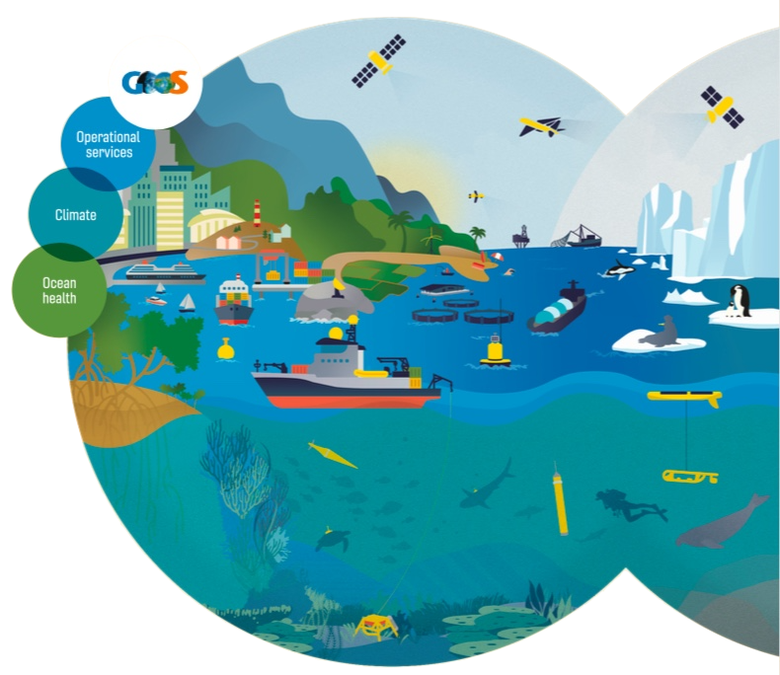


Initial Implementation Plan
Published as IOC/INF-1376 for the IOC Assembly, as guidance on a GOOS work plan
An open framework for GOOS components, present and potential partners, to evolve through co-design
Built around the Strategic Objectives

Slide 4
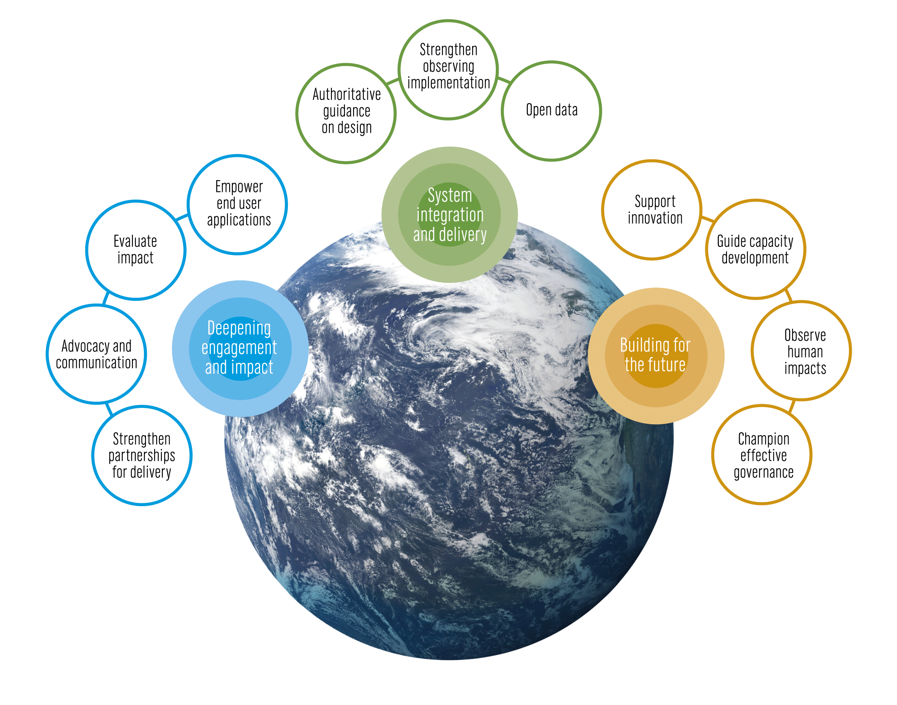
Strategic Objectives
System integration and delivery
Deepening engagement and impact
Building for the future

Slide 5
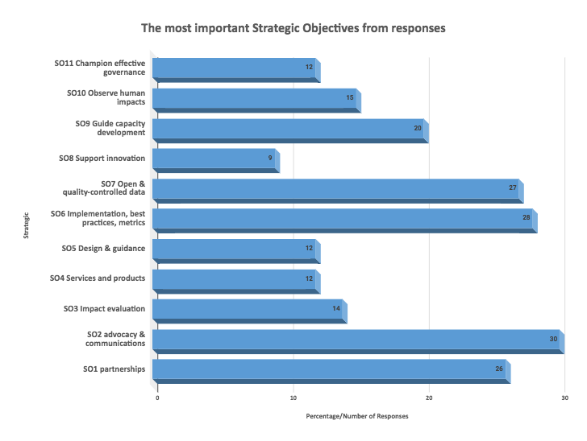

Slide 6
Strawman priority outcomes
3-5 year time frame, proposed focus for funding and evaluation/assessment, extending across SOs and value chain
Improved 7-day and seasonal forecasts
Improved information on boundary currents effects
Increased understanding of biological and ecological status
Development of an African observing system, with initial data flowing to regionally-relevant applications
Improved delivery of indicators to global conventions
Implementation of three new human pressure EOV observing systems
A pilot responsive observing system for tropical storms

Slide 7
Working on common objectives
Partnerships for delivery
Operational
services
Weather &
marine
services
Ocean &
coupled
forecasts
Early warning
systems
Satellite
and
in situ
networks
Global
Regional
National
Real-time
data
systems
Reanalysis
Forecasts
Projections
Research
Climate services
Climate
Archives
Climate
assessments
Models
Research
Scenarios
Indicators
Early warning
systems
Ocean
health
services &
assessments
Ocean
health
Observations
Data management
Analysis,
Forecasts,
Models
Applications
Users
Res. & innov.

Slide 8
Development of the implementation plan timeline
Feedback requested; document will evolve through partner and community dialogue
Initial phase through 2019 with input from partners and from the OceanObs’19 Conference (16-21 September 2019, Honolulu, USA)
Version 2 of the initial Implementation Plan in early 2020 defining partner roles and more specific 3-5 year actions towards achieving the major outcomes
Regular and on-going cycles of evaluation

Slide 9
Development of the implementation plan
GRAs
Do the strawman priority outcomes resonate with your desired outcomes?
What is the role of the GRAs in implementation of GOOS?
What does a more defined regional component of implementation look like?
What are the partnerships needed? and the resource implications?

