Slide 1
Resourcing: status, fragility, opportunities
The Global Ocean Observing System
goosocean.org
3 May 2019

Slide 2
Distributed GOOS office
Paris – IOC (4.7 FTEs over 7 people)
Strategy - steering
Work plans across GOOS
core observations coordination
GOOS engagement with sponsors, partners
Intergovernmental processes
nodes of the distributed GOOS Office (7.3 FTEs over 9 people)
Brest, Geneva, Oostende, Sopot, Hobart, …
Disciplinary expert panels – requirements and design
technical coordination (JCOMMOPS)
Projects: building readiness for the next generation of GOOS
some regional work

Slide 3
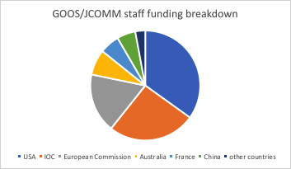
GOOS staff resources snapshot May 2019
12 FTEs
of which 4 at JCOMMOPS
Funders in order:
USA
IOC/UNESCO
EC (AtlantOS)
Australia
France
China

Slide 4
GOOS staff resources: fragility
Long-term voluntary: 4.25 FTE
Secure funding: 3 FTE
Short-term/project: 4.75 FTE
Overall funding ratio
Staff: 80%
Activity: 20%

Slide 5
Where we focus now by Strategic Objective

Slide 6
Opportunities
Directly into GOOS
G7 through UK, EC, Germany, [Italy?]
WMO
EC Euroseas proposal
Partnership development
Commonwealth Blue Charter ocean observations
Growing multiple team management, partnership management challenges

Slide 7
What is the potential?
The implementation plan provides guidance
Double the resources: some possibilities
Communication and advocacy (SO2)
Engage and respond to national systems (SO2)
Develop stronger partnerships for delivery in each area: operational services, climate, and ocean health (SO1)
convene and start to build mechanisms for better governance (SO11)
Start a reflection on capacity development of observing systems and institutions (SO9)
Provide greater assistance to developing observing networks (SO6)

