Slide 1
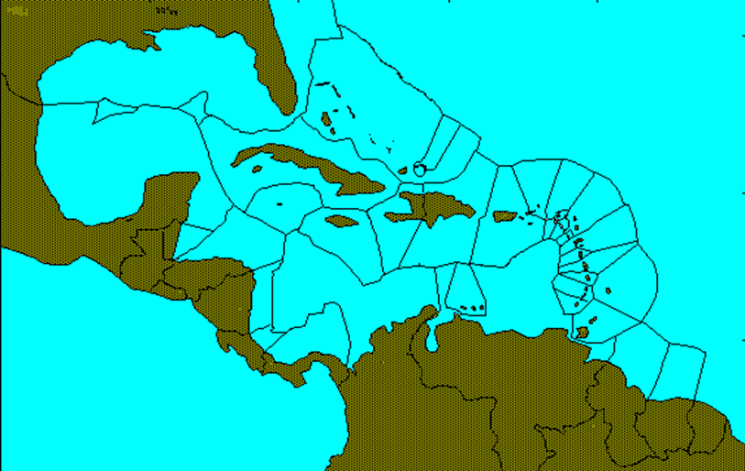
Addressing polycentric ocean governance in the Wider Caribbean Region
Atlantic Ocean
Pacific Ocean
IOC UNESCO Workshop on governance of the ocean observing system
30 April 2019, GEOMAR, Kiel, Germany
Robin Mahon,
Centre for Resource Management and Environmental Studies (CERMES)
University of the West Indies, Barbados

Slide 2
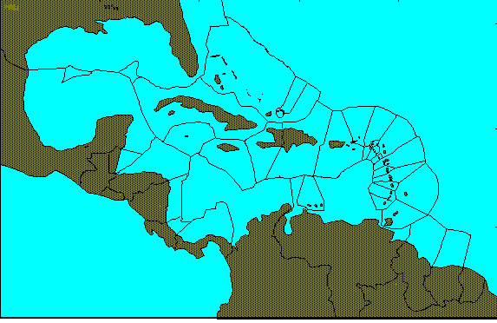
The WCR context
The Wider Caribbean Region is geographically and politically highly diverse and complex
Geopolitical
– 29 countries
– 45 state entities
Cultural
– ethnicity, language
Size
– smallest to largest
Development
– poorest to most wealthy
Institutions
-- > 25 organisations
Hypothetical EEZs

Slide 3
What was done – in a nutshell
Recognised system was polycentric and weak transboundary governance was a root cause of unsustainable use
Developed a conceptual model of the polycentric system
Oversimplification, but
Facilitated structured discussion
Used model to break system into manageable parts, when appropriate
Analysed parts or whole to determine what was needed
Developed activities to address needs

Slide 4
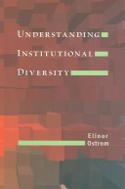


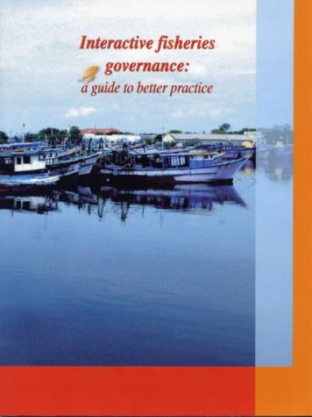
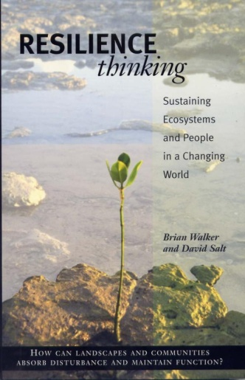
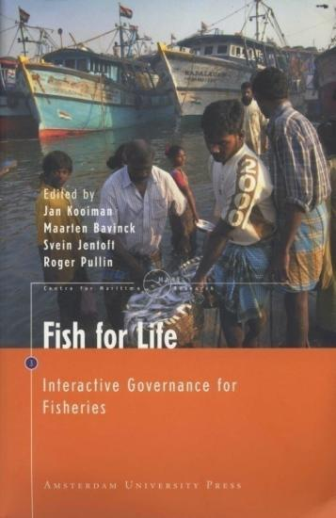
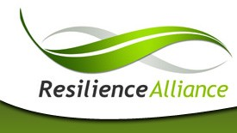
Developing the conceptual framework
Institutional Analysis Framework
Interactive Approach to Governance

Slide 5
A multi-level policy-cycle based governance framework
ANALYSIS AND ADVICE
DATA AND INFORMAT-ION
DECISION- MAKING
REVIEW AND EVALUATION
IMPLEMENT-ATION
Notes:
The policy cycle must fit the purpose. The various stages can be evaluated regarding how well they are structured for purpose and also whether they are performing as planned.
Can apply to the production and dissemination of data and information as well as to governance of an issue. Peformance effectiveness criteria will be different.

Slide 6
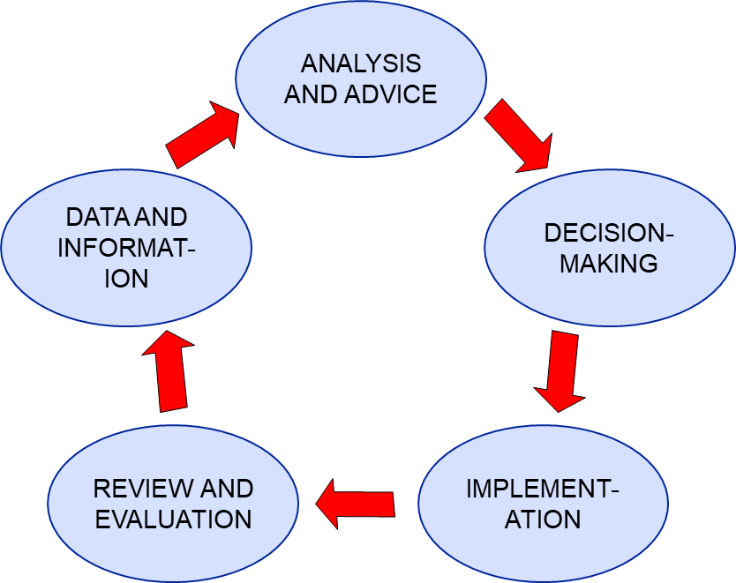
The governance framework
A multi-level policy-cycle based governance framework
Policy cycles must be:
Complete
Linked vertically
Linked laterally
Diversity of policy processes as appropriate
Notes:
6

Slide 7
Framework building interventions
Long-term goal of interventions is ‘fully-functional policy cycles at all appropriate levels with the appropriate vertical and lateral linkages’
Interventions can be specifically targeted at various parts of the system to:
Establish or strengthen policy cycles
Build or enhance linkages

Slide 8
Applying the framework
Framework allows for specific questions about different parts of the system
Policy cycles, e. g.
What are the policy cycles at various levels?
Is there a typology of policy cycles?
What are desired characteristics for various types?
What is needed to build capacity towards those characteristics?

Slide 9
Applying the framework
Interactions, e. g.
Where are interactions needed?
What types of interactions?
Sharing information
Coproduction of outputs
Planning and strategizing together
Making joint decisions
Do modes of interaction at national, regional, global levels differ?
What is needed to build capacity towards effective interactions?

Slide 10
Applying the framework
What type of mechanism is needed to provide overarching guidance and monitoring?

Slide 11
Some reactions
Are we going to spend the whole project talking about governance arrangements needed to do things without actually doing anything
Governance strengthening interventions can be designed in a learning-by-doing mode, so progress can be made while the system learns
“Increasingly, the debate turns toward what we describe as the overarching architecture of global environmental governance, that is, the entire interlocking web of widely shared principles, institutions, and practices that shape decisions by stakeholders at all levels.”
Bierman and Pattberg 2012

Slide 12
Fitting the Caribbean into the framework
UNGA – CSD
COFI?
ACS – CSI/CSC
WECAFC?
CARICOM/CRFM?
SICA/OSPESCA?
OECS/ESDU?
OECS?
WECAFC FFWG?
CRFM?
OSPESCA?
WECAFC WG?
Notes:
To examine the appropriateness of the concept, we developed 4 propositions that we saw as underlying the construction of the framework and as such, to be examined within the context of the Caribbean:
1.
2.
3.
4.

Slide 13
The CLME Project – Structure:
Building a multi-level policy-cycle based governance framework
LME Level Monitoring and Reporting
Develops indicators to monitor LME status
Strengthening Regional Governance
Engages regional and sub-regional organisations to put LMR governance on their agendas for policy decision-making.
Promoting the Caribbean Sea Initiative
Works with ACS and its Caribbean Sea Commission and other regional organisations to implement the UN Resolution on the Caribbean as a special area.
Large Pelagics Project
Increases involvement in ICCAT for oceanic species and pursues regional governance arrangements for species contained in the Wider Caribbean area.
Guianas-Brazil Shrimp and Groundfish
Establishes and operates sub-regional cycle for cooperation in management of the shared stocks.
Eastern Caribbean Flyingfish
Establishes and operates sub-regional cycle for cooperation in management
Reef Fisheries and Biodiversity
Enhances local level linkages among fishery and non-fishery stakeholders and upward linkages to national and regional levels
Spiny Lobster
Enhances local level capacity and linkages among western Caribbean fishery stakeholders and upward linkages to national and regional levels
Notes:
Fanning, L., R. Mahon and P. McConney. 2009. Focusing on living marine resource governance: the Caribbean Large Marine Ecosystem and Adjacent Areas Project. Coastal Management 37: 219 – 234.

Slide 14
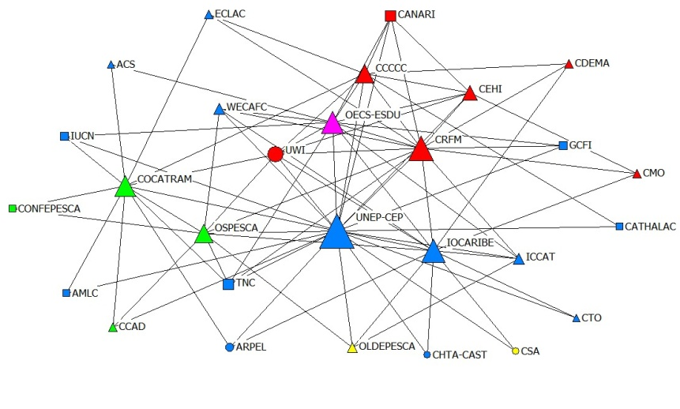
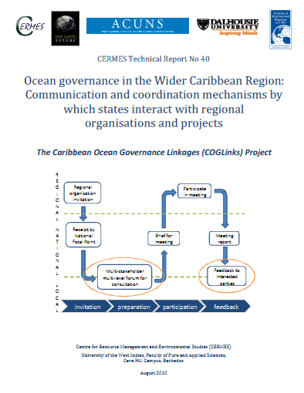
Framework Assessment
Whole
Notes:
Roles of actors inside the network: Star: Actors who have high level of centrality. Broker: The actors who connect two or more unrelated sides.
Bridge: The actors who are member of 2 or more groups (network sets). Gatekeeper: The actors who control the information flow from one part of the network to another part with a single link. Isolates: Actors who have very few or no links with the others.

Slide 15
Global-regional-national ocean governance
GLOBAL LEVEL
REGIONS
NATIONAL LEVEL

Slide 16
Thanks
Notes:
The policy cycle must fit the purpose. The various stages can be evaluated regarding how well they are structured for purpose and also whether they are performing as planned.
Can apply to the production and dissemination of data and information as well as to governance of an issue. Peformance effectiveness criteria will be different.

