Slide 1
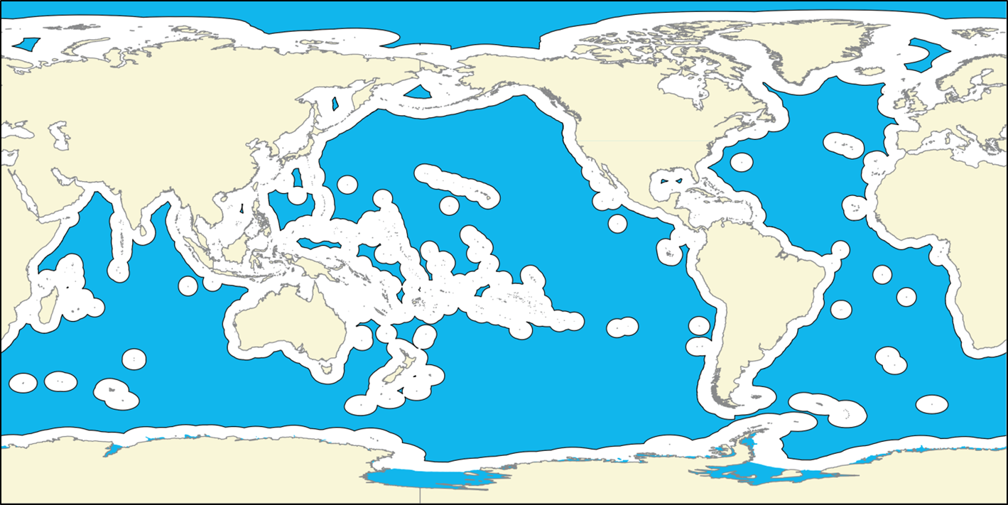
Polycentric governance systems: the global ocean observing system
IOC UNESCO Workshop on governance of the ocean observing system
30 April 2019, GEOMAR, Kiel, Germany
Robin Mahon,
Centre for Resource Management and Environmental Studies (CERMES)
University of the West Indies, Barbados

Slide 2
GOOS- FOO Governance
The situation described in the white paper by Tanhua et al.
Multiple centres of responsibility for GOOS components
Lack of an entity or mechanisms with responsibility for overall for coordination of the system
Not an uncommon situation in governance
Significant work has been done on:
Characteristics of such systems
How to make them effective
This may help with understanding and developing appropriate arrangements for governance of GOOS.
Notes:
The situation of multiple centres of responsibility for GOOS components and the lack of an entity or mechanisms with responsibility for overall for coordination of the system described by Tanhua et al. (2018) is not uncommon in the world of natural resources governance.
There has been a significant amount of work on the characteristics of such systems and how to make them effective, that may be useful in understanding and developing appropriate arrangements for governance of GOOS.

Slide 3
Polycentricity in governance
Early researchers of governance systems noted they were often multicentered, uncoordinated and chaotic
1961 Elinor Ostrom and colleagues, look closer, there is structure
Introduced the term polycentric
Multiple centers of influence or decision-making that address a particular issue
Polycentric systems should have:
Overarching rules
Mutual adjustment of activities (collaborate and avoid conflict)
Willingness to experiment
Trust among members (domains)
Local action by members
Notes:
Governance researchers had been noting than many systems had multiple centers of decisionmaking little coordination and appeared to be totally chaotic In 1961 Elinor Ostrom and colleagues termed such systems as polycentric, defined by the existence of multiple centers of influence or decision-making that address a particular problem area.
Polycentric systems should have:
• overarching rules,
• mutual adjustment of activities to foster collaboration and avoid conflict,
• willingness for experimentation,
• trust,
• local action.

Slide 4
Caveats
No off-the-shelf solution (that I know of) to apply
It will take some careful analysis and planning to see what can be done.
Notes:
We will come to this later when we look at the example of what was done in the Wider Caribbean to promote effective governance in the face of polycentricity

Slide 5
Research on polycentric systems
Most work at subnational level: cities, water management systems, local irrigation systems, forest resources, protected areas.
More recently:
Global systems for governing climate change or ocean ecosystems, and
Regional systems, such as Large Marine Ecosystems, or ocean regions
Finding that most have multiple centres of responsibility and meet (or almost) criteria for polycentricity

Slide 6
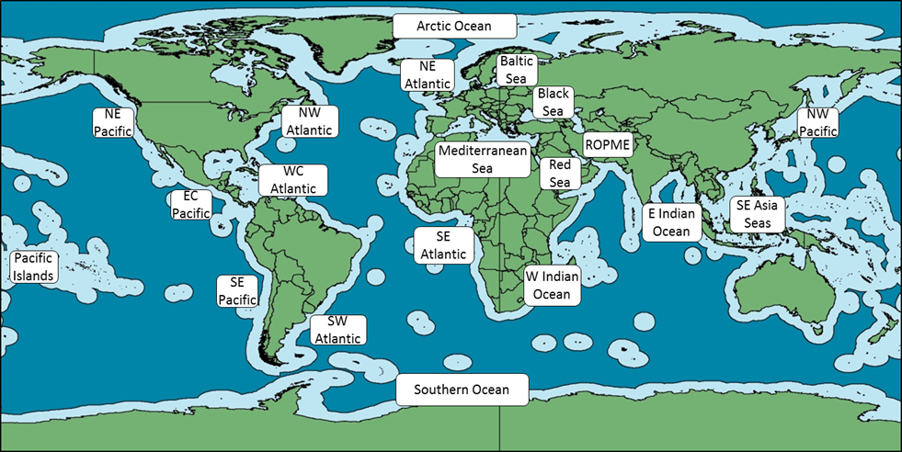
Polycentricity in global oceans governance
Global level – 25+ arrangements
Twenty regions

Slide 7
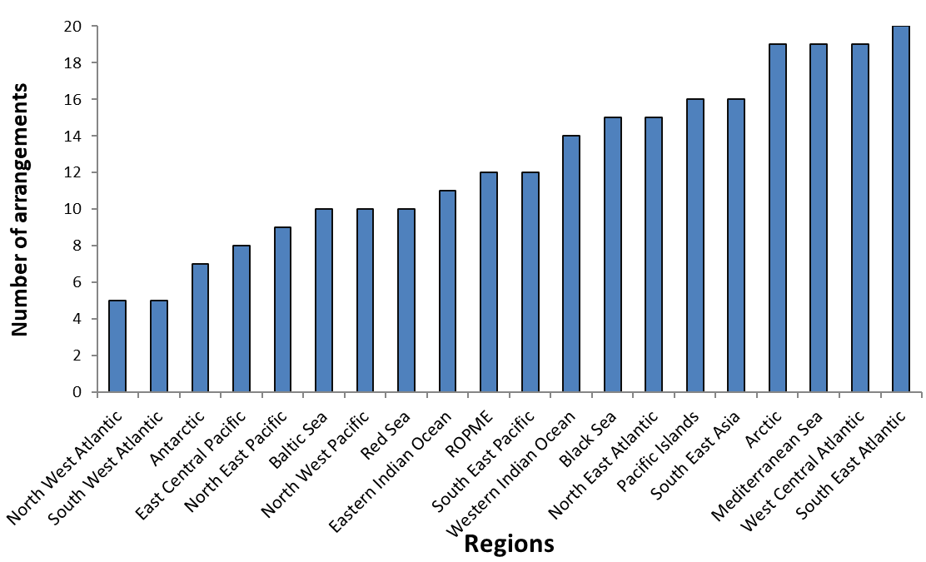
Polycentricity in global oceans governance
Many intergovernmental arrangements in each region
EBM only
Not including NGOs, private sector
Notes:
RFBs, Regional Seas, indigenous bodies, many Regional Multipurpose that include oceans. This is the governance environment in which GOOS is situated.
Arrangement is generic for agreement plus the secretariat, rules of procedure, etc. to make it work

Slide 8
Multilevel polycentricity
Most of these systems include multiple levels:
Global
Regional
Subregional
National
National regions
Local
Vertical connectivity is an issue
Clearly GOOS is polycentric and multilevel with global, regional, subregional, national, and subnational levels.

Slide 9
Other perspectives on polycentricity
Others have observed that governance systems are often polycentric
Developed other terms and concepts
Chaotic systems
Fragmented systems, when there is little interaction among their parts;
Bricolages, when there are attempts to coordinate and facilitate interaction of what is there;
Complex self-organizing systems, when some level of organizing emerges organically
Network systems, when there are linkages that may have evolved or been facilitated.
Not mutually exclusive categories, just different ways of looking at multilevel polycentric systems
Not a nice clean neat package of thinking
Notes:
Although she may have brought the term into common usage, Ostrom is by no means the only person to have observed that governance systems are often polycentric.
Not a nice clean neat package of thinking
Several terms and concepts have sprung up in relation to ideas of multilevel polycentricity.
These systems have been variously referred to as:
• Chaotic systems
• Fragmented systems, when there is little interaction among their parts;
• bricolages, when there are attempts to coordinate and facilitate interaction of what is there;
• complex self-organizing systems, based on the fact that some level of organizing can often occur from inside the system;
• Network systems, when there are linkages that may have evolved or been facilitated.
These are not mutually exclusive categories, they are different ways of looking at multilevel polycentric systems; and there may be others.

Slide 10
Polycentricity in governance
This way?
Or that?
Polycentric fragmented
Polycentric bricolage
Polycentric codesigned
Fully functional polycentric
Centralised authority
Governance modality spectrum
‘An important lesson is that simply recommending a single governance unit to solve global collective-action problems—because of global impacts—needs to be seriously rethought’ (Ostrom, 2010)

Slide 11
Is polycentricity all bad?
Should we be aiming to eradicate it? What are its disadvantages and what are its benefits if any?
Cons
Inefficiency (duplication of effort)
Gaps in coverage
Unpredictable
Pros (may be more ordered than they initially appear)
Multiple mechanisms for mutual monitoring, learning, and adaptation
Subsidiarity, in which problems can be addressed at the most relevant and capable scale;
Decentralised decision-making facilitates the input from relevant stakeholders
Resilience due to redundancy
Notes:
Often self organizes – police example
May not be an option anyway, we can seldom wipe the slate clean and start fresh.

Slide 12
Polycentricity in governance
Consolidation of multiple arrangements into a single arrangement or a hierarchy of arrangements
Attending to overall architecture and interactions. Harmonizing principles rules and mandates. Analysing gaps, overlaps. Establishing cooperation/conflict management mechanisms. Network development, Applying subsidiarity. Strengthening learning and sharing mechanisms.
Centralised authority
Polycentric fragmented
Polycentric bricolage
Polycentric codesigned
Fully functional polycentric
Governance modality spectrum

Slide 13
To conclude
Knowing that others have recognized and tackled these problems before may help the GOOS community to reflect on the current situation.
GOOS is different to other polycentric governance systems as it is mainly about governing its own activities so that it can produce the best possible set of outputs for other issue oriented governance systems to use.
A thought to reflect on, do the characteristics of those other governance systems that use GOOS outputs have any bearing on how the GOOS governance systems should be structured?

Slide 14
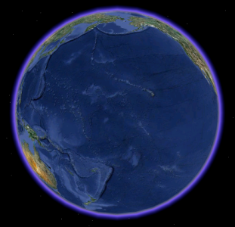
Thanks

