Slide 1

Principles Underlying Good Governance
Our present governance models are not working (fully)
We do not all agree why our present governance is not working (where, why, …)
We have set ambitions to achieve much more than we presently have, but how?
Ocean Observing brings together ‘actors’ with differing perspectives, levels of engagement, expectations, social histories
Layered governance, or polycentric forms, requires clear underlying, well defined characteristics to be sustainable
Discussion of governance reveals many of the pragmatic issues related to operations

Slide 2

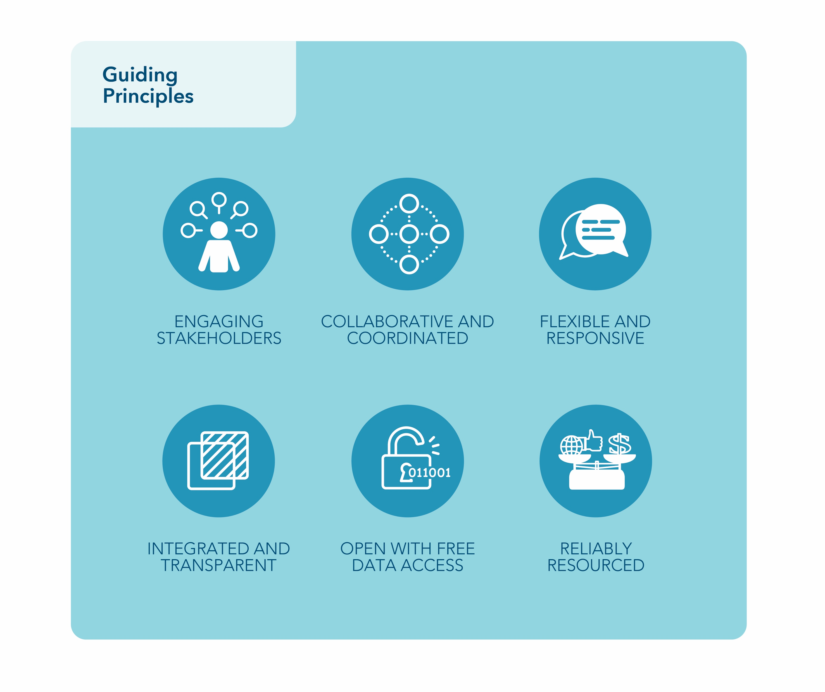
Program
All AtlantOS services are available and functioning at the desired level
Designated AtlantOS data providers are integrated and making accessible essential ocean observing variables as part of the Global Ocean Observing System
A fully functioning governance framework is in place and provides a forum for coordination, resource mobilization, review and decision making
Long-term sustainability has been achieved through voluntary national and multi-stakeholder contributions

Slide 3
Program
Engaging Stakeholders The diverse range of stakeholders must be identified, to address
user needs for ocean information products.
Collaborative and coordinated: The stakeholder groups should form partnerships to define the roles and responsibilities of the partners and to extend and enhance the observational capability of the network or system.
Integrated and transparent: The network or system should bring together all the observing components, partners and users to ensure that all of their interests are best met and that the maximum value is derived from each component. All partners must recognize and agree to their participation, and understand their expected contributions to and benefits from the observing network or system.
Flexible and responsive: The observation network or system should be adaptive and responsive and have the ability to change in response to a shifting ocean environment and to changes in societal needs and structures.
Open with free data and information access: The ocean observation network or system should support and promote the open exchange of data to ensure that the maximum benefit is derived from the data collected.
Reliably resourced: An effective ocean observation network or system requires reliable funding to ensure that it is sustainable.

Slide 4
Principles of Sustainable Governance (Costanza 1999)
Responsibility – The responsibilities of all actors (governmental, academic, private sector, et al. ) should be aligned
Structures should be matched to the scales of action, both for input and output, and should be able to integrated across scale boundaries
Precautionary approach – in the face of uncertainty action should be apply the precautionary approach
Adaptive management – given the complexity of the systems and shifting requirements and expectations it should be expected that structures will need to change
All of the internal and external costs should be accounted for
All stakeholders should be involved in the formulation and implementation of decisions

Slide 5
Principles (Tanuha et al. 2019)
Responsiveness. Governance must respond to the needs of stakeholders and participants, from
local, regional to global, across all relevant sectors, and include governmental and non-governmental aspects.
Purposeful. Governance must be purposeful for, and on behalf of the community.
Clear objectives.
Transparency. Transparency and openness must be a priority, to ensure public access to and
benefit from the system.
Efficiency and Effectiveness. Governance must ensure that maximum value is derived from invested resources and must have enough flexibility and nimbleness to ensure guidance/decisions are provided in a timely way.
Adaptive. Governance must support innovation and openness to change, to ensure that benefits accrue for new solutions and improved practices.
Sustainability. Governance must have a long-term orientation, taking account of the broad- range of existing and likely future drivers, and the need for dependability and robustness.
Authoritative. The individuals and teams contributing to governance must have the appropriate capability, skills, and respect of the community to act on their behalf.
Performance and accountability. The governance must include monitoring and measures of success and performance.

Slide 6
Other Perspectives (Meeting Notes)
Responsiveness. Governance must respond to the needs of stakeholders and participants, from local, regional to global, across all relevant sectors, and include governmental and non- governmental aspects.
Purposeful. Governance must be purposeful for, and on behalf of the community.
Clear objectives. Good governance relies on clear and purposeful (relevant) objectives and strategy.
Transparency. Transparency and openness must be a priority, to ensure public access to and benefit from the system. While private networks may be warranted on the grounds of security or because of the narrowness of the target audience, in general information should be public and governance arranged accordingly.
Efficiency and Effectiveness. Governance must ensure that maximum value is derived from invested resources and must have enough flexibility and nimbleness to ensure guidance/decisions are provided in a timely way.

Slide 7
Missing Principles
Equity – of different types
Stewardship responsibilities
Distinction between different types of principles: e.g. procedural, fundamental, pragmatic, form, function

Slide 8

Project
Program

