Slide 1
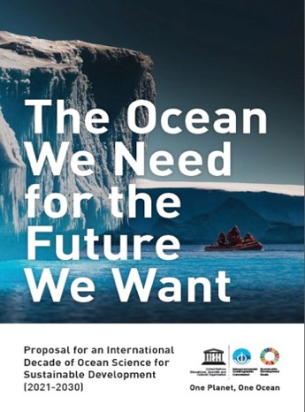

The UN Decade of Ocean Science for Sustainable Development
(2021-2030)
Dr Vladimir Ryabinin,
Executive Secretary of IOC,
Assistant Director General, UNESCO

Slide 2

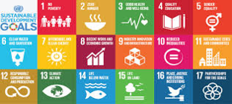
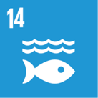


Ocean and the UN Frameworks
+ Paris
+ Ocean Pathway
+ BBNJ

Slide 3




Conserve and Sustainably Use Oceans, Seas and
Marine Resources for Sustainable Development
Reduce marine pollution
Manage & protect of marine & coastal ecosystems (by 2020) (Ind.)
Address impacts of ocean acidification (Indicator Tier III, +progress)
Eliminate overfishing, manage stocks scientifically (by 2020)
Conserve > 10% of coastal and marine areas (by 2020)
Prohibit harmful fisheries subsidies (by 2020)
Ensure economic benefits to SIDS & LDCs from sustainable
use of marine resources (e.g. fisheries, aquaculture, tourism)
Build science capacity through IOC Criteria and Guidelines
on the Transfer of Marine Technology (Indicator Tier III-> Tier II)
Access of artisanal fishers to resources and markets
Conventions, UNCLOS

Slide 4
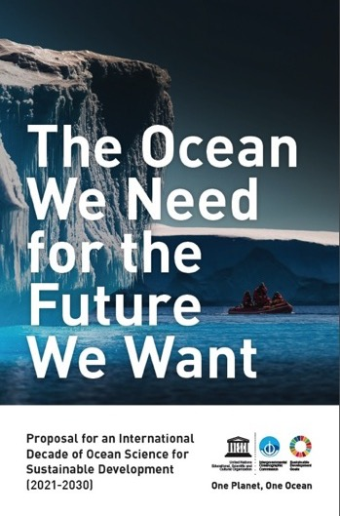
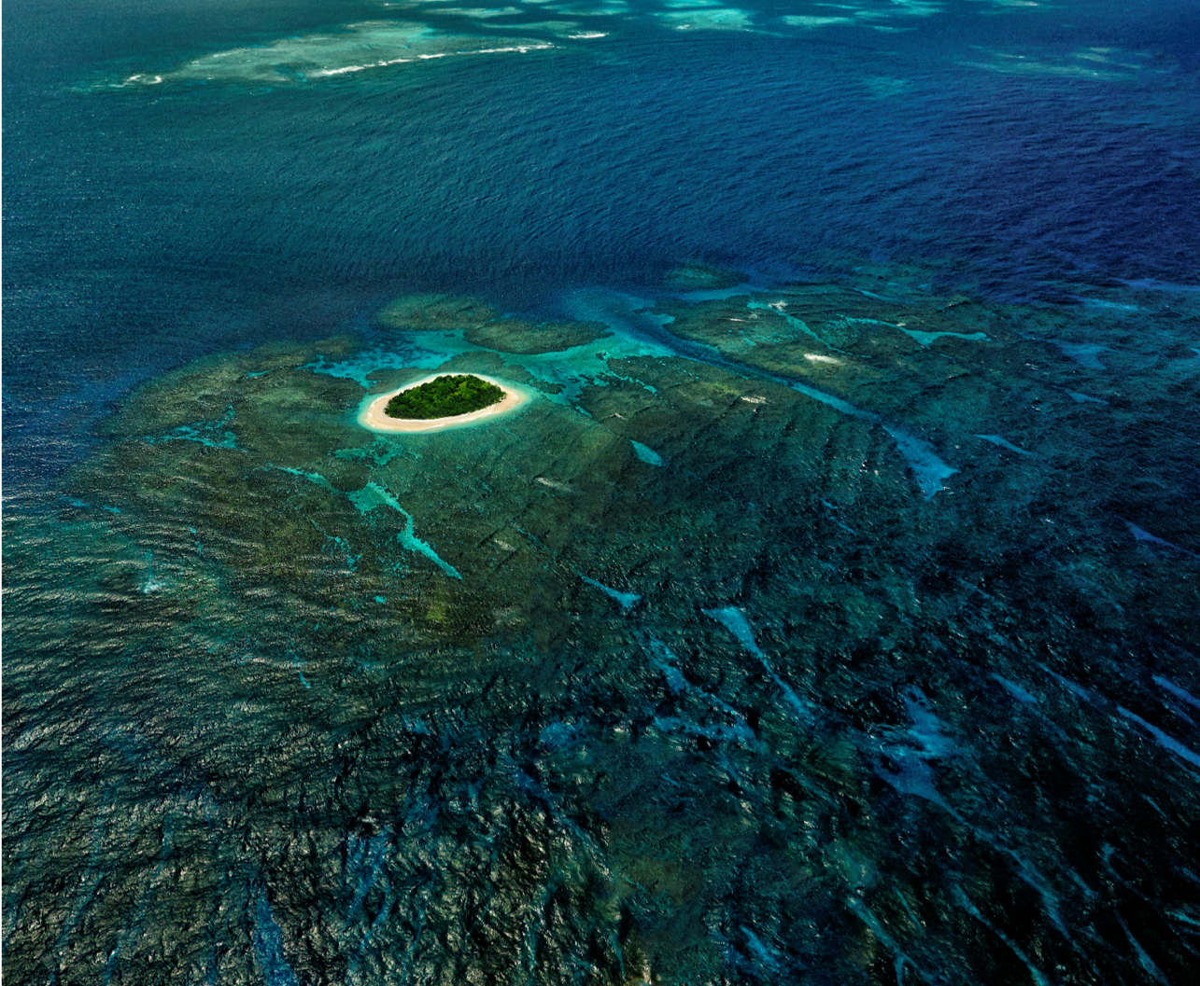
2016: Thinktank of IOC, the idea!
2017: discussions, massive support
from UN, IGOs, NGOs, …
Proposal to UN
6 December 2017
72nd UN General Assembly Resolution
UN Decade of Ocean Science for
Sustainable Development (2021-2030)
Vavau © Stuart Chape

Slide 5
Omnibus Resolution for Oceans and the law of the sea (A/RES/72/73)
The UNGA decided (Para. 292) to proclaim
the United Nations Decade of Ocean Science for Sustainable Development
for the 10-year period beginning on 1 January 2021,
within existing structures and available resources,
and called upon the Intergovernmental Oceanographic Commission
to prepare an implementation plan for the Decade
in consultation with Member States, specialized agencies, funds, programmes and bodies of the United Nations, as well as other intergovernmental organizations, non- governmental organizations and relevant stakeholders.

Slide 6
Further, the UNGA:
  - Requested that the Intergovernmental Oceanographic Commission provide information on the development of the implementation plan and regularly consult with, and report to, Member States on the United Nations Decade of Ocean Science and its implementation;
  - Invited the Secretary-General to inform the General Assembly about the implementation of the United Nations Decade of Ocean Science through his report on oceans and the law of the sea, on the basis of information to be provided by the Intergovernmental Oceanographic Commission;
  - Invited UN-Oceans and its participants to collaborate with the Intergovernmental Oceanographic Commission on the United Nations Decade of Ocean Science.

Slide 7
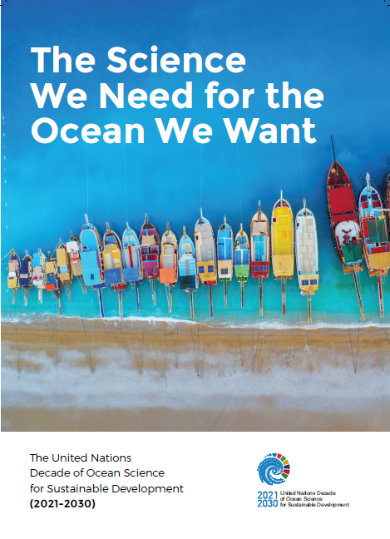
ROADMAP
Notes:
We are pleased to unveil the logo of the Decade which will from now on be used for all communication purpose. This is also a tool available to MS and our UN partners to communicate activities at national or regional level, using a well defined visual identity. To facilitate its use, we have developed specific guidelines in accordance with UNESCO and UN practice. IOC National Committees/focal point will be consulted when national entities are requesting to use the logo for Decade related activities.

Slide 8

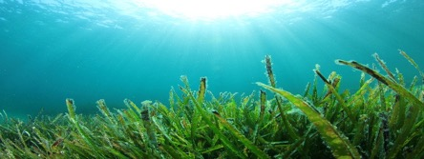






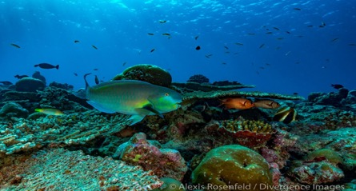




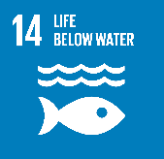


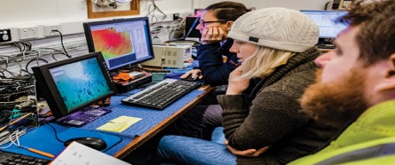




Societal outcomes
A clean Ocean
Sources of pollution are identified, quantified and reduced, and pollutants removed from the Ocean.
A healthy and resilient Ocean
Marine ecosystems are mapped and protected, multiple impacts, including climate change, are measured and reduced, and the provision of Ocean ecosystem services is maintained.
A predicted Ocean
Society has the capacity to understand current and future Ocean conditions, forecast their change and impact on human wellbeing and livelihoods.
Notes:
Responsive to societal needs:
If the societal benefits of the sustainable use of the ocean are to be accrued through achievement of the SDG targets as well as other frameworks, it is important to define a number of outcomes that the Decade will address over the course of its implementation.
These outcomes are considered to be highly transformative because they are expected to trigger environmental, societal and policy changes.
The Decade will address both deep disciplinary understanding of ocean processes and solution-oriented research to generate knowledge.
This knowledge will support societal actors in reducing pressures of the ocean, preserving and restoring ocean ecosystems and safeguarding ocean-related prosperity for generations to come.
The Decade should turn the scientific knowledge and understanding into effective actions supporting improved ocean management, stewardship and sustainable development.
Here are 6 societal outcomes.

Slide 9
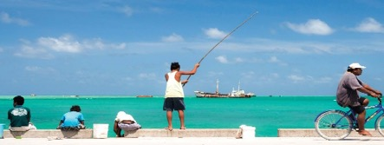






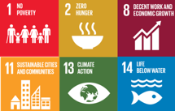



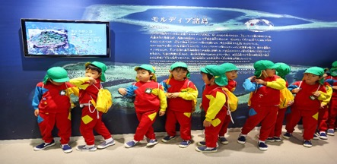


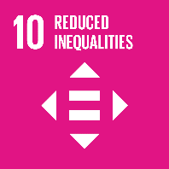



The Decade will be mission-oriented
A safe Ocean
Human communities are protected from ocean hazards and the safety of operations at sea and on the coast is guaranteed.
A sustainable
productive Ocean
The provision of food supply and alternative livelihoods are secured.
A transparent and accessible Ocean
All nations, stakeholders and citizens have access to ocean data and information, technologies, and are capable of making informed decisions.
Notes:
This Decade will empower decision-makers with Science solutions.

Slide 10

Implementation Plan
Between 2018 and 2020, the UNGA tasked IOC with preparing the Decade and coordinating the development
of an Implementation Plan, which will include:
- Science Plan
- Capacity Development Plan
- Resource Plan
- Communications &
Engagement Plan
- Monitoring & Reporting
Vavau © Stuart Chape
Notes:
The United Nations called upon IOC (please explain very briefly what is IOC) to prepare an implementation plan for the Decade in consultation with Member States, specialized agencies, funds, programmes and bodies of the United Nations, as well as other intergovernmental organisations, non-governmental organisations and relevant stakeholders.
The Implementation Plan will include the following elements :
An international Science plan that will define key issues, priority scientific questions of high relevance to sustainable development (Agenda 2030) and will propose scientific themes and outcomes to structure the implementation of the Decade. The Science Plan should also define the modalities for synthesizing the results of research activities undertaken during the Decade;
A Capacity Development Plan with the objective to greatly improve the scientific knowledge base, transfer of marine technology, and education in regions and for groups that are presently limited in capacity and capability, especially SIDS and LDCs. The Plan will provide detail on the strategy and actions needed to significantly enhance the opportunities and equitable access to economic benefits arising from marine resources and technology, including from areas beyond national jurisdiction;
A Resource mobilization Plan/Business Plan which will describe the Decade specific financial mechanisms as the success of the Decade will depend on its financing;
A Communication and Engagement Plan that will define the networking tools to investigate for the challenge of networking Decade scientists, describe the Decade branding, designate spokespeople for the Decade and the dedicated resources, use of web-based or other modern forms of communications. The Engagement Plan will emphasise engagement and involvement and the value the Decade may provide for the identified stakeholders.

Slide 11
Principles: Inclusive & transformative, focused on solutions
Science breakthroughs –> top-down designed
Solutions
Mapping
Observations
Eco-systems
Data and Information
Multi-Hazard Warning Systems
Ocean in Earth System Science
CD, Education, Ocean Literacy
Pickup by practice –> stimulated bottom-up
Resources

Slide 12
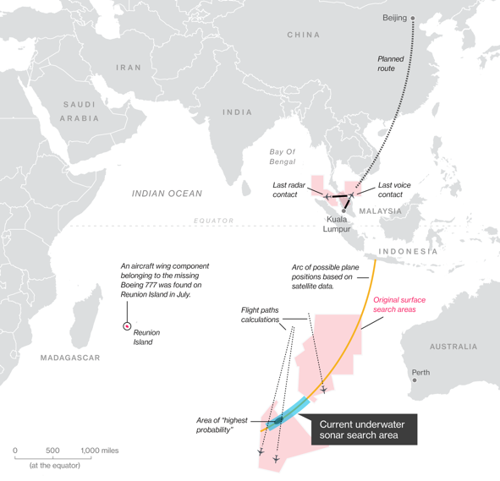
UN Decade of Ocean Science for Sustainable Development
Priority Research and Development Areas
R&D Priority Area 1: Comprehensive map
(digital atlas) of the ocean
(Scope:
well beyond topography)
Vavau © Stuart Chape

Slide 13
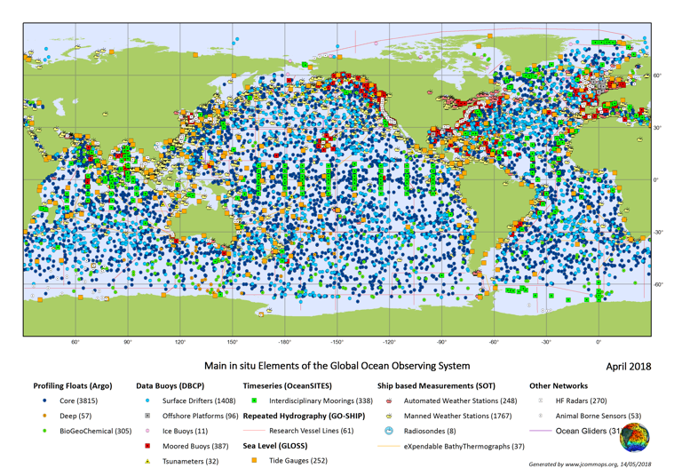
UN Decade of Ocean Science for Sustainable Development
Priority Research and Development Areas
R&D Priority Area 2:
A comprehensive ocean observing system
(polar, bio, eco, BGC,
eDNA, deep ocean, +)
Vavau © Stuart Chape

Slide 14
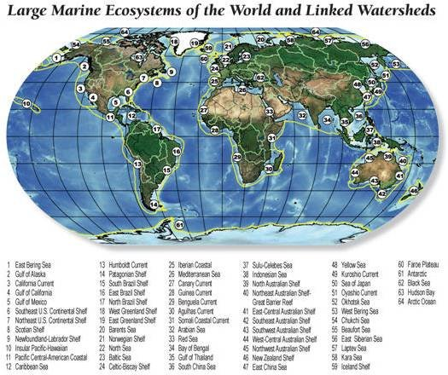
UN Decade of Ocean Science for Sustainable Development
Priority Research and Development Areas
R&D Priority Area 3:
A quantitative understanding
of ocean ecosystems as the
basis for their integrated ocean management
(multiple stressors, deep ocean, bottom, predictive, assisted adaptation, e.g. of coral reef ecosystem)
Vavau © Stuart Chape

Slide 15
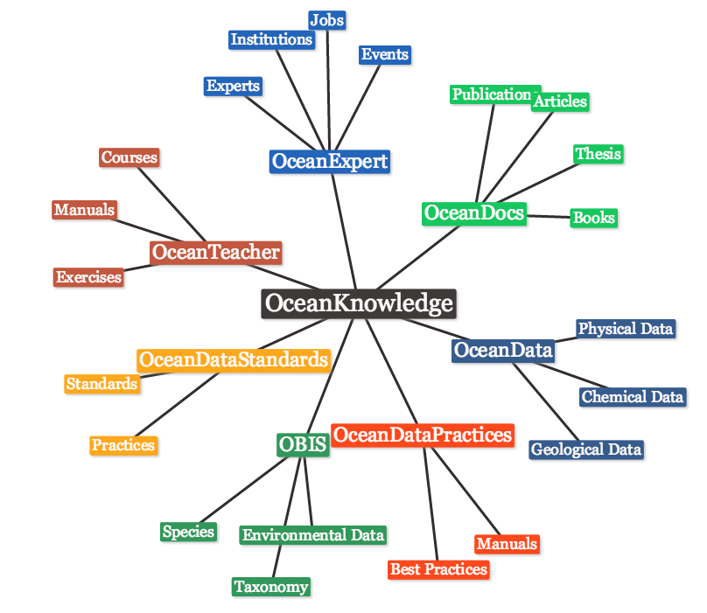


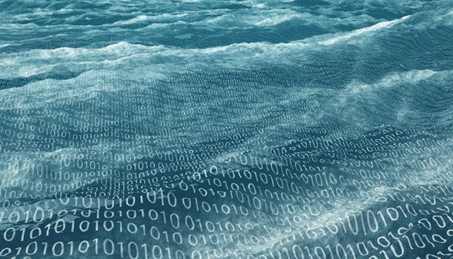
UN Decade of Ocean Science for Sustainable Development
Priority Research and Development Areas
Data
Ocean
Big
R&D Priority Area 4:
Data & information System

Slide 16
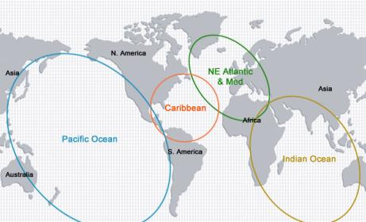
UN Decade of Ocean Science for Sustainable Development
Priority Research and Development Areas
R&D Priority Area 5: Ocean dimension in an integrated multi-hazard warning system
Vavau © Stuart Chape

Slide 17
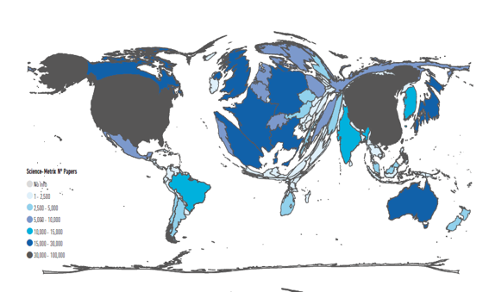
UN Decade of Ocean Science for Sustainable Development
Priority Research and Development Areas
R&D Priority Area 7:
Capacity Development
Education and Training
Ocean Literacy
Vavau © Stuart Chape

Slide 18
Regional Stakeholders
Arctic Council
EC
JPI Oceans
ICES
EMB
PICES/ WESTPAC
Black Sea Com
PICES/ WESTPAC
MAP/
CIESM
IOCARIBE
IOCAFRICA
PERSGA
OECS
UNESCAP
AORA
Indian Ocean Commission/
IORA
WIOMSA
Pacific Community /SPREP
CPPS
CCAMLR / SCAR
Notes:
5 regional workshops will take place in 2019 to cover the main Ocean basin and will contribute to the Regular Process (corresponding to the workshops organized to assist the Regular Process for global reporting and assessment of the state of the marine environment, including socioeconomic aspects):
The North Pacific;
The South Pacific;
The Indian Ocean (including the Arabian Sea and the Bay of Bengal), the Red Sea and Gulf of Aden and the ROPME/RECOFI area; 5
The North Atlantic, the Baltic Sea, the Mediterranean Sea and the Black Sea;
and The South Atlantic (between the African and American coasts) and the wider Caribbean.

Slide 19
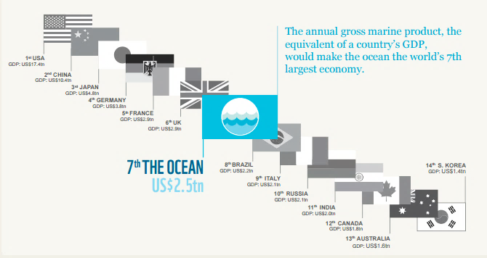
Blue Economy
Notes:
Message: Value of the ocean economy –
If the ocean were ranked among nations’ GDPs, the ocean economy would be the 7th largest economy in the world. (World Wildlife Fund Ocean Economy report, 2015).
AND even as we use the ocean as a source of resources, we must also acknowledge that over 40% of the World’s oceans are heavily affected by human activities.
The ocean’s role in earth systems and as a provider of ecosystem services must be safeguarded if we are to maximize our scientific understanding to be applied to societal benefit, protecting and feeding human communities, and supporting their sustainable development.
IF NEEDED
There are large extents of heavily impacted ocean in the North Sea, the South and East China Seas, and the Bering Sea. Much of the coastal area of Europe, North America, the Caribbean, China and Southeast Asia are also heavily impacted.
The least impacted areas are largely near the poles, but also appear along the north coast of Australia, and small, scattered locations along the coasts of South America, Africa etc
#OceansAt40 90% of people who derive livelihoods from fishing live in developing countries.
#OceansAt40 About 46,000 pieces of plastic are est to be afloat on every square mile of ocean.
#OceansAt40 1bn people in developing countries depend on fish for their primary source of protein.
#OceansAt40 85 nations & an est US$102bn per year are involved in the international trade in fish and fish products.
#OceansAt40 The annual value of the fish trade for dev countries is about US$25bn -2x the value of the coffee trade.
#OceansAt40 In 2008, nearly 80 million tonnes of fish were captured - that's an est US$80bn & 35m jobs.
#OceansAt40 Today > 30% of the world's fish stocks are overexploited, depleted or recovering from depletion.
#OceansAt40 #didyouknow Over 400 dead zones-where nothing can live-exist in today's oceans, covering 95,000 sq miles.

Slide 20
Blue Economy
Near-term growth:
Shipping, shipbuilding and repair, port activity,
marine aquaculture, offshore wind,
and marine tourism
Later:
Renewable energy, biotechnology and CCS
Less strong growth:
Oil and gas, capture fisheries
Ocean Economy in 2030 (OECD, 2016)

Slide 21
Ocean Management Domains
Coastal Zone Management
Marine Spatial Planning
Marine Protected Areas
Fishery Regulations
Carbon Capture Storage
Nationally Determined Contributions
of UN FCCC (WRT Carbon Emissions)
Environmental and Economic Enforcement and Market Regulation

Slide 22
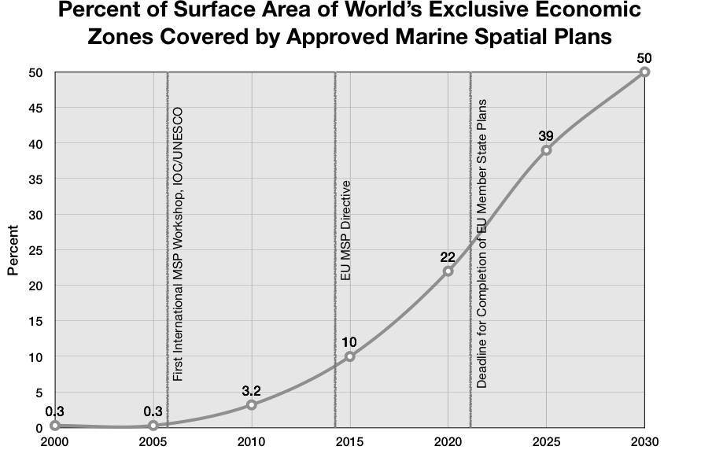
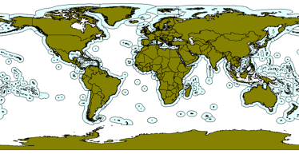
50%
2030
Notes:
The Directorate General for Maritime Affairs and Fisheries of the European Commission, (DG MARE) and the Intergovernmental Oceanographic Commission of UNESCO (IOC-UNESCO) are committed to support the implementation of the Agenda 2030 for Sustainable Development, and in particular the dedicated goal SDG 14, in a comprehensive, consistent and holistic way.
In the interest of both institutions to move forward the global agenda on the oceans - in particular promoting maritime spatial planning at global level – we launched last year the Joint Roadmap to accelerate marine spatial planning processes worldwide that also defines priority areas and strategic objectives for mutual cooperation. We have already started the work on transboundary MSP with pilot projects in the Western Mediterranean and the Southeast Pacific, the MSP for Blue Growth Conference last year and the launching last month of the International MSP Forum of experts which next session will take place in Reunion Island (France) in December.
In line with these priority actions, the European Commission invited last year IOC-UNESCO to apply for an EU Grant under the European Maritime and Fisheries Fund to support internationally accepted Maritime Spatial Planning guidance (MSPglobal)
1) to develop a guidance document on international cross-border maritime spatial planning
2) to support concrete actions in the selected sea-basins helping to build capacity for maritime spatial planning;
3) to support the establishment of lasting mechanisms for cross-border cooperation.
IOC-UNESCO will establish the necessary complementarities and synergies with our member states, existing actions and relevant initiatives.

Slide 23
UN-Oceans
Meeting
Planning Group ToRs approved by IOC-EC 51 (July)
Interim report to IOC Assembly 30
UNGA Resolution proclaiming Decade
Endorsement of plan by IOC EC-52
UNGA consideration of Implementation plan
TODAY
Interim Planning Group established
Partnership Platform Event (?)
Global Meeting# 2
+ Stakeholder Forum (Q1)
Global Meeting# 1
+ Stakeholder Forum (Q1)
2018
2019
2020
2021
1st Meeting EPG (Nov)
Regional Workshops
2nd Meeting EPG (Nov)
Imp. Plan review by MS and other stakeholders
Official start of Decade
Preparatory Phase
UNGA 72
UNGA 73
UNGA 74
UNGA 75
Preparing for the Decade: Next Steps
Notes:
The IOC Executive Council formally established the Planning Group at its 51st in July 2018. A call for nominations for experts was issued (deadline is 5th September) and widely disseminated to IOC MS, UN agencies and the Decade institutional partners (academics, international organisations, NGOs, foundations, etc…).
The Planning Group will meet at least twice during its term, once during each of the IOC intersessional periodes 2018-2019. Representatives of the Planning Group will be invited to share information, inter-act and receive inputs on the elements of the IP.
Two physical meetings of the Stakeholder Forum will be organized, back-to-back with the regional meetings in the preparatory phase. It will provide inputs through the expertise, knowledge, data, information and capacity-building experience of its members on the work carried out by the EPG.
The IOC Executive Council will endorse the Decade Implementation Plan at its 52nd session, in 2020.
It will then be submitted to the UNGA for its consideration.

Slide 24
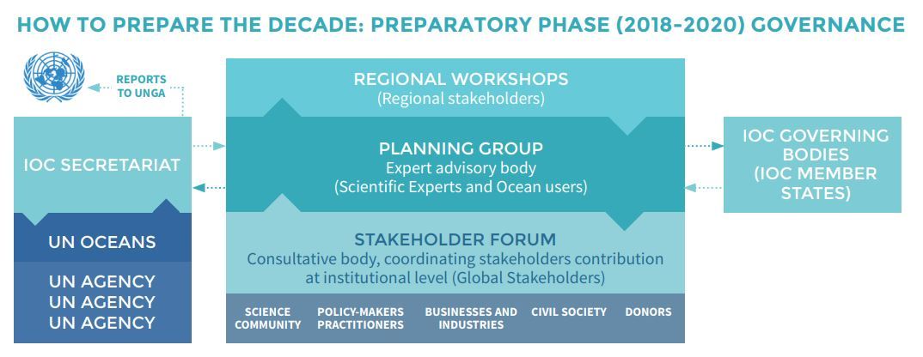
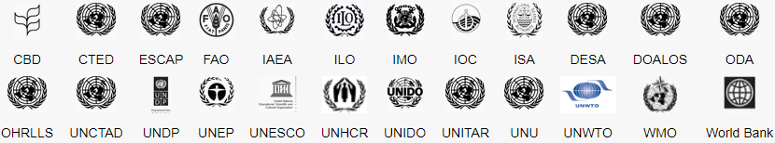
PARTNERSHIP PLATFORM EVENT

Slide 25
Executive Planning group
Francisco Arias, Director General, Invemar, Colombia
Elva Escobar Briones, Institute of Marine Sciences and Limnology, UNAM, Mexico
Karen Evans, Senior Research Scientist, CSIRO Oceans and Atmosphere, Australia
Kristina Gjerde, Senior High Seas Advisor to IUCN’s Global Marine & Polar Programme
Anna Jöborn, Director, Science Affairs Department, Agency for
Marine and Water Management, Sweden
Suzan Kholeif, Director, National Institute of Oceanography and Fisheries, Egypt
Jens Kruger, Head of the Ocean & Costal Geoscience Sector, Pacific Community (SPC)
Youn-Ho Lee, Professor, Korea Institute of Ocean Science and Technology, Republic of Korea
Margaret Leinen, Director, Scripps Institution of Oceanography, USA
M.A. Atmanand, Director of the National Institute of Ocean Technology , India
Craig McLean, Acting Chief Scientist, NOAA, USA
Linwood Pendleton, Global Ocean Lead Scientist, World Wide Fund for Nature
Fangli Qiao, Vice-Chair , National Scientific Committee of Global Change and Mitigation, Ministry of Science and Technology of China
Ricardo Serrao Santos, Member of the European Parliament, Portugal
Sergey Shapovalov, Head of the Center for Coordination of Ocean Research of RAS, Russian Federation
Gilbert Siko , Director in the Department of Science and Technology (DST), South Africa
Mitsuo Uematsu, Emeritus professor, University of Tokyo, Japan
Martin Visbeck, Professor for Physical Oceanography, GEOMAR Helmholtz Centre for Ocean Research Kiel and Kiel University, Germany
Christa von Hillebrandt-Andrade, Manager of the NOAA National Weather Service Caribbean Tsunami Warning Program, USA

Slide 26
2019 planning events
Decade meetings | Possible side-events at internation meetings | Planning and consultative meetings
January
February
March | AtlantOS General Assembly, 26-29, UNESCO HQ, Paris | 1st Global Planning Meeting & Stakeholder Forum, March/April, Denmark
 | IOCARIBE 15th Intergovernemental session, 11-15, | Regional workshop 1: Carribean (back-to-back with IOCARIBE 15th session)
April |  | Regional workshop 2: Pacific Islands, SPC, April/August
 |  | Regional workshop 3: Southeast Pacific, CPPS, April/August
May | European Maritime Day, 16-17, Lisbon | Regional workshop 4: South Atlantic, Brazil, Brazil,
June | IOC Assembly 26th June-4th July | Regional workshop 5: North Atlantic, European Marine Board/JPI Oceans,
 | EurOCEAN 2019, 11-12, UNESCO HQ, Paris
July | IOC Assembly 26th June-4th July
August | 11th WIOMSA Scientific Symposium, 8-13, Mauritius | Regional workshop 6: North Pacific, WESTPAC, August
 | GOOS Regional Alliances | Regional workshop 7: Indian Ocean, Mauritius, Mautitius, August (back-to-back with 11th WIOMSA Scientific Symposium)
September
October | OceanObs’ 19 – An Ocean of opportunity, 16-20, Honolulu, Hawaï | Cross-regional wrap-up workshop back-to-back with OceanObs'19
November
December
TBD |  | Regional workshop 8: Arctic, Norway, TBD
 |  | Regional workshop 9: Mediterranean, TBD
 |  | Regional workshop 10, Antarctic, SCAR, (?)
 |  | Regional workshop 11, Red Sea & Gulf of Aden, PERSGA, Saudi Arabia(?)

Slide 27
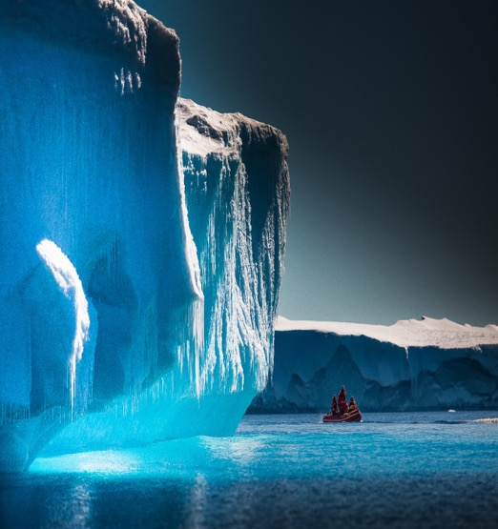




Get in touch
Write to us: oceandecade@unesco.org
Follow all Decade news: http://oceandecade.org
Social media:
The United Nations Decade of Ocean Science for Sustainable Development (2021-2030)
IocUnesco
IocUnesco
ioc_unesco
Towards The Ocean We Need
for the Future We Want
v.ryabinin@unesco.org
Notes:
Are you interested in working toward the Ocean We Need for the Future We Want?
Visit our website, read our brochure and let us know and we will keep you informed of all future developments.

