Slide 1

JCOMM MAN-15
2.1: SFSPA Update
Tom Cuff
NOAA/NWS/Ocean Prediction Center
SFSPA Chair
JCOMM Management Committee Meeting
31 October 2018, Paris, France

Slide 2
Overview
Highlights since JCOMM-5
Workplan
SWOT
Priorities based on budget scenarios
Potential cross-PA projects
Other issues
2

Slide 3
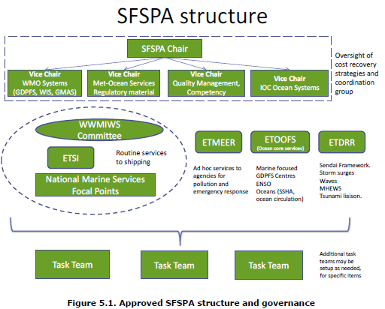
SFSPA Terms of Reference

Slide 4
Highlights since JCOMM-5
Completed selections to expert teams
Instituted monthly telecons
  Primary issues have been the workplans and WMO reform
Held SFSCG meeting 22-24 August 2018
4

Slide 5
SFSCG-9, 22-24 August 2018
Key issues included:
  Development of a workplan
  WMO reform
  Capacity Building discussion
  Marine Competencies
  Enhance reach to CBS, CHY, CAg, and CAeM, particularly as related to GDPFS, DRR, and cost recovery
  The need to strengthening relationships with key partners (IMO, IHO, IALA) as well as the private sector
  Consideration for cost recovery and formation of a subsequent task team
  Initial discussion on a SFS Strategy
5

Slide 6
SFSPA Strategy
Proposed SFS Strategic Vision:
  By 2021, the global maritime community will have access to world class authoritative marine and coastal met-ocean products and decision support services, which will enhance safety of life and property at sea while mitigating the damaging impact of hazardous weather events along the coasts.
6

Slide 7
SFSPA Strategy (cont’d)
Notional SFS Strategic Goals:
  Engender high-quality, consistent routine met-ocean services, to inform decision-making by maritime and coastal users, reducing risk
  Establish a framework for providing timely and accurate met-ocean support to marine environmental emergencies.
  Foster an integrated approach to operational weather, ocean, and polar ice forecasting.
  Improve the inextricable link between high quality observations of the maritime environment with forecasts.
  Establish standards and protocols to modernize the dissemination of marine weather products to users at sea
Work in progress; complete by end 2018
7

Slide 8
Highlights since JCOMM-5
WWMIWS
  Held inaugural meeting at IHO, Monaco, 27-31 Aug:
    Held in parallel with the IHO Subcommittee for the Worldwide Navigation Warning System (WWNWS)
    METAREA and NAVAREA coordinators met for 2nd time
  WWMIWS-2 and WWNWS plan their next joint meeting in 2020
8

Slide 9
Highlights since JCOMM-5
WWMIWS-1 (cont’d)
  Endorsed the following priorities for Congress 2019:
    Cost sharing model should be proposed to WMO Congress in relation to the cost to broadcast Enhanced Group Call (EGC) bulletins on satellite, in recognition of the new requirement to broadcast on multiple satellite systems.
    Develop a model training course and proposal to support Members in implementing the Guide to Marine Meteorological Services (WMO No.471).
    Establish a network of new marine-related RSMC’s categories to further support and enhance marine service delivery.
    Develop a competency framework for METAREA Coordinators.
9

Slide 10
Highlights since JCOMM-5
WWMIWS-1 (cont’d)
  Prioritized the following items on its workplan:
    Highlight the challenge and dangers of small scale weather features and communication of danger to non-SOLAS vessels.
    Improve education material about the WWMIWS, and promote and distribute this information to maritime users.
    Reinforce need for greater consistency of bulletins & terms.
    Finalize the skills development matrix to present to the JCOMM Capacity Development officer, to incorporate into the capacity development workplan.
    Facilitate a Spanish and French version for the METAREA Coordinator Operations Handbook as priority, and Chinese and Russian versions as secondary priority.
10

Slide 11
Highlights since JCOMM-5
CIFDP:
  Seeking linkages with ETOOFS
  Reviewing the Tsunami Ready criteria and processes
  Provide certificates for completed CIFDP sub-projects at Congress
  Upcoming Technical Workshop: 19-21 November, Nadi, Fiji
11

Slide 12
Highlights since JCOMM-5
ETDRR
  Consider DRR aspects to the UN Decade of Ocean for SD, Sendai Framework, and MHEWS
  Contribute to IN-MHEWS conference 2019
  Confirm ETDRR meeting dates and location (India ?)
  Finalize ET workplan, providing it to the SFSPA CG
12

Slide 13
Highlights since JCOMM-5
ETMEER
  Decommission MPERSS website
  Establish links with relevant Expert Teams
  Consider MEER services within WWW GDPFS; connect with JCOMM Liaison for GDPFS
  Connect with the International Ice Charting Working Group (IICWG) for lessons learned in a recent table top exercise for response to an oil spill in the Arctic
  Connect with WMO regions to determine their needs.
  Finalize ET workplan, providing it to the SFSPA CG
13

Slide 14
Highlights since JCOMM-5
ETOOFS
  Complete the Operational Ocean Forecasting System Guide.
  Build links to WWW GDPFS; connect with JCOMM Liaison for GDPFS
  Consider connectivity with ETSI and ETMEER, at a minimum
  Connect with UN Decade of Ocean Science, particularly the “predicted ocean” and “safe ocean” themes
  Finalize ET workplan, providing it to the SFSPA CG
14

Slide 15
Highlights since JCOMM-5
ETSI
  Strengthen collaboration with CBS, GCW, and the RCCs, where sea ice is a priority need
    ETSI-7 meeting: 6-8 May 2019, Helsinki. Third day will be a joint session with PARCOF-3/ArcRCC
  Increase collaboration with DBCP, to improve service capabilities for buoys in polar regions
  Include sea ice in the GDPFS and ETOOFS manuals
  Finalize ET workplan, providing it to the SFSPA CG
15

Slide 16
Highlights since JCOMM-5
Satellite Data Coordinator
  Suggested focus includes UN Decade of the Ocean and EC-PHORS needs
  Reviewing TOR for former Task Team on Satellites
  Coordinating a session on Operational Oceanography at CGMS-47, May 2019
Task Team on Climate, Weather, and Fisheries
  New chair is needed
  SFS chair will engage
16

Slide 17
SFSCG Workplan
Highlights:
  Complete OOFS Manual
  Nominate a POC for the WMO Statement of Guidance, to contribute to the delivery of ocean applications
  Aggressively pursue implementation of Marine Competencies
  Tighten linkages between marine services and IOC and WMO regions
    Regional marine advisors?
    Engage WMO regions on Marine Competencies
    Consider partnering with Copernicus
    Hold special VTC to discuss priorities
17

Slide 18
SFSCG Workplan
Highlights (cont’d):
  Capacity development:
    Define the minimum requirements for a viable marine met service that meets IMO requirements
    Identify those NMHS that require marine services (self assessment)
    Consider partnering with Copernicus
    Hold special VTC to discuss priorities
  Determine how NMHS are supporting the Polar Code
  Complete SFS Strategic Vision and Goals
18

Slide 19
SFS SWOT
Strengths: in what areas does SFSPA excel?
  Unique coordination with WMO and IOC
  Connectivity with IHO, linking the navigation and weather safety issues
Weaknesses: where are area of improvement for SFSPA
  Less than optimal interaction across like WMO (and IOC) entities
  Relatively small number of countries are very active, but many are not
19

Slide 20
SFS SWOT (cont’d)
Opportunities: where can we increase service?
  Capacity building, to improve services
  Foster stronger partnerships
    With Private Sector
    Across WMO, IOC, and other relevant bodies, including regional bodies
Threats: what may harm us?
  Budgets/funding
  Uncertainty regarding WMO reform -- notably final structure, links, and length of time to get “there”
  Relatively quiet users
    …
    …
20

Slide 21
SFSPA Budget Priorities
General thoughts:
  Very challenging for CG and ETs to achieve much of value with face-to-face meetings just every 2 years
    Attempting to mitigate with regular telecons
    In person meetings essential to developing functioning teams
  Notional priorities (critical – essential – enhancing)
    WWMIWS: critical
    ETSI: critical
    ETDRR: critical
    ETMEER: critical/essential
    ETOOFS: critical/essential
  Additional workshops would help advance efforts
21

Slide 22
SFSPA Budget Priorities (cont’d)
  Full budget (110K):
    Presently allows meeting every 2 years for SFSCG, WWMIWS, ETDRR, ETMEER, and ETOOFS, and ETSI
    Two ETs could meet; third and fourth may be able to meet
    Some travel for SC
  ↓30% (77K):
    Two ETs could meet; a third may be able to meet.
    Would not have a ETMEER meeting
    No travel for VCs or SC
  ↑50% (150K):
    CG and all ETs meet
    Travel for VCs and SC, as appropriate/necessary
22

Slide 23
SFSPA Cross-PA Projects
Potential cross PA activities could include:
  OPA
    Adaptive ocean sampling, to improve analysis and prediction of oceanic storms (e.g. Drifting buoys – impact on models and forecast operations)
    Address coastal winds gap
    Participation in OceanObs’19
  DMPA
    Strengthen services link with climatology (ETMC), to include scoping marine climatological requirements as they relate to international programs, WMO resolutions/programs, etc.
    Participation in CLIMAR-5 (May 2019) organized by ETMC
    Contribute to IPET-MOIS
23

Slide 24
Additional Items of Interest
Nomination of a POC for the WMO Statement of Guidance on Marine Applications:
  Will address by Dec 2018
  In view of JCOMM-5 Dec. 14, we must work to better integrate marine data into the WMO’s Rolling Review of Requirements
Vice-Chair positions:
  Discussed options; will resolve by end 2018
Marine Competencies:
  WWMIWS reviewed responsibilities of TT to assist in global implementation
  Developed a skills development priority matrix for METAREA coordinator and marine forecaster training, to be provided to the JCOMM Capacity Development officer
Impact of WMO Reform
24

Slide 25
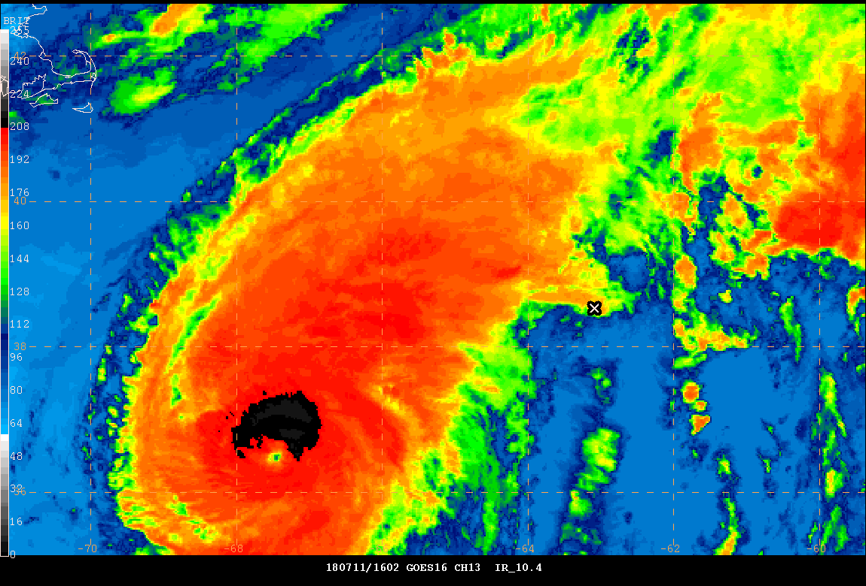
Closing thought on Marine Services
X- vessel position via Satellite AIS
GOES-E CONUS IR_10.4
1602 UTC 7/11/18 – 0637 UTC7/12/18
Vessel nominal speed – 14.5 knots
Speed less than 10 knots – 25h 46m
less than 5 knots – 54m

Slide 26
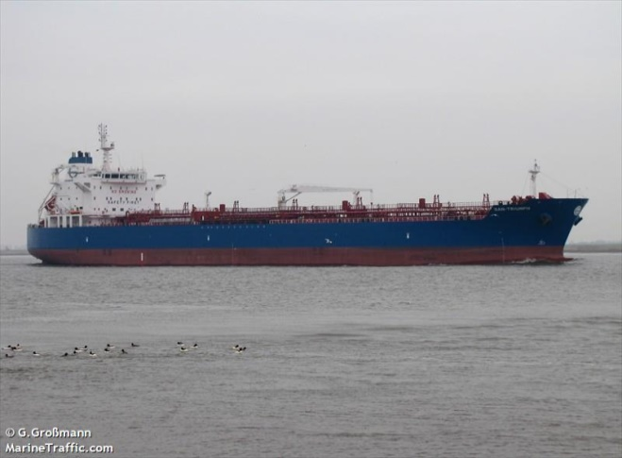
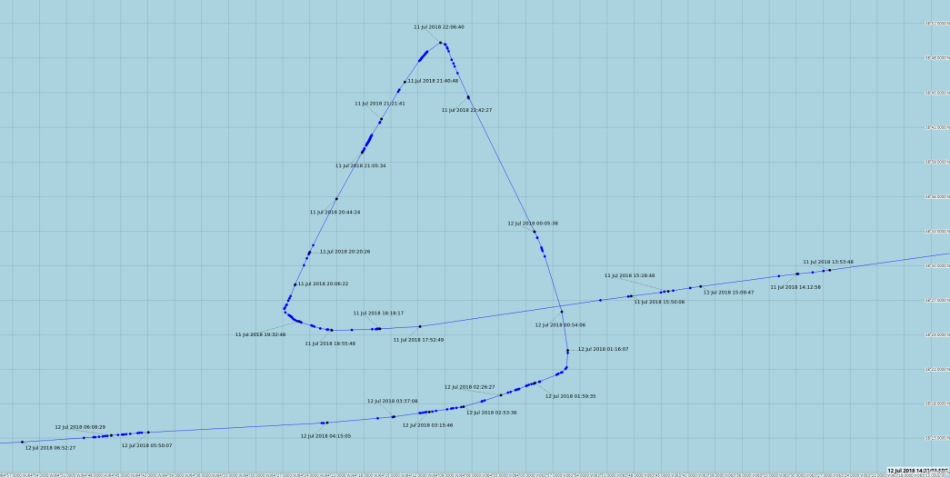
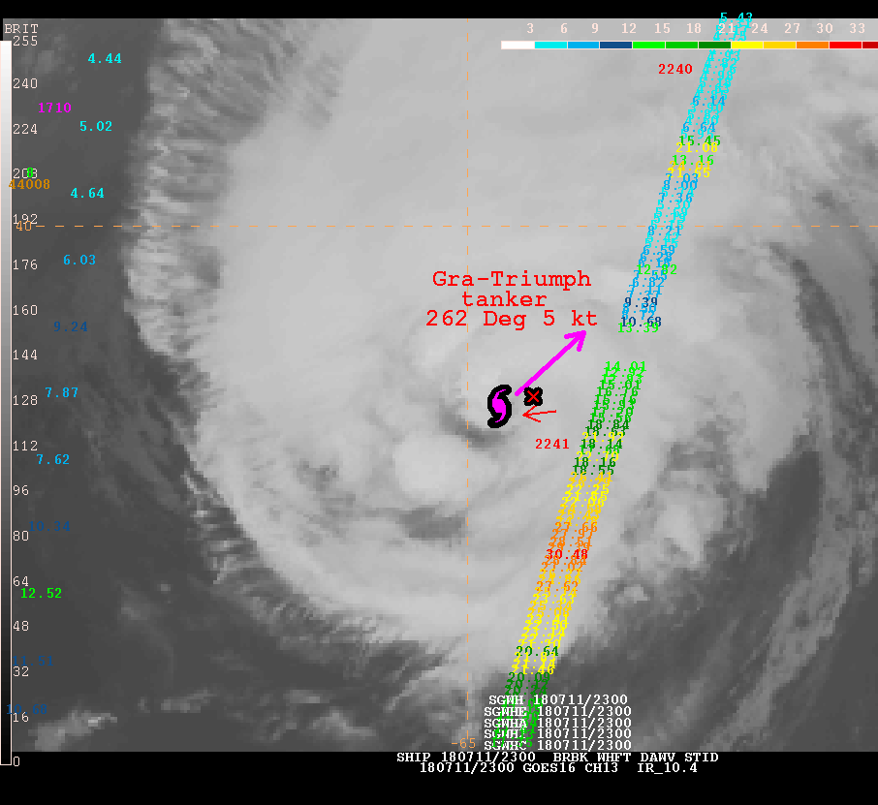
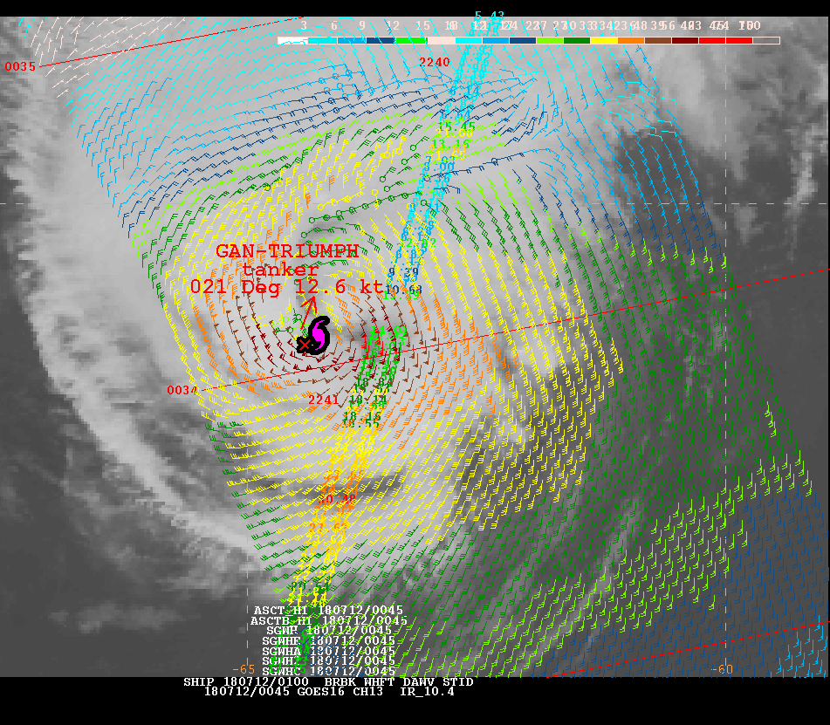
Closing thought on Marine Services
Hurricane Chris – Extreme Weather Impact (July 2018)
Nearly all vessels avoided
extreme winds and seas.
Tanker GAN-TRIUMPH
Enroute Spain to NYC
Encountered Hurricane Chris
  2300 ~15 nm ENE center
  0045 W of center
AIS shows vessel slowed and
did a loop of ~140 nm
AltiKa – seas to 30 ft
ASCAT-A – HF to E of center
  Large area TS winds
No observations received from ship
No report of impact to vessel
0044 UTC
2300 UTC
2300 UTC 11 Jul 0045 UTC 12 Jul

Slide 27
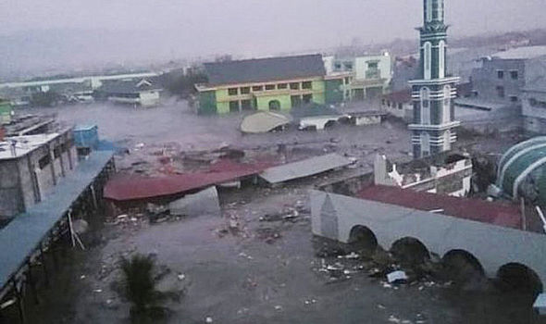
Questions?
Image: TWITTER via www.express.co.uk
27

