Slide 1
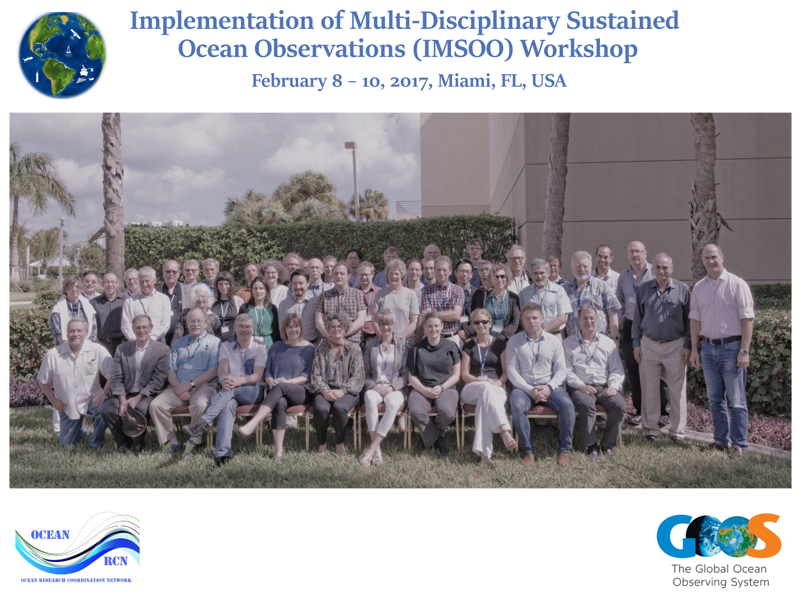
8-10 February 2017, in Miami, FL, USA
Organized by 3 GOOS Expert Panels and the NSF OceanObs RCN
49 experts from 35 institutions/11 countries
Notes:
Here the challenges of cross disciplinary work should be recognized.

Slide 2
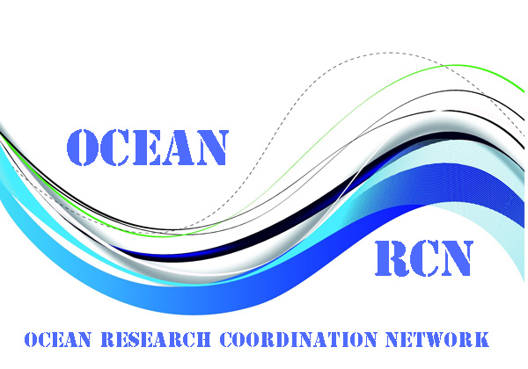
Implementation of Multi-Disciplinary Sustained Ocean Observations (IMSOO)
Building on the established societal and scientific requirements expressed in EOVs, identify the key applications and phenomena that will benefit from co-located, multi-disciplinary sustained observations
Identify near-term innovation priorities for observing platforms and sensors to enable multi-disciplinary observations, and
Identify programmatic and professional connections between existing and emerging observing networks that will increase multi-disciplinary observations
Notes:
Starting from the desire to have cross discipline efforts in physical, biogeochemical and biology.ecosystems, we felt these were too broad and worked with the GOOS panels and other experts to pick a focus

Slide 3
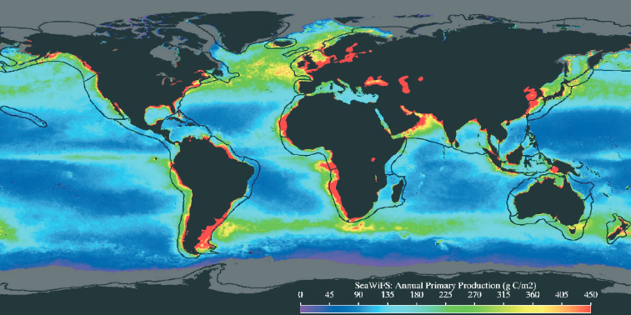
IMSOO Themes
Demo Theme #1
Demo Theme #3
From Zhang & Gawarkiewicz (2015)
Changes in plankton communities (including ocean colour)
Boundary currents
(open ocean/shelf interactions)
Demo Theme #2
For IMSOO, the umbrella of interdisciplinary ocean sciences is the core objective
Oxygen minimum zones
Demo Theme #3
Demo Theme #3
From Zhang & Gawarkiewicz (2015)
From Zhang & Gawarkiewicz (2015)
Boundary currents
(open ocean/shelf interactions)
Boundary currents
(open ocean/shelf interactions)

Slide 4
Key Challenges
Most biological measurements are currently not automated.
The challenge of data sharing is a key issue and a recommendation is to conform to existing standards and best practices.
The use of common approaches facilitates capacity building with special benefits for developing countries.
For the coastal science: work across gradients of anthropogenic impact, emphasis on eutrophication, and other pressures.
For the open ocean community: increase synergies with existing autonomous networks and the remote sensing community
Notes:
; initiate dialogues with global observing platforms/networks (e.g. GO-SHIP) to integrate measurements of biological EOVs, incentivize more routine collection of environmental data from continuous plankton recorders with oxygen being the first priority. ; initiate dialogues with global observing platforms/networks (e.g. GO-SHIP) to integrate measurements of biological EOVs, incentivize more routine collection of environmental data from continuous plankton recorders with oxygen being the first priority.

Slide 5
IMSOO Workshop Outcomes and Recommendations
New capabilities and new observation systems must build on existing capabilities, e.g. addition of water sampling for biological measurements to repeat hydrography surveys.
Need for a blueprint of a multidisciplinary backbone observing system for broader implementation, including a generic design process.
Need for common use of existing standards and best practices for data management, creation of best practices manuals and similar documentation.
Palacz AP, et al. 2017. Report of the workshop on the Implementation of Multi-disciplinary Sustained Ocean Observations (IMSOO). Global Ocean Observing System (GOOS) Report No. 223, http://www.goosocean.org/imsoo-report
Notes:
For more input on these planned activities please contact Patricia Miloslavich and Katy Hill. IOCCP is focusing on the follow up activities to the OMZ Demonstration Theme.

Slide 6
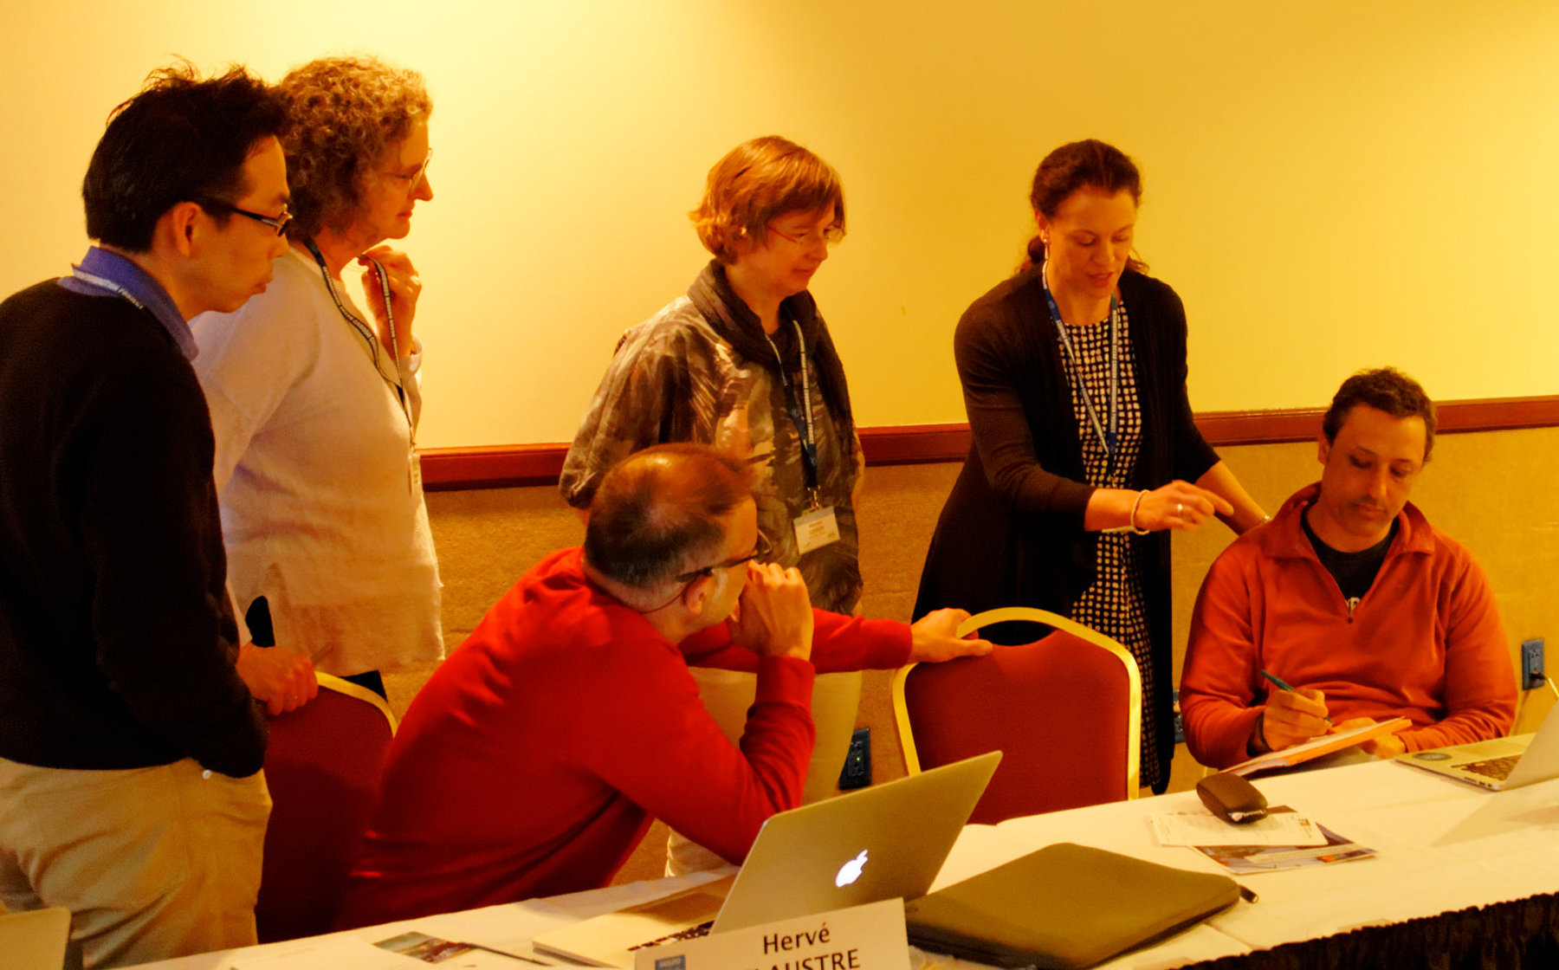
Outcomes
Articulate requirements for plankton community observations within an integrated, multi-disciplinary approach (i.e. including necessary physical, biogeochemical and biological observations).
Articulate the role and synergies of the range of networks and technologies in plankton community observations, including (but not limited to), Satellite observations, CPR surveys, Imaging FlowCytoBots, Deep and Shelf Moorings, Gliders, HF Radar.
Envision technological developments to facilitate and automate multi-disciplinary observations of plankton communities.

Slide 7
Thoughts for a 5 Year Plan
Design, propose, and implement a coastal observing program within GOOS
Develop and produce an initial ‘health check’ report for coastal ecosystems
Identify opportunities to build out the observing system and promote the use of biological sensors on alternative platforms such as gliders, floats and moorings.
Advocate that BGC-Argo floats incorporate a UVP.
CPR surveys: Support the development/inclusion of addition sensors on the CPRs e.g. for nitrate and pH.
Connect GO SHIP and Argo approaches and optimize the BGC Argo data
Open Ocean time series stations – what can they do?

Slide 8
The IMSOO Family
IMSOO Workshop
P-OBS
SCOR WG
VOICE Workshop 1
EBUS SCOR WG
Plankton Workshop
VOICE Workshop 2
Plankton Community
Oxygen Minimum Zones
Boundary Currents

Slide 9
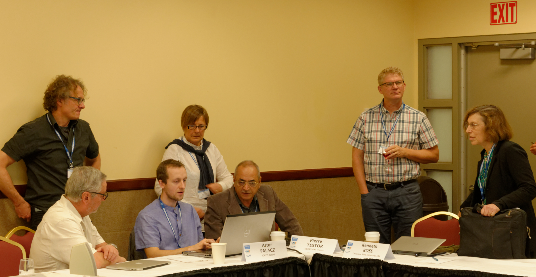
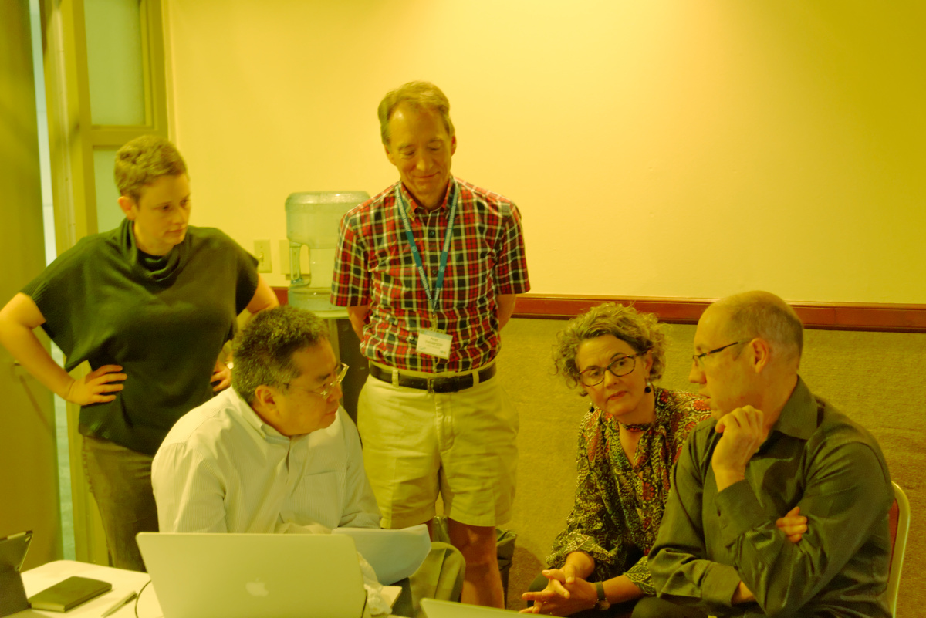
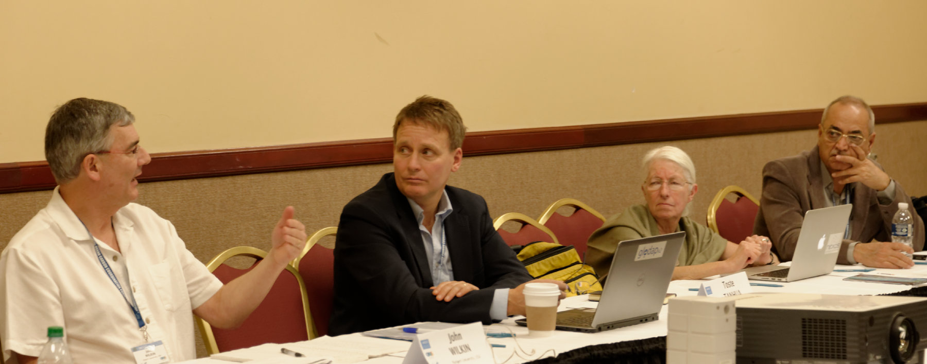
Thanks to all the IMSOO Workshop Participants
The workshop was sponsored through NSF Grant OCE-1143683, NASA Grant NNX16AP22G, and through NOAA's Climate Program Office, GOOS of IOC-UNESCO, the OceanObs Research Coordination Network and IEEE.

