Slide 1
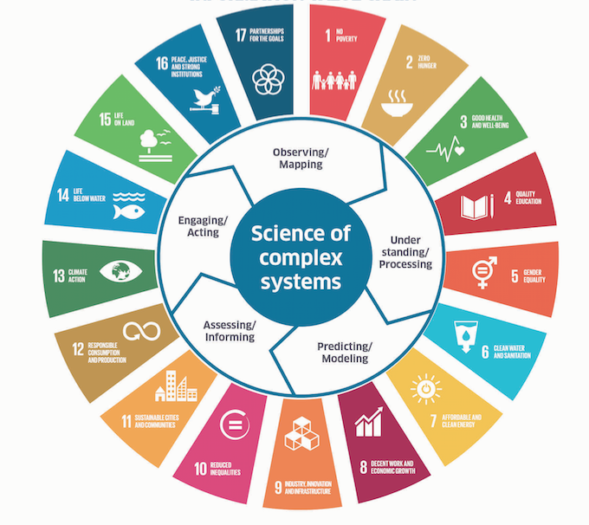

United Nations Decade of Ocean Science for Sustainable Development (2021-2030)
SDG 14
Paris
Sendai
SAMOA
Biodiversity

Slide 2
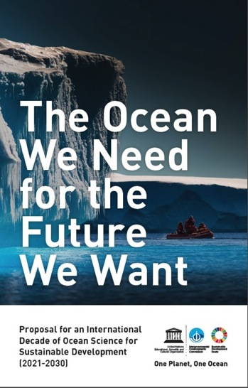
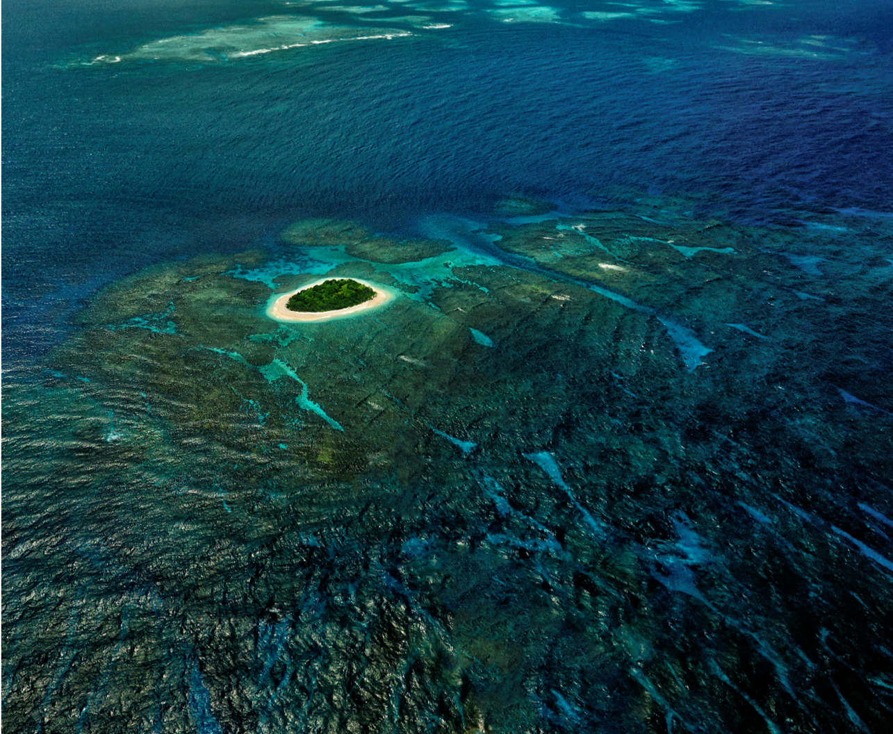
2016: Thinktank of IOC, the idea! 2017: discussions, massive support from UN, IGOs, NGOs, … (including ICES, PICES and FAO), proposal to UN
6 December 2017
72nd UN General Assembly Resolution
UN Decade of Ocean Science for Sustainable Development (2021-2030)
Vavau © Stuart Chape

Slide 3
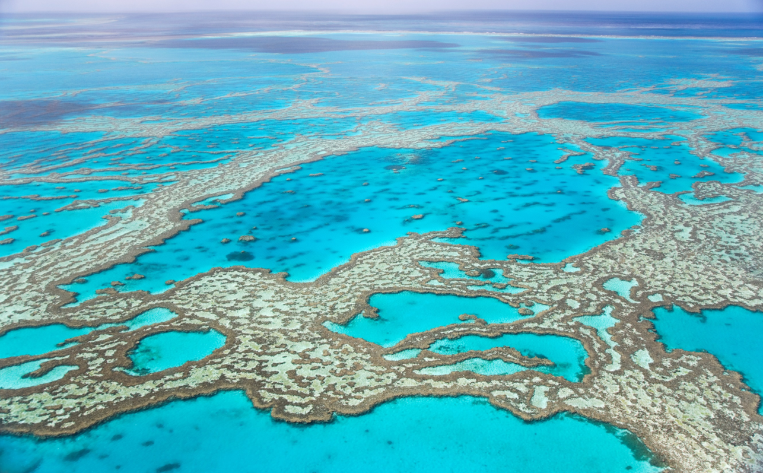
A Vision for the Decade
Develop scientific knowledge, build infrastructure, and foster partnerships (to trigger effective action) towards a sustainable and healthy ocean

Slide 4
Decade: Mutual Acceleration of Science and Practice
Planned R&D –> +/- top-down design
Science
Pickup by practice –> stimulated bottom-up
Science
Practice
Science
Practice
Practice

Slide 5
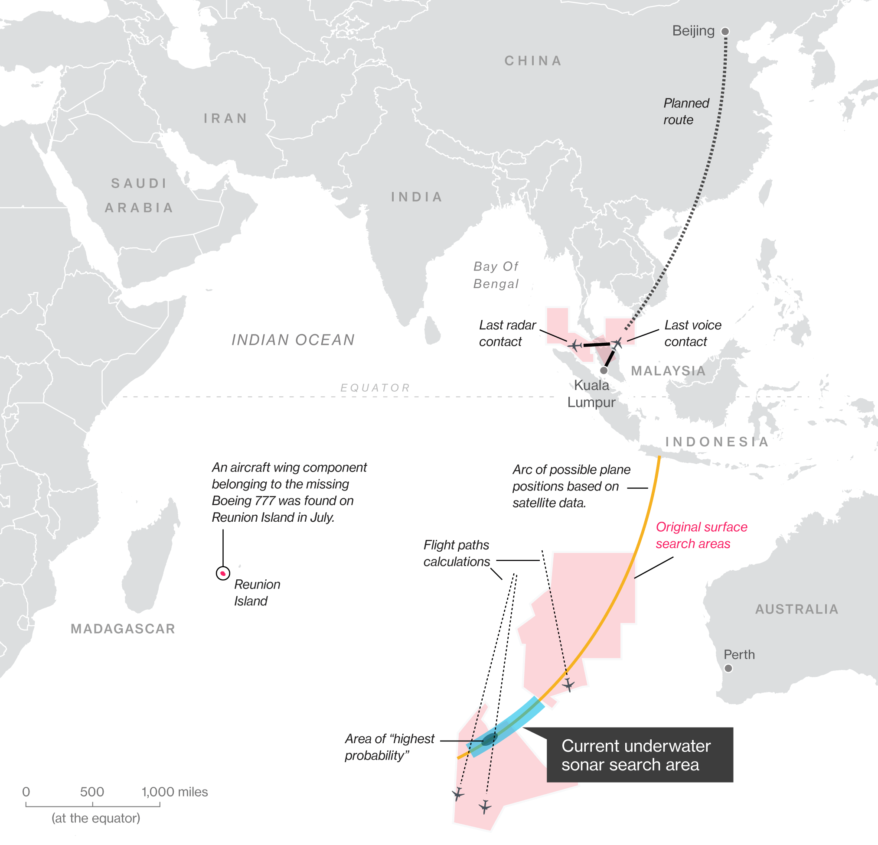
UN Decade of Ocean Science for Sustainable Development
Priority Research and Development Areas
R&D Priority Area 1: Comprehensive map (digital atlas) of the ocean
(well beyond topography)
Vavau © Stuart Chape

Slide 6
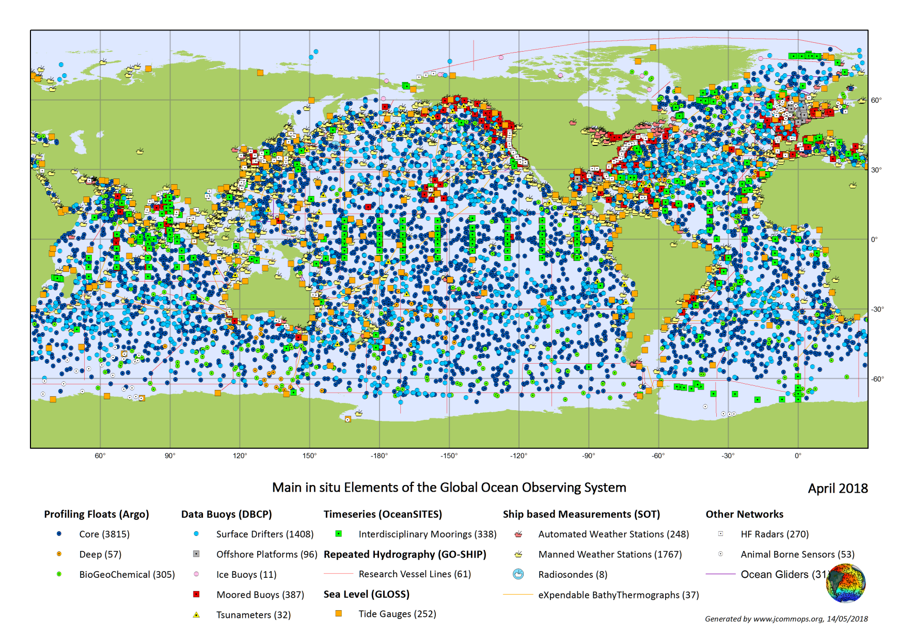
UN Decade of Ocean Science for Sustainable Development
Priority Research and Development Areas
R&D Priority Area 2: A comprehensive ocean observing system (polar, bio, eco, BGC, eDNA, deep ocean)
Vavau © Stuart Chape

Slide 7
From the Road map, Priority area 2 – A comprehensive OOS
Today’s Global Ocean Observation System () is competent when it comes to physical state variables in the upper two kilometres of the water column and at the surface.
It is expanding to include additional measurements in the deeper ocean, and in the domains of biogeochemistry, biology and ecosystems.
GOOS is generally a shared undertaking
Member States need to engage further to construct and sustain a global ocean observing system that covers all the world’s major ocean basins.
All the ocean sciences and their applications would benefit from additional coverage in density of observations and parameters, and in particular, in the Southern Ocean and the Arctic that are currently remarkably under-observed.
Efforts will focus on expending observations to the deep ocean
Partnerships with industry will be required to promote data sharing and guiding the development of new technologies.
The Decade should produce a regime of international cooperation that completely monitors the major ocean basins of the world, at all depths, blending into the Global Ocean Observing System, and maintained by the nations of the basin region, among others.
remotely sensed observations and strongly benefit from emerging observing technologies.
These requirements for observations have been known for a long time but GOOS remains grossly underinvested.
The Decade should create conditions for involvement of down-stream beneficiaries of the ocean observations.
The current ocean observing community should then reach out to a much wider consortium of stakeholders, which would turn GOOS into a “system of systems”.
Vavau © Stuart Chape

Slide 8
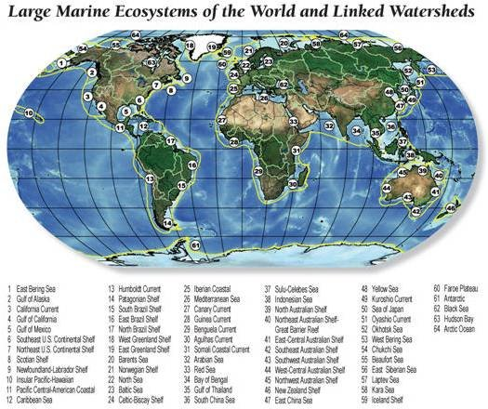
UN Decade of Ocean Science for Sustainable Development
Priority Research and Development Areas
R&D Priority Area 3: A quantitative understanding of ocean ecosystems as the basis for their management and adaptation
(multiple stressors, deep ocean, bottom, predictive, assisted adaptation, e.g. of coral reef ecosystem)
Vavau © Stuart Chape

Slide 9
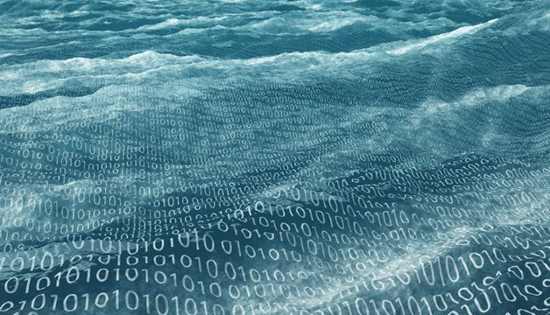
UN Decade of Ocean Science for Sustainable Development
Priority Research and Development Areas
R&D Priority Area 4: Data & information portal
Data
Ocean
Big
Vavau © Stuart Chape

Slide 10
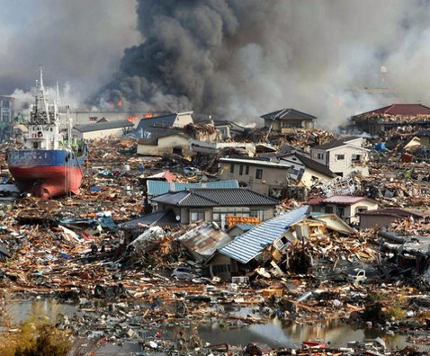
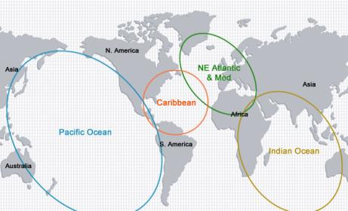
UN Decade of Ocean Science for Sustainable Development
Priority Research and Development Areas
R&D Priority Area 5: Ocean dimension in an integrated multi-hazard warning system
Vavau © Stuart Chape

Slide 11
UN Decade of Ocean Science for Sustainable Development
Priority Research and Development Areas
R&D Priority Area 6: Ocean part of Earth System Science and Observations
Vavau © Stuart Chape

Slide 12
Decade: Mutual Acceleration of Science and Practice
Planned R&D –> +/- top-down design
Science
Pickup by practice –> stimulated bottom-up
Science
Practice
Science
Practice
Practice

Slide 13


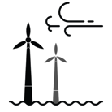
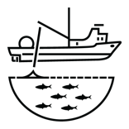





Key Societal Benefit Areas
Marine
Spatial
Planning/
Blue economy
Coastal zone
management
and adaptation
Establishment of
Marine Protected
Areas
Nationally
Determined
Contributions
to UNFCCC
Governance: Implemented
national ocean
policies
Fishery
management
Regional and
national capacity
development
planning
Development of national R&D strategies
Early warning
systems

Slide 14
oceandecade@unesco.org
Your UN Decade of Ocean Science for Sustainable Development!
Your once-in-a professional-life time opportunity to make the difference!

