Slide 1
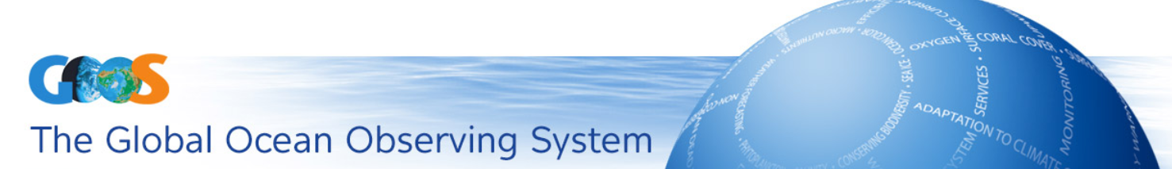
Ocean Observation governance
A discussion presentation for the GOOS SC-7 meeting
2018

Slide 2

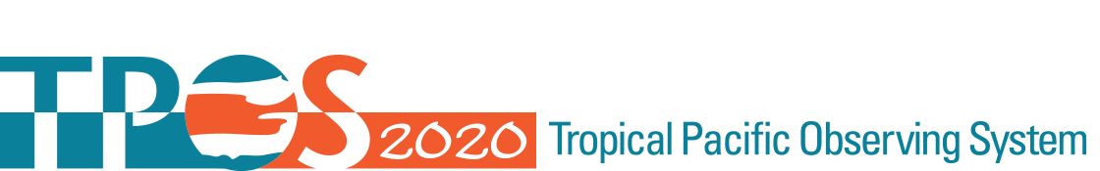
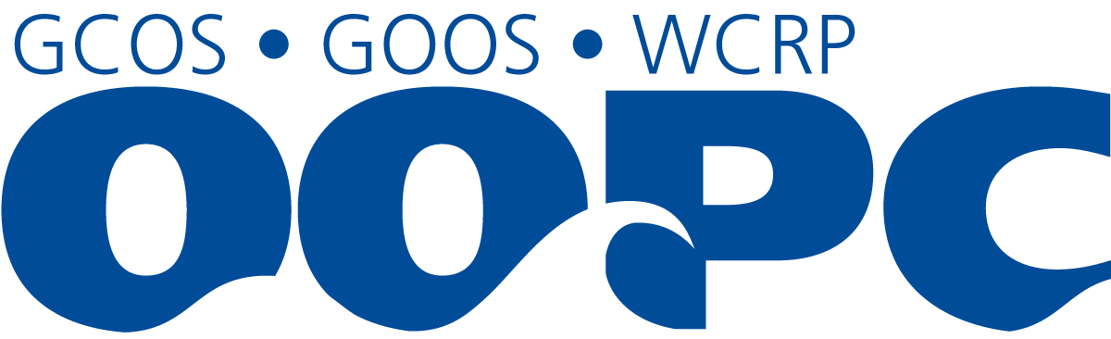
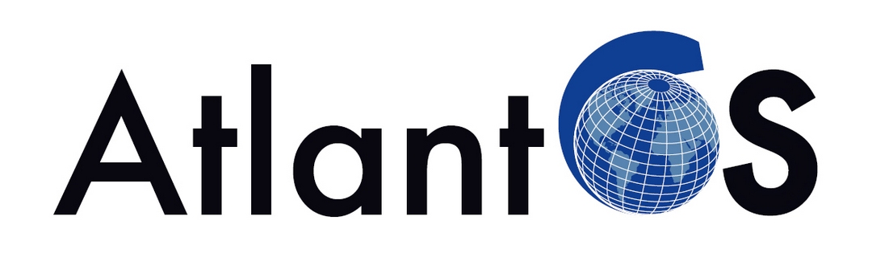
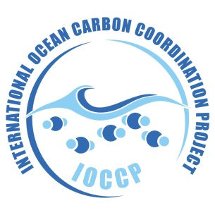
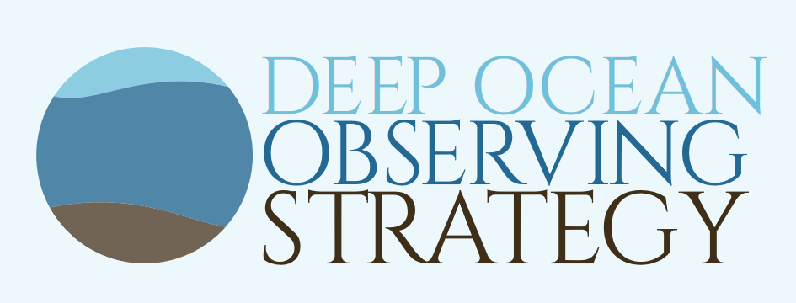
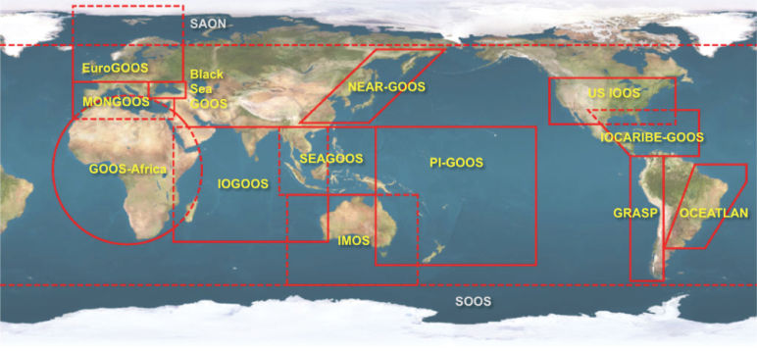
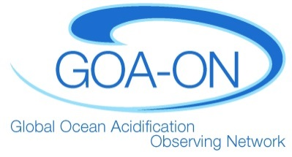
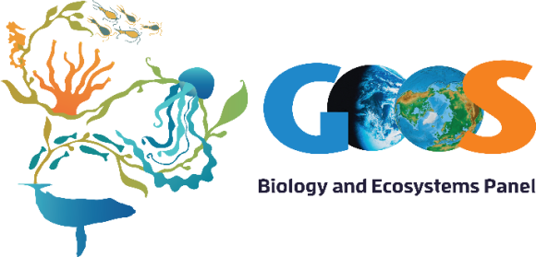
Steering Committee
Scientific Oversight
Observation coordination
Project development
Expert Panels
Physics
Biogeochemistry
Biology and Ecosystems
Global observing networks and platforms
Regional and national organizations
GOOS Regional Alliances (GRAs)
Improving through innovation and renovation
Ocean Coordination Group (OCG)
Integrated Atlantic Ocean Observing Systems

Slide 3
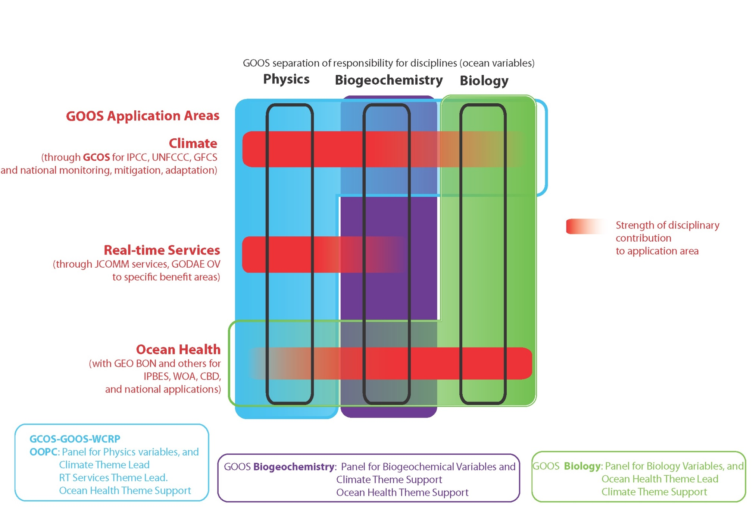
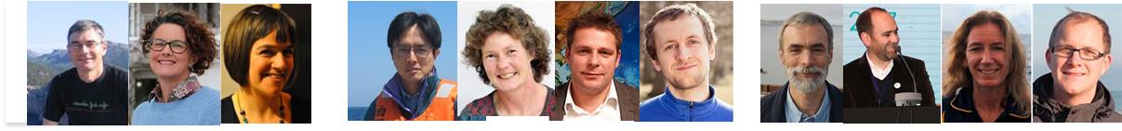

Slide 4
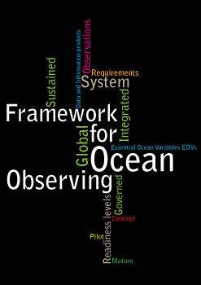
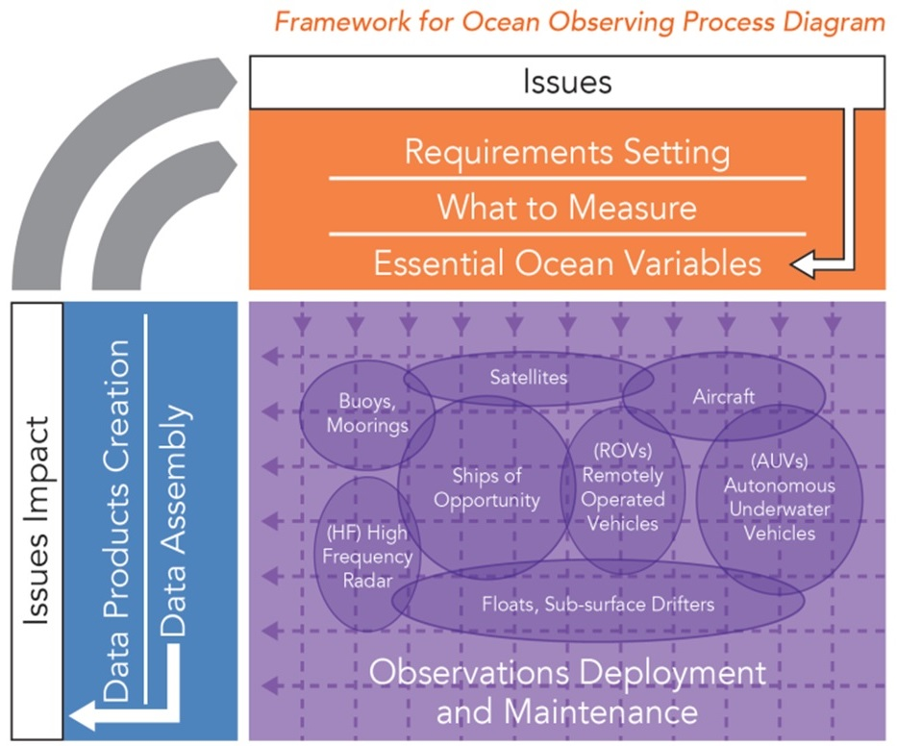
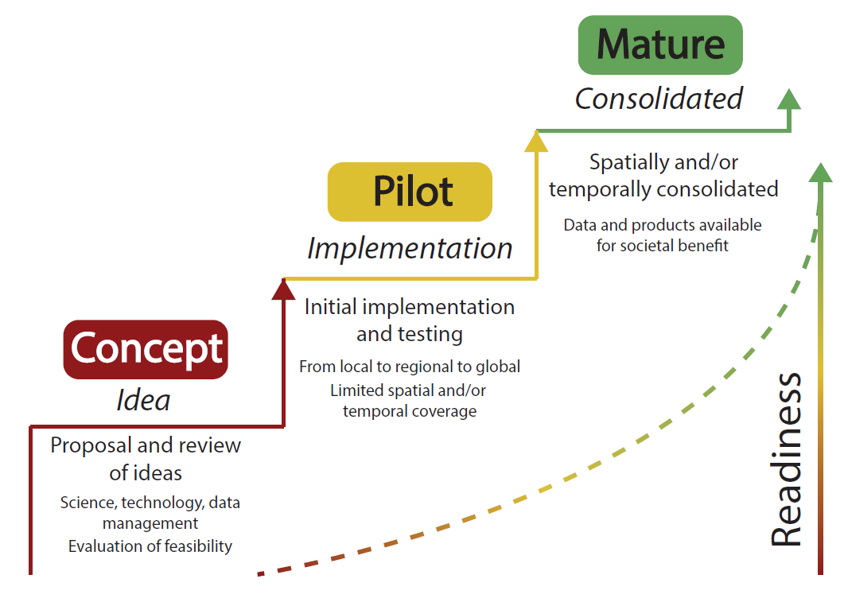
Framework for Ocean Observing
A systems approach

Slide 5



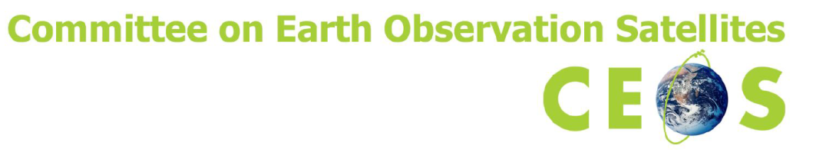
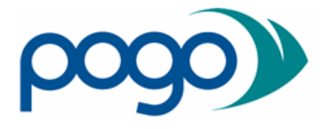


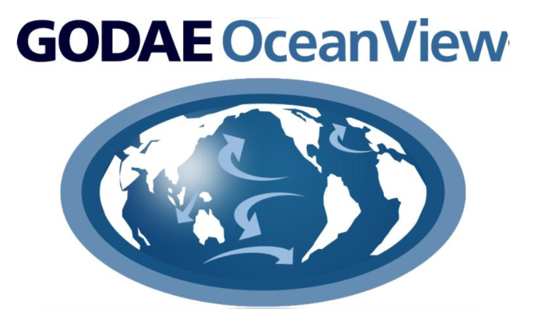

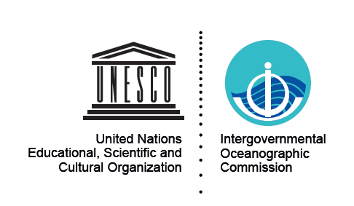
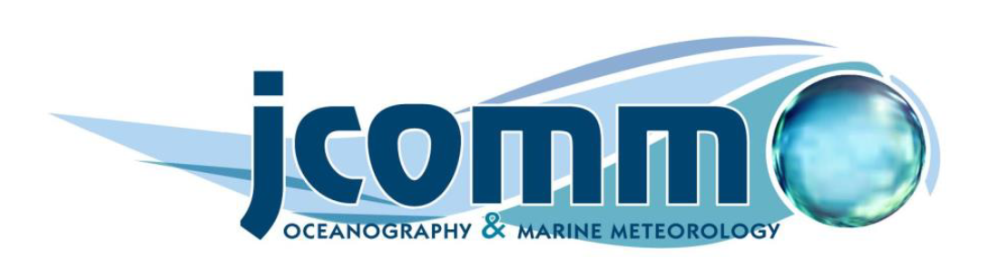
Who are the partners in todays OO Governance?
The Global Level, some examples

Slide 6
The current governance system?
Since ocean observations, in EEZ’s and international waters, are largely funded and implemented by nations, it is essential that coordination and governance of a global ocean observing system meets the needs of nations and a diverse group of stakeholders.
The governance of this system needs to embrace the complete value chain of ocean observations from requirement setting and system design, management of observing networks, through delivery of data and information with a regular evaluation process of the system, see the Framework of Ocean Observations.
During recent years the scope of ocean observations has increased including physics, biogeochemistry and biology, driving increased complexity of the system.
The current ocean observing governance have evolved over time with duplication, and varying degrees of clarity, responsibility and coordination.
Weaknesses
Loosely coordinated
Lack of clear responsibilities
Fragmented
No clear governance structure
Fragile funding
Strengths
Transparency (?)
User oriented networks

Slide 7
What would a more effective and well-structured governance arrangement look like?
Can the existing system be modified?
Do we need to rebuild it from scratch?
An effective governance system would:
promote cooperation and coordination, including end-users,
facilitate best practice and support open and timely data management,
provide for regular review of information delivery, and how all components, including satellites, perform and are integrated.
It would recognize the different scales from:
a) local to regional to
b) basin-scale and
c) global-scale.
Governance should be purposeful and respect intergovernmental agreement but be nimble, efficient and effective, include non-governmental actors, with a collective focus on achieving effective and sustainable implementation. It will provide authoritative guidance and be transparent and inclusive, and provide clear and strong leadership.

Slide 8
Some principles
Stakeholder engagement. The different stakeholder groups must be identified, addressed and clearly met by an integrated Atlantic Ocean observing system to develop the needed ocean information products.
Collaboration and coordination: The stakeholder groups should form defined partnerships to define the roles and responsibilities of the partners and to extend and enhance the observational capability of the network or system.
Open and transparent: All partners must recognize and agree to their participation, see their roles and understand their expected contributions and benefits to be derived from the observing network or system.
Flexible and responsive: The observation network or system should be adaptive and responsive and have the ability to change in response to a shifting ocean environment and societal needs and structures.
Open and free data and information: The ocean observation network or system should support and promote the open exchange of data to ensure that the maximum benefit is derived from the data collected.
Fully integrative: The network or system should bring together all the different observing components, partners and clients to ensure that all of their interests are best met and that the maximum value is derived from each component.
Reliable commitment for a 5-10 year period: An effective ocean observation network or system requires reliable funding to ensure that it is efficient and sustainable.

Slide 9
What are the characteristics of good governance?
A sustainable governance structure that facilitates different networks and systems to work closer and more effectively together
Three dimensions
The ocean observing system itself
diverse resource engagement
an ocean information system
The governance system must be balance the top-down development and intergovernmental relations together with bottom-up inclusion of the scientific community and operators of observing networks and stations.
Ultimately, ocean observing is a global enterprise that relies on the contributions of many countries working cooperatively.

Slide 10
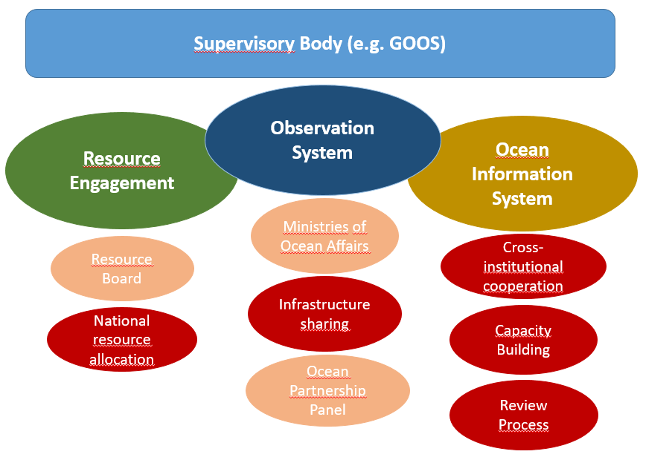

Slide 11
Final thoughts
It is a pragmatic challenge as to how to move forward building upon existing structures so that we do not waste effort by working to ‘reinvent the wheel’ but at the same time ensure that we follow the key principles that are needed to ensure sustainability.
It may be too late to develop a fully new governance structure as there are just too many existing structures and systems already in place, from the local to the regional to the global scale.
Care has to be taken to build a basin-scaly system that can integrate all the relevant existing structures but may evolve to attain the desired governance structure.

