Slide 1
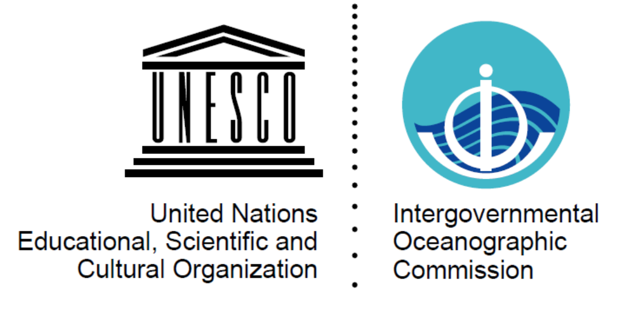


Monitoring and Assessment – Biology and Ecosystems
Patricia Miloslavich, Nic Bax, Sam Simmons, Ward Appeltans & GOOS BioEco Panel
http://goosocean.org/
Daniel Dunn

Slide 2
GOOS 2030 Strategy – Vision
A truly global ocean observing system that delivers
the essential information needed for our sustainable
development, safety, wellbeing and prosperity

Slide 4
GBR Integrated Monitoring Framework
Hedge et al. 2017

Slide 5

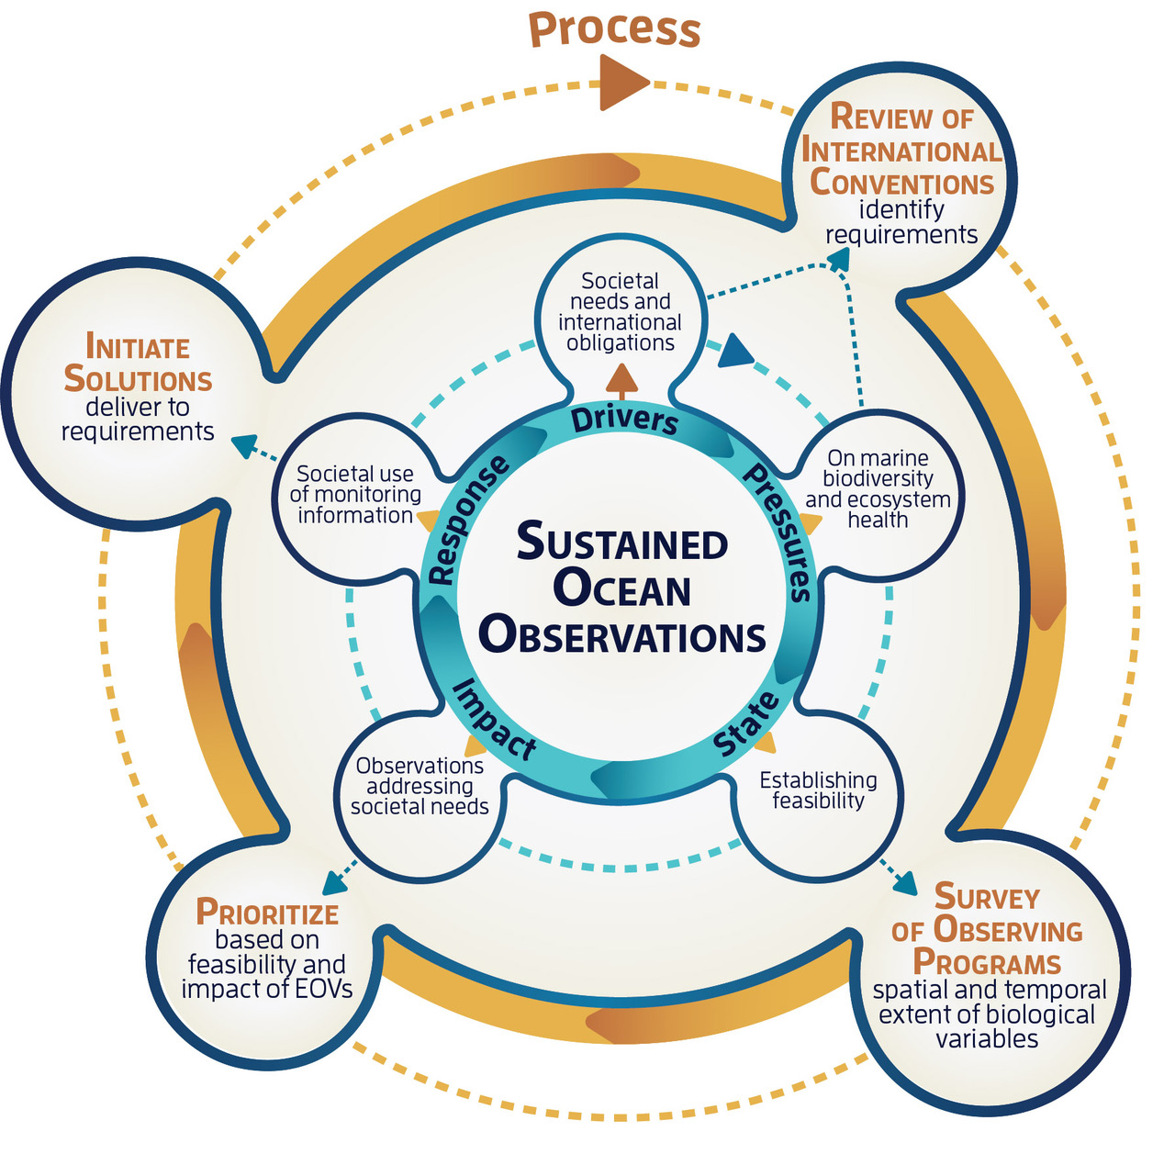

















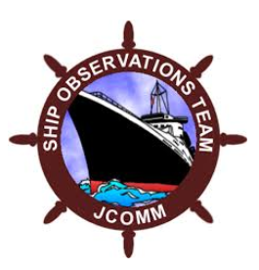




















Biology and Ecosystems Panel
EOV
Specifications sheets:
Sub-variables
Derived products
Methods
Networks
Data & information
N=24 conventions
Papers (1995-2016)
Drivers: 12000+
Pressures: 65000+
Variables: 7000+
N=104 observing programs

Slide 7
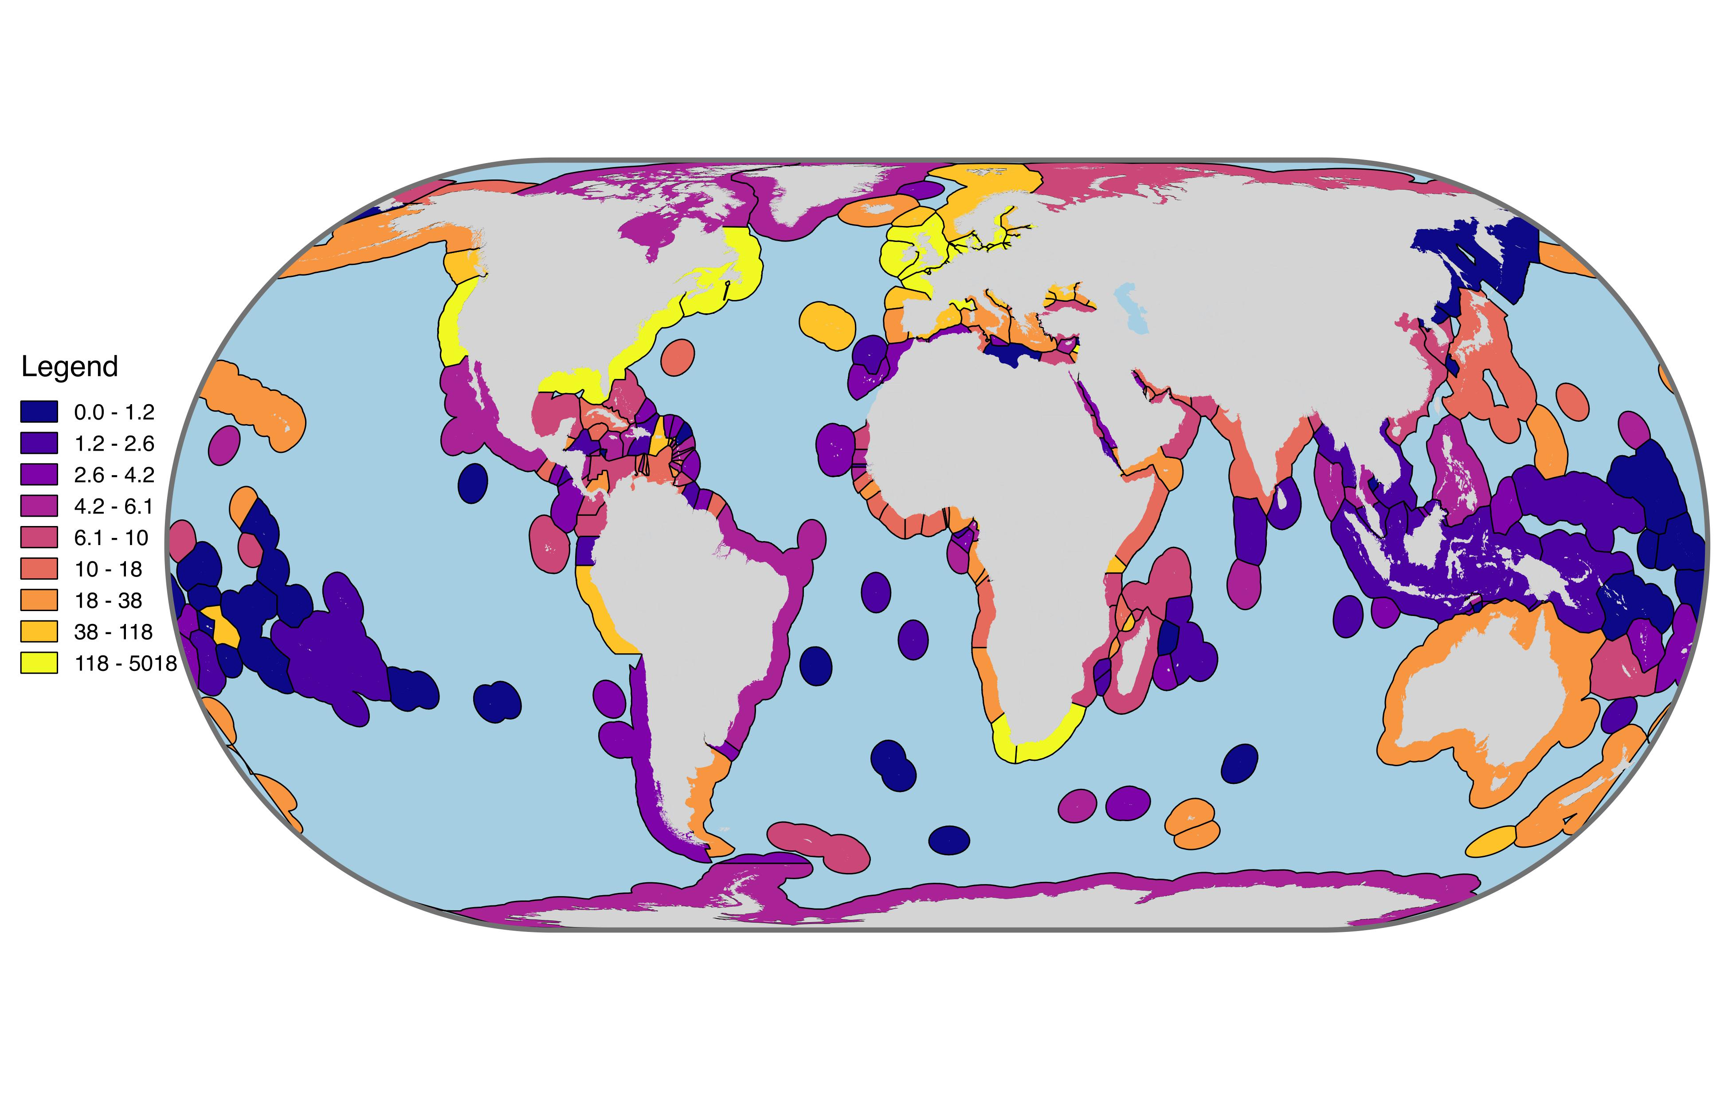
# OBIS records per country

Slide 8
Conclusions
Integrated monitoring requires clear monitoring objectives
Assessment of monitoring systems needs to reference those objectives
GOOS Biology and Ecosystem EOVs are based on defined user needs (as are other monitoring systems following the FOO)
Potential for assessing impact at many levels in a hierarchy from measurement through reporting to uptake and impact
May need hierarchical monitoring system that allows us to report progress at different levels
Starting at lowest step on hierarchy – sampling coverage and data accessibility (November 2018)(but consider higher levels as well)
Interpret in context of GOOS Vision
Much work to do

Slide 9

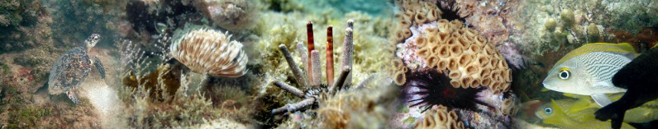
Valerie Allain – Pacific Community – New Caledonia
Sonia Batten – SAHFOS - Canada
Lisandro Benedetti-Cechi –UP - Italy
Dave Checkley – Scripps – USA (Retired)
Sanae Chiba – JAMSTEC - Japan
Dan Costa – UCSC - USA
Daniel Dunn – Duke University - USA
Emmett Duffy – Smithsonian - USA
Raphael Kudela – UCSC - USA
Frank Muller-Karger – USF - USA
David Obura – CORDIO – Kenya
Lisa Maria Rebelo – IWMI - Laos
Yunne Shin – IRD - France
GOOS BioEco Panel
Chairs: Nic Bax and Samantha Simmons
Project Officer: Patricia Miloslavich
Secretariat: Ward Appeltans
http://goosocean.org/

Slide 10
 | Targets |  | Indicators
14.1 | By 2025, prevent and significantly reduce marine pollution of all kinds, in particular from land-based activities, including marine debris and nutrient pollution | 14.1.1 | Index of coastal eutrophication and floating plastic debris density
14.2 | By 2020, sustainably manage and protect marine and coastal ecosystems to avoid significant adverse impacts, including by strengthening their resilience, and take action for their restoration in order to achieve healthy and productive oceans | 14.2.1 | Proportion of national exclusive economic zones managed using ecosystem-based approaches
14.3 | Minimize and address the impacts of ocean acidification, including through enhanced scientific cooperation at all levels | 14.3.1 | Average marine acidity (pH) measured at agreed suite of representative sampling stations
14.4 | By 2020, effectively regulate harvesting and end overfishing, illegal, unreported and unregulated fishing and destructive fishing practices and implement science-based management plans, in order to restore fish stocks in the shortest time feasible, at least to levels that can produce maximum sustainable yield as determined by their biological characteristics | 14.4.1 | Proportion of fish stocks within biologically sustainable levels
14.5 | By 2020, conserve at least 10 per cent of coastal and marine areas, consistent with national and international law and based on the best available scientific information | 14.5.1 | Coverage of protected areas in relation to marine areas

Slide 11
Global NWP High-resolution NWP Nowcasting Sub-seasonal to Longer-range Fc Aeronautical Meteorology Forecasting Atm Composition Monitoring Atm Composition Atmospheric Composition Urban Ocean Applications (JCOMM) Agricultural Meteorology Hydrology Climate Monitoring Climate Science Space Weather
The WMO Rolling Review of Requirements (RRR) process
Observing capabilities
User requirements for observations
User requirements for observations
User requirements for observations
User requirements for observations
Gap Analyses
(Statements of Guidance)
Implementation Plan
Long-term Vision for global observing systems
Programmes of Members and Agencies
Erik Andersen
Notes:
And this is what we deliver to our community at a glance...

Slide 12
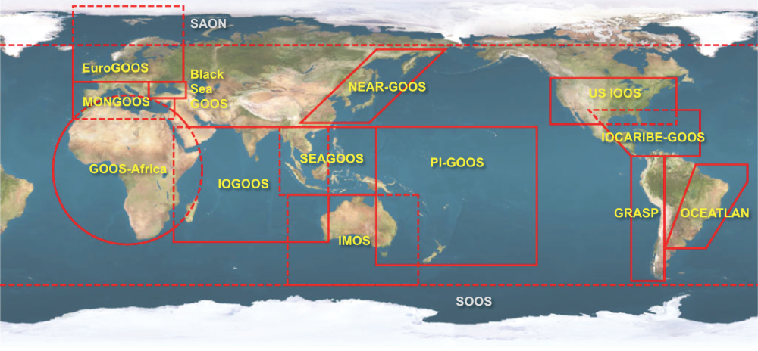
13 GOOS Regional Alliances + 2
Formed in 1994 under Intergovernmental Oceanographic Commission of UNESCO (meet every 2 years)
Notes:
OOPC: Ocean Observations for Physics and Climate
IOCCP: International Ocean Carbon Coordination Project
JCOMM: Joint Technical Commission for Oceanography and Marine Meteorology
NEAR-GOOS: The North-East Asian Regional GOOS (NEAR-GOOS) is a regional pilot project of the Global Ocean Observing System (GOOS), and is implemented by China, Japan, the Republic of Korea and the Russian Federation.

