Slide 1
The Global Observing System for Climate
GCOS Requirements Process, OOPC’s Phenomena based reviews.
Essential climate variables, indicators and actions in the 2016 GCOS implementation plan to support the Paris Agreement goals
Katy Hill, Bernadette Sloyan, John Wilkin.

Slide 2
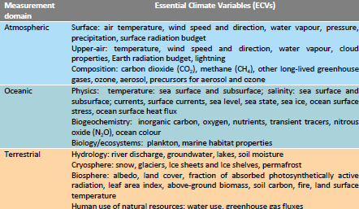
Identify key parameters - Essential Climate Variables (ECV)
Parameters that need to be observed in order to monitor the state and changes of the global climate system; to support planning for adaptation to, and mitigation of, climate change; and to communicate the state of the climate system and its changes.
Consider observational needs of users planning adaptation to, and mitigation of, climate change, at global, regional and national levels.
For each ECV specify the products required and their requirements, at global and, if needed, regional and local scales (e.g. resolution, accuracy and stability)

Slide 3
new GCOS Implementation Plan aims to improve monitoring of Global Climate Cycles
Carbon Budget
Quantify fluxes of carbon-related greenhouse gases to +/- 10% on annual timescales
Quantify changes in carbon stocks to +/- 10% on decadal timescales in the ocean and on land, and to +/- 2.5 % in the atmosphere on annual timescales
Global Water Cycle
Close water cycle globally within 5% on annual timescales
Global Energy Balance
Balance energy budget to within 0.1 Wm⁻² on annual timescales
Explain changing conditions of the biosphere
Measured ECVs that are accurate enough to explain changes of the biosphere (for example, species composition, biodiversity, etc.)

Slide 4
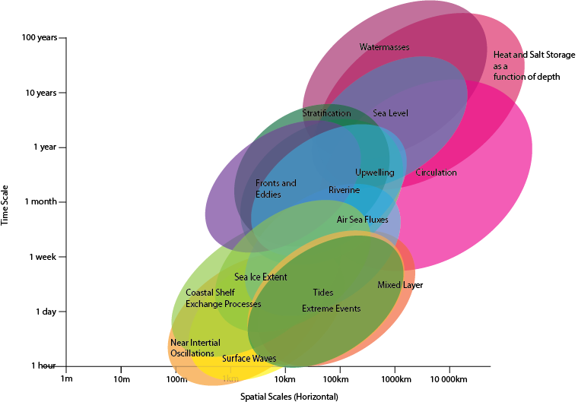
Phenomena to capture

Slide 5
Why Phenomena Based Reviews?
GCOS Requirements:
‘Product Requirements’: Global space/time/accuracy requirements by ‘sub variable’.
Performance assessed against these requirements (does the observing system in combination, meet these space/time/accuracy requirements?).
Enthusiastically embraced by Space Agencies.
Hard to highlight need for spatial heterogeneity of observations in GCOS requirements.
OOPC’s Observing system evaluations:
Focussed on phenomena: e.g. our ability to meet requirements for capturing changes in ocean heat and freshwater content.
From monitoring global multidecadal climate change signal.
Enables us to consider spatially heterogenous requirements.
To regional heat content on monthly timescales for informing tropical cyclone forecasts.
See also:
TPOS 2020: revised design focussed on requirements for capturing ‘regimes’.

Slide 6
The Global Observing System for Climate
Thank you
gcos.wmo.int

Slide 7
Extra Slides (GCOS IP)

Slide 8
Ensure that the climate system continues to be monitored
Improve global, regional and local long-term climate forecasts
Support planning for adaptation & mitigation
Improve the provision of useful information to users
Identify and observe additional parameters
Improve the communication of the state of the climate
aims of the 2016 implementation plan
adaptation is a key driver and cuts across these areas
2016 GCOS implementation plan

Slide 9
GCOS IP: Ocean Chapter
Overview section
‘The role of the ocean in the climate system’
Overarching actions (O.S. Development and review, data management, products and reanalyses)
EOV Section
Actions by ECV (Draw on EOV Specification Sheets)
Observing System section
Actions by Observing Network or Satellite Constellation (Draw on Network Specification sheets
Annex 1: ECV Product Requirements
Product Definitions
Product requirements (time/space resolution, accuracy and stability)

Slide 10
EOV Action:
Action O9: Upper-ocean temperature observing system
Action: Maintain a global upper ocean (0-2 000 m) temperature observing system for the assessment of ocean temperature and heat content change and its contribution to sea-level rise
Benefit: High-quality ocean temperature time series for accurate estimates of annual ocean heat storage as a function of depth and its spatial distribution to assess the role on the ocean in the Earth’s energy balance and ocean warming contribution to sea-level change
Time frame: Continuous
Who: Parties’ national agencies working with GOOS observational networks (Drifters, CEOS, Argo, SOOP, OceanSITES), in cooperation with the Observations Coordination Group of JCOMM.
Performance indicator : Spatial coverage, interoperability of observations platforms, annually updated global upper-ocean temperature records
Annual cost: US$ 30–100 million

Slide 11
Observing System action: (In Situ)
Action O37: Argo Array
Action: Sustain and expand the Argo profiling float network of at least one float every 3° x 3° in the ocean, including regional seas and the seasonal ice zone (approximately 3 800 floats)
Benefit: Global climate-quality observations of the broadscale subsurface global ocean temperature and salinity down to 2 000 m
Time frame: Continuous
Who: Parties participating in the Argo programme and in cooperation with the JCOMM Observations Coordination Group
Performance indicator Spatial coverage and number of active floats
Annual cost: US$ 30 million

Slide 12
ECV Product Requirements (Annex 1)

Slide 13
ECV Product Requirements (Annex 1)

Slide 14
ECV Product Requirements (Annex 1)

Slide 15
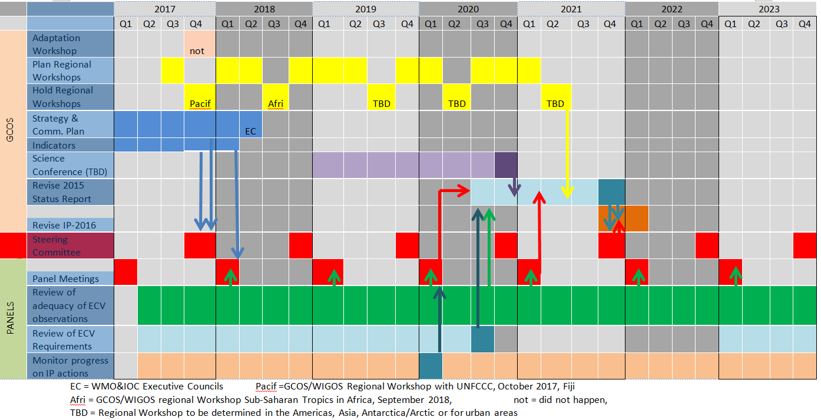
Time Plan
.

