Slide 1
Assessment and evaluation of the observing system: Copernicus Marine Service & Atlantos perspective
P.Y. Le Traon, Mercator Ocean
7th GOOS Steering Committee, June 2018

Slide 2
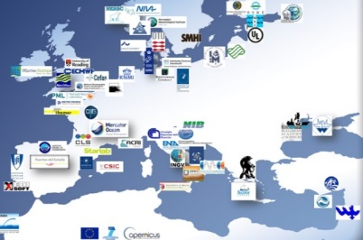
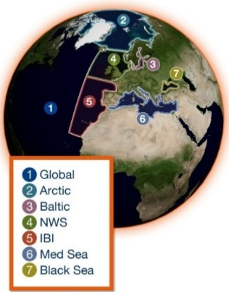
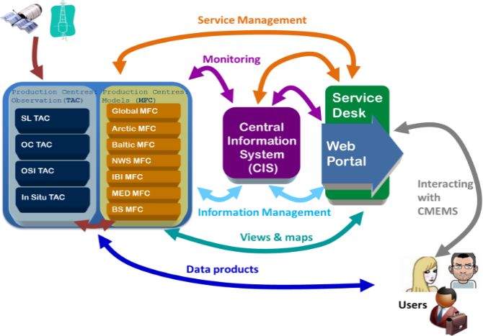
The Copernicus Marine Service
A state of the art and user driven Copernicus service
Operational and scientifically assessed
Observations (satellite, in-situ) and models (analyses/forecasts)
Physics and Biogeochemistry
A network of European producers
A single catalogue: Worldwide and European-wide coverage
A central information system to search, view, download products and monitor the system
A service desk to support users who relies on a network of technical & marine experts
Generic to serve a wide range of downstream applications. More than 12 000 subscribers.

Slide 3
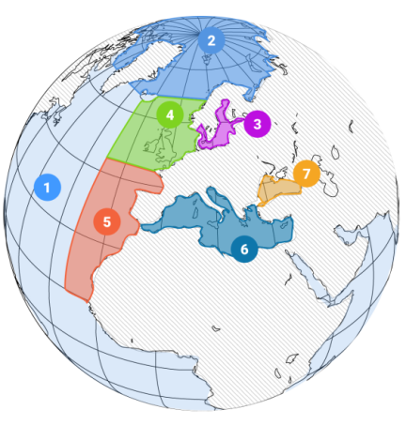
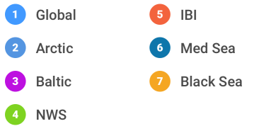
The Copernicus Marine Service
MULTI-YEAR
10 to 45 years
REAL-TIME
Daily, hourly
FORECAST
2 to 10 days
ESSENTIAL MARINE VARIABLES
Physics
Sea-ice
Waves
Biogeochemistry
Observations
In-situ & Satellites
Numerical models & data assimilation
Open and Free access

Slide 4
Assessing the impact of observations
Observation impact studies are performed to:
verify that observation information is « optimally » used in the analysis step and improve the assimilation components
quantify the impact of the present observation network in ocean analysis and forecasts,
demonstrate the value of an observation network for operational ocean analysis and forecasts,
help defining and testing future observing systems from an integrated system perspective involving satellite and in-situ observations and numerical models.
OSEs (Observing System Evaluations) => assessing the impact of existing data sets on a data assimilation system (by withholding observations). Alternative approaches (e.g. DFS) are also developed and will be more systematically used.
OSSEs (Observing System Simulation Experiments) => help designing new observing systems and to perform preparatory data assimilation work.

Slide 5
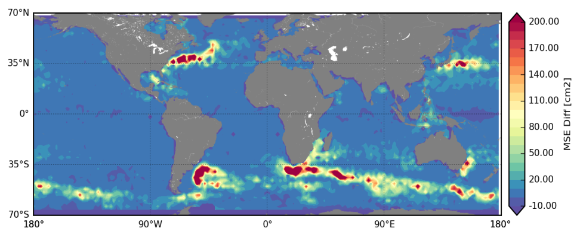
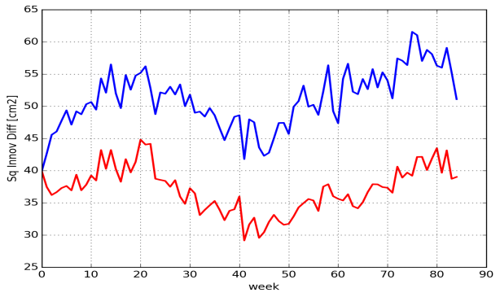
Impact of the altimeter constellation (OSE)
Studies performed to assess the impact of the number of altimeter on the quality of ocean analyses and forecasts.
Forecast error is divided by 2 when moving from 1 to 4 altimeters.
Hamon et al., 2017
7-day sea level forecast errors : PSY3OSE1 - PSY3OSE4
Variance of 7-day sea level forecast error

Slide 6
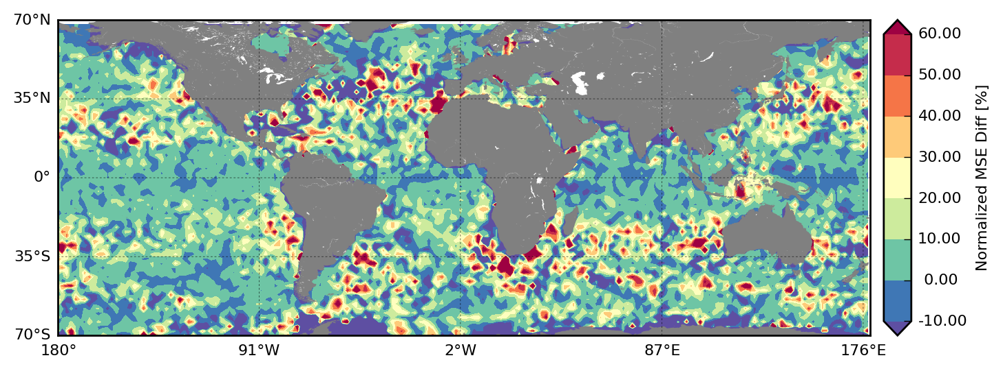
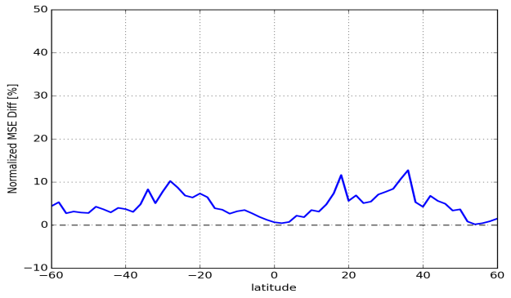
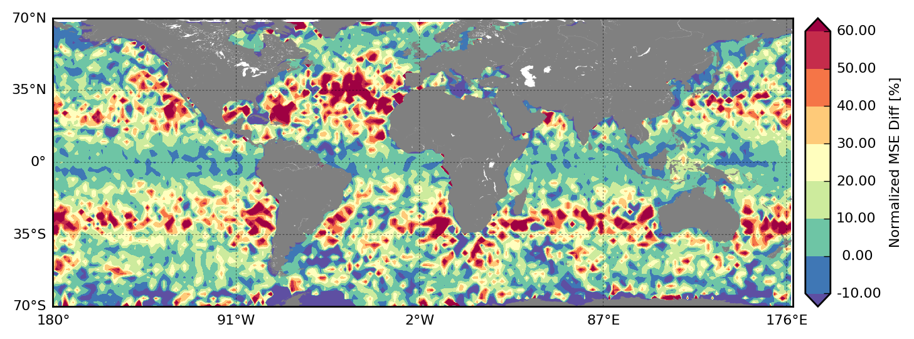
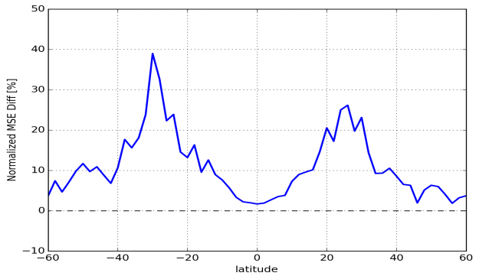
Impact of the altimeter constellation (OSE)
Contribution of a 4th altimeter in a 1/4° model and a 1/12° model (Hamon et al., 2017): Reduction of 7-day forecast errors in % wrt to a 3 satellite configuration.
PSY3
PSY4

Slide 7
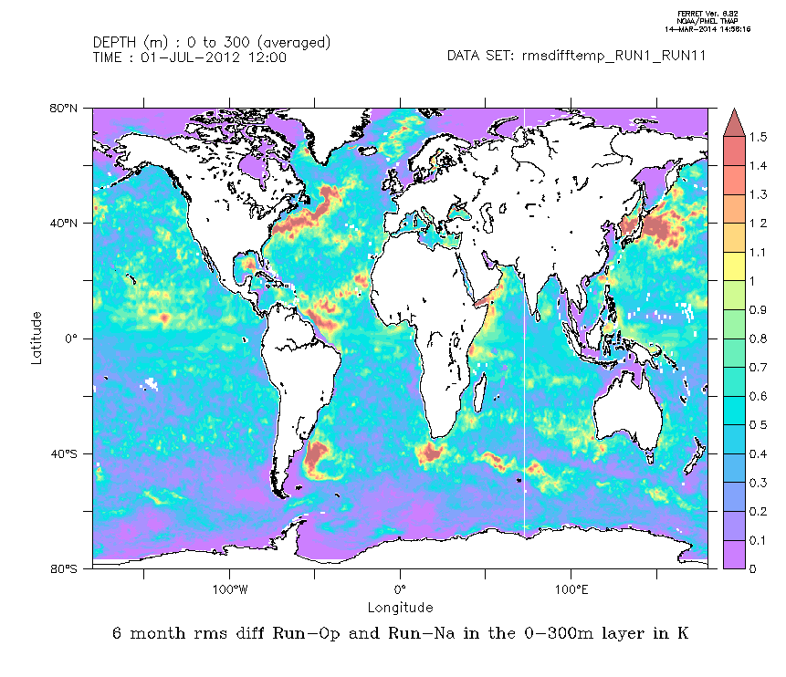
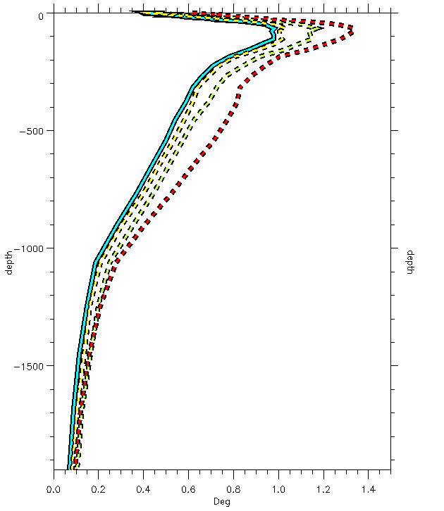
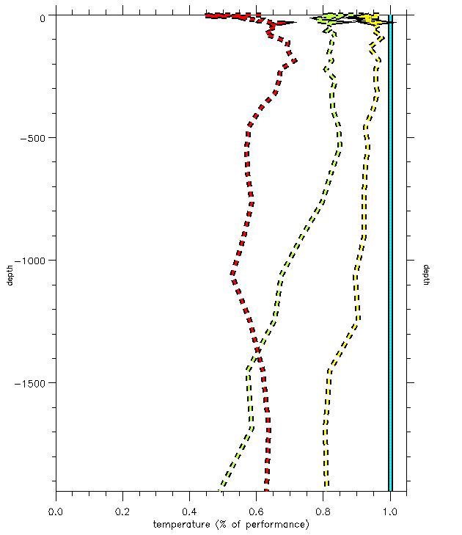
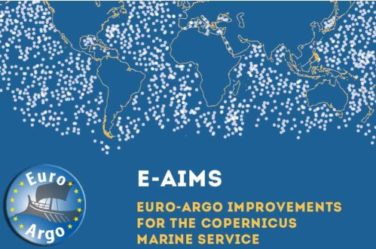
Impact of Argo for the Copernicus Marine Service
1-year OSEs with the Mercator Ocean global ocean ¼° analysis and forecasting system (Turpin et al., 2016). Impact of the assimilation of Argo floats and their density.
RMS of 0-300 m temperature differences between Run-Ref and Run-NoArgo
Absolute (left) and normalized (right) RMS of temperature innovations for Run-Ref(blue), Run-Argo/2(yellow), Run-NoArgo (green) and Free Run (red)
Temperature and Salinity forecast errors are reduced by 20% to 60% when Argo float are assimilated. Keeping only half of the Argo floats degrades significantly the analysis.

Slide 8
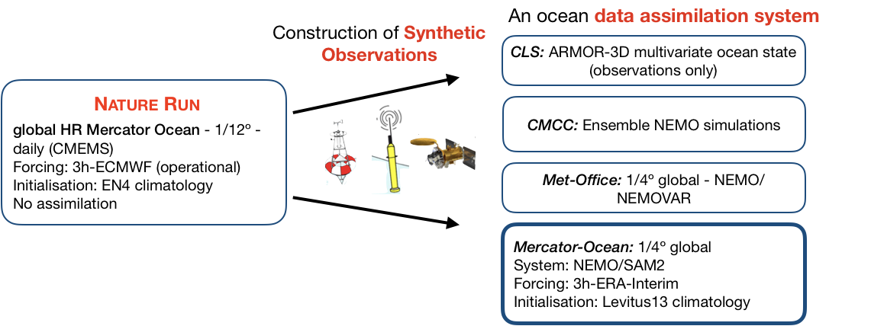

Observing System Simulation Experiments in AtlantOS (physics)
➔ Multi-models / multi-approaches exercise considering the same synthetic observations

Slide 9
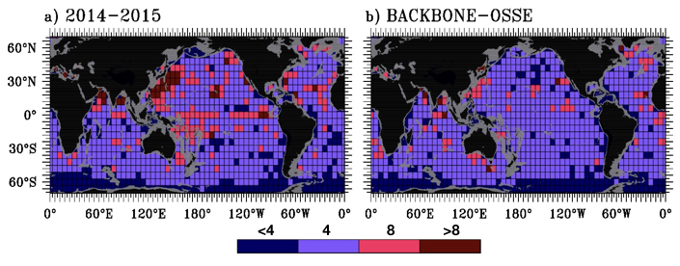
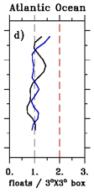
A set of 3-year OSSE Experiments
OSSE1 – BACKBONE (Satellites+Argo+Mooring+XBT)
OSSE2 – ARGO2X (BACKBONE + Enhancing WBC and Equatorial regions)
OSSE3 – DEEP4000 (BACKBONE + Extension to 4000m)
OSSE4 – DEEP6000 (BACKBONE + Extension to 6000m)
Construction of synthetic observations by subsampling the Nature Run at the space and time location of each observation (SSH, SST, Argo, Mooring, XBT)
Addition of realistic errors on synthetic observations (instrumental + representativity errors) following observing network recommendations
OSSE1: Experiment BACKBONE (SSH, SST, Argo, Mooring, XBT)
Number of floats per 6ºx6º square from the CORA4.3 data set, and from the synthetic BACKBONE design

Slide 10
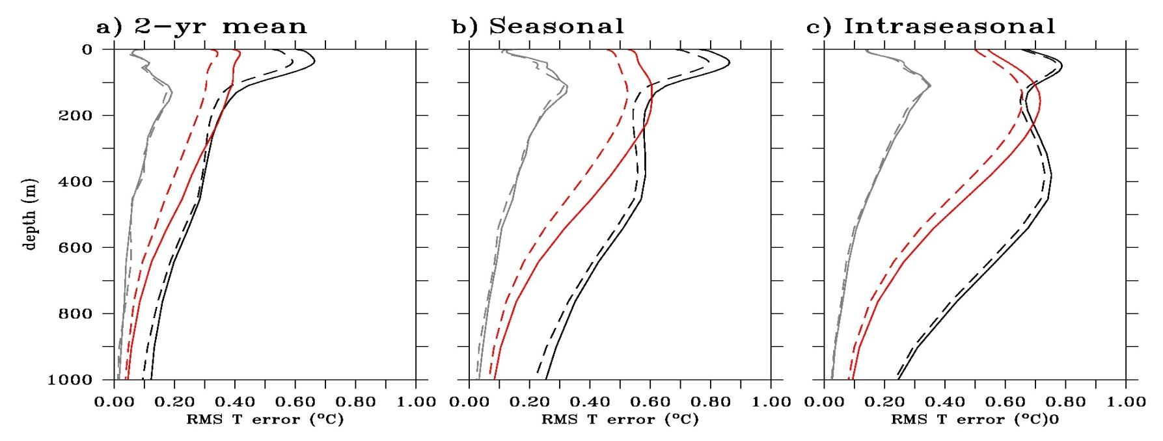
Doubling of Argo in WBC and EQUATORIAL (3s-3n) regions
Temperature RMS diff. area-averaged in the Gulf stream, the Brazil Current, and the Equatorial Atlantic for representing the 2-yr mean, and seasonal and intraseasonal variability
~ 10 % of error reduction
~ 10 % of error reduction
~ 10 % of error reduction
Impact limited along the equator possibly reflecting (i) statistics on a too short period, (ii) a “simple” dynamic mostly controlled by atmospheric forcing, (iii) role of altimetry.
Effective impacts in WBC for 0/2000 SH, Temperature and salinity at different time scales
Brazil Current region is more affected by doubling Argo floats

Slide 11
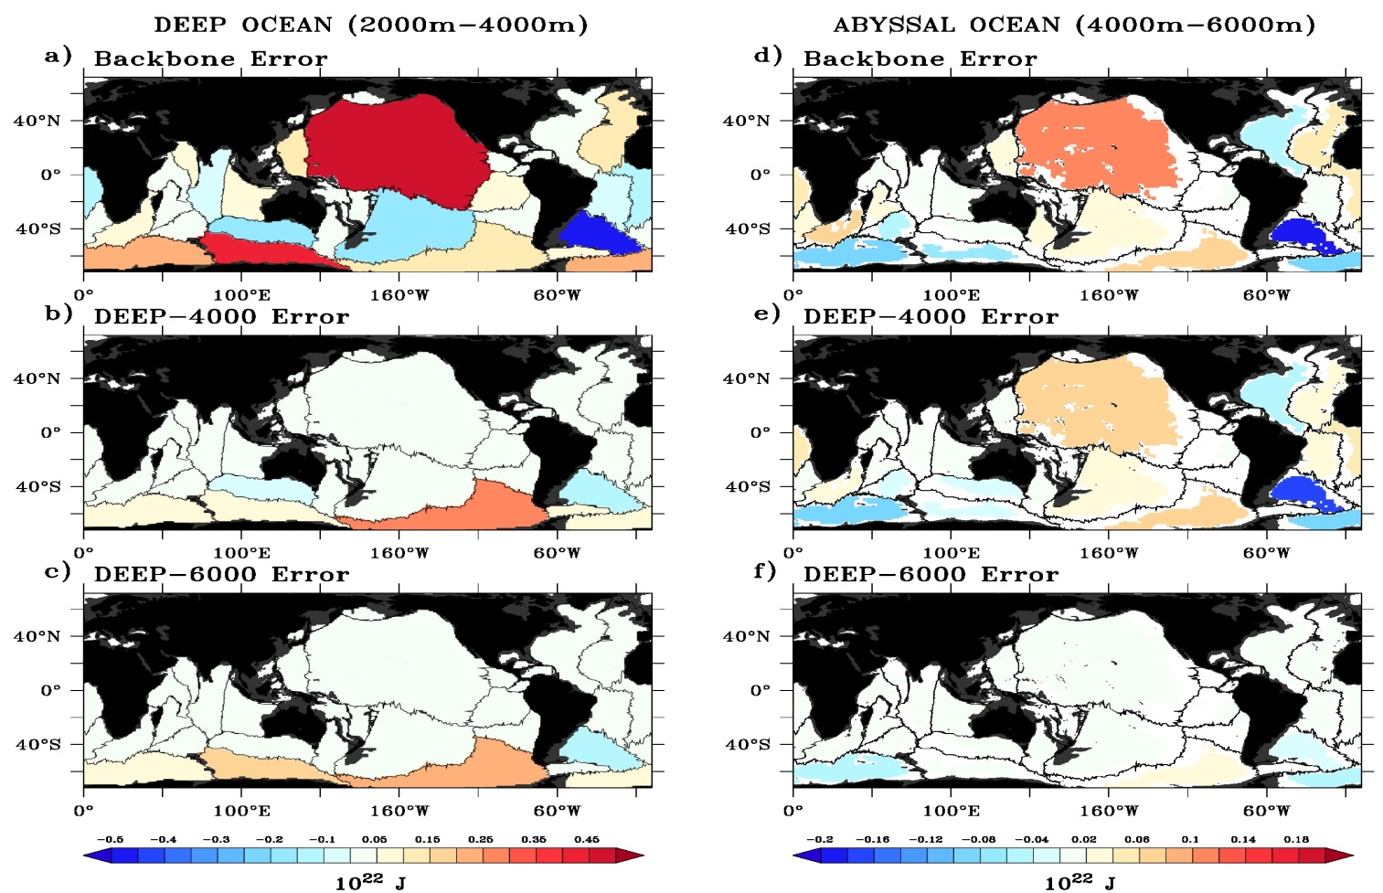

The extension of Argo into the deep ocean
2010 OHC error in the deep and abyssal oceans for the Backbone, DEEP4000 and DEEP6000 experiments
Gasparin et al., 2018

Slide 12
Assesment/Evaluation of the observing system: lessons learnt and recommendations
Essential to take into account the complementarity of in-situ, satellite observations and models. Integrated approach/integrated design. Impact of observations can be quite different when a given observing system is analyzed independently from the others (e.g. altimetry already informs a lot on temperature, models do have skills, etc).
Assessing the impact of observations is becoming a regular activity of ocean forecasting centers. Time consuming activities. Need to be planned and be part of regular activities. Tools exist and provide highly useful inputs (physics/mature, bgc/in progress – data assimilation remains challenging).
Some observation types have large impacts on ocean analyses and forecasts (altimetry, Argo).
Limited impact in a data assimilation system does not mean that data are useless. Need expert and educated judgment. Limited impact could be due to limitations in data assimilation methodologies. Some data sets are critical for model validation (+ process studies).
Multiple system approaches are highly valuable but they require large and dedicated resources (e.g. Atlantos). Essential to develop robust recommendations (and develop useful collaboration between modeling teams).
International collaboration on observation assessment and evaluation. Structured partnership between GOOS and its panels and GODAE OceanView/OceanPredict and its task teams: observation evaluation and design issues, experiment design, assessment methodologies (e.g. metrics, indicators). GEO Blue Planet involvement on the user/application side (e.g. user requirements, external metrics).

