Slide 1
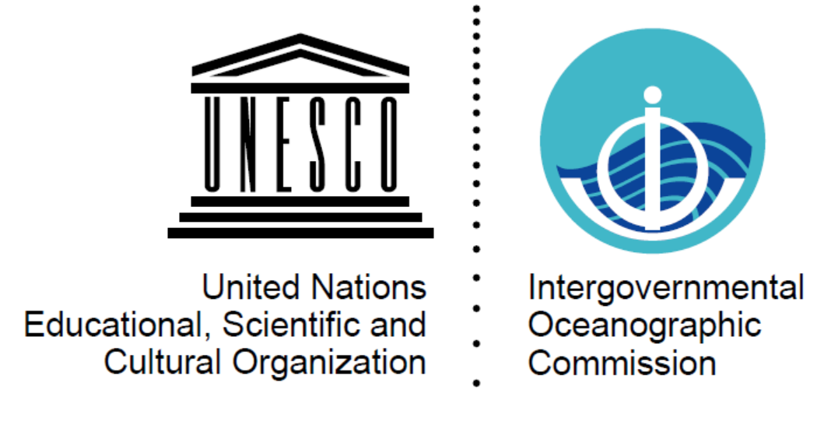

Experience with assessment and evaluation of the observing system - TPOS 2020 approach and benefits/findings
Neville Smith, Co-Chair TPOS 2020 SC (summarised by Nic)
For GOOS SC, June 2018

Slide 2
Which activities have been most valuable?
Stakeholder input and transparency (IPCC-like process) – expect diverse views and recognize value of resource forum and stakeholder consultation
MUST have clear objectives at the start against which you assess, first the requirements, then the solutions
Modelling and data assimilation need to be supplemented with expert advice, incl. GOOS/GCOS reviews, however recommendations/assessments should be objective and evidence based.
DO NOT conflate (EOV) requirements of users with required observations (networks, platforms, …); there are many viable solutions for a given set of requirements – let the providers (the observing market) compete, recognising advocacy and conflicts of interest
Beware the “Peter Pan” affect – that observations once started must then live forever lest the “record” be broken. Weigh records that have not been started as well as those that might be terminated. Resistance to change and chasing the new are equally a threat to an effective, sustainable and efficient observing system
Big picture review every ~ 7-10 years (eg. OceanObs)

Slide 3
Assessing the adequacy (of the OOS) for climate, services and ocean health
Assess/evaluate user requirements independently of adequacy of the potential response (cf. Rolling Review of Requirements [RRR] process presented by Erik A and WMO Inter Programme Expert Team on the Observation System Design Evolution as an excellent model of this in action).
Ocean community does not (yet) have the same level of modelling and assimilation tools to provide insights into impact.
TPOS jointly considered research and sustained requirements, but it is the latter that is the subject of the adequacy assessments
Research observations may be pilots or short/medium term and will contribute to solutions but let research networks mature, do not rush to sustained/operational configurations.
Multi-use and multipurpose designs (like TPOS) mean assessing the adequacy will be complex. It is rare now to have networks dedicated for a single use:
Climate – adequacy of quality must be paramount (see Katy’s contribution)
Real-time services (NWP, ocean/coastal prediction) – timeliness and delivery (see PYLT contribution).
Sustainable development and ocean health – comprehensive, multi-disciplinary aspects.
Assess adequacy in terms of fitness for purpose (Ralph Rayner).

Slide 4
Regional aspects and partnerships
TPOS is a regional observing system, supported by regional partnerships, and the global backbone (satellites, global in situ networks like Argo). WMO WIGOS and JCOMM have been important in helping TPOS find a path.
The assessment/evaluation needs to address this
Partners may be users or providers or both, and they may have global and regional interests, even local.
Clear separation between adequacy of user requirement evaluation (expressed in terms of EOVs) and of the adequacy of the solutions (expressed in terms rate/density/quality of data returns) is needed.
Stakeholders in general not unique to TPOS, or to GOOS; must factor in other observing coordination mechanisms (WIGOS, GCOS, etc.) and not expect to meet all user requirements.
Sustainability of TPOS requires a regional coordination mechanism to support need for partnerships rather than regionality of EOV requirements. This might change as global systems play an increasing role.

Slide 5
An action plan?
The RRR approach is good, particularly when we are examining global needs and solutions at the ocean surface. However, the ocean has fundamental differences in terms of circulation, structure, sustainability needs and health that will never easily fit that model. So GOOS should plan on using the RRR wherever it is appropriate, but also plan its own ocean version of RRR.
TPOS 2020 was born of an unforeseen “failure” of the TPOS (mooring degradation).
Suggest that regular risks assessments are one way of setting priorities for assessment/evaluation. A strategic approach.
Need to use a variety of tools
C.f. Erik A we have limited capability to undertake model-based objective assessment (e.g. Degree of Freedom System (DFS) or Forecast System Observation Impact (FSOI) studies). We should aspire to such, but in the meantime make use of what we do have available; that is build evidence in different ways.
PYLT will probably show examples for Atlantos where some of these tools have been used successfully.
Our lack of maturity demands flexibility.
Focus effort where reach major/critical levels and/or where use/users demand change (e.g. efficiency, improved effectiveness).
Original text

