Slide 1
GOOS STRATEGY FROM AFRICAN AND ARABIC COUNTRIES PERSPECTIVE
Prof. AFFIAN Kouadio
Remote Sensing specialist
Vice-President Felix HOUPHOUET-BOIGNY University
COTE D’IVOIRE

Slide 2
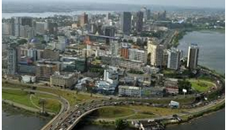
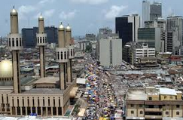
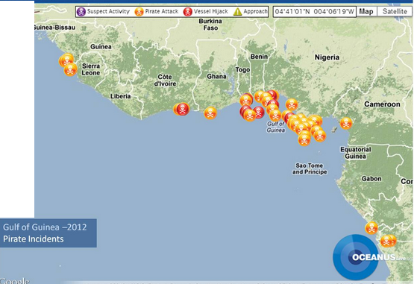
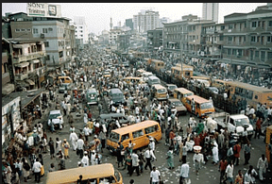
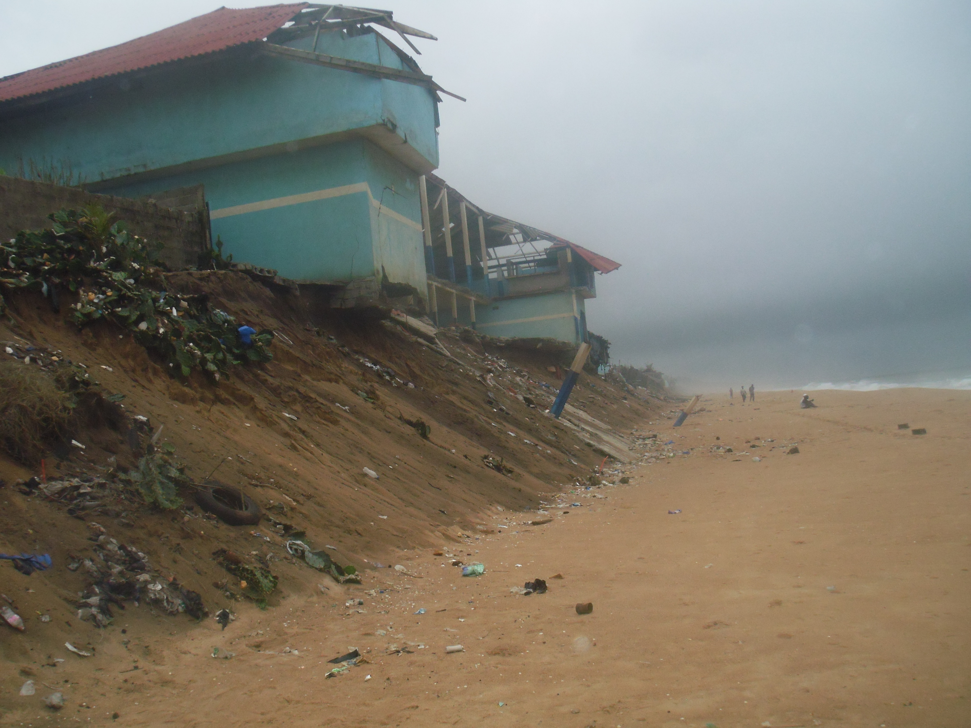
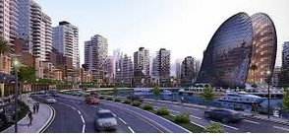
COMMON ISSUE
High population growth
Natural hazards (erosion, flooding etc..)
Environmental degradation (pollution, reduction
in water quality etc..)
Fast Urbanization,
Fisheries depletion,
habitat degradation,
coastal erosion,
loss of biological diversity and land-use.
Occurrence of piracy in the gulf of GUINEA and Gulf of Aden
Existence of Hugh offshore petroleum resource
exposure the region to oil pollution

Slide 3
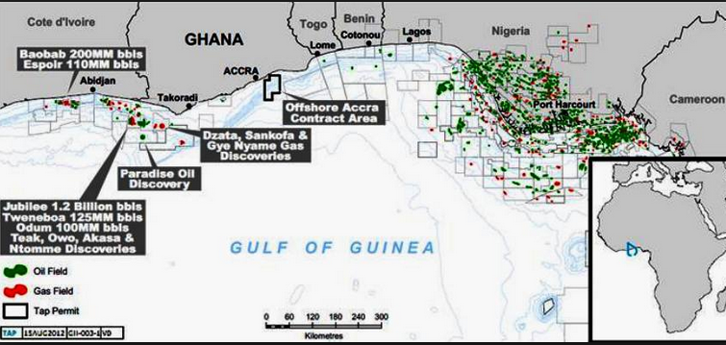
OPPORTUNITIES
The eight oil states in West Africa around the Gulf of Guinea together produce some five million barrels of oil a day and may hold as much as a tenth of the world's oil reserves.
The ocean is rich in living marine resources, with the fishing industry providing livelihood for thousands of fishermen and foreign exchange for the countries
West African Economic and monetary Union made available funds for coastal area study
WACA West Africa Coastal areas management funded by world bank

Slide 4
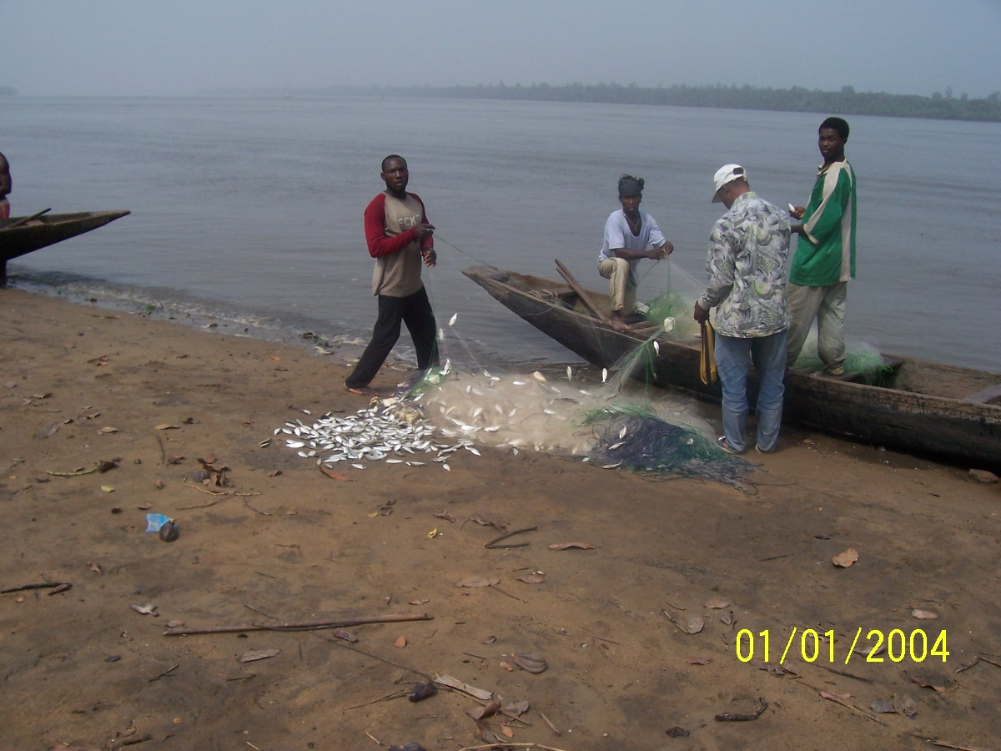
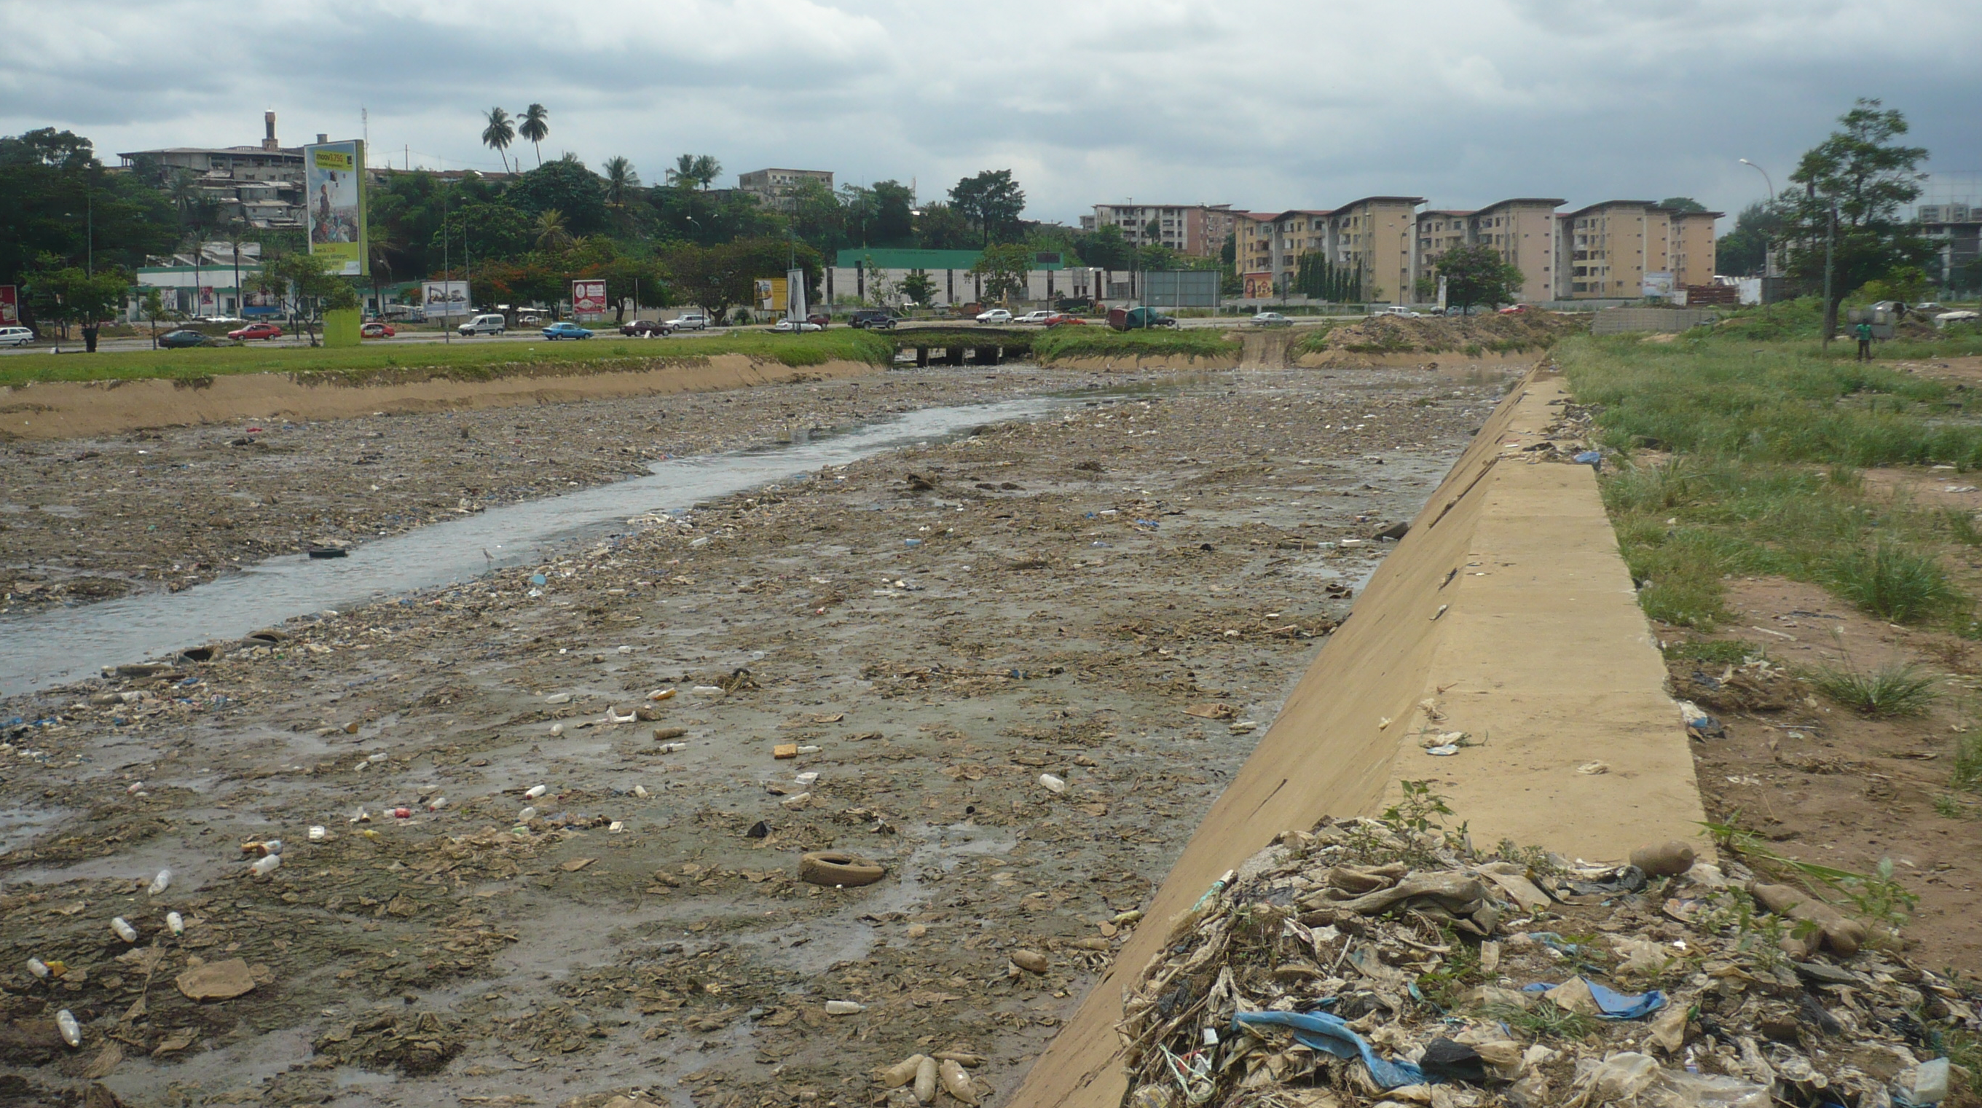
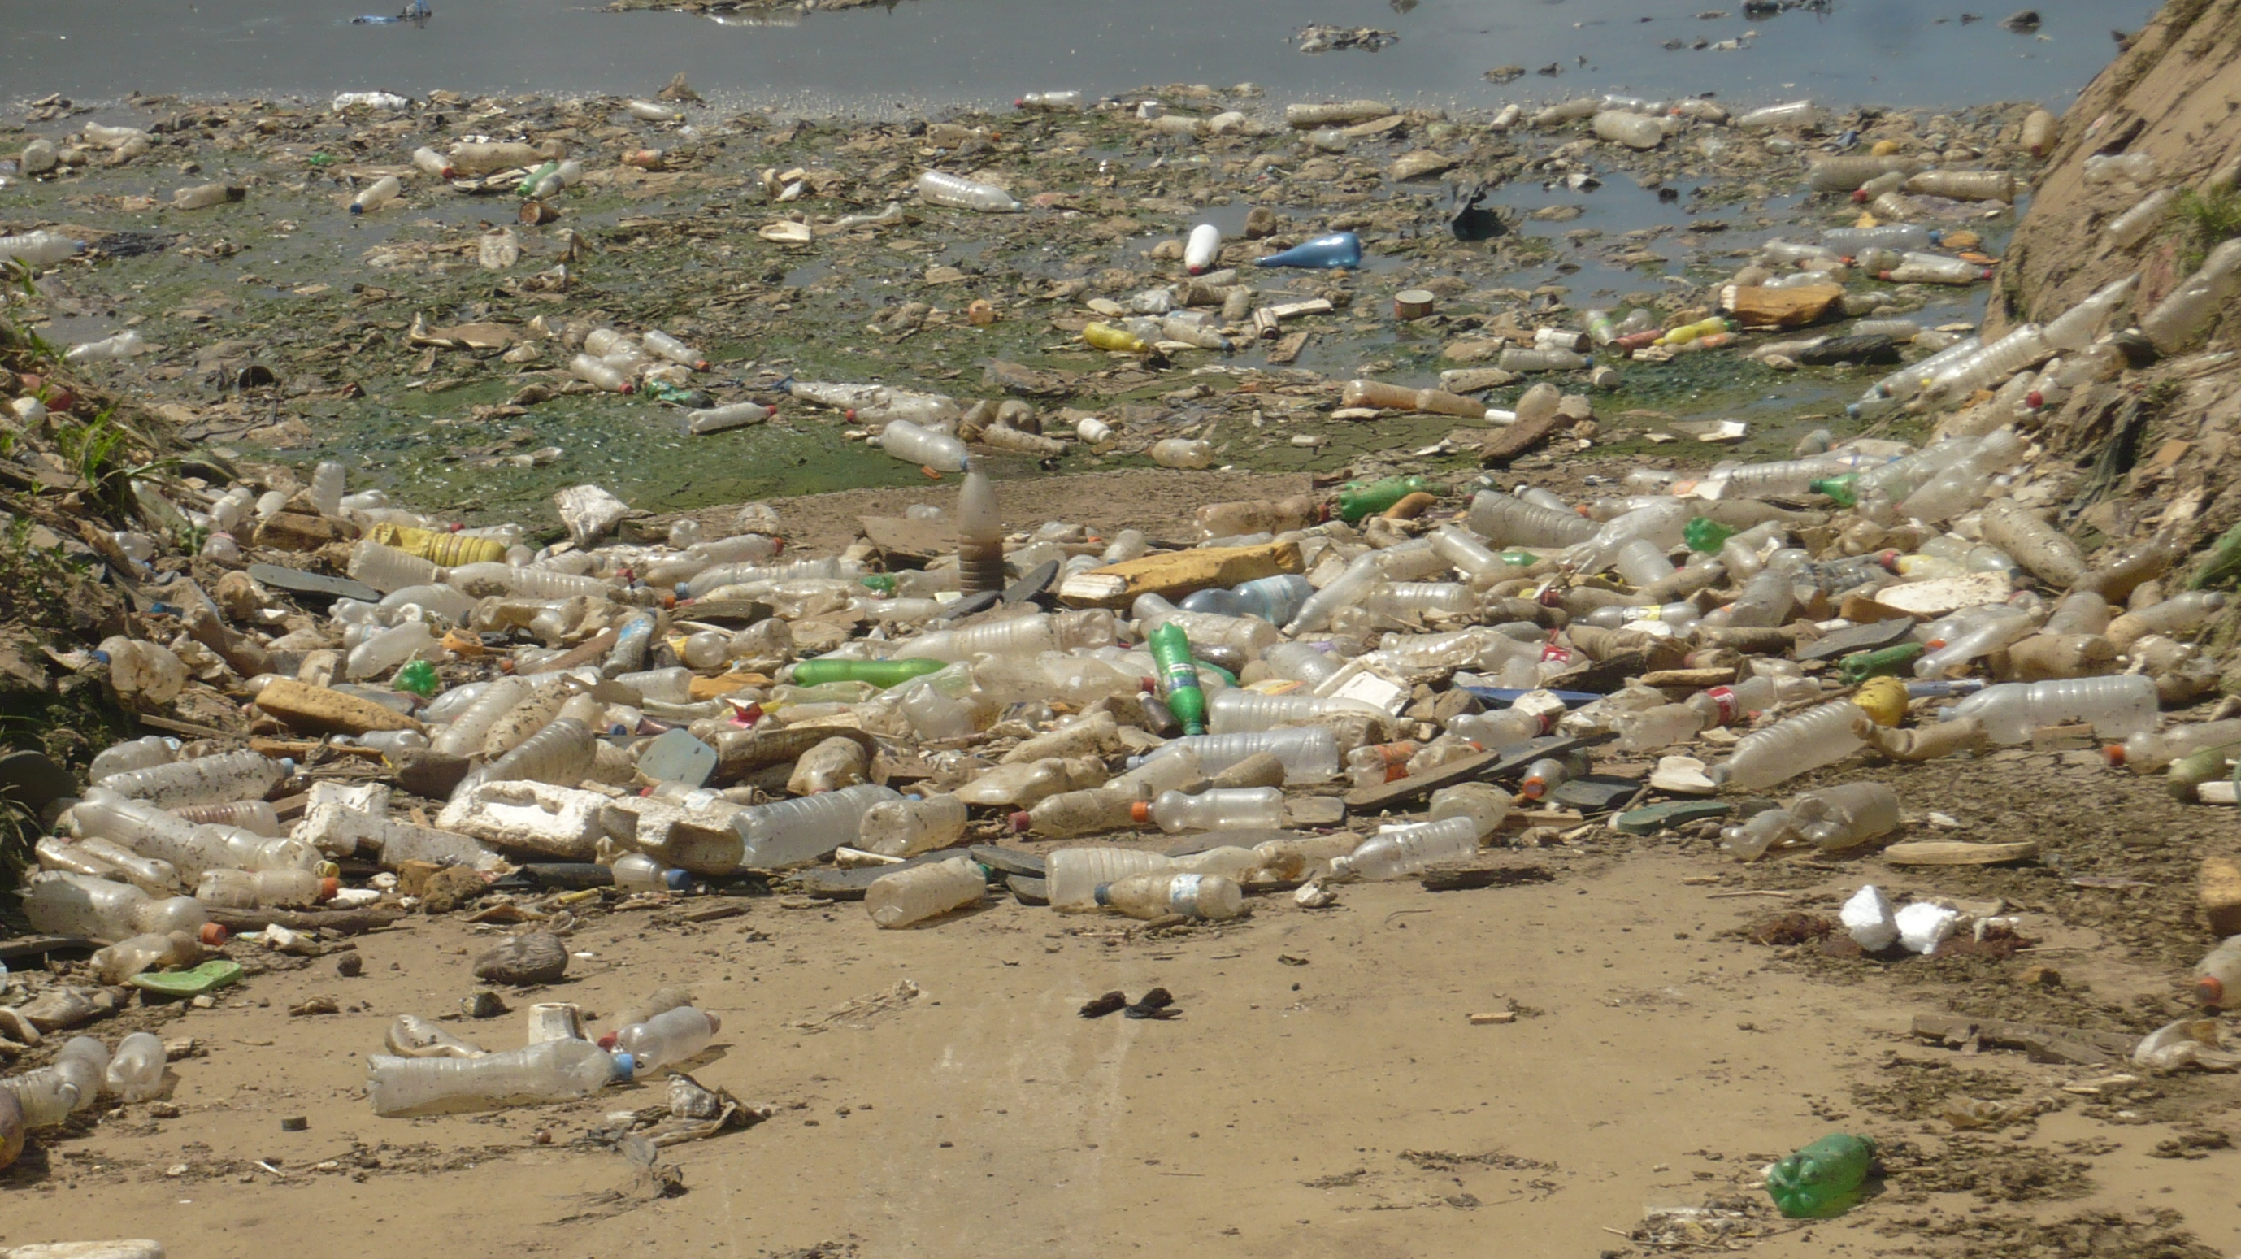
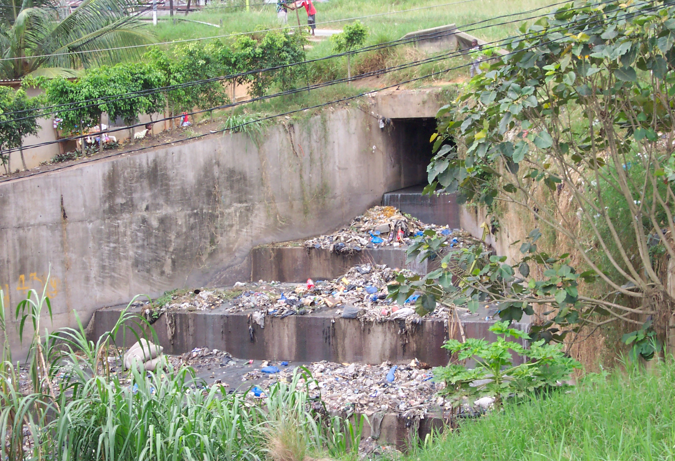
CHALLENGES
reverse declines of fish stocks and non-optimal harvesting of living resources
Reduction land based pollution
loss of ecosystem integrity arising from changes in community composition
deterioration in water quality from land and sea-based activities
harmful algal blooms
habitat destruction and alteration including modification of sea bed and coastal zone, degradation of coasts capes and coastline erosion.

Slide 5
ACTIONS TO BE TAKEN (1/2)
Cooperation with sub-regional & regional bodies;
Cooperation with Partners,Donors,etc;
Cooperation with International Organizations;
Regional consultation framework
Cumulative Impact Assessment
Development of Environmental Early Warning System;
Environmental Baseline Establishment;
Enhancing Predictability of Extreme Events;
Combating Coastal and Marine Pollution
Waste Minimization and Cleaner Technology Policy

Slide 6
ACTIONS TO BE TAKEN (2/2)
Ship Ballast Water Policy;
Protection and Conservation of Marine Biological Diversity;
Capacity Building and institutional strengthening;
Stakeholder participation;
Public participation;
Investment Actions.

Slide 7
CONCLUSION
1-How does the GOOS Strategy work from African and Arabic countries perspective?
  The group V needs fit with the new vision reflected in the strategy
  Welcome the new vision
  Fully happy with the idea that ocean affair must be treated wrdwide
  No region must be out of the wagon

Slide 8
2-Are there specific objectives that are of higher priority in Group V countries
  Coastal erosion
  Combating piracy
  Pollution
  Capacity building

Slide 9
3-What can the region help implement GOOS strategy (1/2)?
  Let Africa organize itself to participate in the implementation of the GOOS strategy
    Let the African, organise themselve to participate fully in GOOS programme
      Respect the spirit of Action 20 (GSC6); let those who have been committed to solve the political problem between GOOS Africa and IOCAFRICA doing their job. Any proposal setting aside the interim chair and the coordinating committee of GOOS Africa is doomed to failure
      Any proposal setting aside the interim chair of GOOS AFRICA and the coordinating committee of GOOS Africa is doomed to failure

Slide 10
3-What can the region help implement GOOS strategy (2/2)?
  Let GOOS AFRICA definitively play its role
  Show to decision makers the importance of the ocean in livelihood
  Fit GOOS objective with the objective of Africa Union’s science department
  get financial support from national and sub-regional organizations
  get financial support from private sectors (Oil companies, port authorities, etc..)
  Convince sub-regional banks to give their support to the implementation of GOOS strategy

