Slide 1
Seventh Meeting
Wednesday-Friday 13-15 June 2018
with Regional Workshop Tuesday 12 June 2018
INVEMAR, Santa Marta, Colombia
How does the GOOS Strategy work from a regional perspective?
Are there specific objectives that are of higher priority regionally?
What can the region help implement?
R Venkatesan
SC member Group IV
12 June 2018

Slide 2
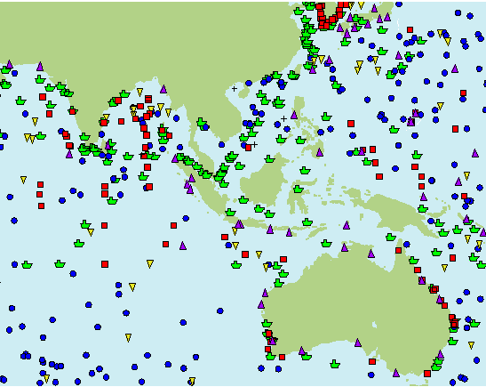
IOC Group IV
Observational platforms in IOR
Group IV
Afghanistan
Australia
Bangladesh
China
Cook Islands
Democratic People's Rep. of Korea 7
. Fiji
India
Indonesia
Iran (Islamic Republic of)
Japan
Kazakhstan
Kiribati
Malaysia
Maldives
Myanmar
Nauru
18 New Zealand
19. Niue
20 Pakistan
21. Palau
22. Papua New Guinea
23. Philippines
24. Rep. of Korea
25. Samoa
26. Singapore
27. Solomon Islands
28. Sri Lanka
29. Thailand (Somkiat Khokiattiwong)
30. Timor-Leste
31. Tonga
32. Tuvalu
33. Vanuatu

Slide 3
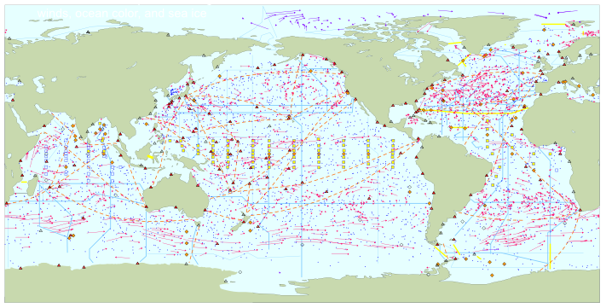
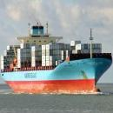
GOOS/GCOS Group IV Asia Oceania
Total in situ networks
66%
March 2015
continuous satellite measurements of sea surface temperature, height, winds, ocean color, and sea ice
100%
Surface measurements from volunteer ships (VOS)
250 ships in VOSclim pilot project
100%
Global drifting surface buoy array
ice buoys
5° resolution array: 1250 floats
40%
Tide gauge network (GLOSS committed)
Fast data
300 real-time reporting gauges
Slow/no data
GPS
39%
XBT sub-surface temperature section network
37000 XBTs deployed
100%
Argo profiling float network
3° resolution array: 3200 floats
66%
Global time series network
76%
Global tropical moored buoy network
62%
Repeat hydrography and carbon inventory
(Planned)
87 combined sites
125 moorings planned
Full ocean survey in 10 years
Representative Milestones
100%
Original goal for full implementation by 2010
30
34
40
45
48
55
56
59
60
62
62
62
62
62%
63%
System % sustained, of initial goals
2000
2001
2002
2003
2004
2005
2006
2007
2008
2009
2010
2011
2012
2013
2014
Notes:
GOOS leverages a sustained ocean observing system which is a multi-billion US dollar investment yearly. We are working together with JCOMM to expand the tracking of the status of the observing system, which here at present is focused on the global-scale observations required for climate, captured in the work of the Global Climate Observing System GCOS.

Slide 4
GOOS Strategy
By 2030 we envision an ocean observing system with greatly expanded coverage, delivering a wider variety of essential information to a broader range of end users.
How do we bring them together
Community encompasses
In situ networks and
Satellite systems,
Governments,
UN agencies and individual scientists.
Very complex

Slide 5
Goal 1: Deepening Engagement & Impact
1 Strengthen partnerships, to improve delivery to end users from observations through forecasts, services, and scientific assessments;
2. Build advocacy and visibility for the sustained observing system with stakeholders, including key users and national funders;
3. Regularly evaluate the system to assess fitness-for-purpose;
4. Strengthen knowledge and exchange around value creation from ocean observation, empowering the spread of end user applications at a local level.
IOCINDIO Regional workshop in Kuwait May 2017
Training centre Level 2
INCOIS India and Iran
IOGOOS active

Slide 6
Goal 2: Supporting Integration & Delivery
Deliver an integrated observing system that is fit for purpose, built on a systems approach as outlined in the Framework for Ocean Observing:
Provide authoritative guidance on implementation for integrated observing, synthesizing across evolving requirements;
Sustain, strengthen and expand observations coordination through GOOS and partner communities, promoting standards and best practice, and developing metrics to measure success;
Ensure GOOS ocean observing data and information are findable, accessible, interoperable, and reusable; with appropriate quality and latency.
India is providing services to the region
Tsunami , Potential Fisheries Zone, Ocean state Forecast
Training to countries in Region

Slide 7
Goal 3: Building for the future
Support innovation in observing technologies and network
Happening ex RAMA network
.Develop capacity to ensure a broader range of stakeholders participate in, and benefit from, GOOS;
happening short term
Extend systematic observations to understand human impacts on the ocean;
Sharing of experience among countries
Play a leading role in establishing effective governance for global in situ and satellite observing, together with partners and stakeholders.
Not so much happening

Slide 8
Challenges/ Short comings on Strategy and EOVs
Role of GOOOS SC IV member to member countries IOC should use them as Regional partner to communicate with PR of IOC
Not known to many- To Publicize and popularise through IOC
Specific long term capacity building is needed – short term trainings
Continued long term data collection witin EEZ is needed
Industry Nippon (Japan) TATA (India) Seabird Inc (USA)
Sharing of data is a big concern within EEZ
EOVs need to be used by Operators Publishers Journals publishing ocean data should be aware of EOVs

Slide 9
Implementation
How do GOOS to implement GOOS Strategy
Time for implementation
What type of approach Soft or Hard
Yearly deliverable - Indicators
Suggest special conference on EOVs and Strategy implementation
Prepare postcards Posters on these Goals and circulate like SDG
Major opportunity during OceanObs19

Slide 10
How do we encourage Coastal member states to undertake ocean observational program
Coordinating agency - PR for IOC
As GOOS SC representative would prefer to have list of PR for Group IV countries for getting feed back
Involve JCOMM, DBCP
Call for a side meeting in IOC in Paris with Group IV countries on EOV and Strategy
Specific objective
To build capacity to start new member countries to have sustained ocean observations
To use observational data for forecast of coastal hazards

