Slide 1





GOOS Biology & Ecosystems Panel:
HIGHLIGHTS 2017-2018
Chairs: Nic Bax and Daniel Dunn
International Project Officer: Patricia Miloslavich
Secretariat: Ward Appeltans

Slide 2

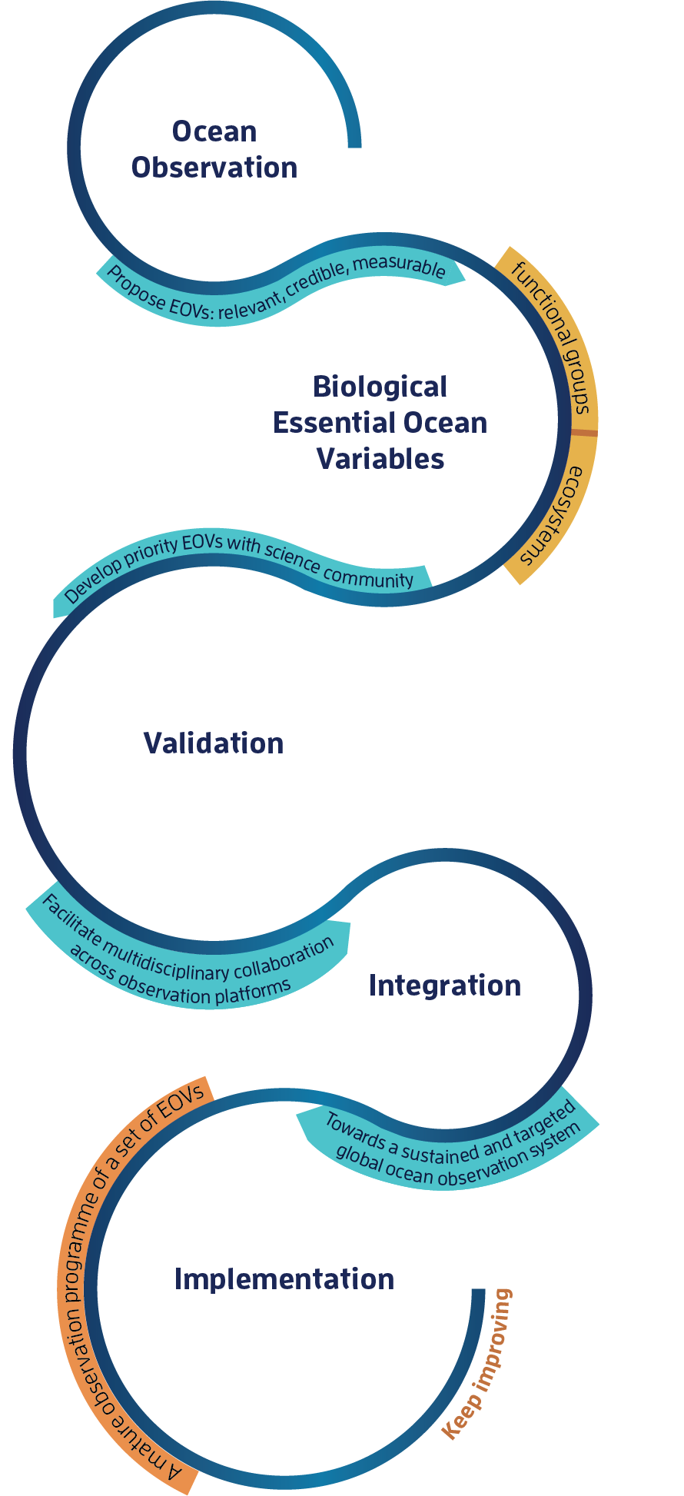
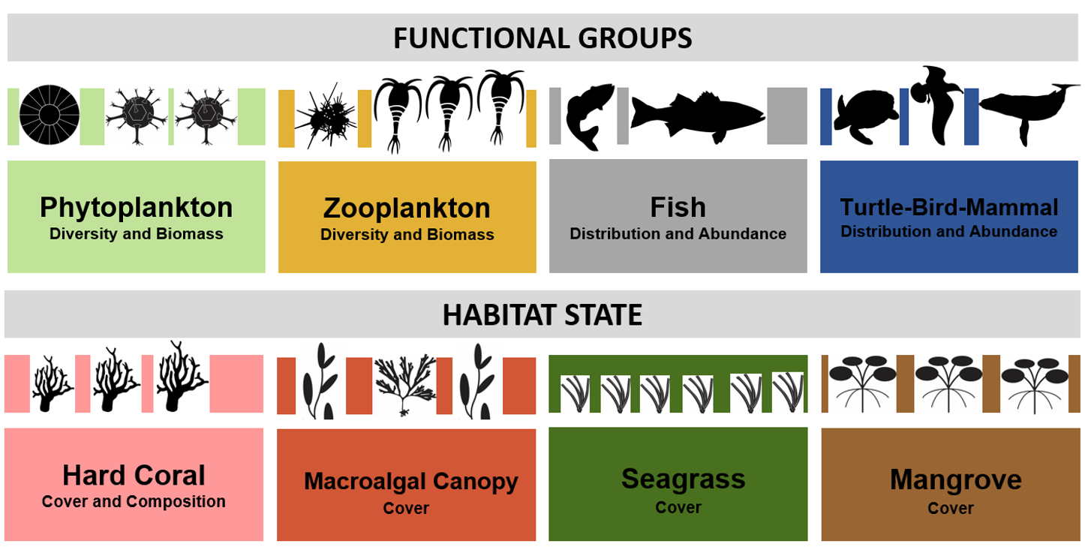
GOOS – BioEco
HIGHLIGHTS 2017/2018
GOOS Program
Science
Policy
GCOS
Emerging: Microbe diversity and biomass
Benthic invertebrate distribution and abundance
Disciplines
Networks
Communities of practice
Needs, requirements and gaps
Plans and challenges 2018/2019

Slide 3

HIGHLIGHTS 2017/2018
GOOS Program
Implementation of agreement between GOOS BioEco, the MBON and OBIS
International Project Office moved to IMAS / UTAS – funding secured until March 2019 (+ 5 months IOC)
Updated Terms of Reference and Panel member rotation (new chair / new members)
Contributed to GOOS Strategic Plan
Contributed to GOOS Strategic mapping – pilot example “bleaching”
Contributed to harmonization of “phenomena” across Panels (as addressed by EOVs)
Input for Ocean Best Practices program
Input for Ocean Coordination Group (OCG) on biological networks
Organization / coordination of GOOS Regional Workshop (Latin America and Caribbean / survey of national strategies)

Slide 4
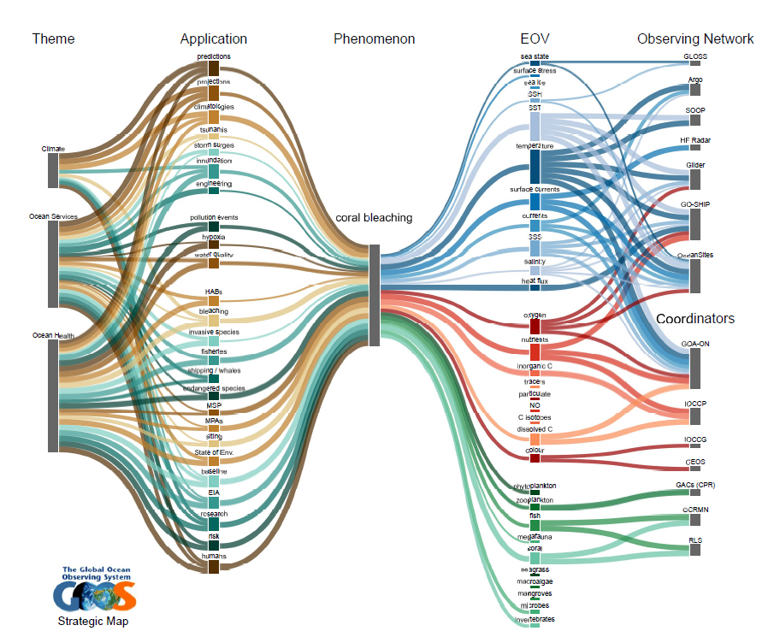

Slide 5
Link to strategic mapping for case example “Bleaching”

Slide 6
HIGHLIGHTS 2017/2018
SCIENCE
Specification sheets – www.goosocean.org/eov
Scientific conferences / technical workshops: Blue Planet, Bio-Logging Symposium, 54th AMSA, 10th WIOMSA, 22nd Biology of Marine Mammals, MEASO-2018, IMBER SC2018, OBIS/IODE-Telemetry Workshop, 4th WCMB (special session on monitoring – NASA), PICES/ECCWO 2018 and others
Papers: 1. Identifying biological EOVs – GCB (2018)
2. Beyond chlorophyll fluorescence – ASLO (2018)
3. Linking EOVs/EBVs – Frontiers (In press)
4. Zooplankton monitoring for conservation – JPR (In press)
5. Linking capacity and monitoring - Frontiers (in review)
6. Global capacity development –JOO (in review)
7. Marine monitoring requirements for Parties to the CBD (in prep)
Abstracts to OceanObs19: contributed 10+ abstracts / merge in 10+ community white papers
Ocean Best Practices - https://www.oceanbestpractices.net/

Slide 7








HIGHLIGHTS 2017/2018
POLICY
UN Oceans Conference (Capacity development Dialogue and P-SIDS)
IOC Ocean Sciences Section and Capacity Development WG
Convention on Biological Diversity (CBD)
Sustainable Ocean Initiative Global Dialogue (SOI)
Food and Agriculture Organization (FAO)
Biodiversity Beyond National Jurisdiction PrepCom (BBNJ)
Convention on Migratory Species (CMS)
Biodiversity Indicator Partnership (BIP)
UN Environment-Large Marine Ecosystem Program (LME)
Marine Ecosystem and Environmental Measurements framework (MEEM)-Australia
Input to the G7 Future of the Seas and Oceans

Slide 8
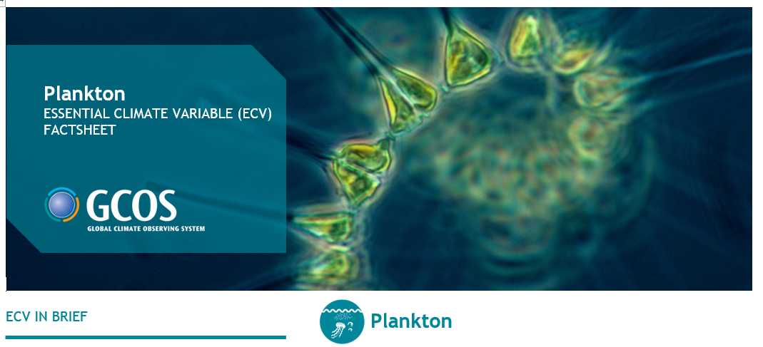
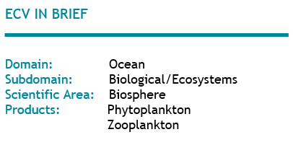

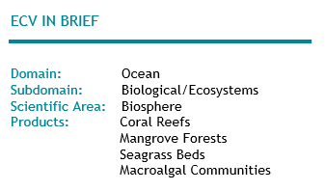
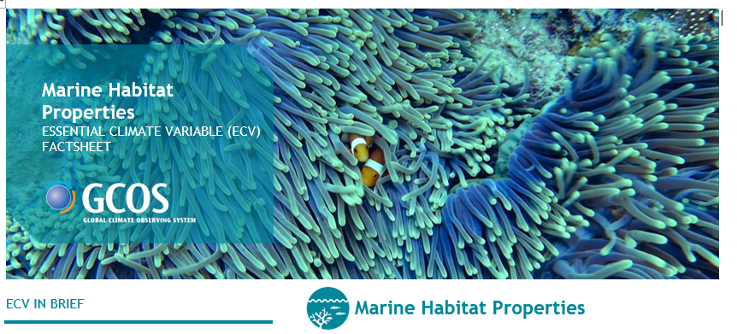
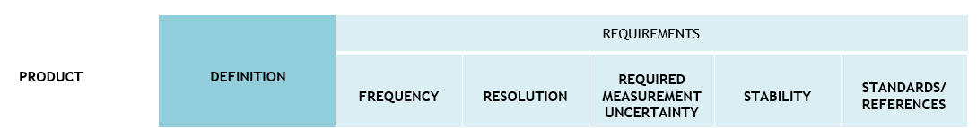
HIGHLIGHTS 2017/2018
GCOS / CLIMATE
Work in progress

Slide 9
















HIGHLIGHTS 2017/2018
INTEGRATION
Across IOC and GOOS disciplines: Ocean Science Section / GOOS: physics, biogeochemistry, biology
Across communities of practice:
National: NOAA, NASA, IOOC, IOOS, NOPP (USA), IMOS (Australia)
Regional: SOOS
Global: OCG, SCOR, EMBRC, IQOE (Ocean Sound), P-OBS (SCOR WG), DOOS, POGO, RLS, MBON, IMBER
Across networks: GCRMN (coral reefs), GACs (zooplankton), Research Coordination Network (RCN/NSF)
→ Supporting EOVs + emerging EOVs (microbes / benthic invertebrates)
Notes:
Interaction with these groups is variable, from formal collaboration, to discussions on how to establish more formal ways of collaboration, being invited to their meetings and reporting on our activities to their meetings, obtaining support in $$$, reviewing their strategy (e.g. EMBRC).

Slide 10









HIGHLIGHTS 2017/2018
IMPLEMENTATION: needs, requirements and gaps
Drafting the implementation plans
-global coordination and coverage
-intercomparable: best practices
-open access data
-support international reporting needs
-aiming to build a network around each EOV
November 2017
Dar es Salaam, Tanzania
EOV IP Workshops
June 2018
Santa Cruz, CA, USA
Vision and mission
Needs and requirements
Capabilities
Impact - capacity development
Funding
Governance
September 2018
Hobart, Australia

Slide 11
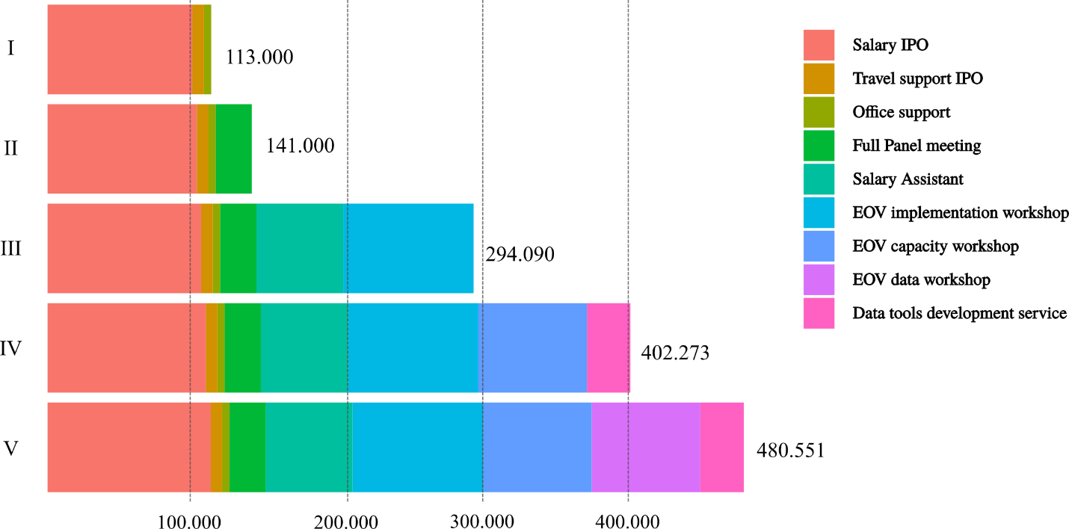
HIGHLIGHTS 2017/2018
Challenges
PROJECTED NEEDS OF THE GOOS BIOECO IPO AND OTHER COORDINATION ACTIVITIES (US$)
Level I: Survival
Level V: Full coordination
Currently (until 2019): Level II
Does not include budget for actual observations
Notes:
The chart shows the budget needs in US$ per year to support the coordination of biological observations within the global ocean observing system by the GOOS BioEco Panel. Such coordination requires a full-time position for an International Project Officer as well as some other core activities to meet the panel’s tasks and to develop the implementation plans of the biological essential ocean variables within the global observing system. This budget does not include the resources to actually carry out the observations.
Level I: is the minimum amount required to support the salary for the international project officer (IPO), including travel (two trips/year) and office support.
Level II: adds to level I by including one full panel meeting per year with the participation of 12-16 people.
Level III: adds to level II by including (a) salary for 50% of the time of an assistant to the IPO to support coordination activities around the EOV networks and (b) approximately US$ 100 k to organize three EOV Implementation Plan workshops aimed at building the networks around EOVs and drafting detailed implementation plans to develop these EOVs.
Level IV: adds to level III by including (a) capacity development workshops to help advance the EOV implementation plans especially in regions where these are needed the most and (b) costs of data services to develop the EOV data management structure (e.g. within OBIS) for product delivery as part of the implementation.
Level V: adds to level IV by including three EOV data workshops to work on data standards, data processing (QA/QC), data archiving, data provenance and traceability, and data access.

Slide 12
HIGHLIGHTS 2017/2018
Requests to the GOOS SC
To help invigorate the GOOS GRAs to support biological observations in a multidisciplinary context
To endorse “Ocean Sound” as a GOOS EOV under the coordination of the BioEco Panel and identify the IQOE group as the partner in developing this network
To use GOOS SC members expertise, connections, leadership within large organizations, access to funding to help support the development of the BioEco EOV IP plans + support continuation of IPO (e.g. host workshops, provide regional experts, facilitate local to regional capacity development, etc.)
To help support multidisciplinary activities across the three panel themes and encourage development of technologies to facilitate this integration
To further develop strategic linkage with other IOC initiatives especially UN Decade
To help improve communication with stakeholders (e.g. industry, the conservation community, policy): potentials to fill the current gaps of Aichi Targets and SDG14 Indicators (e.g. the Biodiversity Indicator Partnership (BIP), World Conservation Monitoring Center (WCMC)

Slide 13

HIGHLIGHTS 2017/2018
Chairs: Nic Bax and Daniel Dunn
Project Officer: Patricia Miloslavich
Secretariat: Ward Appeltans
http://goosocean.org/
Valerie Allain – Pacific Community – New Caledonia
Sonia Batten – SAHFOS - Canada
Lisandro Benedetti-Cechi –UP - Italy
Sanae Chiba – JAMSTEC – Japan
Dan Costa – UCSC - USA
Emmett Duffy – Smithsonian - USA
Raphael Kudela – UCSC - USA
Frank Muller-Karger – USF - USA
David Obura – CORDIO – Kenya
Lisa Maria Rebelo – IWMI - Lao
Yunne Shin – IRD - France

