Slide 1

OCG
JCOMM Data Management Program Area vision and OCG role
Sergey Belov
Chair DMPA
9th Session of the JCOMM Observations Coordination Group
14 - 17th May 2018, Brest, France

Slide 2
Mission
  Implement and maintain a fully integrated end-to-end data management system across the entire marine meteorology and oceanographic community.
  Offer expertise to assist other groups (e.g. OOPC) to specify and implement their own data management requirements, with the overall goal of integrating their data management into the overall end-to end data management system.

Slide 3
DMPA Structure
Data Management Coordination Group (DMCG)
Expert Teams (ET):
ET on Data Management Practices (ETDMP) (joint with IODE)
ET on Marine Climatology (ETMC)
Inter-Program ET for Integrated Marine Meteorological and Oceanographic Services within WMO and IOC Information Systems (IPET-MOIS)
Task Teams:
Table Driven Codes (TDC)
Satellite Data Communication Systems (Satcom)

Slide 4
JCOMM-5 Recommendation 6.1/1 — Joint WMO and IOC Strategy for Marine Meteorological and Oceanographic Data Management (2018-2021)
  JCOMM decides the draft Strategy will replace the current JCOMM Data Management Plan once approved by WMO and IOC Executive Bodies;
  Recommends WMO and IOC Executive Councils to adopt the draft Strategy;
  Requests:
    (1) The DMPA to keep the Strategy under review and develop an Implementation Plan responding to the Strategy in consultation with the other Programme Areas and the IODE;
    (2) All Programme Areas to update their work plans in response to the Strategy;
    (3) The WMO Secretary-General and the IOC Executive Secretary to promote the Strategy and its implementation with WMO Members and IOC Member States;
    (4)The DMPA to assist the Commission for Basic System in developing the information management component of WIS, and to seek to implement the Strategy in a way compatible with it;
  Invites the IODE to collaborate in the implementation of the Strategy;
  Urges Members/Member States and all other contributors identified in the Strategy to collaborate with JCOMM with the view of realizing the outcomes expected from the Strategy

Slide 5
Draft joint WMO-IOC Strategy for Marine Meteorological and Oceanographic Data Management (2018-2021) – Vision and Mission
Vision: Assuring the collection, processing, integration, dissemination & archiving of as much fit-for-purpose relevant data of known quality, to deliver to current demands for integrated oceanographic and marine meteorological information to the research and operational communities
Mission: To realize the Vision, JCOMM will build on existing infrastructure, best practices and standards, and leverage from expertise of both WMO and IOC organizations. It will enable community efforts in data management in line with WMO Information System strategy (WIS 2.0), while seeking enhanced collaboration and partnerships from the public and private sector. It will promote cost effective modernization of current procedures and the use of new technologies and emerging data mechanisms where appropriate and applicable, as well as update existing practices and standards and develop new ones.
Notes:
The purpose of the Joint WMO-IOC Technical Commission for Oceanography and Marine Meteorology (JCOMM) Data Management Strategy is to address the Vision and objectives of JCOMM with regard to marine meteorological and oceanographic (oceanographic and marine meteorological) data and information exchange in the WMO and IOC strategic framework. The JCOMM Data Management Strategy is therefore responding to the current 2016-2019 and future 2020-2023 WMO Strategic Plans, and the IOC Medium Term Strategy 2014-2021 . It is also consistent with the IOC Strategic Plan for Data and Information Management (2017-2021).
It will particularly address the needs of the IOC-WMO-UNEP-ICSU Global Ocean Observing System (GOOS), the WMO-IOC-UNEP-ICSU Global Climate Observing System (GCOS), the WMO Integrated Global Observing System (WIGOS), and the WMO Marine Meteorology and Oceanography Programme (MMOP) for oceanographic and marine meteorological data.
The goal is to make existing and new oceanographic and marine meteorological data available to the end users in such a way that they better meet the end user requirements and remain compliant with WMO and IOC data policies for free and unrestricted data exchange. Leverage will be from existing resources to minimize additional weight on data providers.
WMO Resolution 40 (Cg-17) and WMO Resolution 60 (Cg-17)
http://www.iode.org/index.php?option=com_content&view=article&id=51&Itemid=95

Slide 6
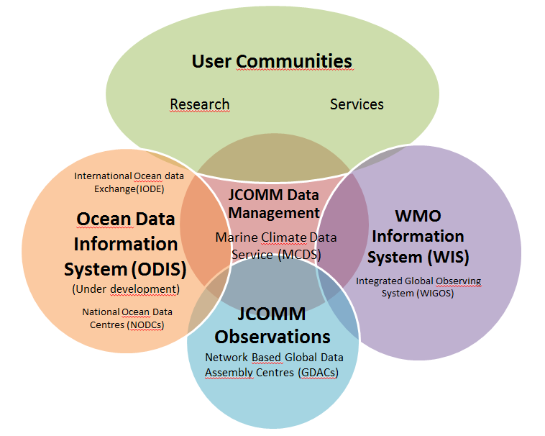
Draft joint WMO-IOC Strategy for Marine Meteorological and Oceanographic Data Management (2018-2021) – Outcomes, themes, goals and objectives
Outcome | Theme | Goals and Objectives
1 | Promoting data sharing | Promoting oceanographic and marine meteorological data sharing with the research and operational communities and the private sector in compliance with WMO Resolution 40 (Cg-12), WMO Resolution 60 (Cg-17), and the IOC Oceanographic Data Exchange Policy.
2 | Data collection | Achieving more comprehensive, consistent and standardized collection of oceanographic and marine meteorological data from observing platforms in real time and near real time as needed.
3 | Data integration, access, rescue and preservation | Integration of oceanographic and marine meteorological data, their quality control and value adding, including structured and regulated data flow, data rescue, archival/preservation and enhanced data access for end users via WMO and IOC information systems.
4 | Data Dissemination | Achieving more comprehensive, consistent and standardized distribution of oceanographic and marine meteorological data to end users in real time and near real time as needed.
5 | Data discovery | Making oceanographic and marine meteorological data sets discoverable using WMO and IOC information systems.
6 | Capacity Development | Enhanced capacities of Members/Member States with regard to oceanographic and marine meteorological data management.
Notes:
The JCOMM data management strategy will help assure the collection, processing, integration, dissemination in real, near real time and delayed mode and the archiving of as much as possible fit for purpose oceanographic and marine meteorological data of known quality from various sources (Annex III) to meet the needs of WMO and IOC operational and research applications with the view to allow both Organizations to fulfil their mandates
The strategy recognizes and builds on the substantive community level data management activities undertaken by the oceanography and marine meteorology observing community (under the Observations Programme Area), and other data management entities (i.e. ICOADS, IQUOD, CMEMS, IOOS, SeaDataNET, ODIP, IMOS, WOD, etc.,)
, the globally coordinated in situ observing networks take responsibility for the collection, management and delivery of observations, through web services and GTS in real time, and delayed mode QC, and archival through identified Global Data Assembly Centres. GOOS Regional Alliances, are also pushing the boundaries of integrated data access and delivery through web services. It is hoped that many of the existing data systems (Argo GDACs, OceanSITES GDACs, etc.,) will become part of the MCDS (as DACs, GDACs and CMOCs). The JCOMM Observations Programme Area recognizes the need for integrating across network based GDACs, and sees ERDDAP as the vehicle to achieve this. ERDDAP in turn will enhance the capability of MCDS portals.

Slide 7
Draft joint WMO-IOC Strategy for Marine Meteorological and Oceanographic Data Management (2018-2021) – Responsibilities
Outcome | Activity | Leader | Comments
1 | Activity 1 – Plan for the promotion of data sharing and exchange | OCG | collaboration from panels/networks and JCOMMOPS
 | Activity 2 – Plan for enhancing collaboration with the private sector | OCG | with assistance from JCOMMOPS
2 | Activity 1 - Rationalization and standardization of data collection | OCG | with assistance from JCOMMOPS
 | Activity 2 - Uniformization and standardization of quality control procedures | DMCG | with assistance from OCG, SCG，ETMC

Slide 8
Draft joint WMO-IOC Strategy for Marine Meteorological and Oceanographic Data Management (2018-2021) – Responsibilities
Outcome | Activity | Leader | Comments
3 | Activity 1 – Guidance to Members and Member States on how to use existing oceanographic and marine meteorological and other relevant data systems, including description of governance and processes | DMCG | with assistance from OCG and IODE
 | Activity 2 – Marine Climate Data System (MCDS) / Development of the CMOC Network in collaboration with IODE | DMCG | with assistance from OCG and IODE
 | Activity 3 – Marine Climate Data System (MCDS) / Development of the DAC and GDAC Network in collaboration with IODE | DMCG | with assistance from OCG and IODE, ETMC

Slide 9
Draft joint WMO-IOC Strategy for Marine Meteorological and Oceanographic Data Management (2018-2021) – Responsibilities
Outcome | Activity | Leader | Comments
3 | Activity 4 – Accessibility of oceanographic and marine meteorological data by the ocean community to GTS data in near real-time | OCG | with the support from members and members states and WMO/WIGOS
 | Activity 5 – Integration of oceanographic and marine meteorological observations by variable-based products, including value added and bias correction | DMCG | with assistance from OCG, ETMC
 | Activity 6 - Scientific Stewardship | DMCG

Slide 10
Draft joint WMO-IOC Strategy for Marine Meteorological and Oceanographic Data Management (2018-2021) – Responsibilities
Outcome | Activity | Leader | Comments
3 | Activity 7 – Data Rescue | DMCG | with the assistance from IODE and Global Oceanographic Data Archaeology and Rescue (GODAR), ETMC
 | Activity 8 – Integrated access to oceanographic and marine meteorological data and products using modern technology | OCG
4 | Activity 1 – Modernized and new data management practices and standards | DMCG | collaboratively led by DMCG and IODE
 | Activity 2 – New and updated templates for Table Driven Codes | DMCG | TT-TDC IPET-MOIS

Slide 11
Draft joint WMO-IOC Strategy for Marine Meteorological and Oceanographic Data Management (2018-2021) – Responsibilities
Outcome | Activity | Leader | Comments
5 | Activity 1 – Interoperability of oceanographic and marine meteorological data sets and products with the WMO Information System WIS) | DMCG | IPET-MOIS
 | Activity 2 – Interoperability of oceanographic and marine meteorological data sets and products with the Ocean Data Information System (ODIS) including ODP ( MCDS, WIS, ….) | DMCG
6 | Activity 1 – Capacity development and training on oceanographic and marine meteorological data management | JCOMM MAN | This activity is a cross-cutting responsibility for all programme areas of JCOMM.

Slide 12
Draft joint WMO-IOC Strategy for Marine Meteorological and Oceanographic Data Management (2018-2021) – Outcomes and activities related to OCG –
Data sharing and exchange
Outcome 1 - Promoting oceanographic and marine meteorological data sharing with the research and operational communities and the private sector in compliance with WMO Resolution 40 (Cg-12), WMO Resolution 60 (Cg-17), and the IOC Oceanographic Data Exchange Policy
Activity 1 – Plan for the promotion of data sharing and exchange
  Identify data not being shared
  Develop rationale & strategy for reaching out with them
  JCOMMOPS to play active role
  Marine Climate data made available via CMOCs
Activity 2 – Plan for enhancing collaboration with the private sector
  Make best use of private sector capabilities (win-win)
  SWOT analysis
  Use Guidance on WIGOS Data Partnership

Slide 13
Draft joint WMO-IOC Strategy for Marine Meteorological and Oceanographic Data Management (2018-2021) – Outcomes and activities related to OCG –
Data collection
Outcome 2 - Achieving more comprehensive, consistent and standardized collection of oceanographic and marine meteorological data from observing platforms in real time and near real time as needed
Activity 1 - Rationalization and standardization of data collection
  Standardize data collection formats
  Work with platform operators, manufacturers & Satcom
Activity 2 - Uniformization and standardization of quality control procedures
  Compile & reference documentation & review existing procedures
  Promote uniformization wherever possible for real-time & delayed-mode QC
  Integral part of MCDS

Slide 14
Draft joint WMO-IOC Strategy for Marine Meteorological and Oceanographic Data Management (2018-2021) – Outcomes and activities related to OCG – Data integration, access, rescue and preservation
Outcome 3 - Integration of oceanographic and marine meteorological data, their quality control and value adding, including structured and regulated data flow, data rescue, archival/preservation and enhanced data access for end users via WMO and IOC information systems
Activity 1 – Guidance to Members and Member States on how to use existing oceanographic and marine meteorological and other relevant data systems, including description of governance and processes
  Updating “AN OCEANOGRAPHER’S AND MARINE METEOROLOGIST’S COOKBOOK FOR SUBMITTING DATA AND METADATA IN REAL-TIME AND IN DELAYED-MODE” (2015, JCOMM TR N/72) (http://www.jcomm.info/index.php?option=com_oe&task=viewDocumentRecord&docID=16012, https://www.oceanbestpractices.net/handle/11329/401)
  More data in MCDS thanks to Members/Member States using Cookbook
Activity 2, 3 – Marine Climate Data System (MCDS) / Development of the CMOC & DAC/GDAC Network in collaboration with IODE
  WOD & ICOADS to become CMOCs
  Establishment of GDACs for moored buoys, Argo, tide gauges …
Activity 4 – Accessibility of oceanographic and marine meteorological data by the ocean community to GTS data in near real-time - OpenGTS Project

Slide 15
Draft joint WMO-IOC Strategy for Marine Meteorological and Oceanographic Data Management (2018-2021) – Outcomes and activities related to OCG
Outcome 4 - Achieving more comprehensive, consistent and standardized distribution of oceanographic and marine meteorological data to end users in real-time and near real-time as needed
Activity 1 – Modernized and new data management practices and standards
  Ocean Data Standards & Best Practices Project (http://www.oceandatastandards.org/) - Review existing standards & work on new ones, e.g. vocabularies
  OceanBestPractices repository (http://www.oceanbestpractices.net/)
Activity 2 – New and updated templates for Table Driven Codes
  Gliders, rigs & platforms, BGC, HF Radars …
  OpenGTS Project

Slide 16
Draft joint WMO-IOC Strategy for Marine Meteorological and Oceanographic Data Management (2018-2021) – Outcomes and activities related to OCG
Outcome 5 - Making oceanographic and marine meteorological data sets discoverable using WMO and IOC information systems
Activity 1 – Interoperability of oceanographic and marine meteorological data sets and products with the WMO Information System WIS)
  ODP, ICOADS, WOD, CMOCs, GDACs, Copernicus, …
Activity 2 – Interoperability of oceanographic and marine meteorological data sets and products with the Ocean Data Information System (ODIS) including ODP ( MCDS, WIS, ….)
  Contribute to definition and development of future ODIS

Slide 17
Draft joint WMO-IOC Strategy for Marine Meteorological and Oceanographic Data Management (2018-2021) – Outcomes and activities related to OCG
Outcome 6 - Enhanced capacities of Members/Member States with regard to oceanographic and marine meteorological data management
Activity 1 – Capacity development and training on oceanographic and marine meteorological data management
  Consideration of IOC CD Strategy (2015-2021)
  Collaboration with IODE & Ocean Teacher Global Academy & regional training centres
  Work with WMO ETR

Slide 18
How can OCG support data management challenges?
  Metadata
  common metadata contents (by network, by discipline, etc.)
  Instrument, platform, sensors, vessel metadata, etc.
  requirements to metadata standards (i.e. ISO 19115, SensorML, FGDC, NAP, DarwinCore, etc.)
  Other requirements?

Slide 19
How can OCG support data management challenges?
  Data
  Data sources
  Formats (i.e. BUFR, NetCDF, IMMA, IMMT, CSV, others.)
  Tools and services (TAC to TDF, GRIB, BUFR, NetCDF encoders/decoders/validators, others)
  Data repositories (endpoints, protocols, etc. → DCAT? www.re3data.org?)
  Other requirements?

Slide 20
How can OCG support data management challenges?
  Services & products
  products targeted at data providers
  products targeted at data system managers
  products targeted at external users
  Best practices
  Publications in OceanBestPractices repository – instrument calibration, sensors deployment, data provision, data management handbooks (examples: JCOMM, Argo, AtlantOS DM handbooks ), manuals and guides, etc.

Slide 21
How can OCG support data management challenges?
  Community standards
  Identify and submit community standards (via IODE ODSBP)
  Data citation
  use of DOI, Handle, etc.
  citation level of data and products
  publications

Slide 22
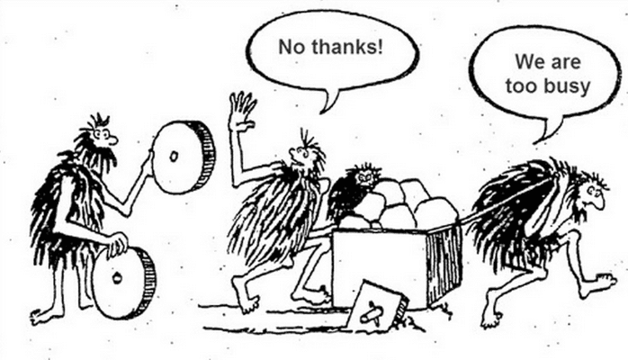
How can OCG support data management challenges?
Support the DM Implementation Plan
Support the DMCG meetings
Helping in…
OCG
DMCG

Slide 23
DMPA & OCG Targets & Impacts in DM
Target: Publicly available data and product repositories
Impact: Higher data & products availability and accessibility by many communities of users
Target: Publicly available metadata catalogues
Impact: Data is discoverable by many communities of users, metadata available in global metadata catalogues(i.e. GEOSS, WDS, etc.)
Target: Publicly available product catalogues
Impact: Improved products discoverability and accessibility

Slide 24
DMPA & OCG Targets & Impacts in DM
Target: Publications of best practices (in IODE OceanBestPractices repository & JCOMM TR, etc.)
Impact: Better knowledge of existing practices, reusability, reproducibility by other communities
Target: Development of community standards
Impact: Wider dissemination and use of existing community standards instead of local/private procedures, improved interoperability arrangements
Target: Data and products has DOIs
Impact: Data and products are used for publications, specialized products, reanalysis, etc. Increased intensity of data & products reuse - > KPIs

Slide 25


