Slide 1
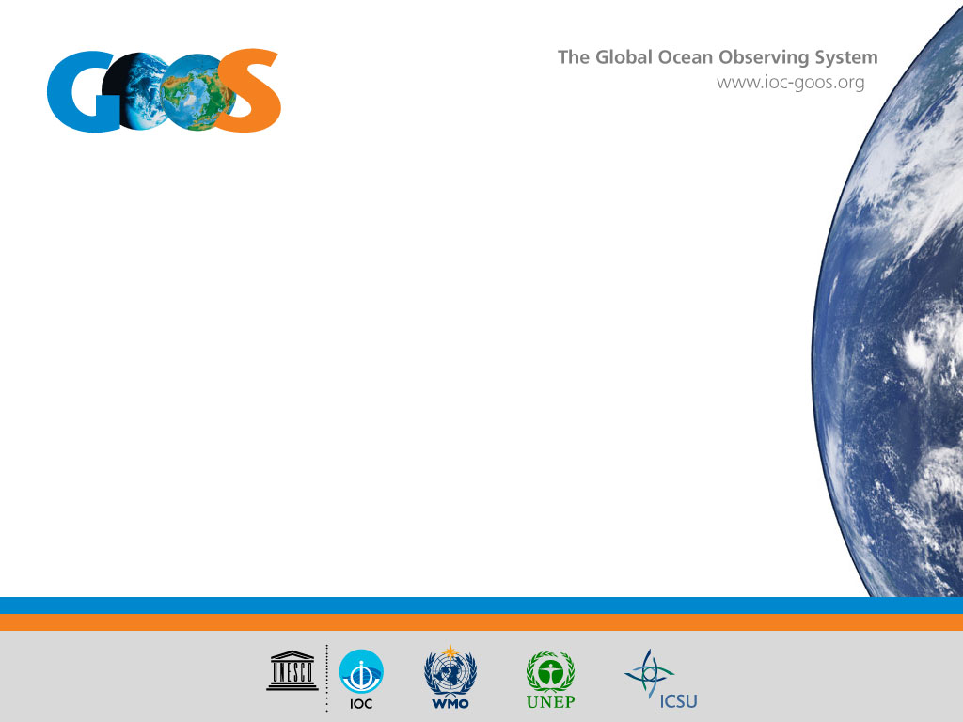
GOOS:
Relationship between GOOS and GCOS functions in context of evolving requirements
Toste Tanhua, GOOS co-chair
Notes:
Thank you for this opportunity to present the work of the Global Ocean Observing System. I’m Toste Tanhua, I work at GEOMAR in Germany, and I am now the co-chair the GOOS Steering Committee with John Gunn.
GOOS is led by the IOC, and co-sponsored by WMO, UN Environment, and the International Council for Science. It is a major ocean contribution to the work of the Group on Earth Observations GEO.

Slide 2
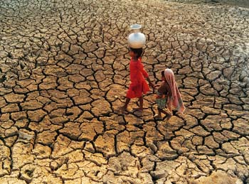
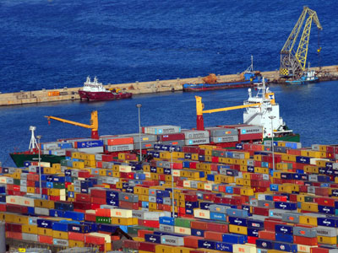
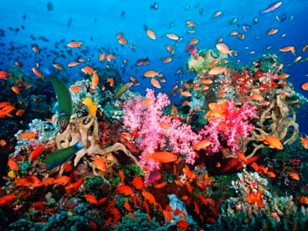
GOOS essential observations for societal benefit
Climate, operational services, ocean health
Notes:
Information from the ocean, and therefore sustained observations of the ocean, can be used to inform decision-making in a number of different areas of key importance to human well-being.
GOOS is aimed at delivering for all IOC Member States the essential sustained observations for climate mitigation and adaptation (GCOS), operational ocean services for disaster risk reduction and to support the development of the Blue Economy, and in order to safeguard ocean health and continued ocean ecosystem services when making local, regional, and global policy decisions.

Slide 3
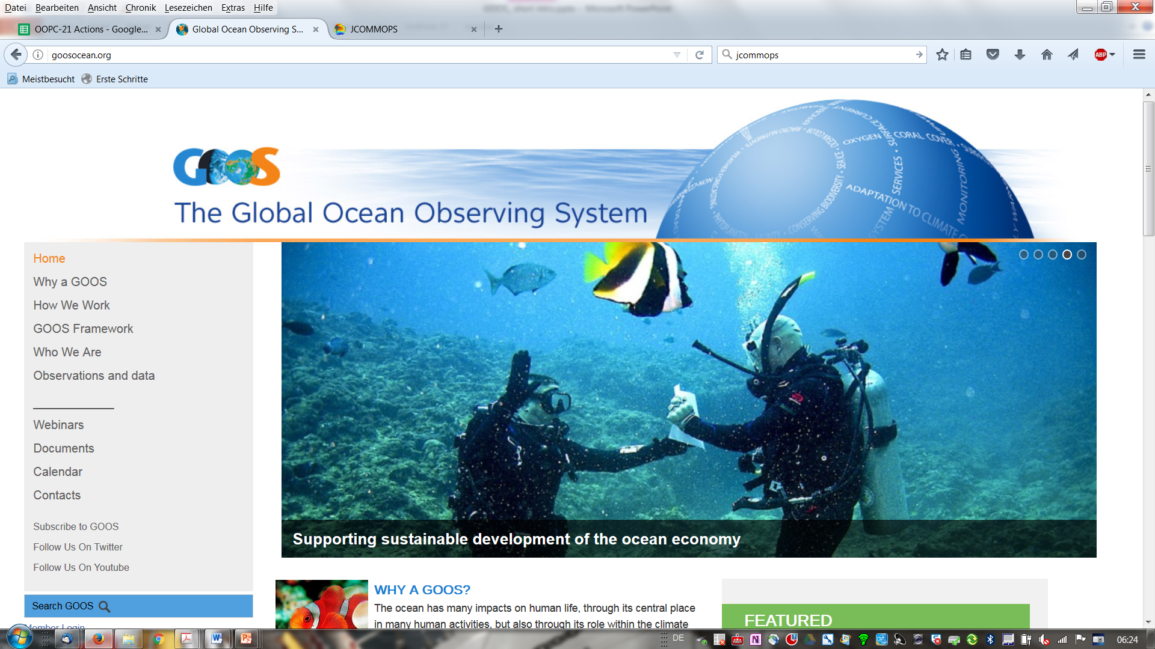
www.goosocean.org

Slide 4








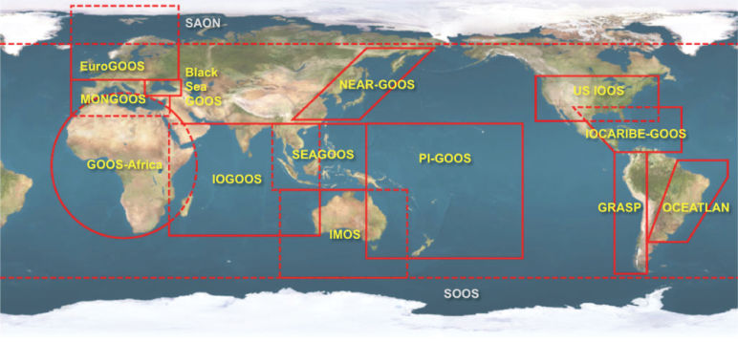


Steering Committee
Scientific Oversight
Observation coordination
Project development
Expert Panels
Physics
Biogeochemistry
Biology and Ecosystems
Global observing networks and platforms
Regional and national organizations
GOOS Regional Alliances (GRAs)
Improving through innovation and renovation

Slide 5
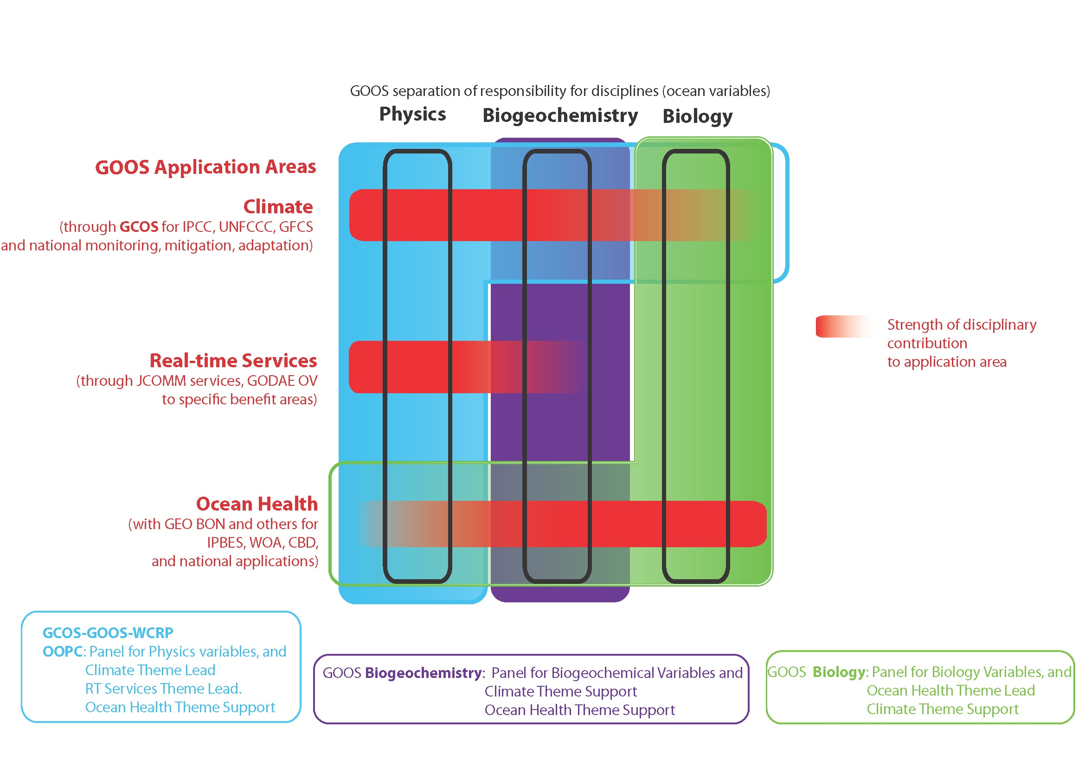

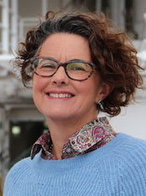
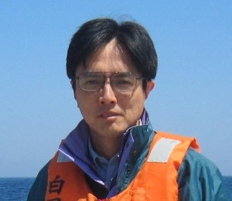
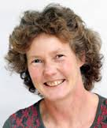
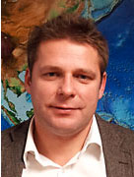
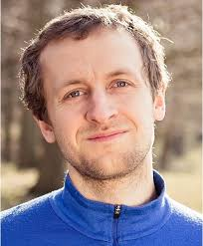

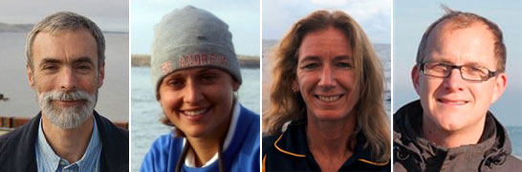
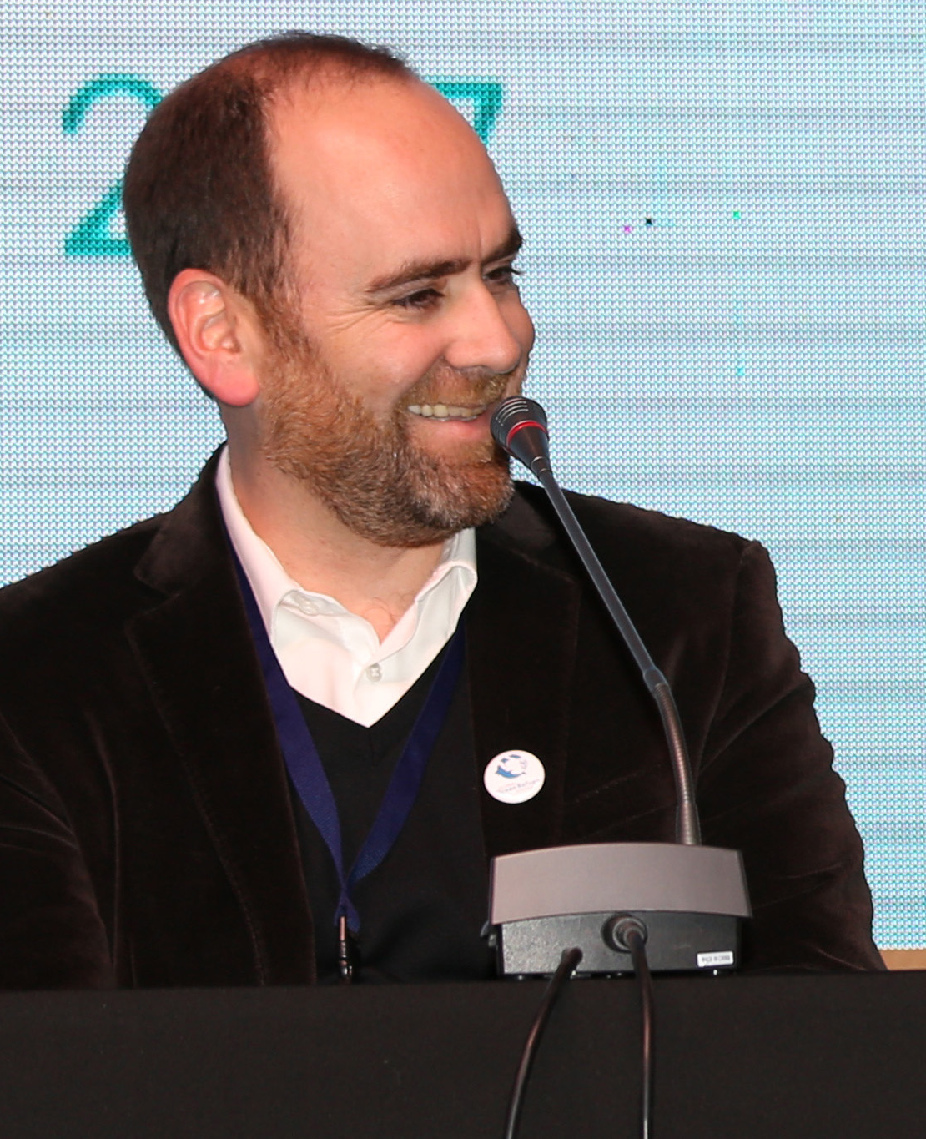
Notes:
GOOS is covering this space with three panels under the Steering Committee. The physics panel is shared with GCOS and WCRP, and chaired presently by Mark Bourassa (USA) and Toshio Suga (Japan), with secretariat support from Katy Hill at the GCOS office in Geneva. The biogeochemistry panel is being led by the SCOR-IOC International Ocean Carbon Coordination Project with additional funding, and is chaired by Toste Tanhua (Germany) with Maciej Telszewski (Poland) serving as the secretariat. The relaunched biology and ecosystems panel is being co-chaired by Nic Bax (Australia) and Samantha Simmons (USA), with secretariat support from Patricia Miloslavich (Venezuela, now based in Australia) and Ward Appeltans of the IOC secretariat. The biology and ecosystems panel is beginning a substantive activity to identify the already ongoing activities, their essential parts for greatest impact, geographic gaps, and building an understanding of how these observations will serve universal needs to monitor ecosystem health.

Slide 6
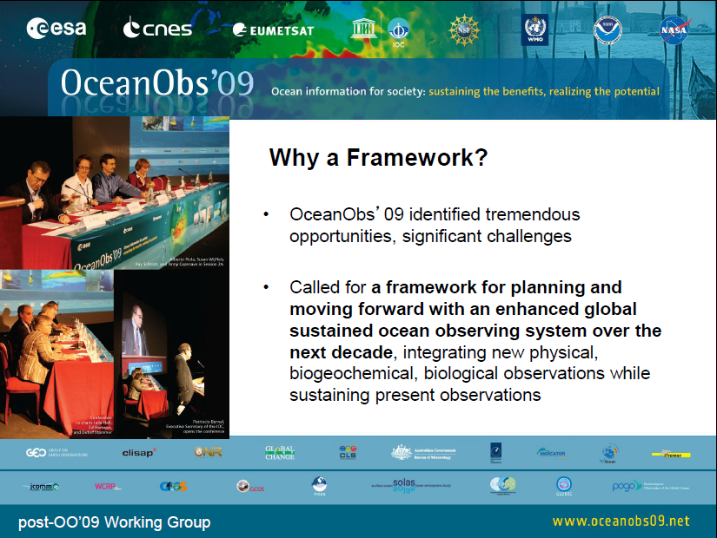
Notes:
What is this Framework for Ocean Observing?
Its genesis comes from the OceanObs’09 conference, which took place 21-25 September 2009 in Venice, Italy. It brought together more than 600 participants from 36 countries, focused on defining a collective vision for the coming decade of ocean observations for societal benefit. The papers from this conference, which form an excellent resource reviewing progress and identifying opportunities and community plans, are all available at its website www.oceanobs09.net
The conference identified tremendous opportunities to expand ocean observing capabilities, and noted significant challenges. There are many players in a potential integrated sustained ocean observing system.
The conference, amongst other things, called for the development of a Framework for planning and moving forward with an enhanced global sustained ocean observing system over the next decade, integrating new physical, biogeochemical, and biological observations while sustaining present observations.
It is this Framework that I’ll describe in the next portion of the talk.

Slide 7
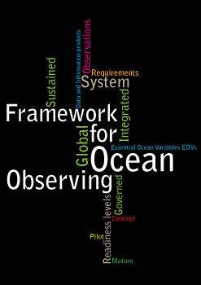

Slide 8
Framework for Ocean Observing
A simple system
Input
(Requirements)
Output
(Data &
Products)
Process
(Observations)
Notes:
Moving from introduction to the core ideas behind the framework team’s work:
We wanted to take a complex system: the ocean observing system built up of research and some operational effort, in situ and satellite observing networks measuring different variables, new technological developments, data streams, and products — and apply systems thinking.
This starts with a simple model of the system, which has an input in the form of requirements, a process in the form of observing networks, and an output in data and products that then feeds a scientific or societal benefit, the source of the requirements.

Slide 9
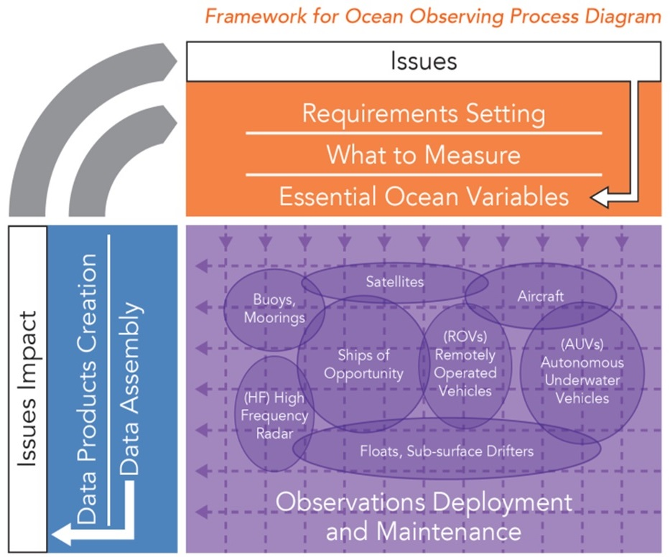
Framework for Ocean Observing
A systems approach
Notes:
GOOS at the global level as a program delivers strategic oversight, coordination, and evaluation of the sustained ocean observing system. The program is helping to coordinate a wide range of efforts by national and regional research and operational agencies, entraining a wide range of voluntary effort.
Since the publication by IOC in 2012 of the Framework for Ocean Observing, a growing community has been working using the same interoperable language of developing observing requirements for societal benefit, identifying Essential Ocean Variables or EOVs based on feasibility and impact, coordinating ocean observing networks through standards and the sharing and promotion of best practices, developing readiness to observe new EOVs in a globally sustained way, and developing coordinated and interoperable data management streams that feed different information generation mechanisms.

Slide 10
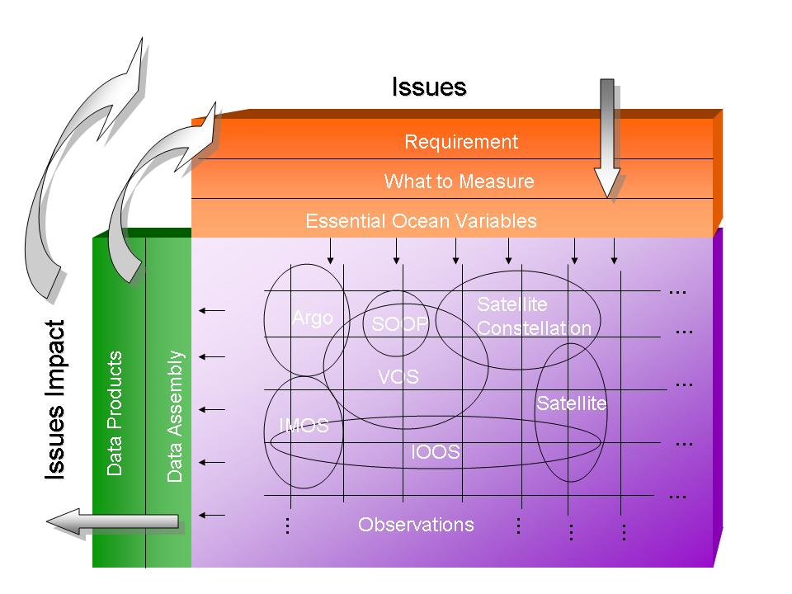
Framework for Ocean Observing
Opening up to new societal drivers
Climate and
Weather
Blue Economy
Assessments and
management of
ecosystem services
Regional
priorities
Hazard
services
Requirements
Expanded EOVs
Expanded observing systems and networks
Data Products
Notes:
We should try to engage these different scientific questions and societal benefits that require sustained ocean observations, including biodiversity, regional seas and regional fisheries management organizations, global fisheries agreements, global marine assessments, and the development of ecosystem-based approaches to management of the ocean environment. Many of these will be impacted by ocean acidification and will need such observations, as well as physical and other biogeochemical and biological sustained observations.
We could follow the model that has successfully been implemented by climate – developing implementation plans from an expert group of scientists like the OOPC, which would be put forward to different international conventions and agreements, to get wider buy-in for sustained ocean observations from the international community and nations. That would expand the number of Essential Ocean Variables into the chemical, biological and ecosystems realm (gray box to right) and expand the number of data products. We will then have impact on more issues (for both science and for society).
A central concept of the Framework is that the nations of the world cannot afford multiple ocean observing systems each responding to different expressed requirements – that one integrated system that responds to many different requirements will be far more fruitful.
This is the 60,000 foot view of the Framework, a high-level picture that looks at driving the observing system with societal issues, developing requirements on what to measure, organizing and coordinating autonomous observing networks, and delivering data that has impacts on these societal issues – helping to drive understanding and good decisions.
In some cases the science is ahead of the conventions in its needs for sustained ocean data, but having these conventions there at the top level is an important reminder that we should be developing sustained observations to feed societal benefit. Some of these conventions are regional, and we expressly did not make a distinction between coastal and open ocean observations.

Slide 11
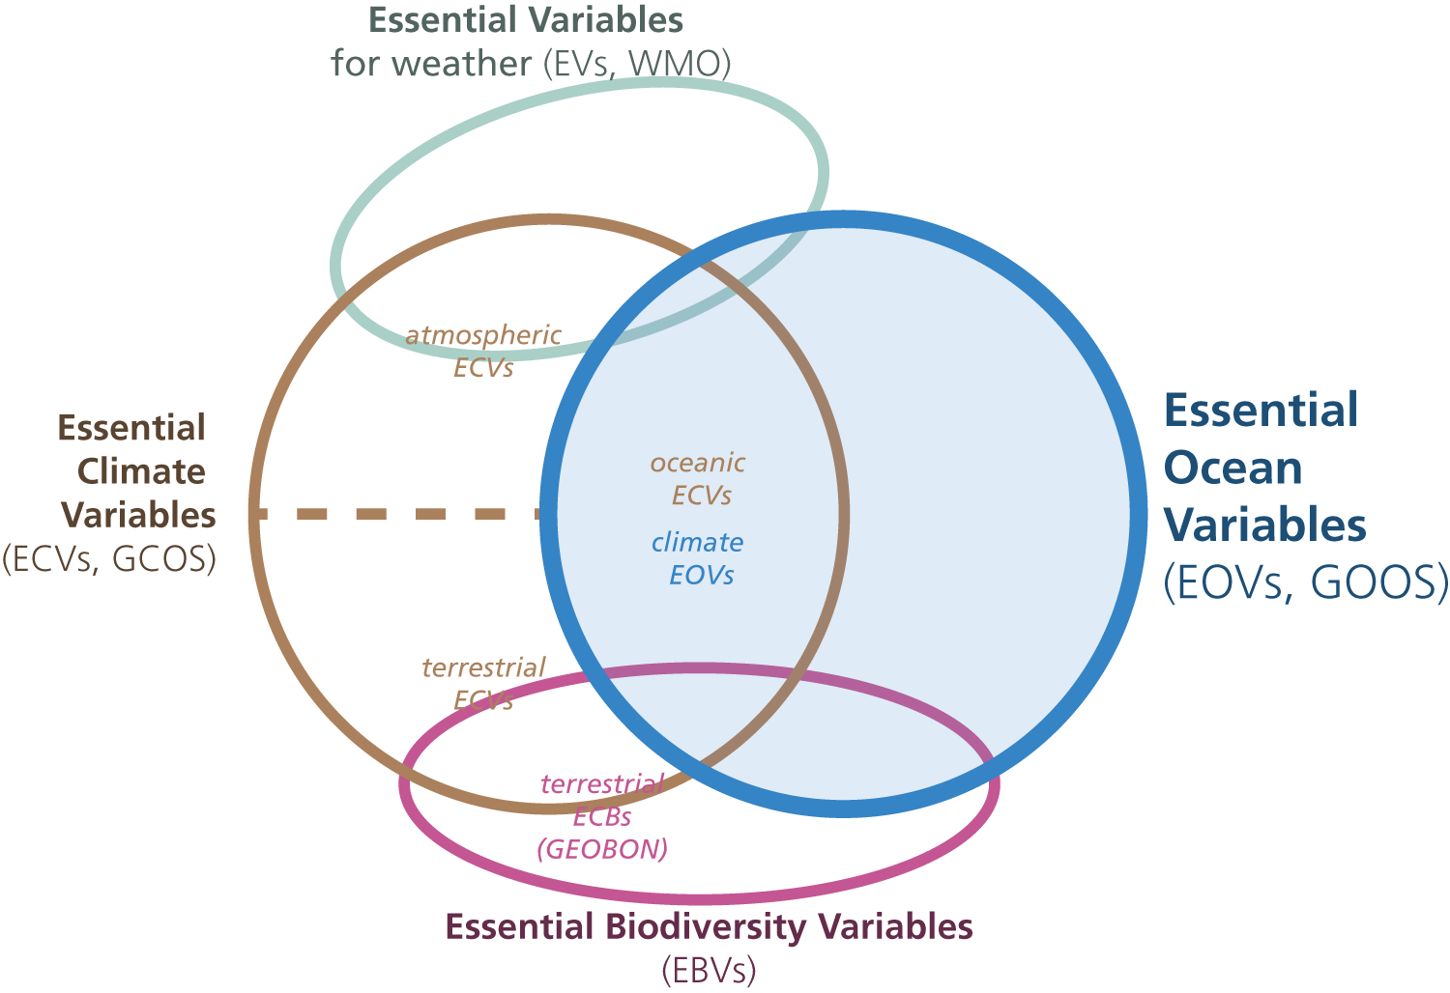
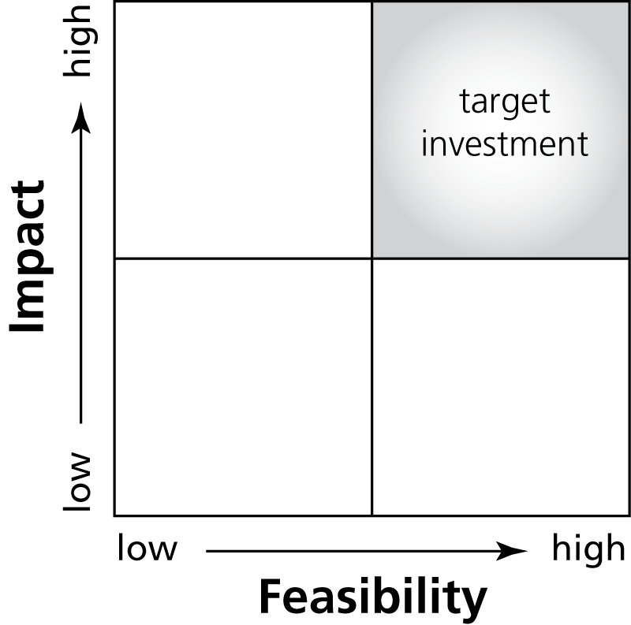
Driven by requirements, negotiated with feasibility
Essential Ocean Variables
We cannot measure everything, nor do we need to
basis for including new elements of the system, for expressing requirements at a high level
Driven by requirements, negotiated with feasibility
Allows for innovation in the observing system over time
Global and ubiqutous impact
Notes:
A key idea in the Framework is the definition of Essential Ocean Variables, which some overlap with other types of essential variables that have been defined, such as Essential Climate Variables defined by GOOS and GCOS, Essential Variables defined by WMO for weather forecasting, and Essential Biodiversity Variables that are being defined by GEOBON (although largely focused on terrestrial variables).
The idea is that for the key societal and scientific drivers of sustained ocean observations, we cannot measure everything, nor do we need to. Essential Ocean Variables should respond to these high-level drivers, related to climate, to understanding and managing ecosystem services, to conserving biodiversity, to managing living marine resources, to safety and protection of life and property at sea and on the coasts.
Aligning the coordination processes of the observing system on variables, rather than by platforms or observing techniques, stays truer to the natural system which we are trying to observe, while allowing for innovation of observing techniques over time as technology and capability develop.
The definition of an EOV must be driven by these requirements, but be rooted in reality, its measurement must be feasible. We may not be ready to measure all EOVs, but this assessing and encouraging the development of readiness is also a part of the Framework.

Slide 12
Towards sustained system: requirements, observations, data management
Readiness
Mature
Pilot
Attributes:
Products of the global
ocean observing system are
well understood, documented,
consistently available, and
of societal benefit.
Increasing Readiness Levels
Concept
Attributes:
Planning, negotiating, testing, and approval within appropriate local, regional, global arenas.
Attributes:
Peer review of ideas and
studies at science, engineering, and data management
community level.
Notes:
The readiness levels are in fact an idea that has been with us on the physical side for a couple of decades, the precursor of OOPC (OODSP) spent a lot of time examining the feasibility and impact of different observing systems, to see if they were ready for global sustained observations. We believe that many biogeochemical and biological variables also need global sustained observations, but perhaps the technologies and techniques are not yet ready for instant application globally. We need to increase the readiness of these observing networks so they drive towards being capable of global sustained observations delivering an important data product that has impact on science or society.
If there is an ambition to run a regional pilot to build a future global system – this type of pull helps engage the research community, and they want to be engaged.
For Argo, new sensors should be and are being trialed in pilot projects, to improve their readiness for deployment on more of the array.

Slide 13
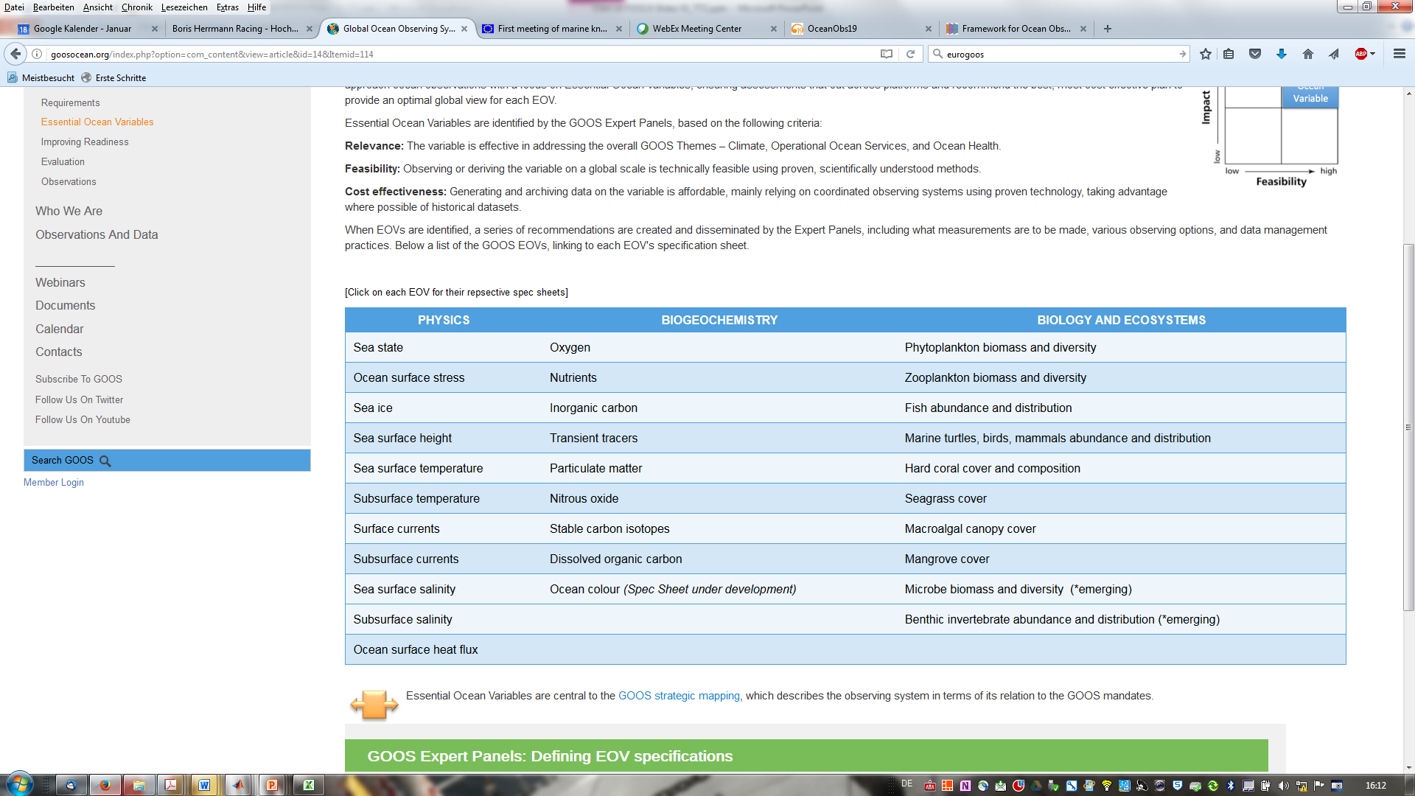
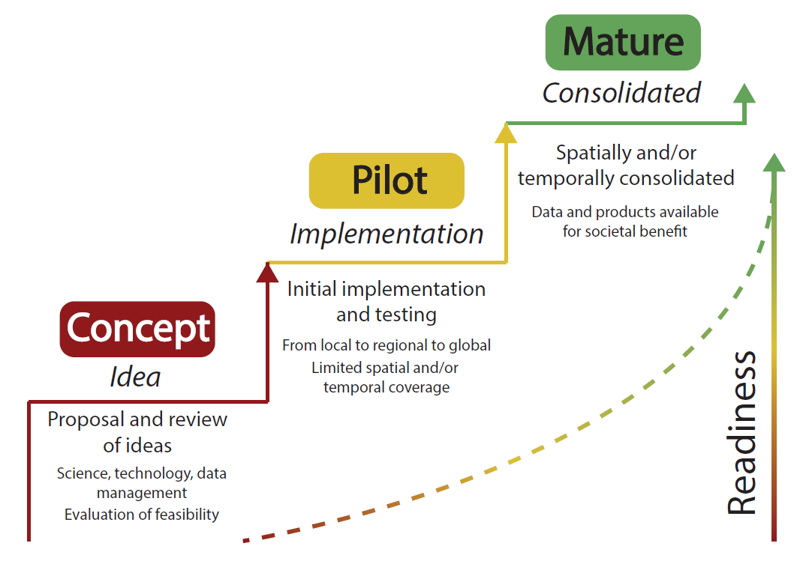
Essential Ocean Variables: all GOOS panels
Relevance: The variable is effective in addressing the overall GOOS Themes – Climate, Operational Ocean Services, and Ocean Health.
Feasibility: Observing or deriving the variable on a global scale is technically feasible using proven, scientifically understood methods.
Cost effectiveness: Generating and archiving data on the variable is affordable, mainly relying on coordinated observing systems using proven technology, taking advantage where possible of historical datasets.

Slide 14
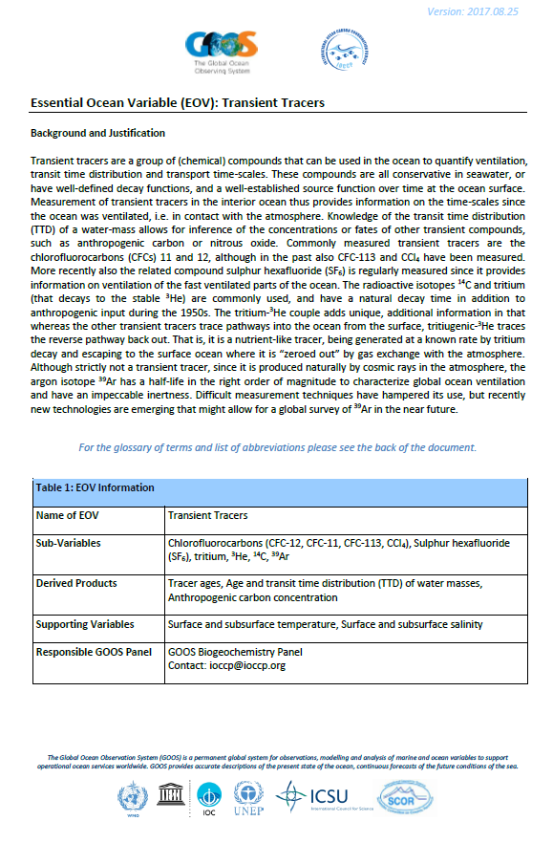
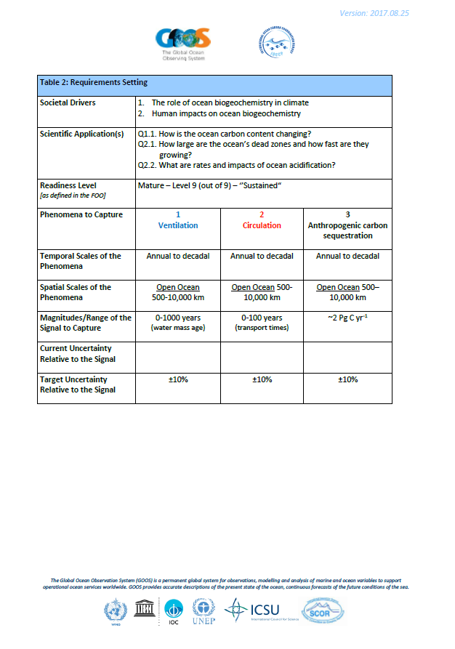

Slide 15
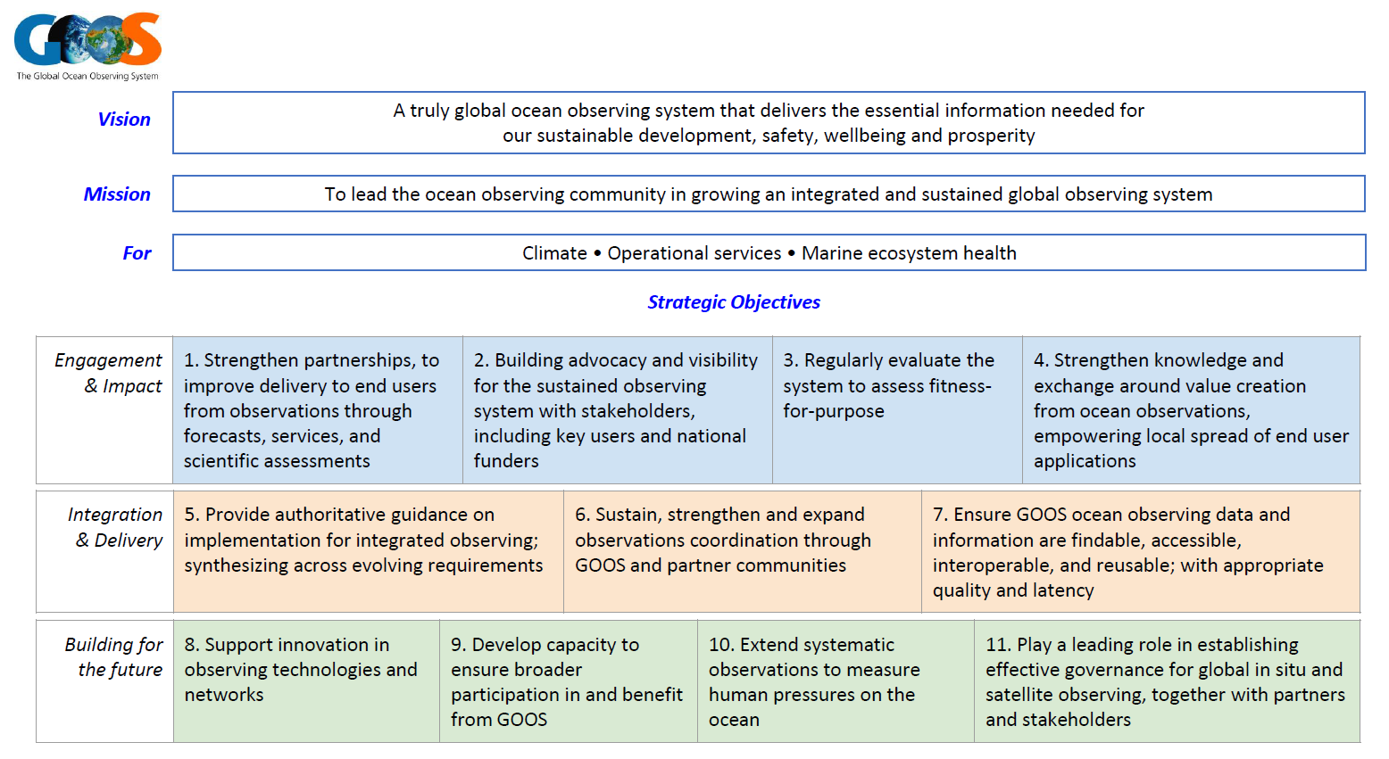
GOOS 2030 Strategy

Slide 16

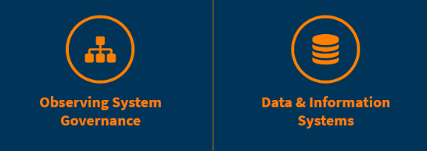
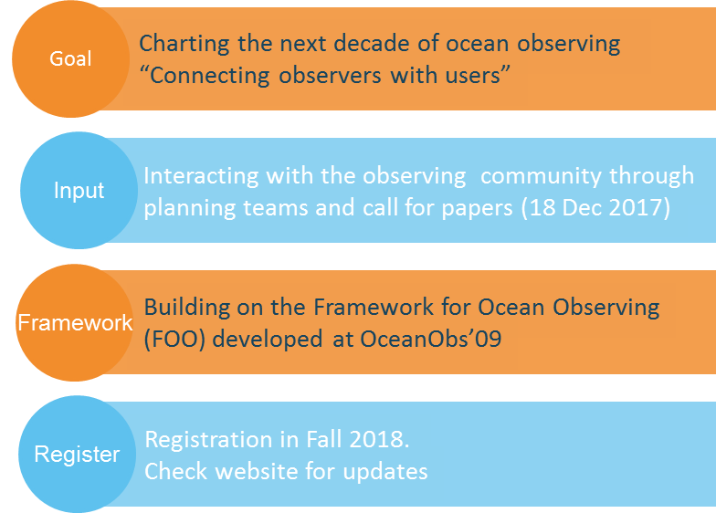



September 16-20, 2019
Honolulu Convention Center
Honolulu, HI, USA
For more info:
www.oceanobs19.net
info@oceanobs19.net
OceanObs’19: An Ocean of Opportunity:
1200 ocean observing scientists, program managers, policy experts, and users expected
7 continents represented, including solicitation and publication of conference white papers
3 organizing committees (Program, Sponsor, Local Organizing)
Conference Themes*

Slide 17
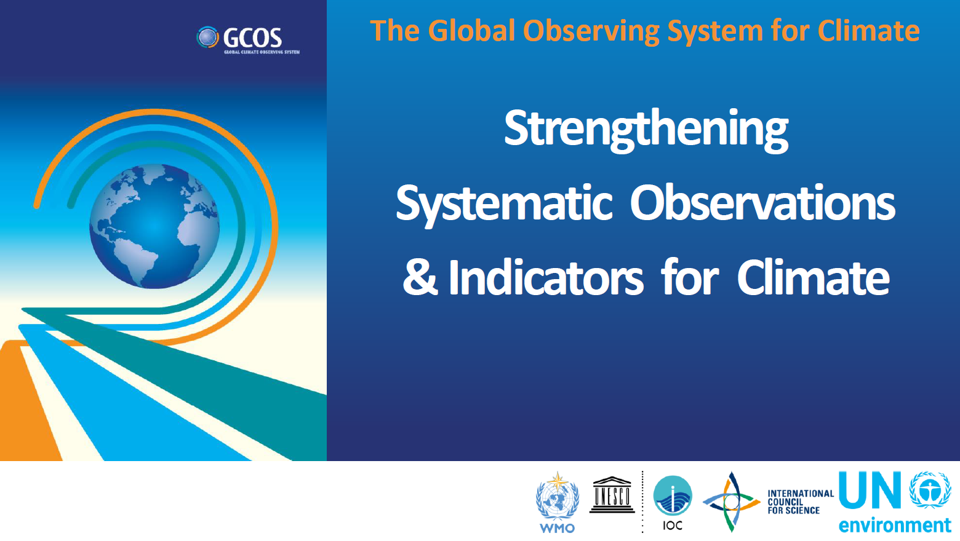

Slide 18
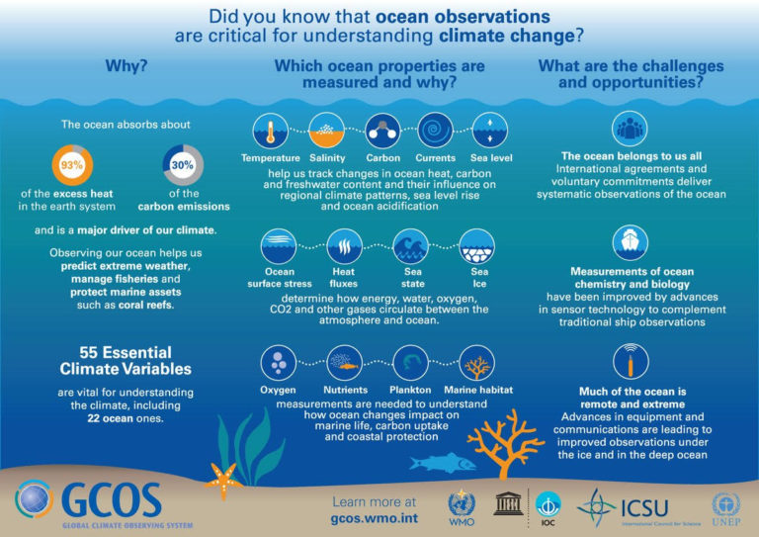

Slide 19
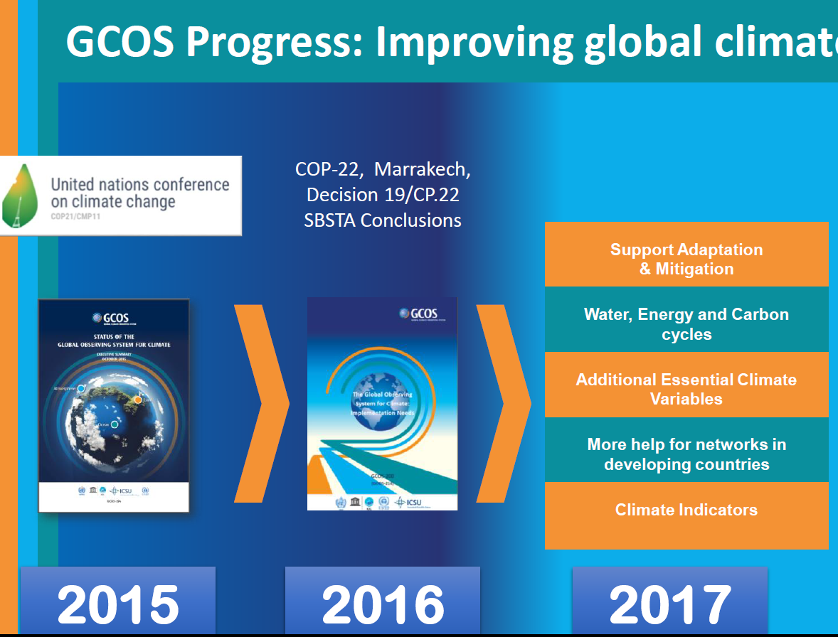

Slide 20
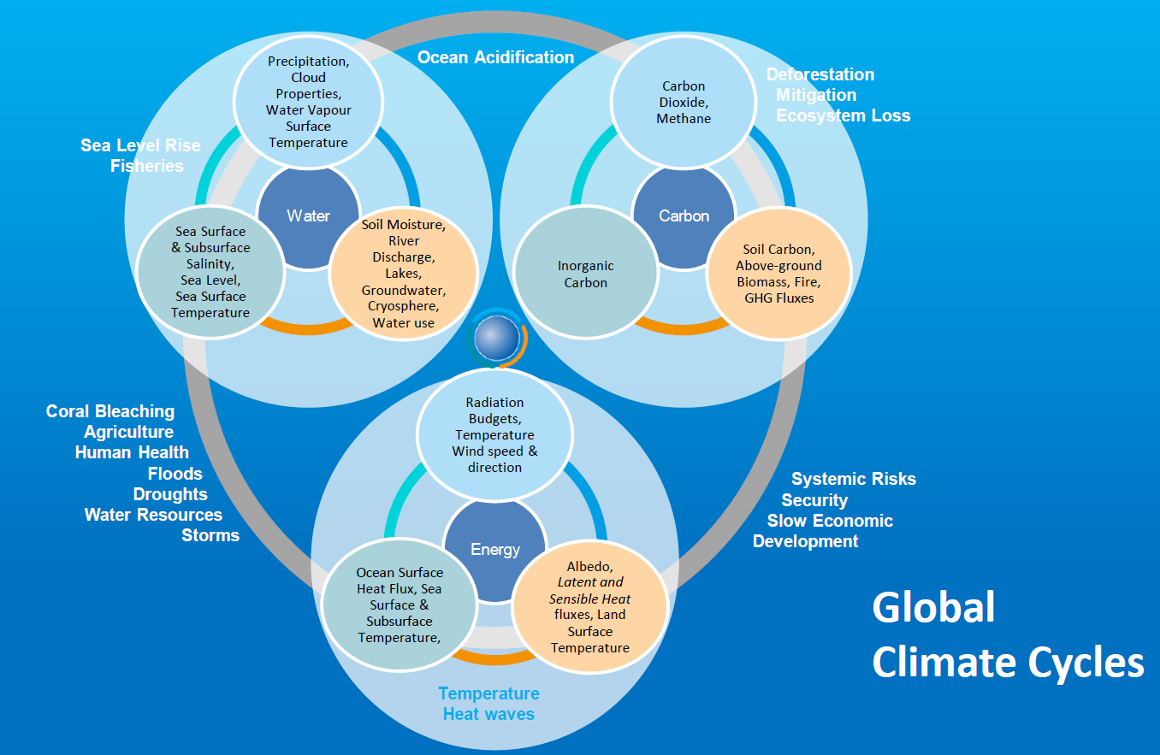

Slide 21
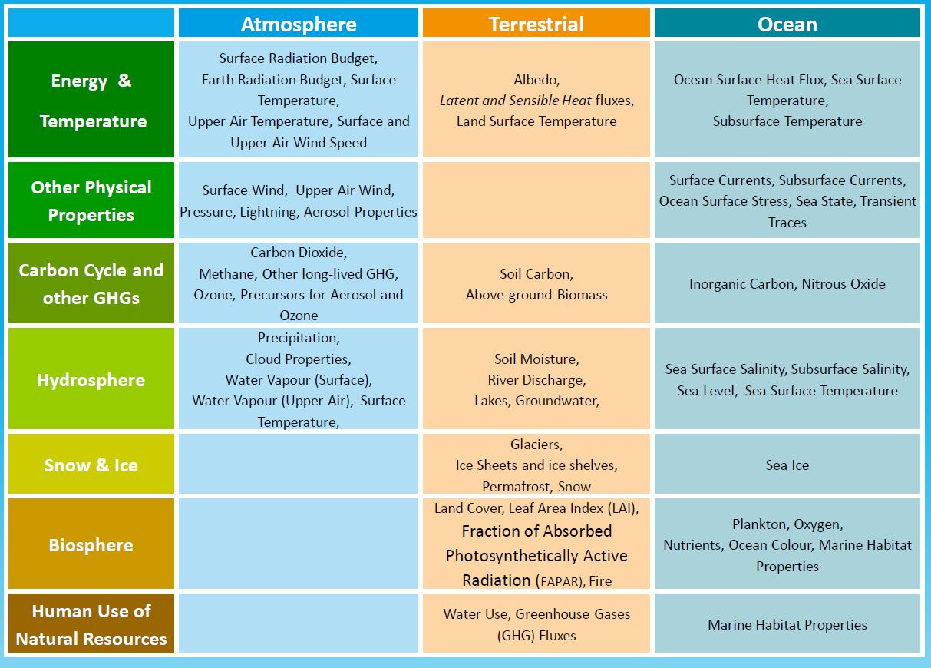
GCOS Essential Climate Variables (ECVs)

Slide 22
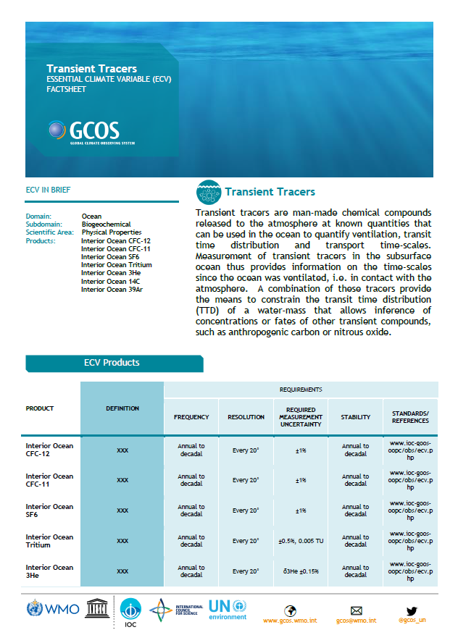
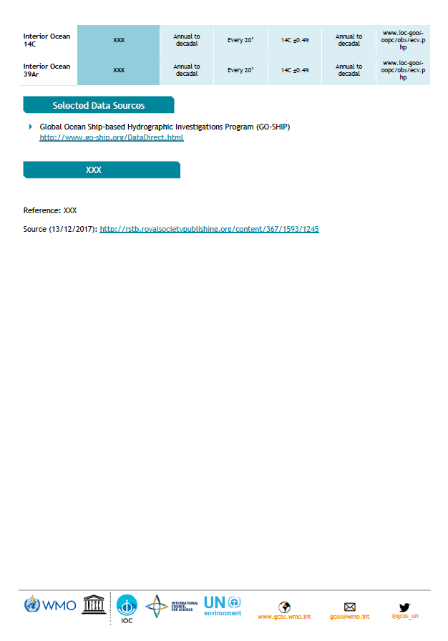

Slide 23
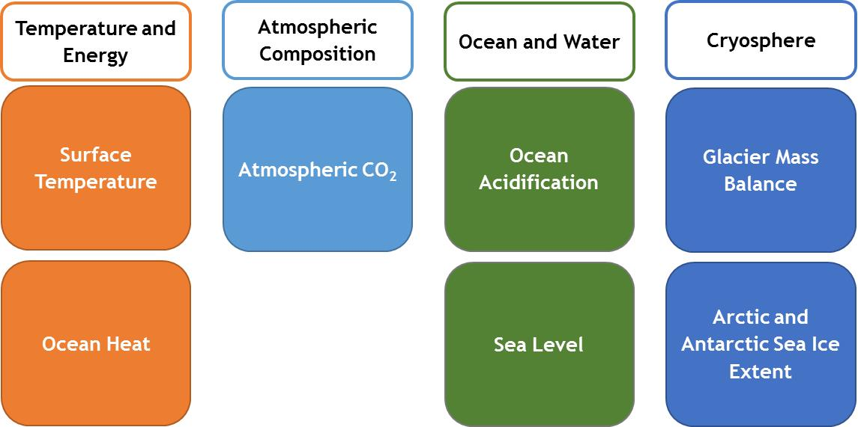
GCOS Global Climate Indicators
The Indicators are meant be used to tell stories about climate change in a way that can be understood by non-experts
The Indicators are not limited to specific datasets or certain storylines

Slide 24
Global Climate Indicators
Temperature and Energy
Atmospheric Composition
Ocean and Water
Cryosphere
Surface Temperature
Atmospheric CO₂
Ocean Acidification
Glacier Mass Balance
Ocean Heat
Sea Level
Arctic and Antarctic Sea Ice Extent
The Indicators are meant be used to tell stories about climate change in a way that can be understood by non-experts
The Indicators are not limited to specific datasets or certain storylines

Slide 25
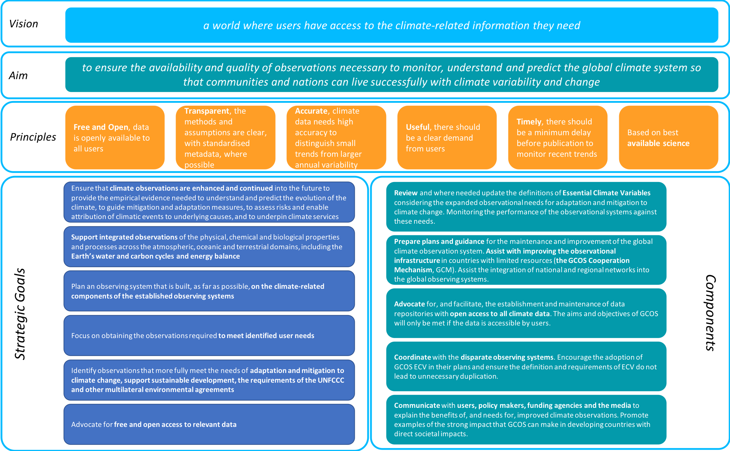
GCOS Strategy: advocate - coordinate - communicate

Slide 26
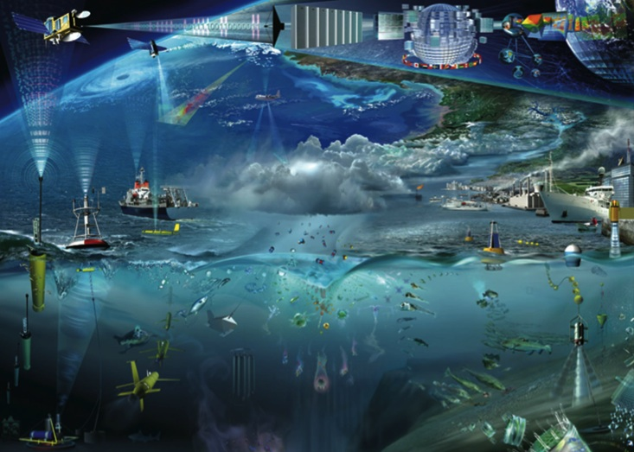
Thank you

