Slide 1
4.3 Metrics and KPIs: OCG-wide metrics and KPIs, both network orientated KPIs and cross-OCG by EOV
(David Legler, Jon Turton & Mathieu Belbeoch)
Notes:
Objectives
Develop OCG-wide metrics and KPIs
network orientated KPIs
cross-OCG KPIs (e.g. by EOV)
Update on OCG-8 actions
US Activities – a possible framing

Slide 2
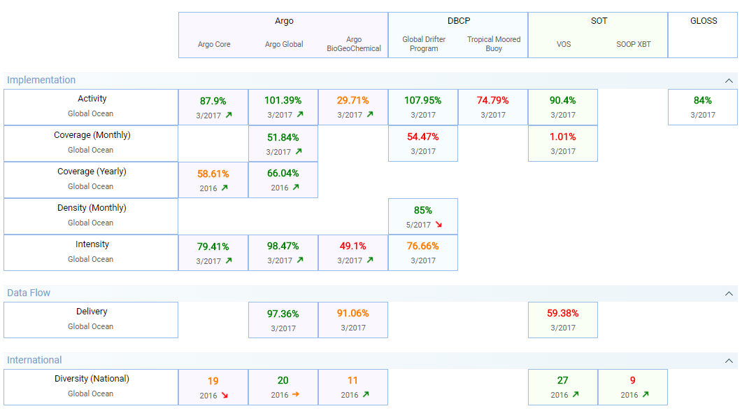
JCOMMOPS KPIs….many, a subset of common KPIs should be finalized

Slide 3
KPIs by EOV
Most data users are primarily concerned with variables (EOVs); e.g. surface air pressure and SST for NWP, SST, sub-surface T (and others) for global (and regional) climate monitoring
At OCG-8 suggested methodology to evaluate the spatial coverage of SST and sub-surface T (and other EOVs) and show where the gaps are (follows Lumpkin et.al 2016)
Action to work with JCOMMOPS to scope and demo (unfortunately no opportunity since OCG-8 to progress)
But to recap…

Slide 4
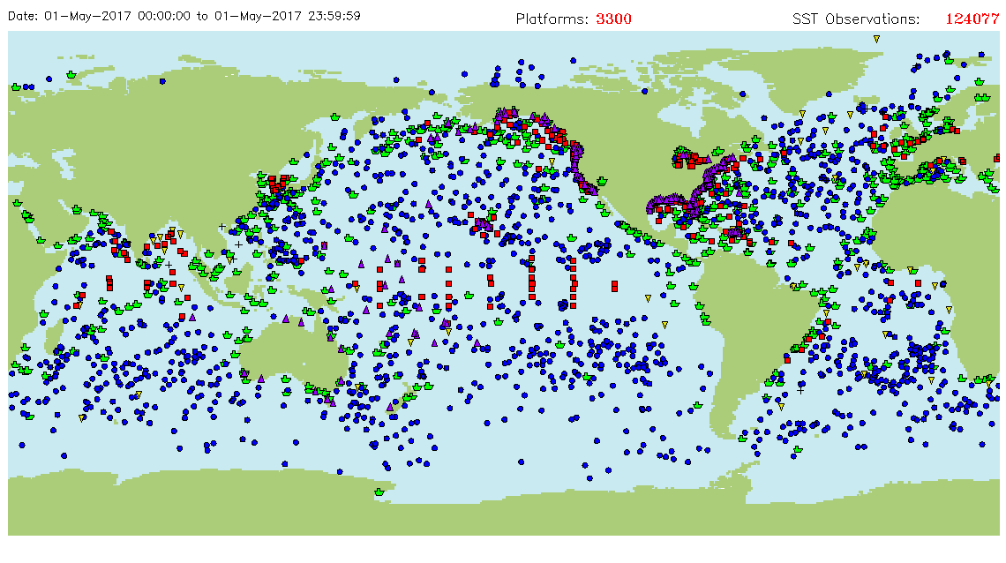
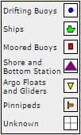
In-situ SST coverage (over 24 hrs) from OSMC
Turton, 2017

Slide 5
Approach (still to do…)
Specify target spatial resolution (r degrees), or resolutions if application or region specific and define the eligible ocean grid points
Over a given time period (perhaps 24 hrs for NWP, 1 month for climate) determine the % of eligible grid points that have a SST observation (from any contributing network) within r degrees
Most appropriate for where global/regional (broad-scale) coverage is required – less so for fixed point and repeat lines where temporal resolution (time-series) are the main driver and for regional coastal observatories/networks
Suggested method would allow to evaluate the spatial coverage of SST and sub-surface T (and potentially other EOVs) and show where the gaps are in relation to the requirement(s)

Slide 6
Gaps?
Simplest way is to show by mapping
A consistent methodology would be to define boxes centred on the specified grid points
Boxes are shaded
Green when nearest observation is ≤ r degrees from its centre
Amber when nearest observation is > r and ≤ r_{a}
Red when nearest observation is > r_{a}
Such a display could accommodate variable grid spacing (e.g. smaller boxes in selected regions)
Turton, 2017

Slide 7
US IOOS Metrics Task Team
Goals:
Determine the audience for metrics
Develop a suite of measurable and repeatable metrics
Recommend a process for US agency contributions
Consider/recommend pilot metric development projects
Suggest ways to assess the impact of metrics
Recommend next steps beyond pilot metrics
Objectives:
Assess landscape of metrics and determine options for IOOS
Develop list of indicators to track
Select 3-5 for beta-testing

Slide 8
Progress

Slide 9
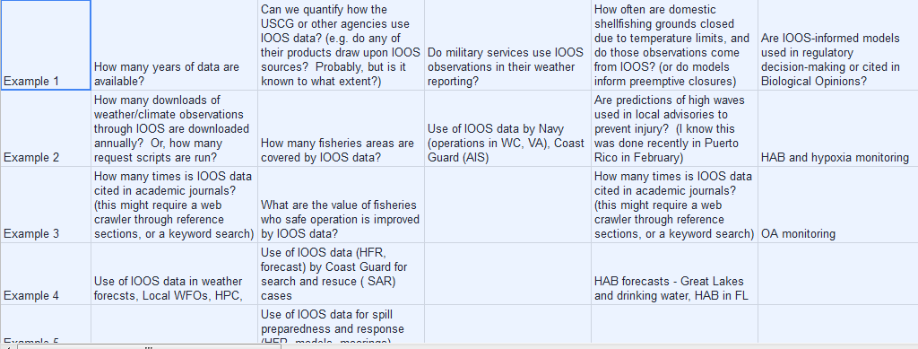
Societal Applications
Weather and Climate | Maritime Operations | National Defense | Public Health

Slide 10
One possible metrics structure
Weather and Climate
Observing
Number of platforms
Data Delivery
Datasets updated/quality controlled/published and available
Modeling and Predictions
Products, Tools, and Integration
Stakeholder decisions
Model development/ improvement and impact
Product development
Average monthly users of products and websites, publication counts
Economic Value
Instruments deployed

Slide 11
Way Forward
Metrics/KPIs are a useful for many purposes
Management/improving system performance
Monitoring changes over time
Telling a story (use cases) e.g. describing the value chain (and sensitivities of outcomes to value chain components)
Suggested way forward
ACTION: Subteam identify a small subset of high-level KPIs for each step in value chain
Lets begin to assemble the value chain
Continue developing variable-based metrics
US will share its progress of the Metrics Task Team

Slide 13
Extra slides

Slide 14
OCG-8 Actions
Jon to work with JCOMMOPS to scope & develop a demo for showing SST and subsurface T variable based metrics and coverage (based on requirements from the OSCAR database) for quantifying and mapping global EOV coverage (following the approach by Lumpkin et al for drifters). Kevin to provide assistance for historical/other data sets.
Develop network KPIs (several networks)
Improve standardization of KPIs in the Report Card

