Slide 1
Summary - JCOMMOPS Day
Objectives: short/medium/long
  Ambitious? Resources too modest?
  Observe what happens beyond Europe.
Priorities/workplan overall agreed by Networks
  Light amendments
  Core services to be defined and “operationalized”
  Networks specifics that make a difference
Chronic deficit (need some actions short/medium) before Review Panel recommendations
  Warning: we cut 1 staff early 2018 …

Slide 2
Summary – JCOMMOPS Day
Workplan:
  WIGOS/OSCAR … not without extra resources
  Link “metadata to data” not a priority
Discussion needed on metadata standards required by JCOMMOPS – cross networks. (roundtable).
List of requirements/services for new networks to be defined (action)

Slide 3
Summary - JCOMMOPS Day.
Consensus to move to the integrated
  Reporting on activities and budget will be eased
  Address workplan item by block
5 years workplan required (action)
  With existing or more means ?
IOC/WMO investment into JCOMMOPS highly expected

Slide 4
Summary – JCOMMOPS Day
Need KPIs for JCOMMOPS
  Operators website users
  Website stats (maps, metadata exports, e.g.)
  Metadata completion
  We happen if we cut on services
Conclusion:
  We are going in the right direction
  But there is a short term reality and no commitments yet.

Slide 5
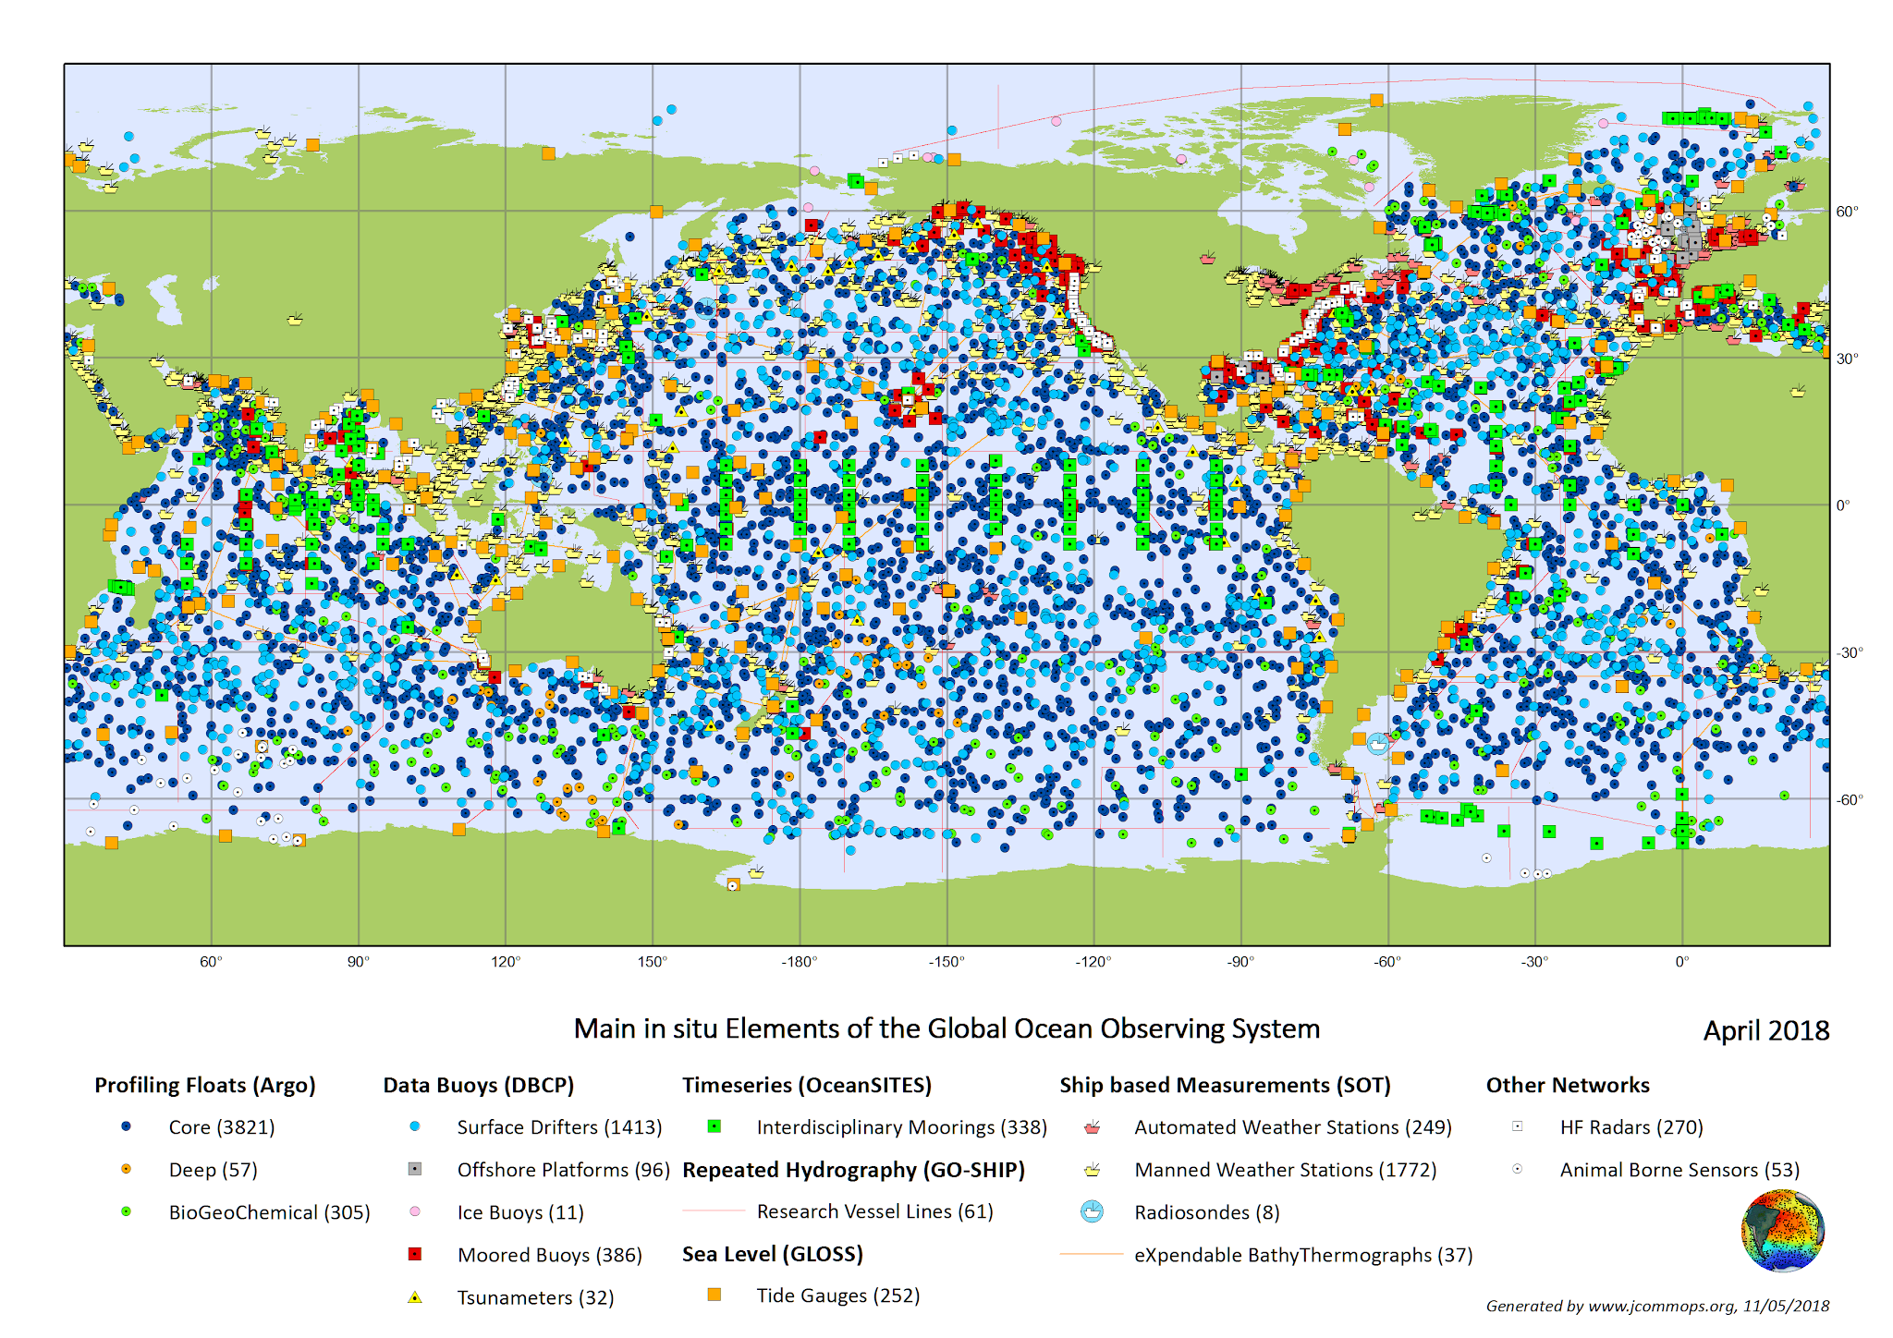
Overview
The vision is simple: Give body, structure and take the pulse of the Global Ocean Observing System, “certifying” every component that is operating, or will operate in the ocean.

