Slide 1
UN Decade of Ocean Science for Sustainable Development (2021-2030)
Notes:
10 year-programme
Collective, global effort, etc.

Slide 2
What is the UN Decade of Ocean Science for Sustainable Development?
Notes:
10 years
Collective, global effort, etc

Slide 3
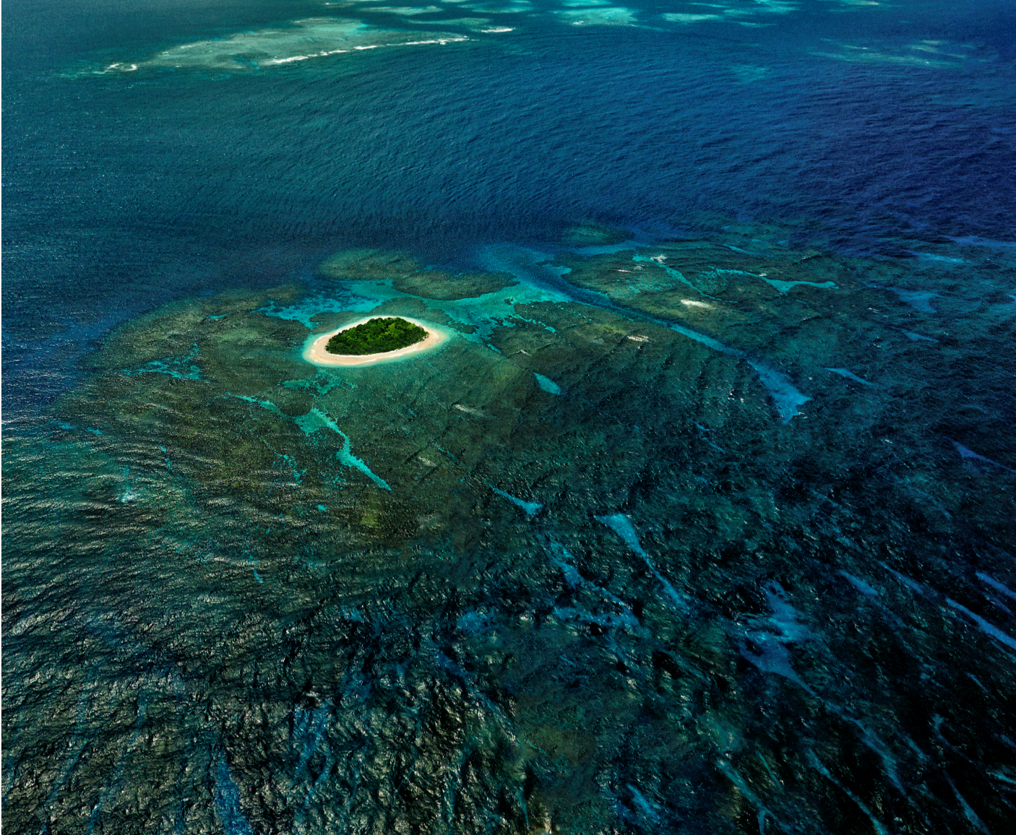
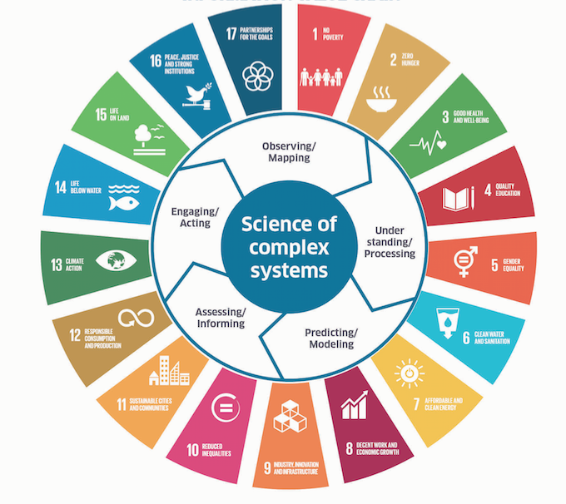
UN PROCESSES for SUSTAINABLE DEVELOPMENT
On 5 December 2017, the UN General Assembly proclaimed the Decade (2021-2030) of Ocean Science for Sustainable Development (Resolution A/72/L.18)
Biological Diversity/Aîchi Biological targets (CBD)
Law of the Sea (UNCLOS + BBNJ + UNFSA)
SIDS Action (SAMOA Pathway)
Disaster Risk Reduction SENDAI Framework
Climate Change/Paris Agreement (UNFCCC)
AGENDA 2030
A global framework that will ensure Ocean Science
can help governments
and societies achieve
the major goals of
our generation
Vavau © Stuart Chape
Notes:
The United Nations has proclaimed a Decade of Ocean Science for Sustainable Development for the 10-year period beginning on 1 January 2021.
This Decade of Ocean Science FOR Sustainable Development will provide a common framework that will ensure Ocean Science can fully support countries in the achievement of the Sustainable Development Goal (and more particularly SDG 14) and will contribute to UN processes (fisheries management RFMOs, SAMOA Pathway, negociations on a future legally binging instrument to sustainably use and protect BBNJ, World Ocean Assessment, IPCC, IPBES).

Slide 4
Ocean Science accounts for only between 0,04% and 4% of total research and development expenditures worldwide (GOSR, 2017)
A global framework to structure and boost scientific efforts nationally and internationally to address global and regional SD challenges
Vavau © Stuart Chape
Notes:
The Global Ocean Science Report found that Ocean Science accounts for only between 0,04% and 4% of total research and development expenditures worldwide. The International Polar Year led to doubling of Norwegian research spending on polar research, and it has not dropped back but remained at the high level !
Imagine what a decade can do for global opposed to very geographically limited oceanography.
The Decade will build on regional and global existing machanisms, programmes, research, and develop a global framework to structure and boost scientific efforts nationally and internationally to adress global and regional SD challenges. Investment in marine research will be leveraged through partnerships.
:
The Decade will improve the scientific knowledge base through capacity development: To regions and groups that are presently limited in capacity and capability Especially SIDS and LDCs

Slide 5
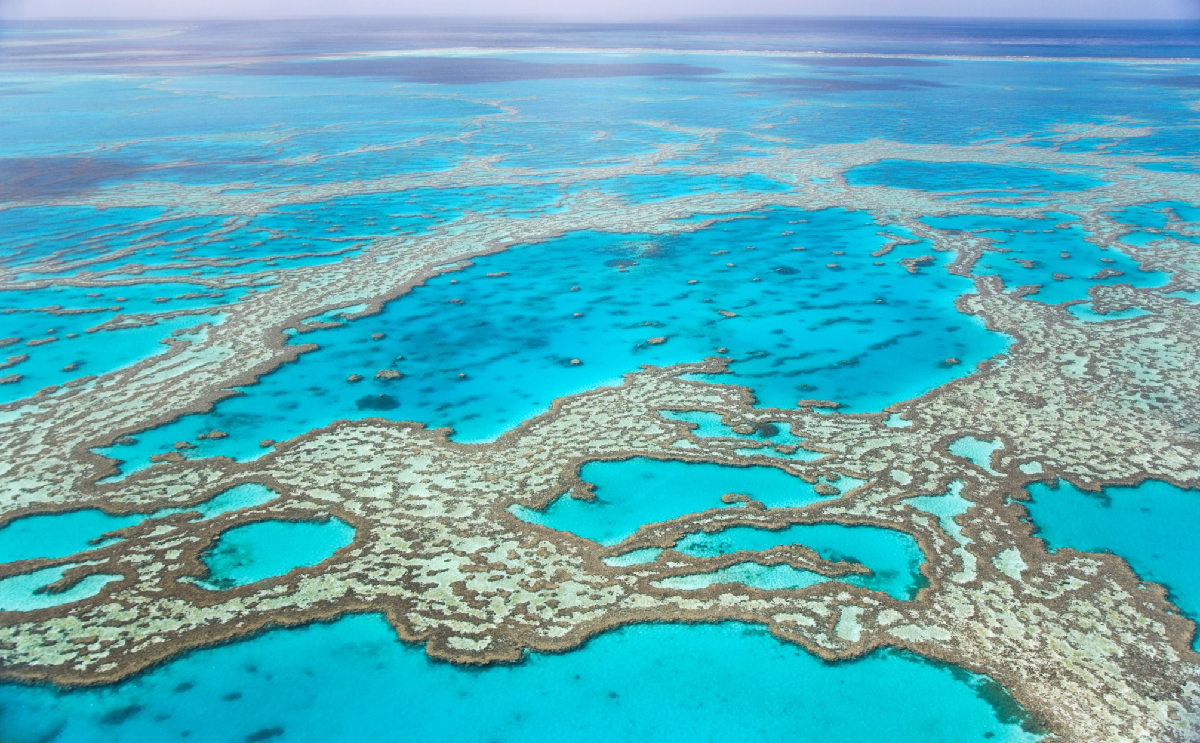
A Vision for the Decade
Develop scientific knowledge, build infrastructure, and foster partnerships for a sustainable and healthy ocean

Slide 6
THE DECADE : RESPOND TO SOCIETAL NEEDS, CONTRIBUTE TO ALL SDGs, FOSTER NEW SCIENCE PROGRAMMES
Contributions to global targets
(not exhaustive)
Grand Challenges/Societal needs
Science outcomes
Decade activities/programmes to be developed (examples)
SDG 14.1 Pollution
SDG 3 –Health well being
SDG 15 Land
SDG 11, 12 – consumption /urbanisation, etc
A clean ocean
Mapping the Ocean
Cumulative Stressors prog.
An Inventory of Ocean Ecosystems and their functions
Polar Obs. System
SDG 1 Resilience
SDG 13 –Climate Change
SDG 7 – renewable energy
SDG 16 Effective institutions
A healthy and resilient ocean
Marine Technology Hub
An Ocean Observing System for All Major Ocean Basins
SDG 8 Blue economy
etc
A predictable ocean
Seafloor Mapping –SB 2030
SDG 13 CC impacts
SDG 13 –Resilient Coastal cities
SENDAI /UNFCC
An integrated multi-hazard early warning systems for all basins
A safe ocean
Ocean Health research prog.
Ocean Literacy for all Prog
A sustainably harvested and productive ocean
Accelerated technology transfer, training and education
SDG 1 Reduce poverty
SDG 2 Food security
Programme X
Programme Y
SDG 16 Peaceful and inclusive society
SDG 4 Education
etc
An open and accessible ocean
A global ocean data portal
Programme Z
community partnerships,
Regional scale /thematic contributions to IP
OVERARCHING GOALS
To provide ocean science data and information to inform policies for a well functioning Ocean in support of all sustainable development goals of the Agenda 2030.
To generate the scientific knowledge and underpinning infrastructure and partnerships needed for sustainable development of the ocean
Notes:
Start by focusing on Grand challenges, which are supported by global targets agreed internationally (SDG, SAMOA, UNFCCC etc…), these societal objectives will be achieved through a number of major science driven outcomes, these outcomes will be attained by alligning and coordinating initiatoves as well as promoting new programmes conrtibuting to the outcomes

Slide 7
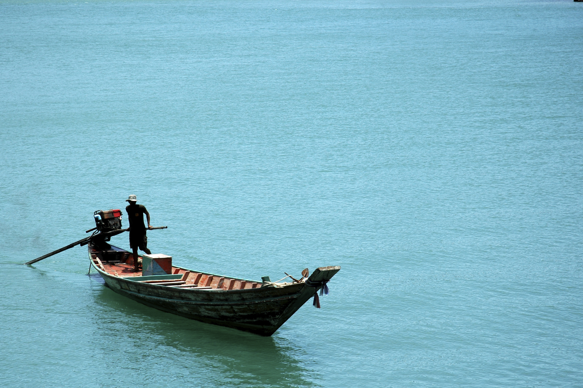
A Decade to…
TRANSFORM
knowledge systems
to support
sustainable
development
Complete mapping of the seafloor
eDNA Sequencing of marine life
Integrated research on climate change impacts
Science products for maritime industries
Enhanced sharing of data and information
Potential activities ….
Notes:
To transform knowledge of the ocean system, its role in the earth and climate system, including the human component, its biodiversity and the seabed, to support sustainable management.

Slide 8
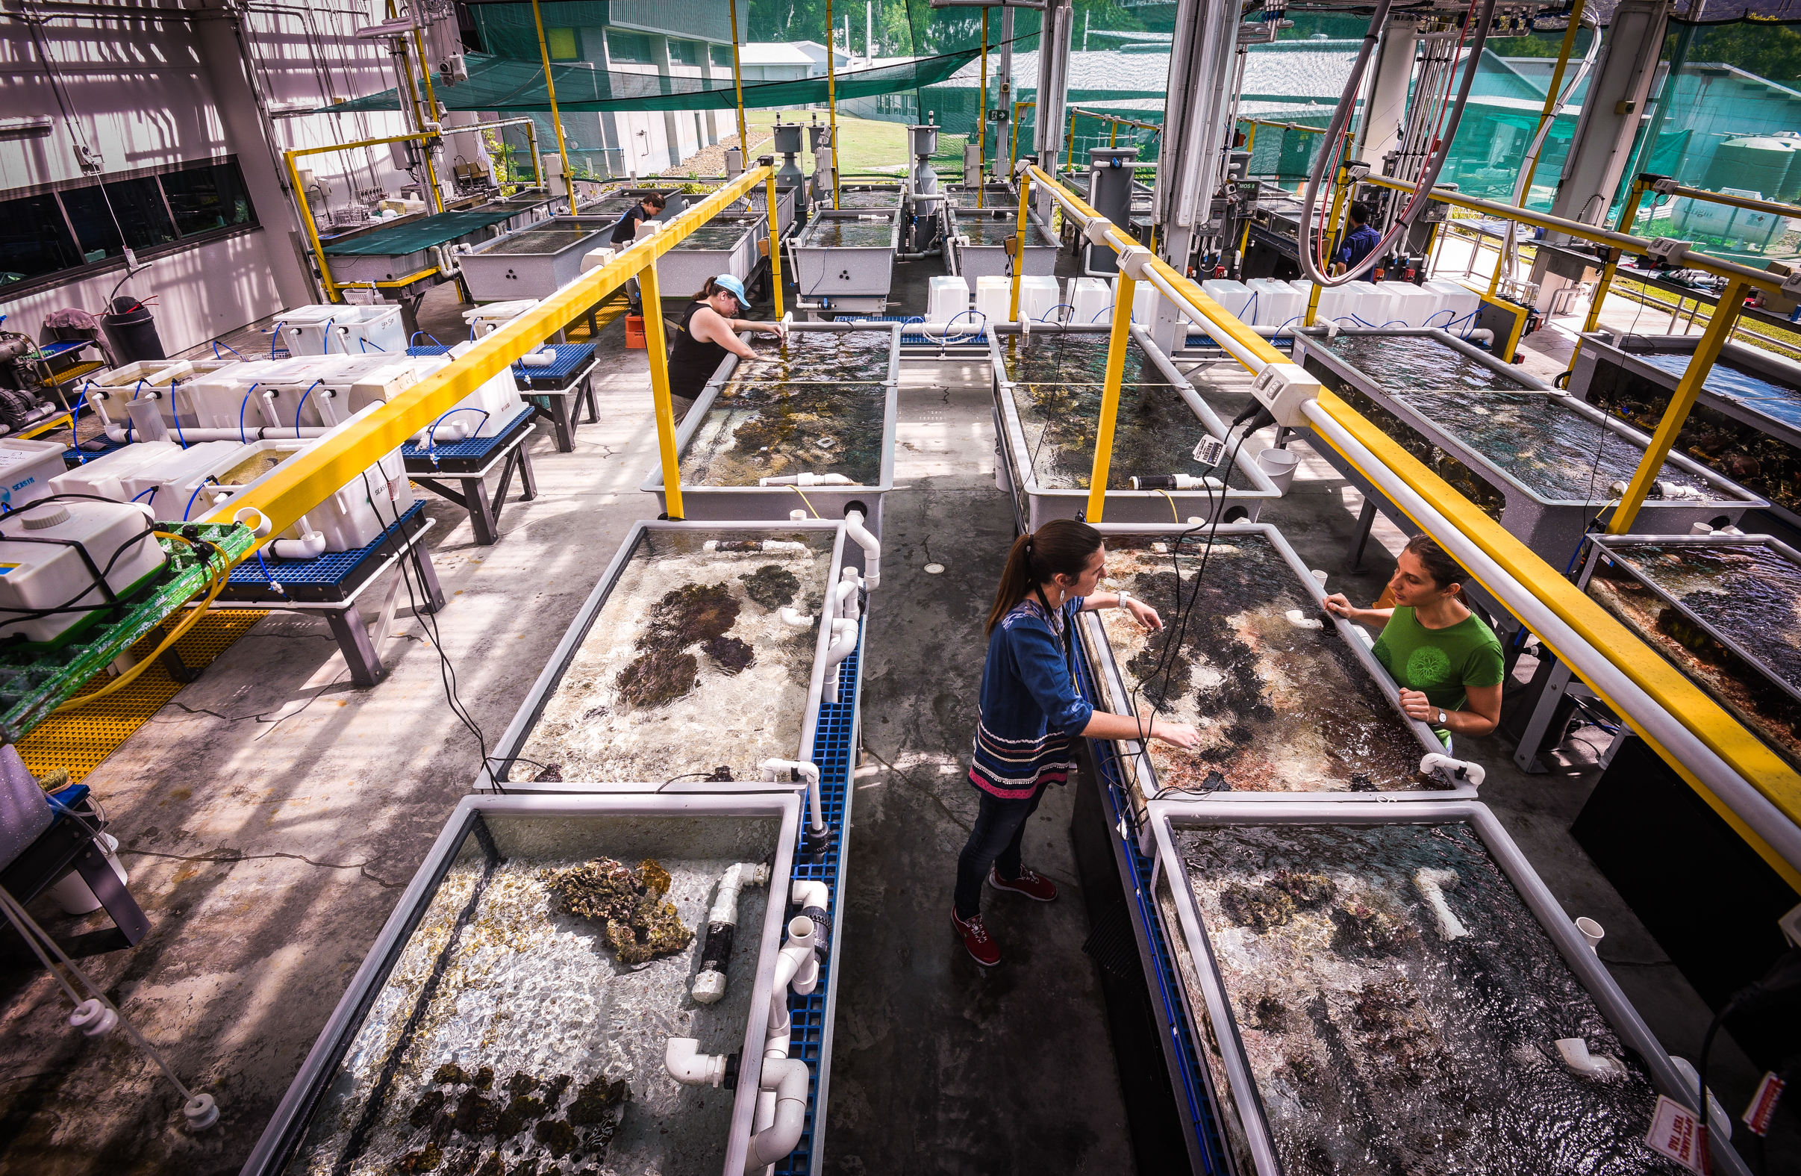
A Decade to…
MEASURE
cumulative impacts
for effective
solutions
Ocean health research programme
New environmental services from ocean data/satellite
Ocean productivity and biodiversity
EBM Tools and models
Potential activities ….
© AIMS/Christian Miller
Notes:
To transform understanding, and elucidate the cumulative impacts, of multiple stressors and develop a comprehensive evidence base and capacities for an interdisciplinary adaptive approach towards ecosystem-based management that will reverse ocean health degradation and promote a blue economy.

Slide 9
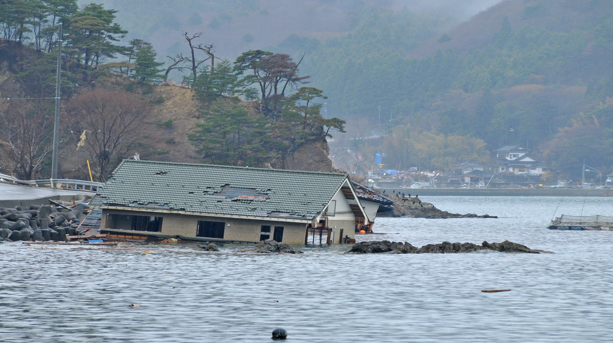
A Decade to…
REDUCE
vulnerability to ocean
and coastal hazards
Improved coastal hazards warnings syst.
Better mapping of vulnerable areas
Coordinated programme of OA research, including forecasting
Sea-level change and coastal impacts projections
Potential activities ….
Notes:
To reduce risks from extreme events and ocean-related hazards for coastal communities and people using the sea through an accelerated program of research and development supporting integrated multi-hazard early warning systems, accompanied by improved community preparedness and awareness.

Slide 10
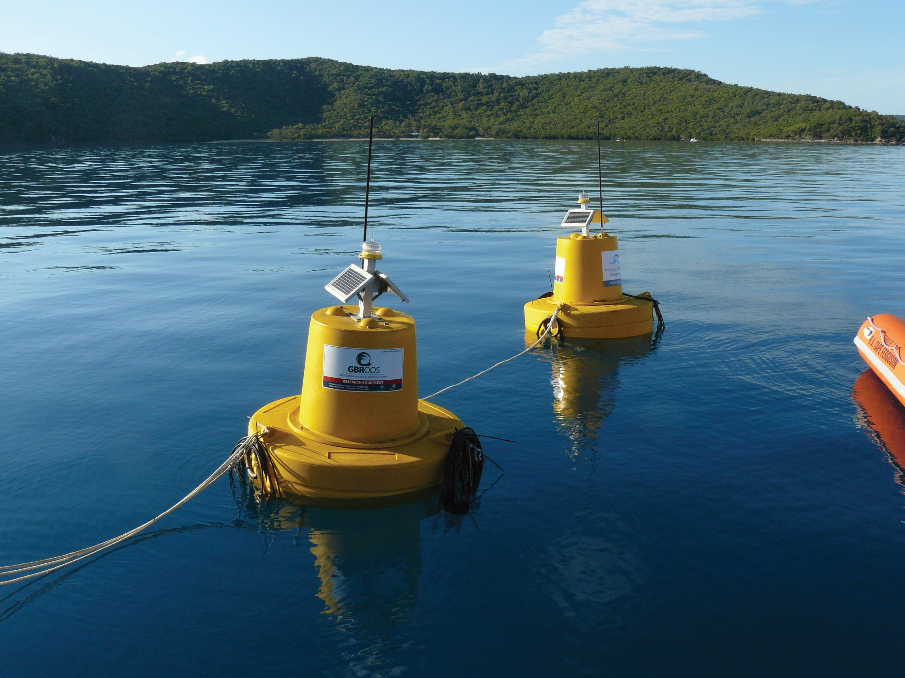
A Decade to…
BOLSTER
ocean observing
and data systems
An Ocean Observing System for All Major Ocean Basins
New ocean technologies
Operational Deep Ocean Observing System
Open access, data portal for all
Social science metrics
Potential activities ….
© AIMS/Scott Bainbridge
Notes:
To enhance and transform ocean observing networks, data systems and other infrastructure, and the cooperation and partnerships that supports it to service the demands of all nations by 2030 and beyond.

Slide 11
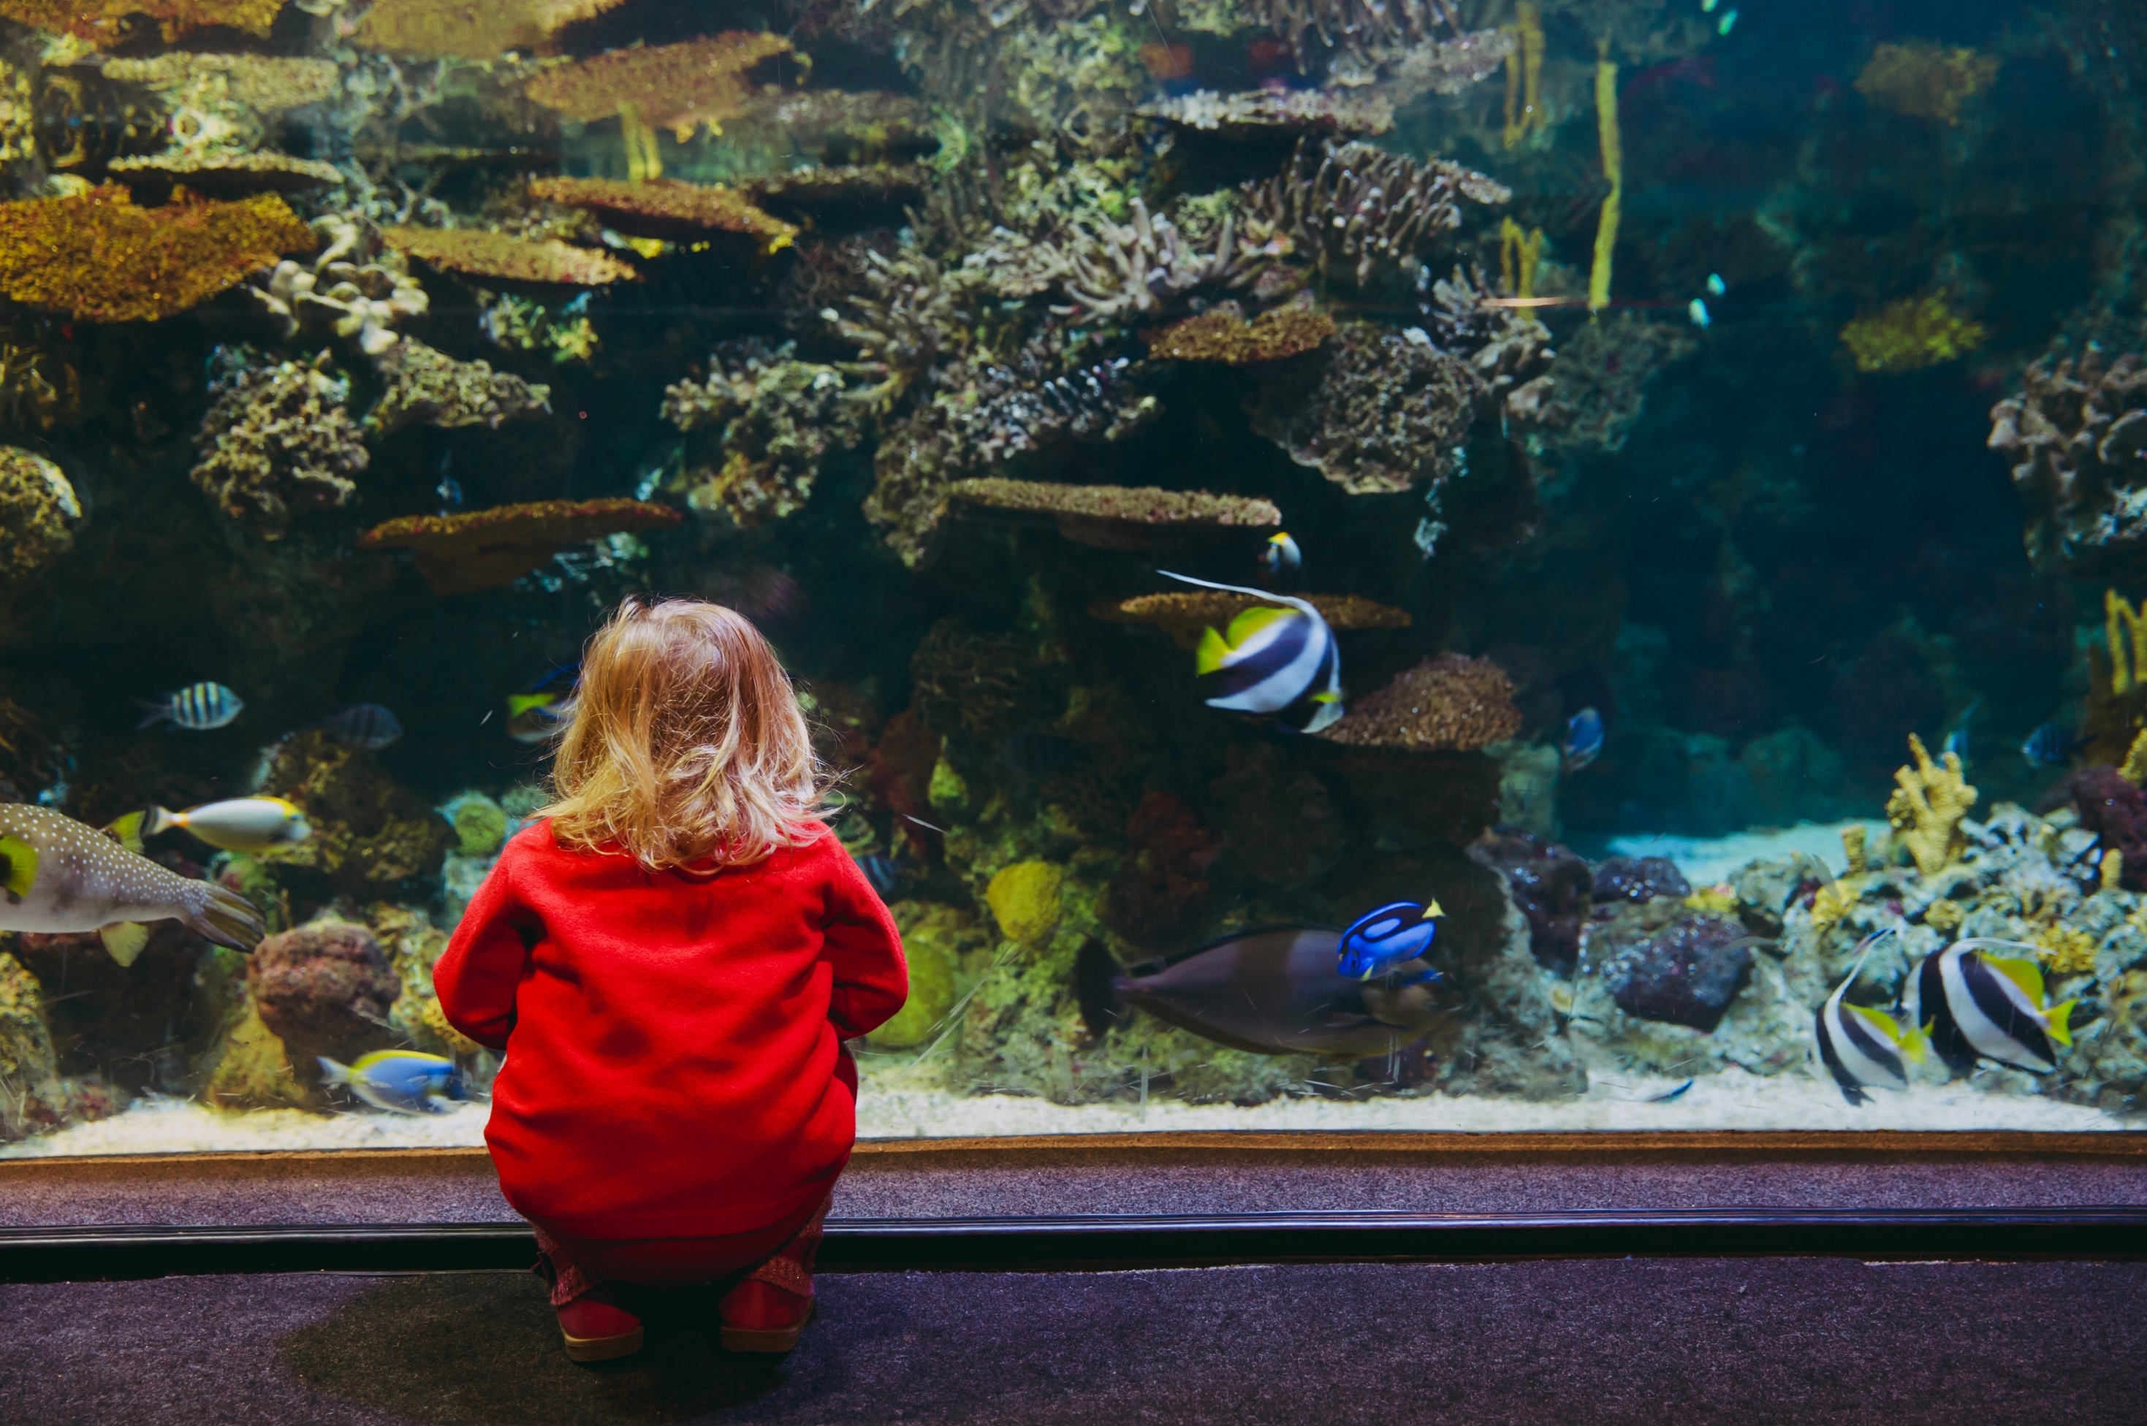
A Decade to…
ACCELERATE
transfer of marine
technology, training
and education
Marine technology transfer/exchange hubs
Self-driven regional capacity development programmes
Ocean literacy initiatives
Citizen science
Gender focused programmes
Potential activities ….
Notes:
To enhance/transform the scientific and technical capacity of the ocean stakeholders, especially for SIDS and LDCs, through greater access to and more informed use of scientific knowledge and accelerated transfer of marine technology, training and education, and increased ocean literacy so that all can participate in, and benefit from, developments in ocean science and technology and its application for sustainable economic development, food production, ocean management, assessments, and responses to climate change.

Slide 12
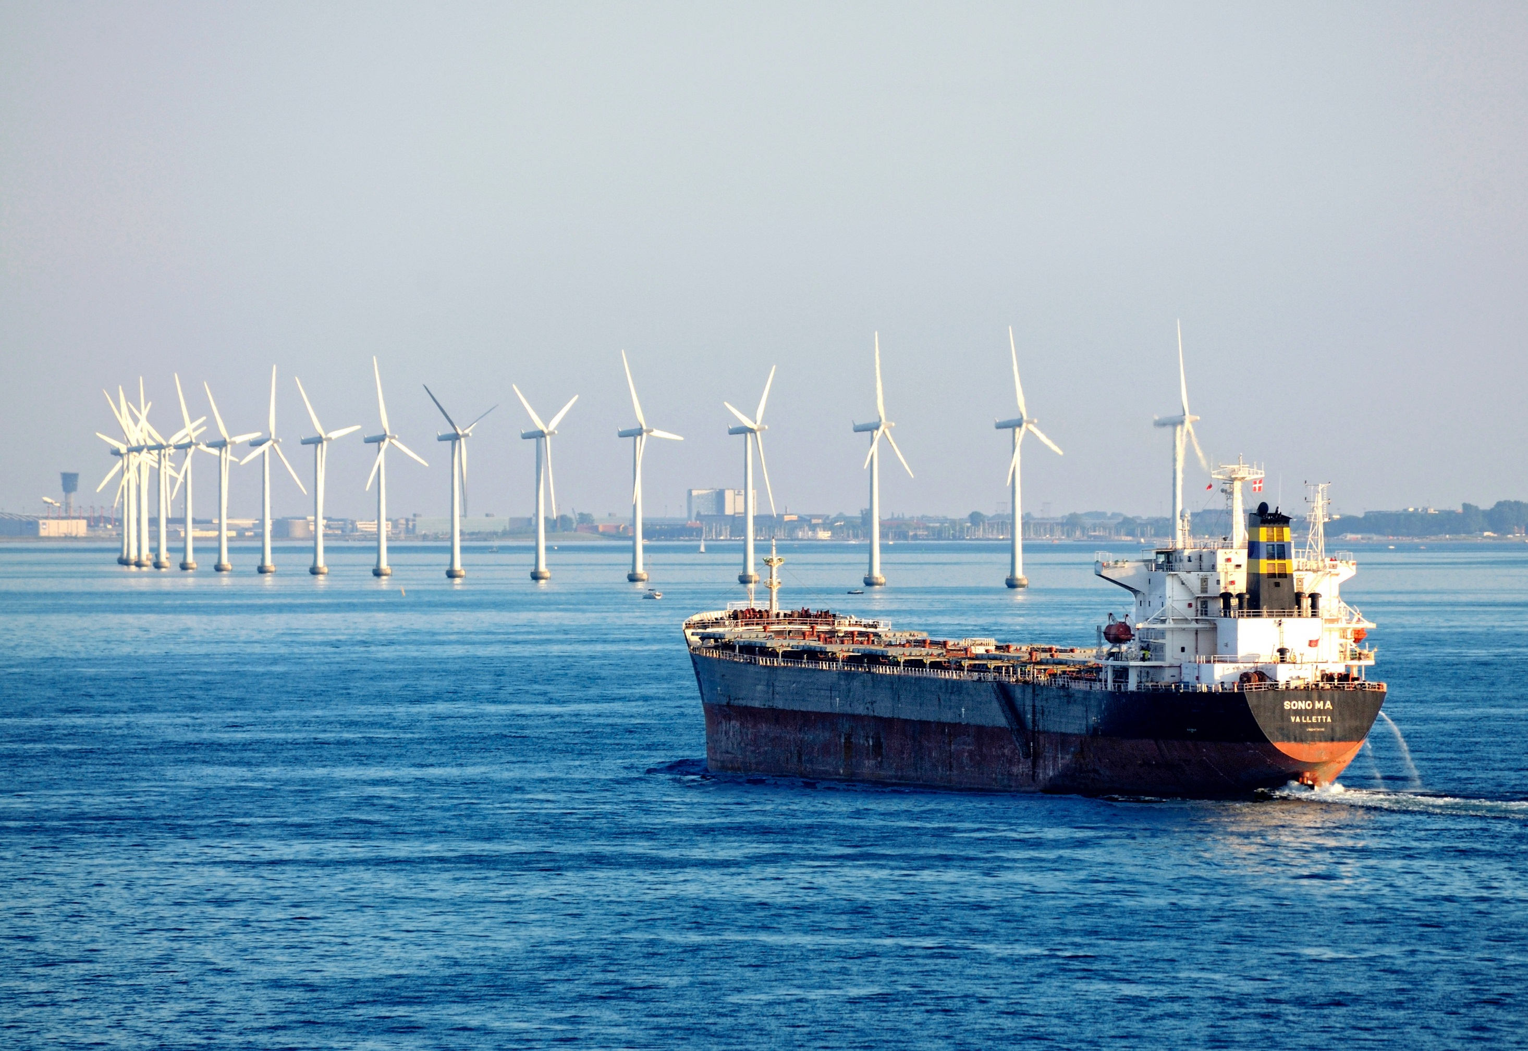
A Decade to…
DELIVER
best available knowledge
to decision-makers
Promotion of Science/policy mechanims
Consolidated network of Decade partners
Enhanced National arrangement for SD
Regional & global dialogue enhancement
Peace through science initiatives
Potential activities ….
Notes:
Enhanced cooperation, coordination, and communication between stakeholders, including the private sector, in ocean science, with faster and more effective delivery of new and existing knowledge to policy and decision-makers in the context of the 2030 Agenda, and beyond.
Focus will be placed on infrastructure and data system that make this information available to all.

Slide 13
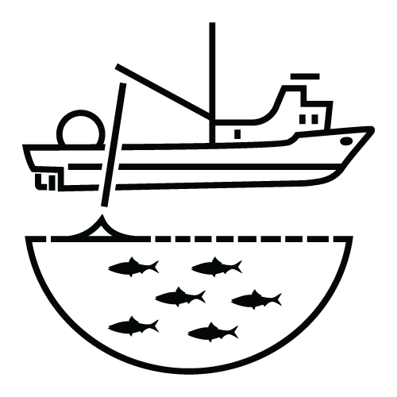
Key Applications of Decade Breakthroughs
Marine
Spatial
Planning/
Blue economy
Coastal zone
management
and adaptation
Establishment of
Marine Protected
Areas
Nationally
Determined
Contributions
to UNFCCC
Development of
national ocean
policies
Fishery
management
Regional and
national capacity
development
planning
Development of
national R&D
strategies
Early warning
systems
Notes:
This Decade will empower decision-makers with Science solutions.

Slide 14
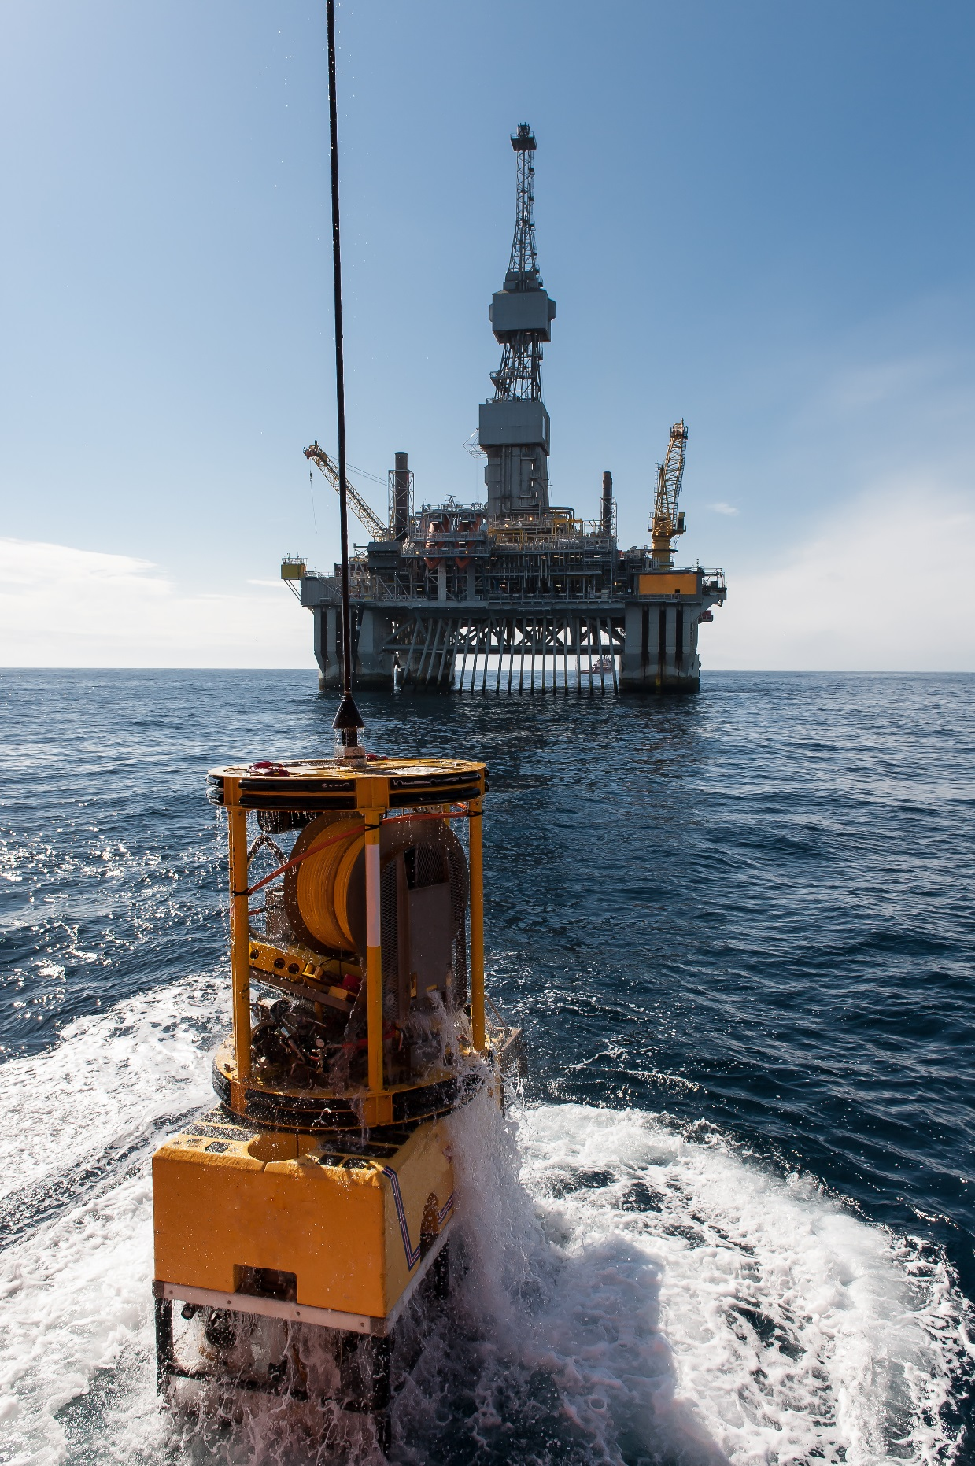
Planning Phase:
2018-2020
Notes:
10 years
Collective, global effort, etc

Slide 15
Between 2018 and 2020, the UNGA tasked IOC with preparing the Decade and coordinating the development of an Implementation Plan:
- Science Plan
- Capacity Development Plan
- Resource Plan
- Communications &
Engagement Plan
- Monitoring & Reporting
Vavau © Stuart Chape
Notes:
The United Nations called upon IOC (please explain very briefly what is IOC) to prepare an implementation plan for the Decade in consultation with Member States, specialized agencies, funds, programmes and bodies of the United Nations, as well as other intergovernmental organisations, non-governmental organisations and relevant stakeholders.
The Implementation Plan will include the following elements :
An international Science plan that will define key issues, priority scientific questions of high relevance to sustainable development (Agenda 2030) and will propose scientific themes and outcomes to structure the implementation of the Decade. The Science Plan should also define the modalities for synthesizing the results of research activities undertaken during the Decade;
A Capacity Development Plan with the objective to greatly improve the scientific knowledge base, transfer of marine technology, and education in regions and for groups that are presently limited in capacity and capability, especially SIDS and LDCs. The Plan will provide detail on the strategy and actions needed to significantly enhance the opportunities and equitable access to economic benefits arising from marine resources and technology, including from areas beyond national jurisdiction;
A Resource mobilization Plan/Business Plan which will describe the Decade specific financial mechanisms as the success of the Decade will depend on its financing;
A Communication and Engagement Plan that will define the networking tools to investigate for the challenge of networking Decade scientists, describe the Decade branding, designate spokespeople for the Decade and the dedicated resources, use of web-based or other modern forms of communications. The Engagement Plan will emphasise engagement and involvement and the value the Decade may provide for the identified stakeholders.

Slide 16
Decade Process : a transformative and participative process
UN/non-UN support
National commitments/contributions
PORTFOLIO
Selection of contributions to realize the Goals of the Decade with proactive monitoring and adjustment base on performance, risk and objectives
PROJECTS
Management of execution, resources, budget and schedule to deliver a specific project outcome/benefit
PROGRAMMES
Management of all the projects (grouped into Programmes) that are necessary to realise the expected benefits and outcomes
THE DECADE
The leadership, processes and structure to enable delivery of a successful Decade of Ocean Science for Sustainable Development
NGOs contributions
Existing system/support
Vavau © Stuart Chape
Notes:
The Decade will be a participative and transformative process

Slide 17
Ocean & sustainable development concerns
Awareness raising
Policy and management solutions to achieve Agenda 2030
Ocean Science & technology
Ocean policy sustainable development
Businesses and industries
Civil society
NGOs
Deliver Ocean knowledge & new transformative Science
Technological Solutions providers
Applications to blue economy
Support Ocean Science and Sustainable Development
Donors/
fondations
Who is being engaged?

Slide 18
HOW TO PREPARE THE DECADE : PREPARATORY PHASE (2018-2020) GOVERNANCE
REGIONAL WORKSHOPS
(Regional stakeholders)
IOC GOVERNING BODIES
(IOC MS)
Reports to UNGA
PLANNING GROUP
Expert advisory body
(Scientific Experts and Ocean users)
IOC SECRETARIAT
UN-OCEANS
STAKEHOLDER FORUM
Consultative body, coordinating stakeholders contribution at institutional level
(Global Stakeholders)
UN Agency
UN Agency
Science Community
Policy-makers, practioners
Businesses & Industries
Civil Society
Donors
UN Agency
Notes:
The overall formulation of the Decade’s Implementation Plan (IP) will be supported through two interlinked mechanims, namely:
An Executive Planning Group (EPG) composed of appointed experts and serving as an expert advisory body to the IOC governing bodies to support the development of an IP for the Decade and the delivery of other activities;
A stakeholder Forum composed of institutional members representing various interest groups, acts as a consultative body to the IOC goberning bodies, and aims to engage a wide range of relevant stakeholders.
IOC Secretariat will provide administrative, technical and editorial support to the Planning Group. The IOC Executive Secretary will coordinate the work of the Planning Group.

Slide 19
UN-Oceans
Meeting
Planning Group ToRs approved by IOC-EC 51 (June)
Interim report to IOC XXX Assembly
UNGA Resolution proclaiming Decade
Endorsement of plan by IOC EC-52
UNGA consideration of Implementation plan
Interim Planning Group established
Global Meeting# 2
+ Stakeholder Forum (Q1)
Global Meeting# 1
+ Stakeholder Forum (Q1)
2018
2019
2020
2021
1st Meeting EPG (Nov)
Regional Workshops
2nd Meeting EPG (Nov)
Imp. Plan review by MS and other stakeholders
Official start of Decade
Preparation Phase
UNGA 72
UNGA 73
UNGA 74
UNGA 75
Preparing for the Decade: Next Steps
Notes:
The IOC Executive Council will formally established the Planning Group during its 51st in July 2018.
The Planning Group will meet at least twice during its term, once during each of the IOC intersessional periodes 2018-2019. Representatives of the Planning Group will be invited to share information, inter-act and receive inputs on the elements of the IP.
Two physical meetings of the Stakeholder Forum will be organized, back to back with the regional meetings in the preparatory phase. It will provide inputs through the expertise, knowledge, data, information and capacity-building experience of its members on the work carried out by the EPG.
The IOC Executive Council will endorse the Decade Implementation Plan at its 52nd session, in 2020.

Slide 20
Decade: Mutually Acceleration of Science and Practice
Science planning –> +/- top-down
Pickup by practice –> stimulated bottom-up
Science
Science
Practice
Science
Practice
Practice
Notes:
The emphasis is on the transformative approach, the way we are setting up the science agenda, articulating clearly to the needs of policy makers, ocean industries, civil society in the framework of the sustainable agenda, will hopefully lead to new partnerships delivering reformed and more effective science-based management of ocean space and resources.
New knowledge on current state of the science will be made available to all communities and governments, supported through appropriately scaled capacity development that provides not just tools to conduct marine science but the capacity to understand the science and use this understanding to inform society and policy makers.

Slide 21
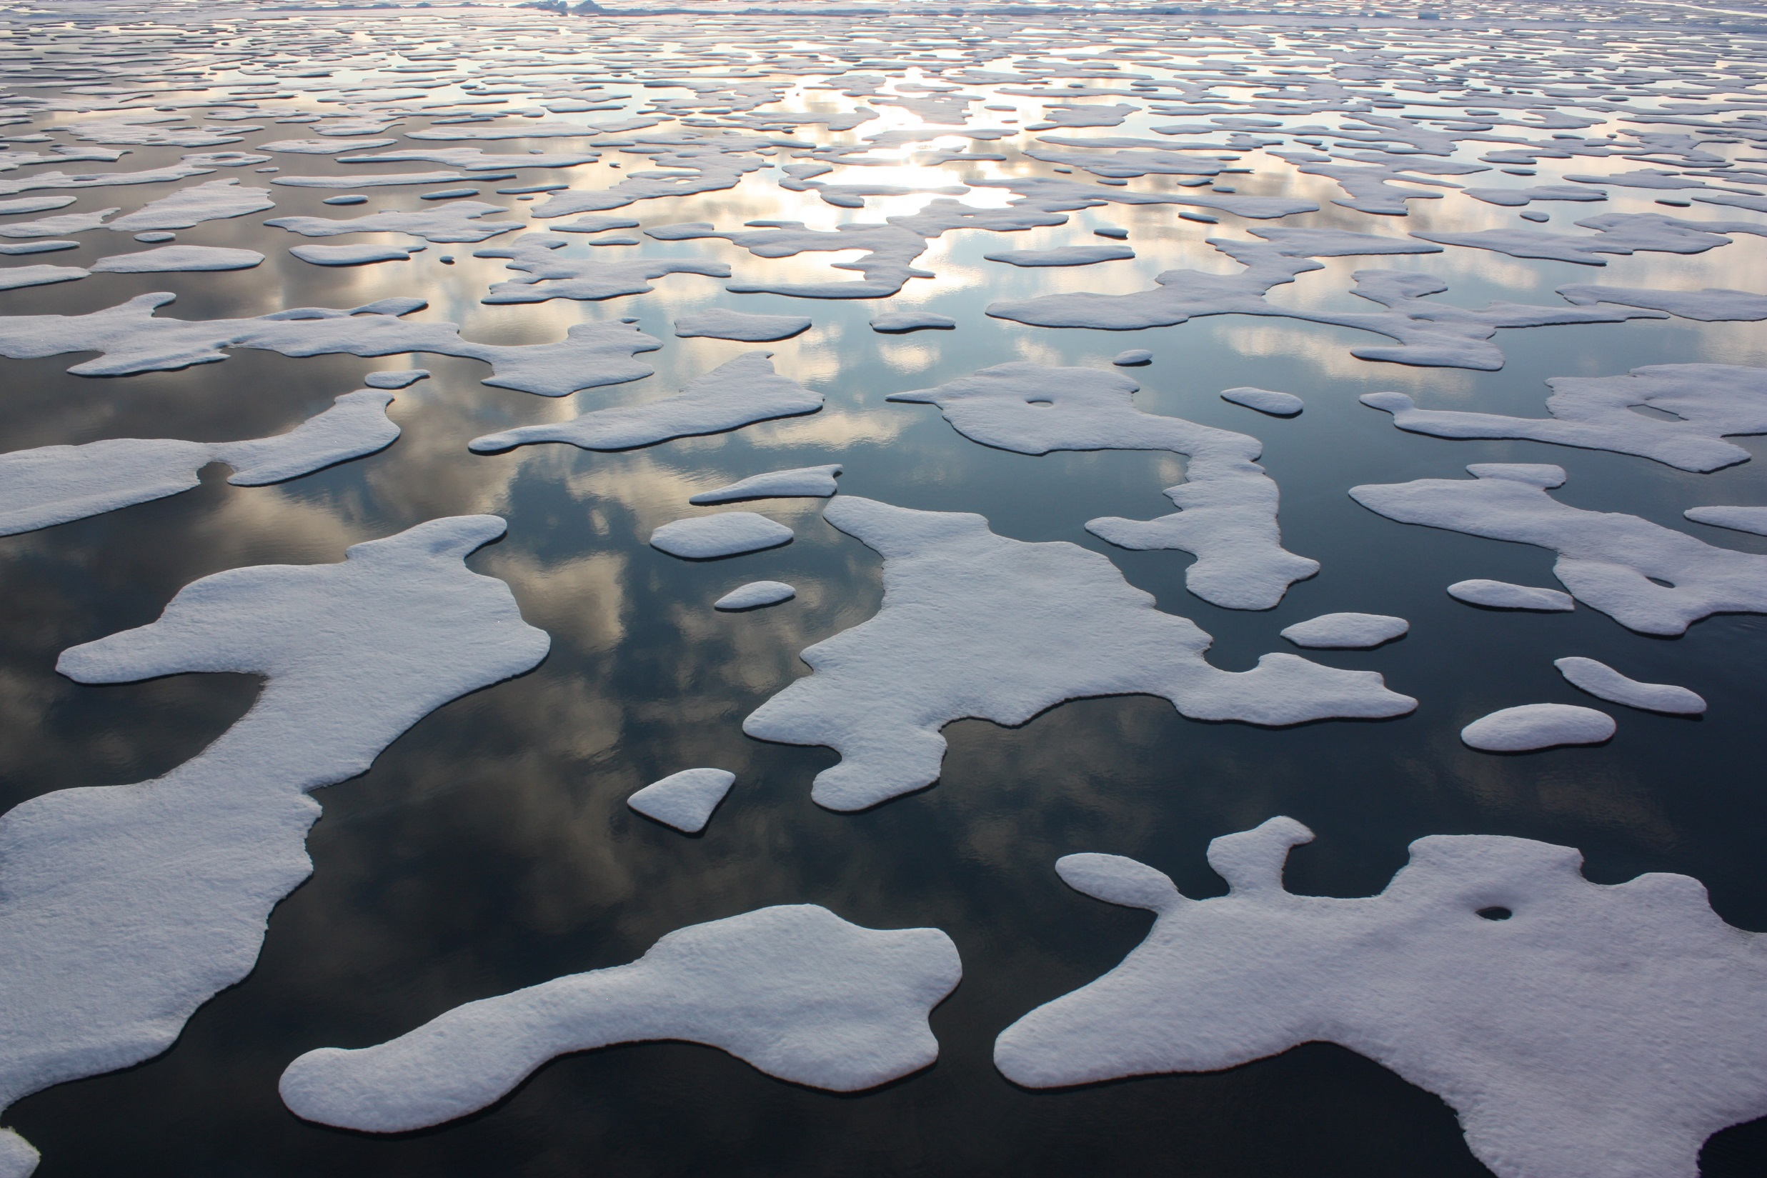
OCG and the Decade
An opportunity to highlight innovation actions
Observing network context:
New technology and observing capability
Data integration and availability
New uses of observations
Systems context (GOOS and JCOMM):
New partnerships in the value chain to improve delivery of information
Highlighting knowledge around value creation
National context:
An opportunity to raise the visibility of ocean observations and their delivery for sustainable development
CC BY 2.0 by NASA Goddard Space Flight Center
Notes:
A Call for inputs and contributions towards the planning phase of the Decade will be launched.
Contribute to the Planing Process : submit ideas or participate in Decade dedicated workshops;
Host and organize events: consult stakeholders, communicate about the Decade and identify opportunities for investment and resource mobilization;
Provide staff and/or financial support : help IOC and its preparing activities;
Communicate : share the purpose and expected results of the Decade, its planning phase and preparatory activities.
Move to notes everything that is not underlined

Slide 22
Get in touch Write to us: oceandecade@unesco.org Follow all Decade news: http://en.unesco.org/ocean-decade Social media:
The United Nations Decade of Ocean Science for Sustainable Development (2021-2030)
IocUnesco
IocUnesco
ioc_unesco
The Ocean We Need
for the Future We want
Notes:
Are you interested in working toward the ocean we need for the future we want? Let us know and we will keep you informed of all future developments.

Slide 23
Strategy 2030
Vision
A truly global ocean observing system that delivers the essential information needed for
our sustainable development, safety, wellbeing and prosperity
Mission
To lead the ocean observing community in growing an integrated and sustained global observing system
For
Climate • Operational services • Marine ecosystem health
Strategic Objectives
Engagement & Impact | 1. Strengthen partnerships, to improve delivery to end users from observations through forecasts, services, and scientific assessments | 2. Building advocacy and visibility for the sustained observing system with stakeholders, including key users and national funders | 3. Regularly evaluate the system to assess fitness-for-purpose | 4. Strengthen knowledge and exchange around value creation from ocean observations, empowering local spread of end user applications
Integration & Delivery | 5. Provide authoritative guidance on implementation for integrated observing; synthesizing across evolving requirements | 6. Sustain, strengthen and expand observations coordination through GOOS and partner communities | 7. Ensure GOOS ocean observing data and information are findable, accessible, interoperable, and reusable; with appropriate quality and latency
Building for the future | 8. Support innovation in observing technologies and networks | 9. Develop capacity to ensure broader participation in and benefit from GOOS | 10. Extend systematic observations to measure human pressures on the ocean | 11. Play a leading role in establishing effective governance for global in situ and satellite observing, together with partners and stakeholders

