Slide 1
OCG-9: Expectations and objectives
David Legler
National Oceanic and Atmospheric Administration (NOAA)
9th Session of the JCOMM Observations Coordination Group
15-17th May 2018, Brest, France

Slide 2
JCOMM Structure
Observations
Data Management
Services and Forecast Systems

Slide 3
OCG Terms of Reference (briefly)
Review and advise on effectiveness, coordination, and operation of observing systems, advise on possible observing solutions, including consideration and trade-offs of new technologies to meet emerging new requirements
(a) Review and advise on the effectiveness, coordination and operation of the Observations work programme
Advise on possible solutions for newly-identified requirements;
Examine trade-offs and use of new and improved observation techniques/developments against: requirement
Coordinate the development of standardized, high quality observing practices and instrumentation;
Coordinate JCOMM’s contribution towards WMO Integrated Global Observing System;
Review in situ data requirements and recommend changes, (and factor in satellite observations);
Liaise with WMO Commissions (Basic Systems, Instruments and Methods of Observation)
Identify capacity development requirements related to the programme area;
Identify requirements on satellite data in the meteorological and ocean domains related to the Programme Area.
HOW: expert teams, task teams, and pilot projects
Standards (develop and follow): observing, instrumentation, traceability, data
WMO interface: support development of WMO Integrated Observing System (WIGOS), support of CBS, requirements collection
Identify capacity development requirements
Emphasis areas: Best practices and standards (across the JCOMM ocean observing enterprise)
REQUIREMENTS: (GCOS, GOOS, Commission for Basic Systems, etc)
Notes:
Won’t be discussing the WMO interface or Capacity development… these are important areas, but probably worth a separate webinar
(a) Review and advise on the effectiveness, coordination and operation of the Observations work programme
Advise on possible solutions for newly-identified requirements;
Examine trade-offs and use of new and improved observation techniques/developments against: requirement
Coordinate the development of standardized, high quality observing practices and instrumentation;
Coordinate JCOMM’s contribution towards WMO Integrated Global Observing System;
Review in situ data requirements and recommend changes, (and factor in satellite observations);
Liaise with WMO Commissions (Basic Systems, Instruments and Methods of Observation)
Identify capacity development requirements related to the programme area;
Identify requirements on satellite data in the meteorological and ocean domains related to the Programme Area.
HOW: expert teams, task teams, and pilot projects
REQUIREMENTS: (GCOS, GOOS, Commission for Basic Systems, etc)

Slide 4
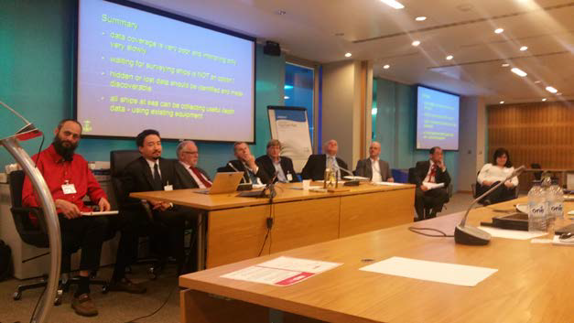
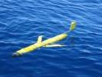
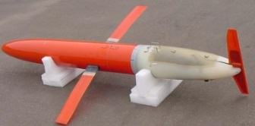
Progress Since OCG-8
Implementation
The ocean observing system has continued to operate nominally!
Getting organized! SOT changed categories, new ID scheme, new recruitment strategies, engagement with shipping industry.
GO-SHIP cruise I07N reoccupied for the first time in 20 years (cruise is underway!)
New wave sensors on 40+ drifters
Tropical mooring tech refresh in TAO, PIRATA, RAMA
Inaugural Global CO₂ network meeting…plans for a pCO2 network
Growth of the coastal HF Radar network (Canada, Australia, etc)
Updated MEOP animal profile database

Slide 5
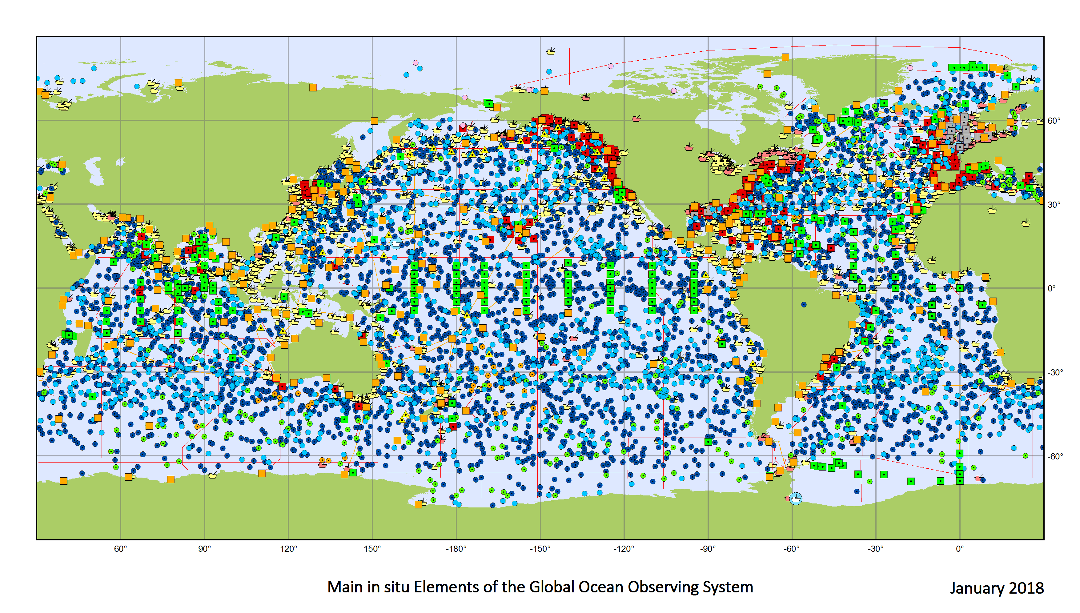
Progress Since OCG-8
Performance and JCOMMOPS
First ever JCOMM Ocean Observations Report Card
All networks are developing performance measures by which we can measure and monitor progress and ultimately communicate risks and impacts
Staffing improved through contract help
A review of JCOMMOPS initiated

Slide 6
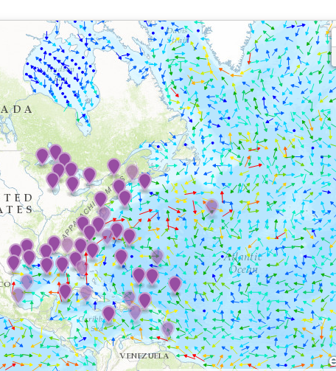
Progress Since OCG-8
Standards and Best Practices
Several workshops, good integration with other groups
Master list of relevant Best Practices initiated
Repository of these documents identified
Data Management and Integration
Welcome Kevin O’Brien, new OCG vice chair for Data and Information
Successful demonstration of OpenGTS pilot project
New JCOMM DMPA leadership: Welcome Surgey!
This week: Next steps for OpenGTS pilot? New

Slide 7
What it Means to be an OCG Observing Network
Global in scale (e.g. implementation and/or impacts )
Map against GOOS observing requirements
Sufficient financial commitments to be sustained (beyond research)
Coordinates a community of best practice and governance; agreed best practices to ensure consistent delivery of observational data.
Has implementation targets that guide development
Is sufficiently ‘mature’ per the FOO (beyond pilot)
Open provision of data (beyond national boundaries)
Has a data management infrastructure that delivers data through an internationally recognised set of data centres or services.
Actively participates in JCOMM OCG meetings & initiatives
Contributes towards development of cross-network capabilities
Engages in GOOS (advance global ocean observing)
Supports monitoring of the integrated system status, e.g. - JCOMMOPS
Notes:
Qualifications (inspired by Framework for Ocean Observing):

Slide 8
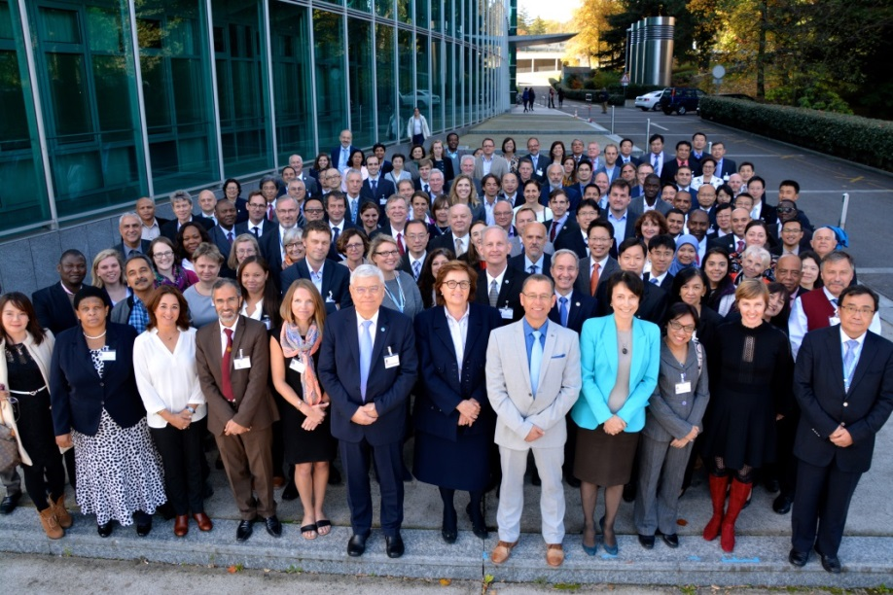
Relevant JCOMM 5 Outcomes
JCOMM 10-year vision (under development)
Approval of OCG intra-sessional work plans
Updated vision (more later)
Capacity building emphasized
Successful Report Card
debut!
Note: Meeting in Geneva, not Bali

Slide 9
JCOMM 5 Vision for OCG
OCG will review, advise on and coordinate ocean and marine observing systems and activities (e.g. improving integration of data through use of data management standards and pilot projects; utilization of new technology/platforms)
Contribute towards fit-for-purpose, integrated and coherent observing systems that supports rapidly expanding stakeholders (and their needs)
Contribute to and engage with international (e.g. WIGOS) and regional observing (e.g. GRAs, TPOS-2020, AtlantOS, SOOS) system implementation and integration efforts
OPA and other Programme Areas will address new frontiers, regionally focused pilots, and increased demand for informational products

Slide 10
Approved OCG governance change
Chair plus vice chairs
WIGOS/WIS: Jon Turton
Standards and Best Practices: Juliet Hermes
Data and Information: Kevin O’Brien
New Technologies: TBD

Slide 11
OCG-9 Expectations
Continue with OCG Foci of coordination towards:
Requirements
Implementation/coordination
JCOMMOPS/Metrics
Standards/Best Practices, and
Data/Information
Identify and agree on a few strategic objectives
Identify opportunities (e.g. Oceanobs19 Conference) to demonstrate/highlight progress towards these goals

Slide 12
Possible Strategic Objectives
JCOMMOPS - Develop strategic goals/improved management/new perspectives on funding, etc.
Metrics – Identify and publish a set of common and specific metrics to tell our observing story better and measuring progress over time.
Moving OpenAccess GTS capabilities beyond pilot stage
Connection to services, e.g. through pilots/demonstrations? (Tom super keen to engage)
Strategy for BGC instrument standards across networks
EEZ permissions (growing friction point)
Define better OCG’s role
Emerging networks, GOOS Pilots, GRAs,
Technology development and transition
Communication about OCG - networks - themes - work
Keeping in mind available resources

Slide 13
Closing Thoughts
Great work over the past 3 years! Congratulations!
Much more to do ;-)
In addition to ongoing work, let’s agree on a few key objectives and go af

Slide 15
Extra slides

Slide 16
OCG Terms of Reference (briefly)
(a) Review and advise on the effectiveness, coordination and operation of the Observations work programme
Advise on possible solutions for newly-identified requirements;
Coordinate JCOMM’s contribution towards WMO Integrated Global Observing System;
Review in situ data requirements and recommend changes, (and factor in satellite observations);
Coordinate the development of standardized, high quality observing practices and instrumentation;
Examine trade-offs and use of new and improved observation techniques/developments against: requirement
Liaise with WMO Commissions (Basic Systems, Instruments and Methods of Observation)
Identify capacity development requirements related to the programme area;
Identify requirements on satellite data in the meteorological and ocean domains related to the Programme Area.
HOW: expert teams, task teams, and pilot projects
REQUIREMENTS: (GCOS, GOOS, Commission for Basic Systems, etc)

Slide 17
JCOMMOPS Review
Purpose
Assess unique contributions and strategic capabilities of JCOMMOPS,
Assess overall effectiveness of JCOMMOPS management in terms of performance and responsiveness
Make recommendations with regards to relationship of JCOMMOPS to its sponsors, appropriate funding models and any relevant future activities
7 external experts
9 month effort
OCG Network participation:
Interviews
Community survey

