Slide 1
Implementation of biological Essential Ocean Variables within the Ocean Coordination Group (OCG)
Patricia Miloslavich, Nicholas Bax, Daniel Dunn, Ward Appeltans and GOOS BioEco Panel

Slide 2
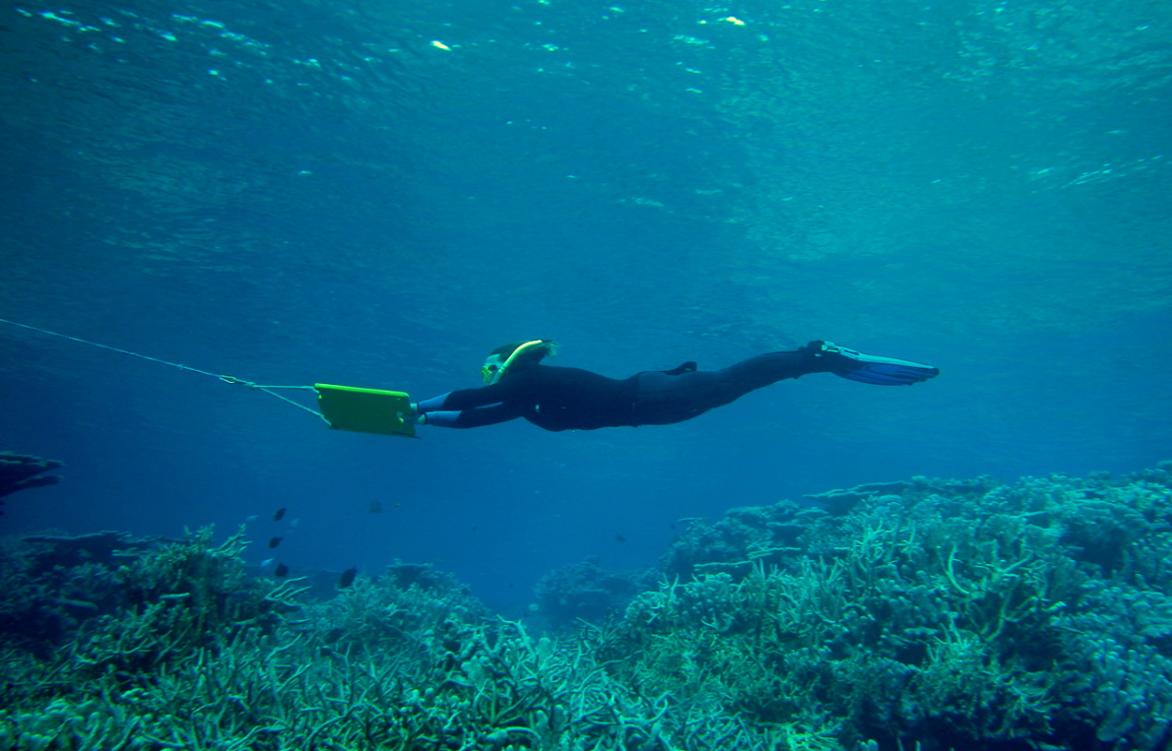
Tasks of GOOS Expert Panels
Physics – Biogeochemistry – Biology and Ecosystems
Identification of and requirement setting for Essential Ocean Variables (EOVs)
Development of EOV implementation strategies and coordination of observations
Promotion of standards and interoperability of data and information products
FOR BIOLOGY: BUILD THE GLOBAL NETWORKS
Photo credits: Dan Costa, Alistair Cheal, Eduardo Klein, Katrin Iken

Slide 3
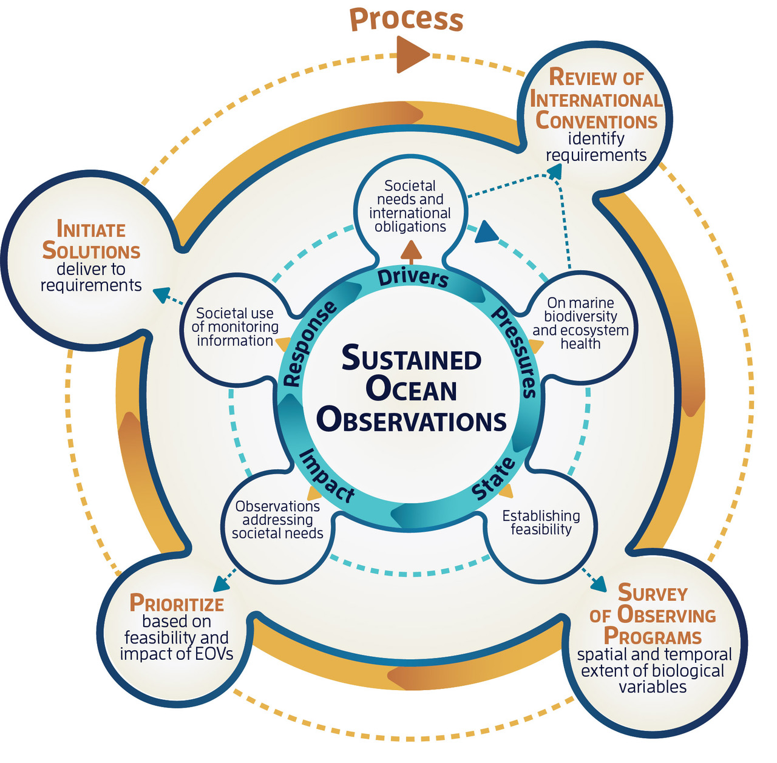
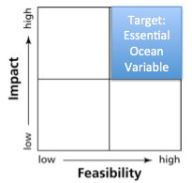
Process to identify biological Essential Ocean Variables
“Drivers-Pressures-State-Impact-Response”
Impact
-Relevant to help solve science questions and address societal needs
-Contribute to improve management of marine resources
Feasibility
-Scientifically credible
-Technically practical, cost effective and within human capabilities
Miloslavich et al. (2018) GCB
Notes:
DPSIR: simple model developed by the EEA (European Environment Agency, 1995) to guide environmental assessment and reporting. Also used to guide prioritization of marine monitoring.

Slide 4
Process to identify biological Essential Ocean Variables
N=24 conventions
Miloslavich et al. (2018) GCB
Notes:
DPSIR: simple model developed by the EEA (European Environment Agency, 1995) to guide environmental assessment and reporting. Also used to guide prioritization of marine monitoring.

Slide 5
Process to identify biological Essential Ocean Variables
N=104 observing programs
Miloslavich et al. (2018) GCB
Notes:
DPSIR: simple model developed by the EEA (European Environment Agency, 1995) to guide environmental assessment and reporting. Also used to guide prioritization of marine monitoring.

Slide 6
Process to identify biological Essential Ocean Variables
Papers (1995-2016):
Drivers: 12000+
Pressures: 65000+
Variables: 7000+
Miloslavich et al. (2018) GCB
Notes:
DPSIR: simple model developed by the EEA (European Environment Agency, 1995) to guide environmental assessment and reporting. Also used to guide prioritization of marine monitoring.

Slide 7
Process to identify biological Essential Ocean Variables
EOV
Validation
Integration
Implementation
PRODUCT DELIVERY
Miloslavich et al. (2018) GCB
Notes:
DPSIR: simple model developed by the EEA (European Environment Agency, 1995) to guide environmental assessment and reporting. Also used to guide prioritization of marine monitoring.

Slide 8
Observing programs: spatial and temporal scales
Miloslavich et al. (2018) GCB

Slide 9
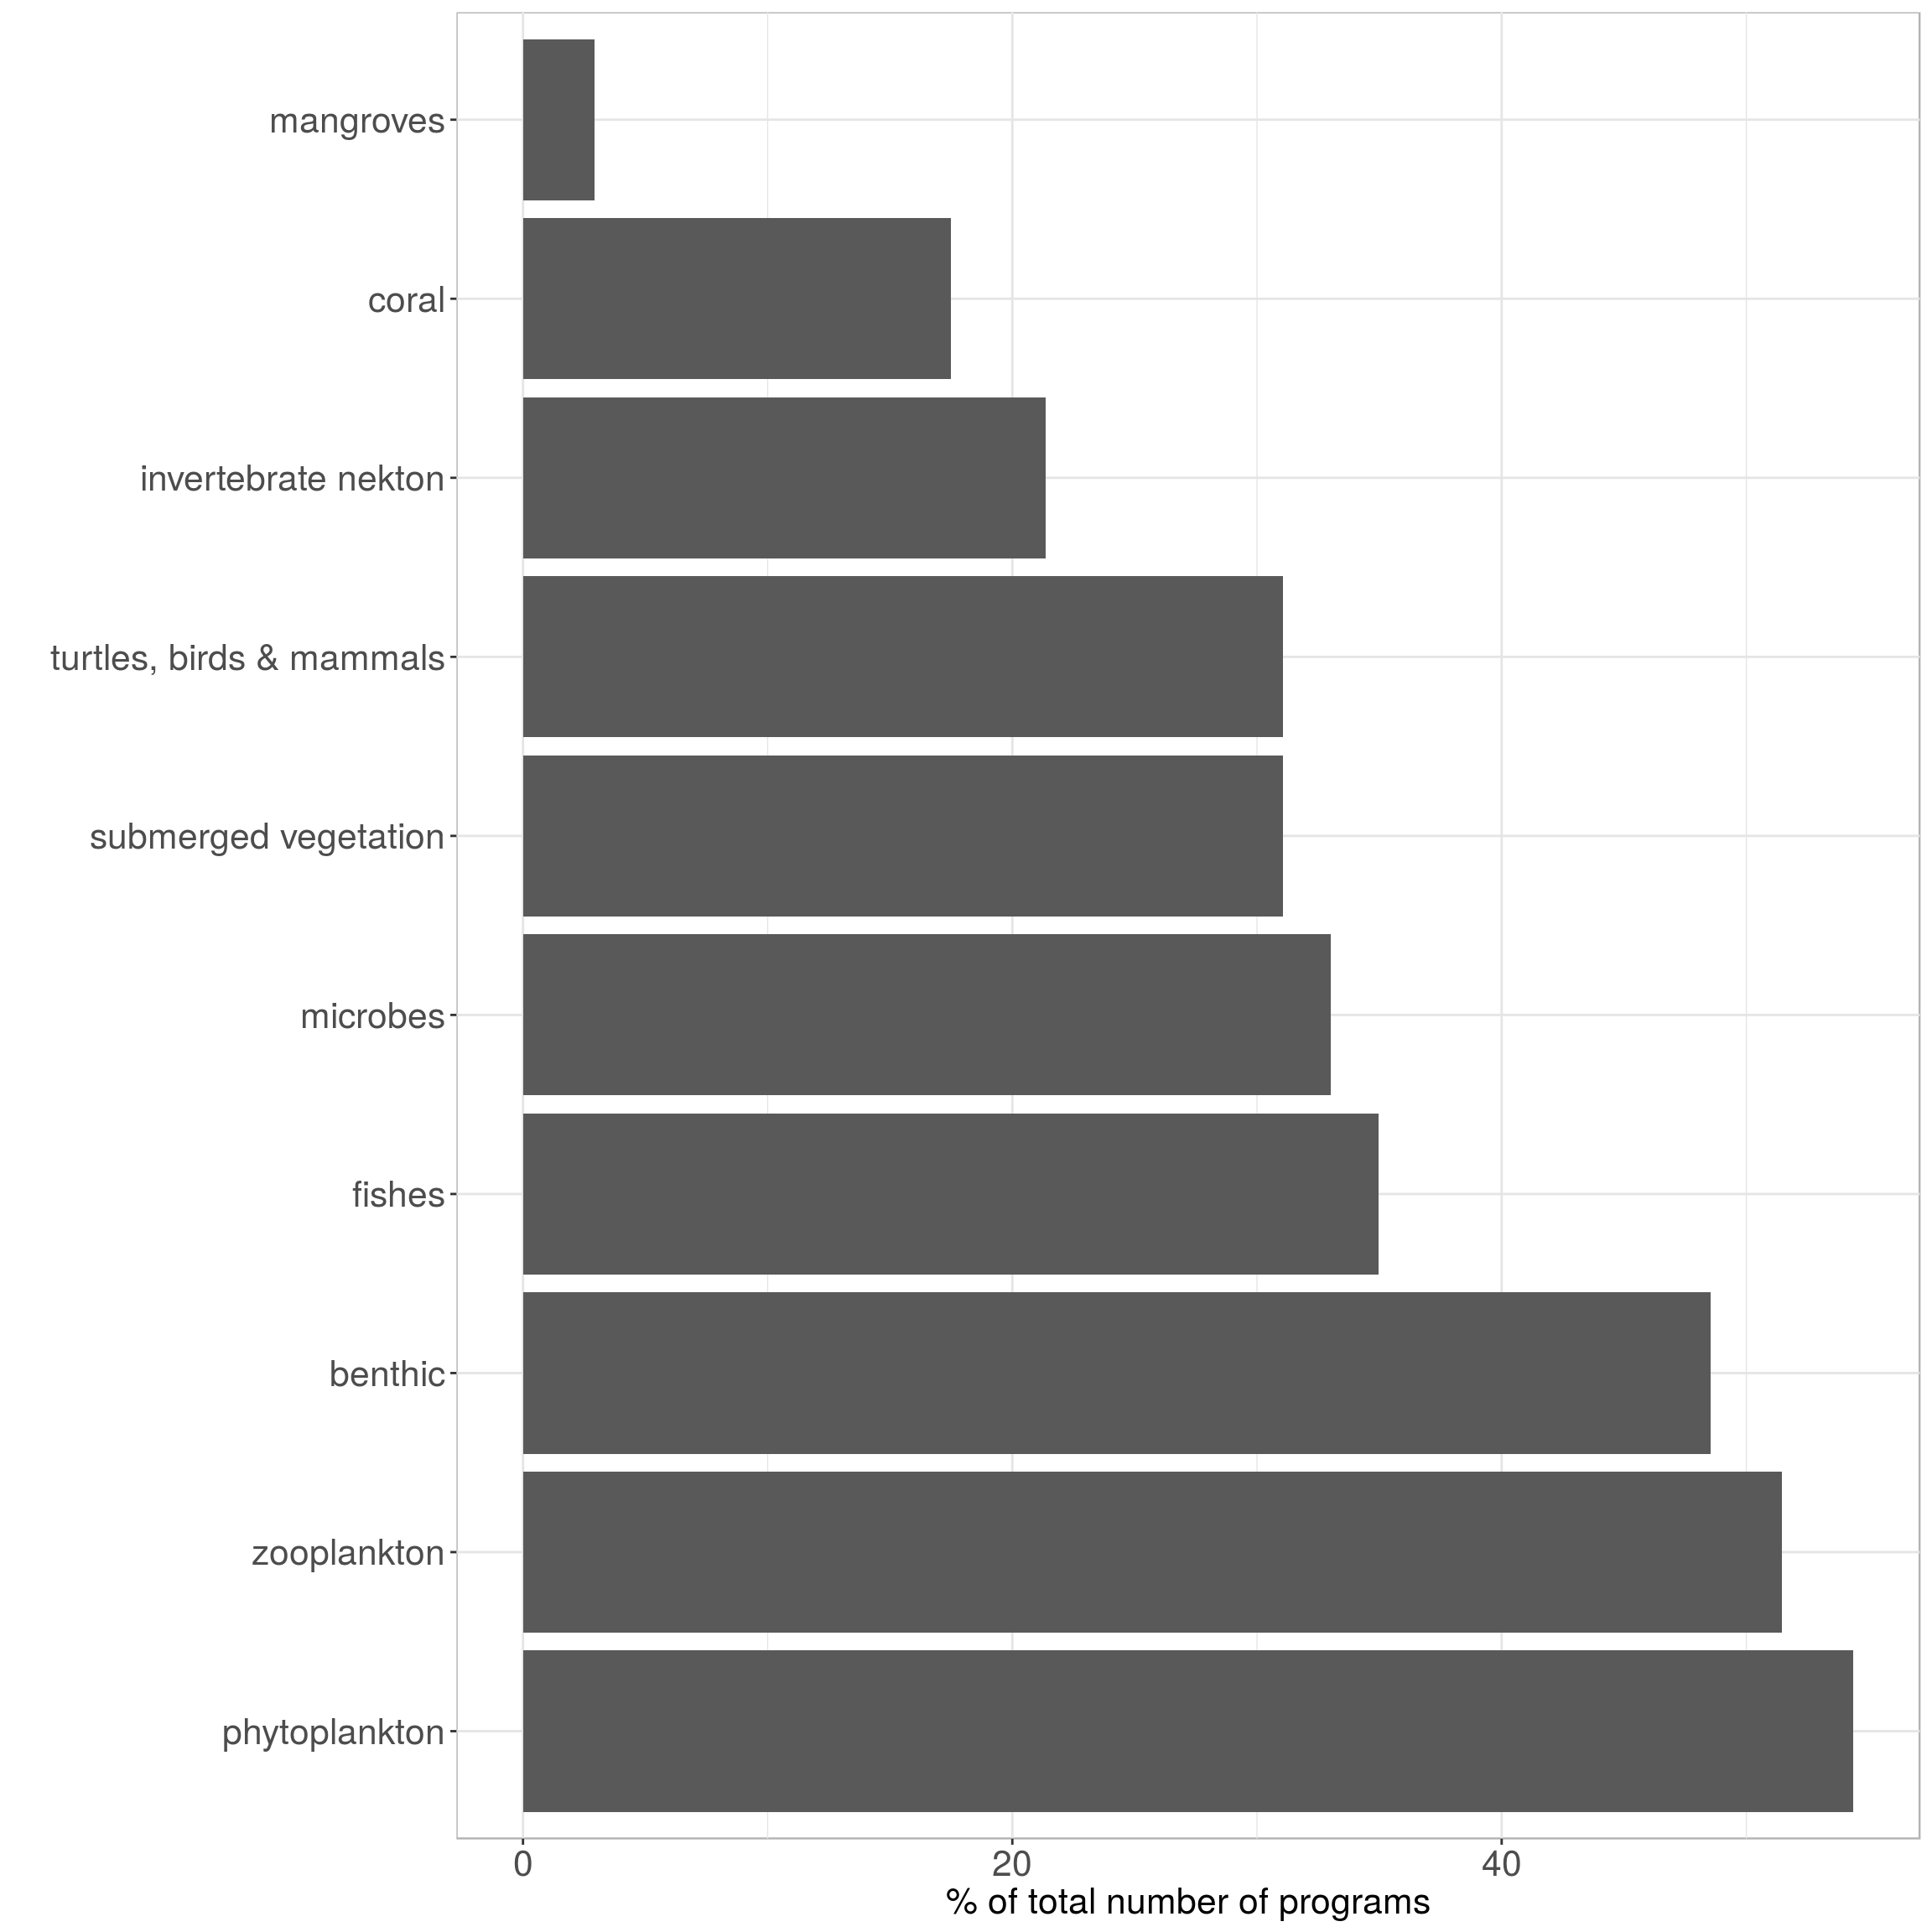
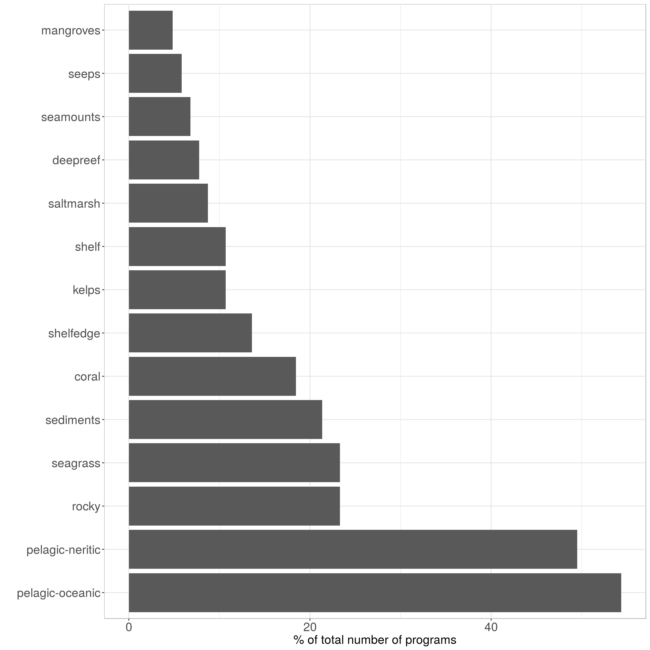
Observing programs: per major groups and per habitats
Miloslavich et al. (2018) GCB

Slide 10
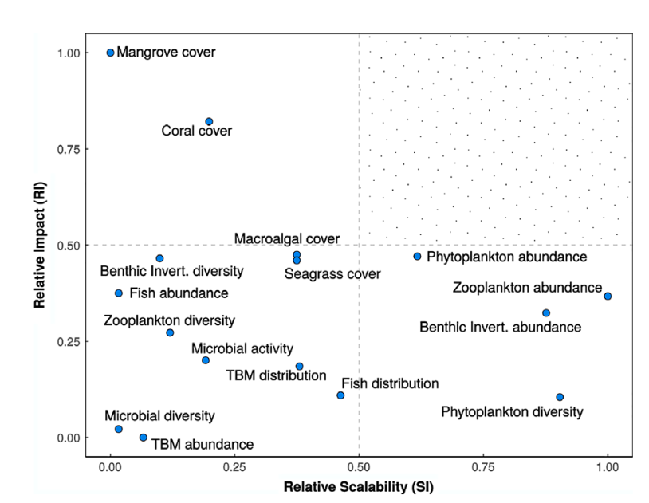
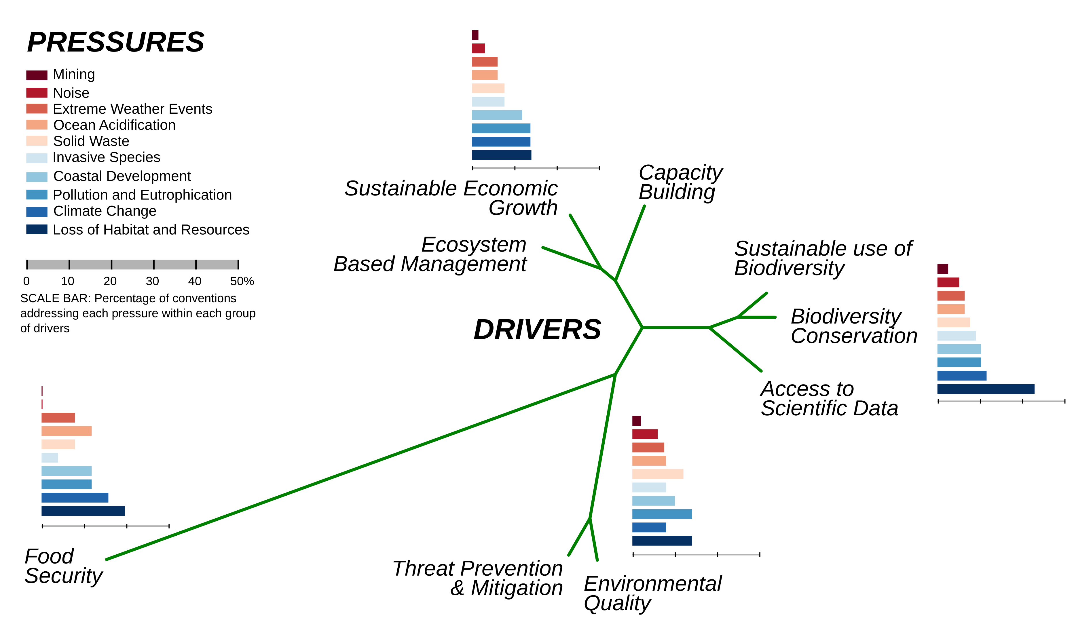
Impact and scalability of prioritized variables
Societal drivers and pressures
(from conventions)
Scalability: Weights temporal and spatial scales
Miloslavich et al. (2018) GCB
Notes:
Results of SCOPUS literature search. Search of “variables” for each of the drivers and the pressures. Blank squares indicates no literature reference. See search codes in Excel file. TBM= Turtles, birds, mammals.

Slide 11
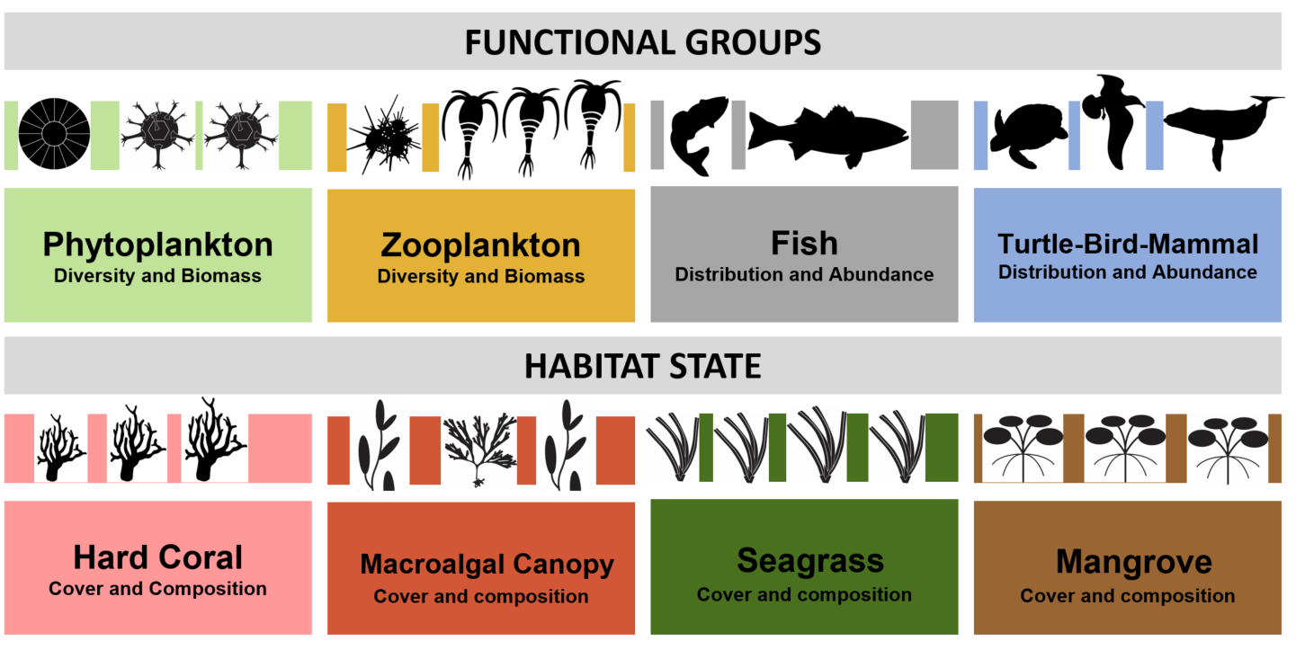
GOOS Biological / Ecological
Essential Ocean Variables
Emerging EOVs: Microbial diversity and biomass
Benthic invertebrate distribution and abundance

Slide 12
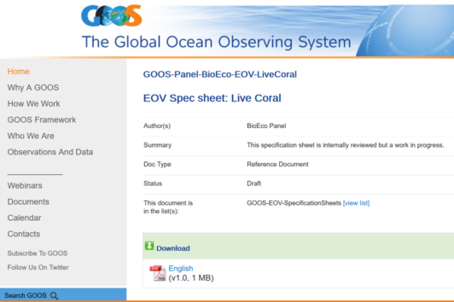
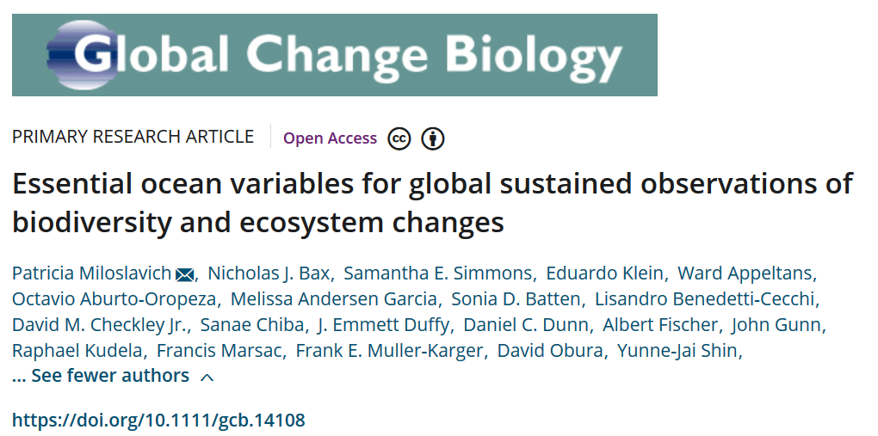
Building the global ocean observing system
1) Validation of EOVs
SCIENCE
Peer reviewed specification sheets at:
goosocean.org/eov
Notes:
Specification sheets (8 EOVs)
Justification
Specifications: sub-variables, derived products
Requirements: drivers, questions, phenomena
Observing networks: technical specifications
Future observing networks
Data and information creation
Links and references

Slide 13
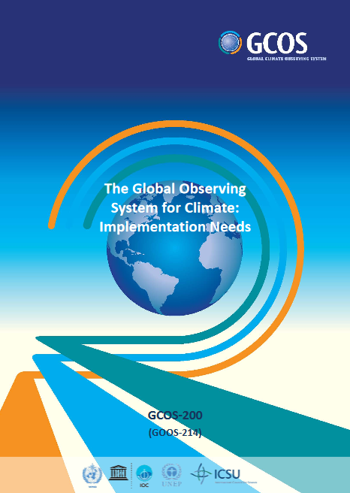
Building the global ocean observing system
1) Validation of EOVs
POLICY
Notes:
Specification sheets (8 EOVs)
Justification
Specifications: sub-variables, derived products
Requirements: drivers, questions, phenomena
Observing networks: technical specifications
Future observing networks
Data and information creation
Links and references

Slide 14
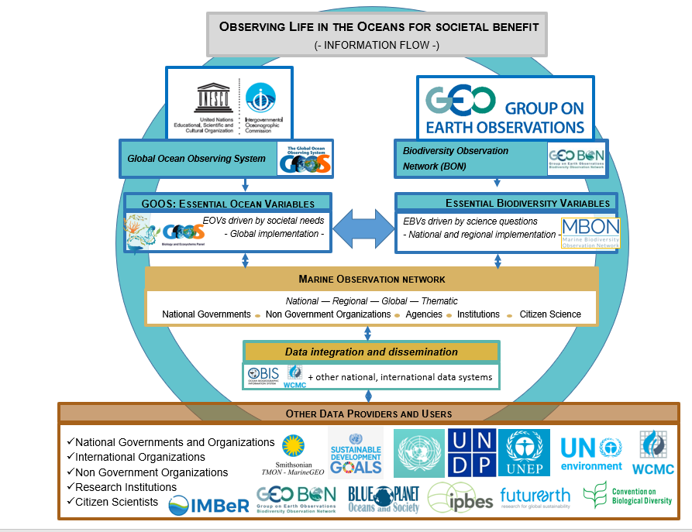
Building the global ocean observing system
2) Integration
-GOOS disciplines
-Global / regional networks
-Communities of practice
-Global programs
-Data: OBIS
Notes:
IMSOO: Implementation of Multi-Disciplinary Sustained Ocean Observations
GEO BON/MBON – GOOS BioEco – OBIS partnership
Building a globally coherent, consistent and coordinated sustained global ocean observing system to assess the state of the ocean’s biological resources and ecosystems

Slide 15
Building the global ocean observing system
3) Implementation – drafting the plans
-global coordination and coverage
-intercomparable: best practices
-open access data
-support international reporting needs
-aiming to build a network around each EOV
November 2017
Dar es Salaam, Tanzania
EOV IP Workshops
Vision and mission
Needs and requirements
Capabilities
Impact - capacity development
Funding
Governance
June 2018
Santa Cruz, CA, USA
September 2018
Hobart, Australia
Notes:
IMSOO: Implementation of Multi-Disciplinary Sustained Ocean Observations

Slide 16
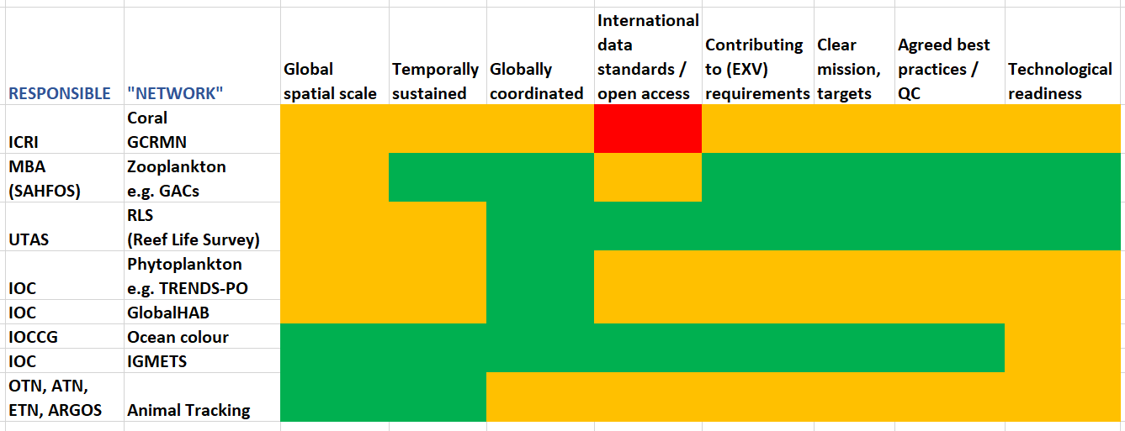
Biological ocean networks: some examples / OCG criteria

Slide 17
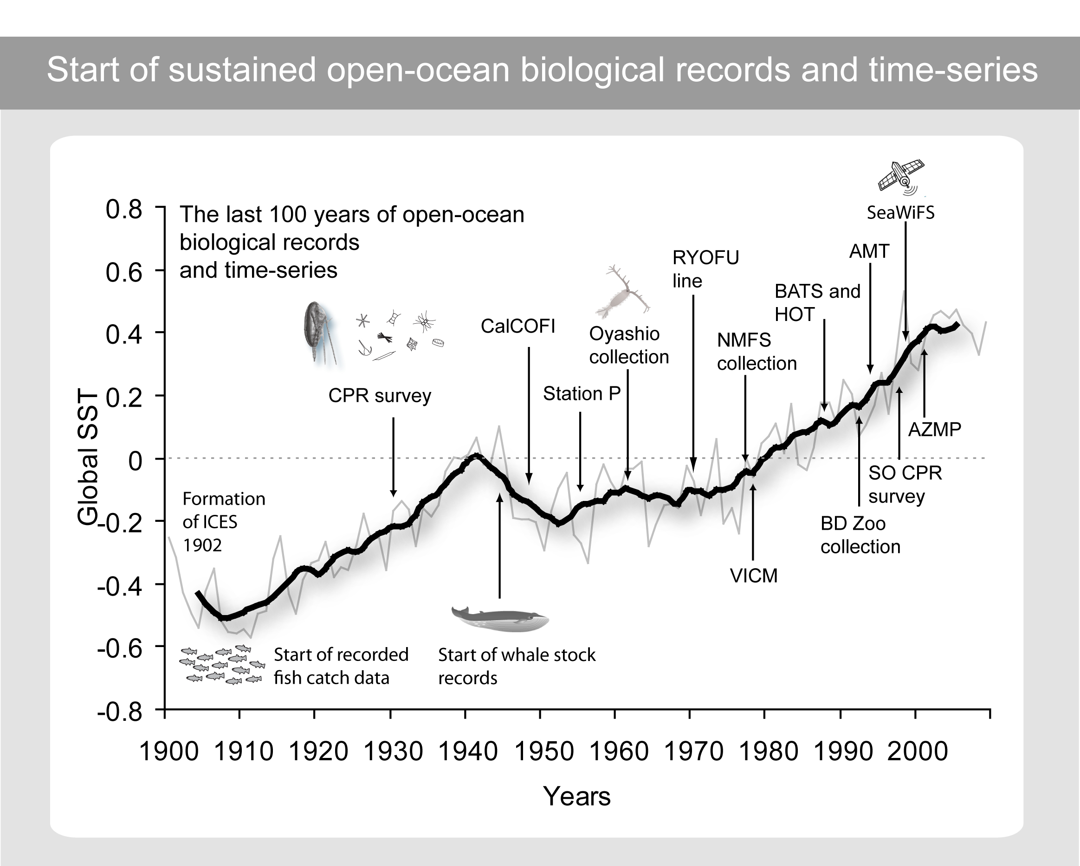
Provided by M. Edwards for the World Ocean Assessment (2015)

Slide 18
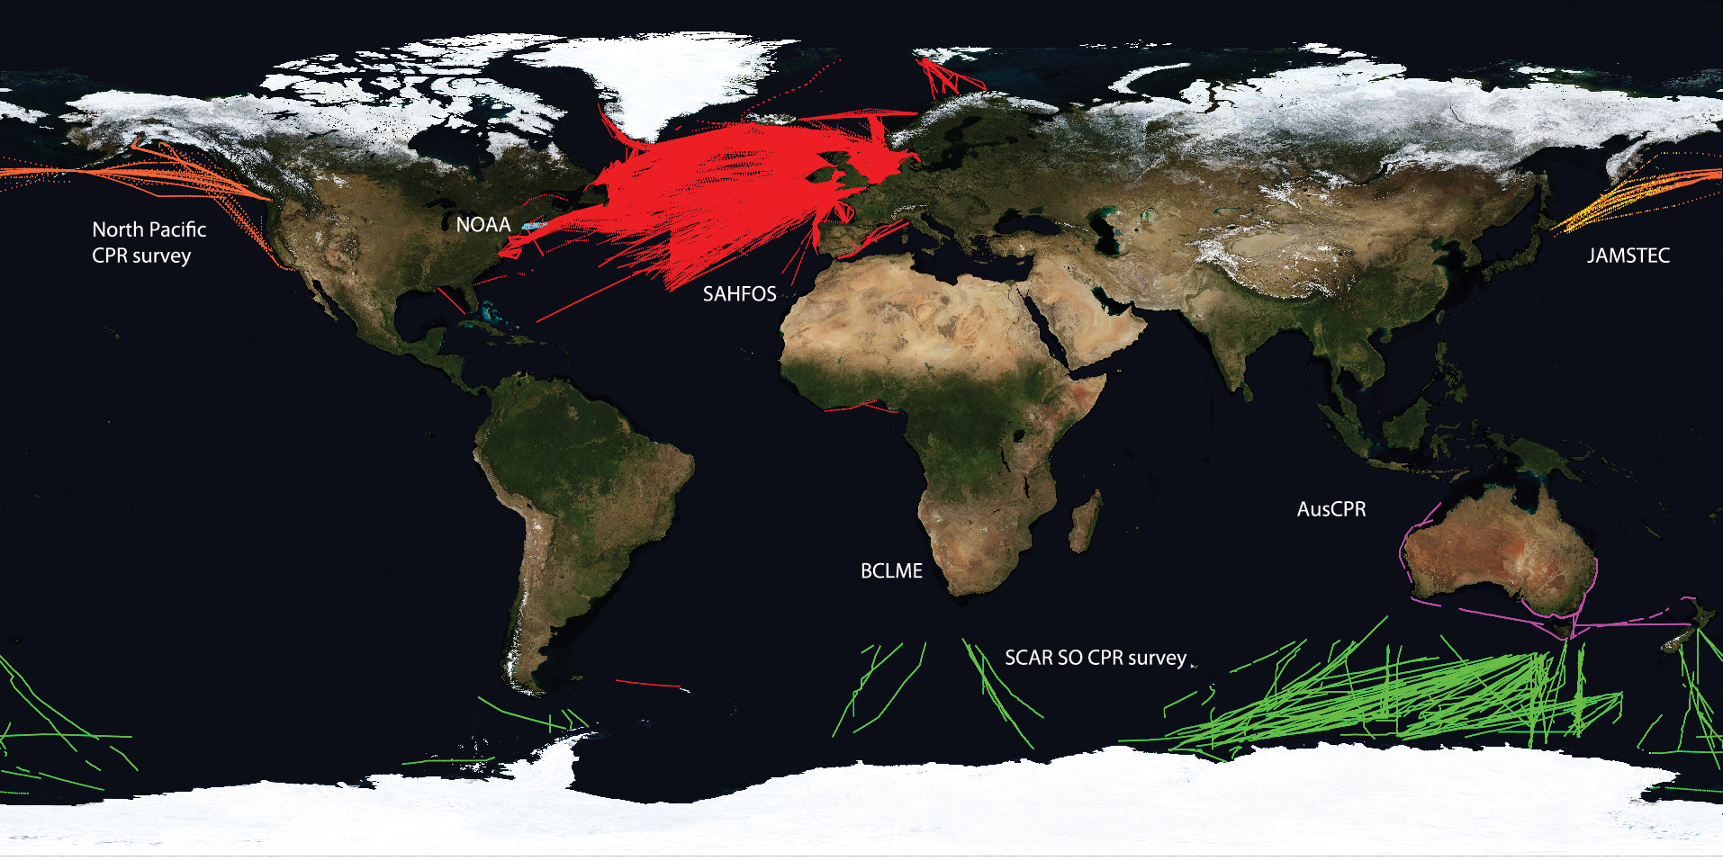
Biological ocean networks:
The Global Alliance of Continuous Plankton Recorders
Variables
Zooplankton diversity, abundance and distribution
Duration
80 years

Slide 19
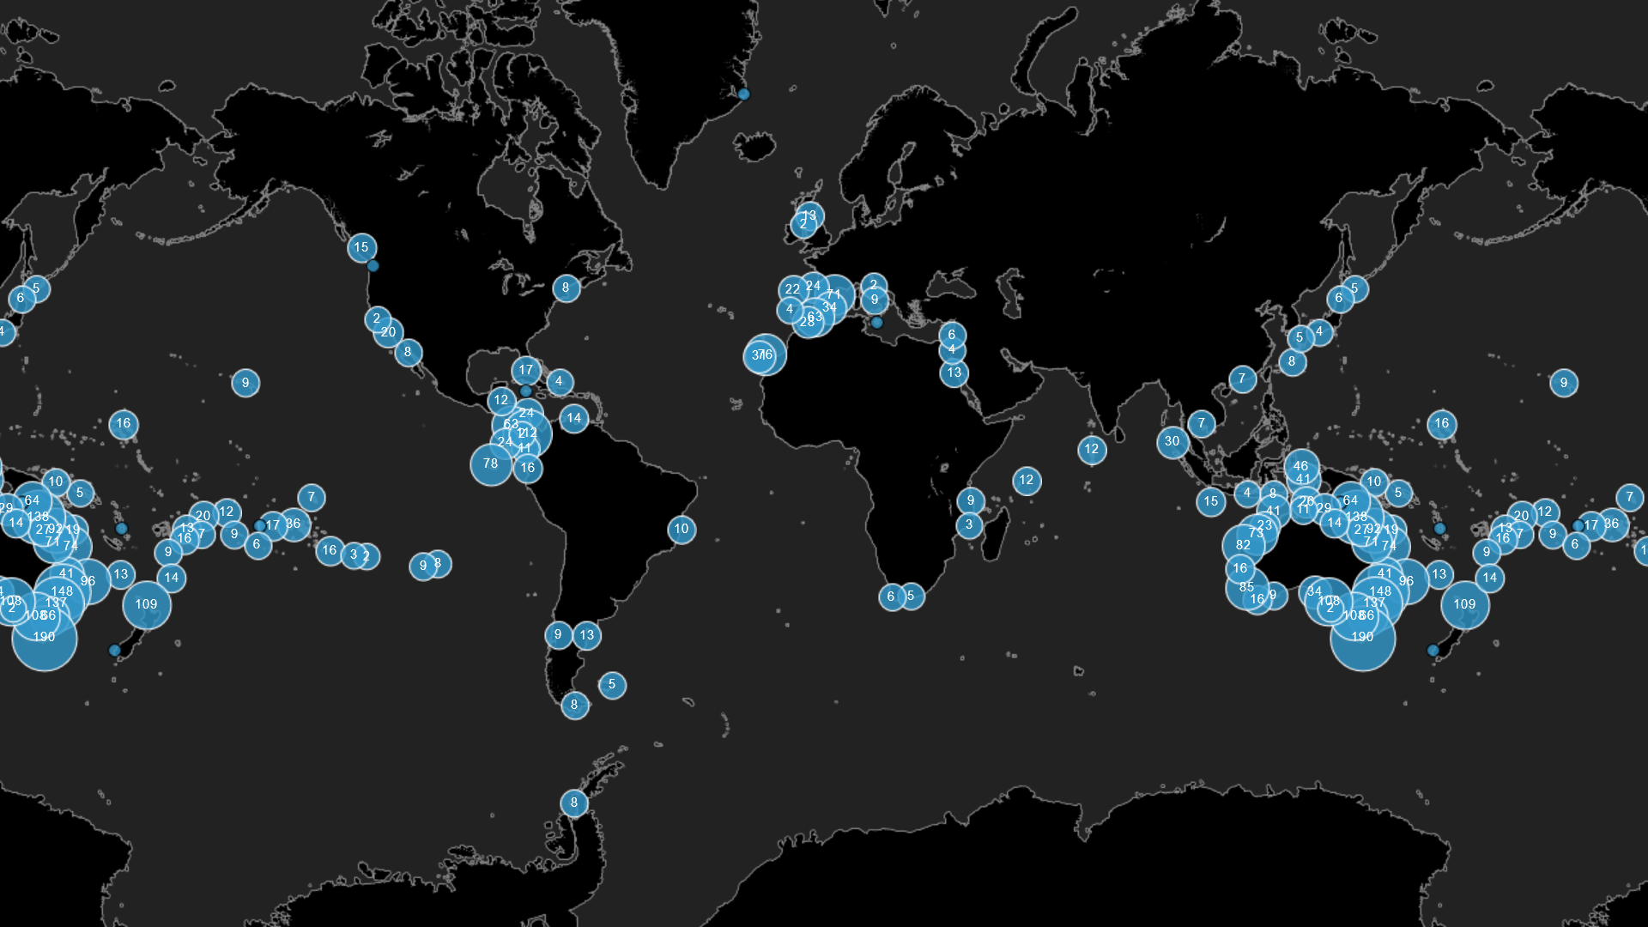
Biological ocean networks: The Reef Life Survey Program
Variables
Coral cover and composition
Macroalgal cover and composition
Fish diversity, abundance, size
Duration
10 years – Australia

Slide 20
Biological ocean networks:
The Global Coral Reef Monitoring Network
A programme of the International Coral Reef Initiative (ICRI)
Secretariat rotating every 2 years: 2016-18, France
2018-20, Australia, Monaco, Indonesia
Members: 26 countries + 37 other entities, including UNESCO-IOC, CBD, etc.
Global and regional reports: Global reports – 1998, 2000, 2002, 2004, 2008
Regional reports – e.g. Caribbean 2014, West Indian Ocean 2017
Manuals and guidance
New Implementation and Governance Plan supported by EN Environment under ICRI

Slide 21
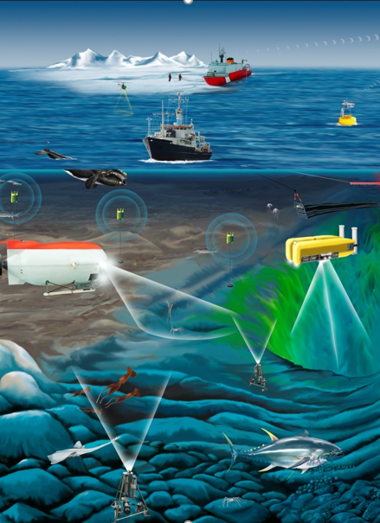
Challenges of biological networks
Communities of practice rather than networks
Most mature networks are local/regional (IMOS in Australia, IOOS in the USA)
Many “individual” efforts contributing to a common good
Sustainability not global but on a case to case basis
Heterogeneity in technology, capacity and funding
Best practices in discussion – collection of, rather than one method
Some of the “networks” only compile data from observations rather than doing the observations (e.g. IGMETS)
Similar efforts (e.g. Seagrass Net and Seagrass Watch) with intention to merge but need more support
Rely on volunteer work (e.g. Reef Life Survey)

Slide 22
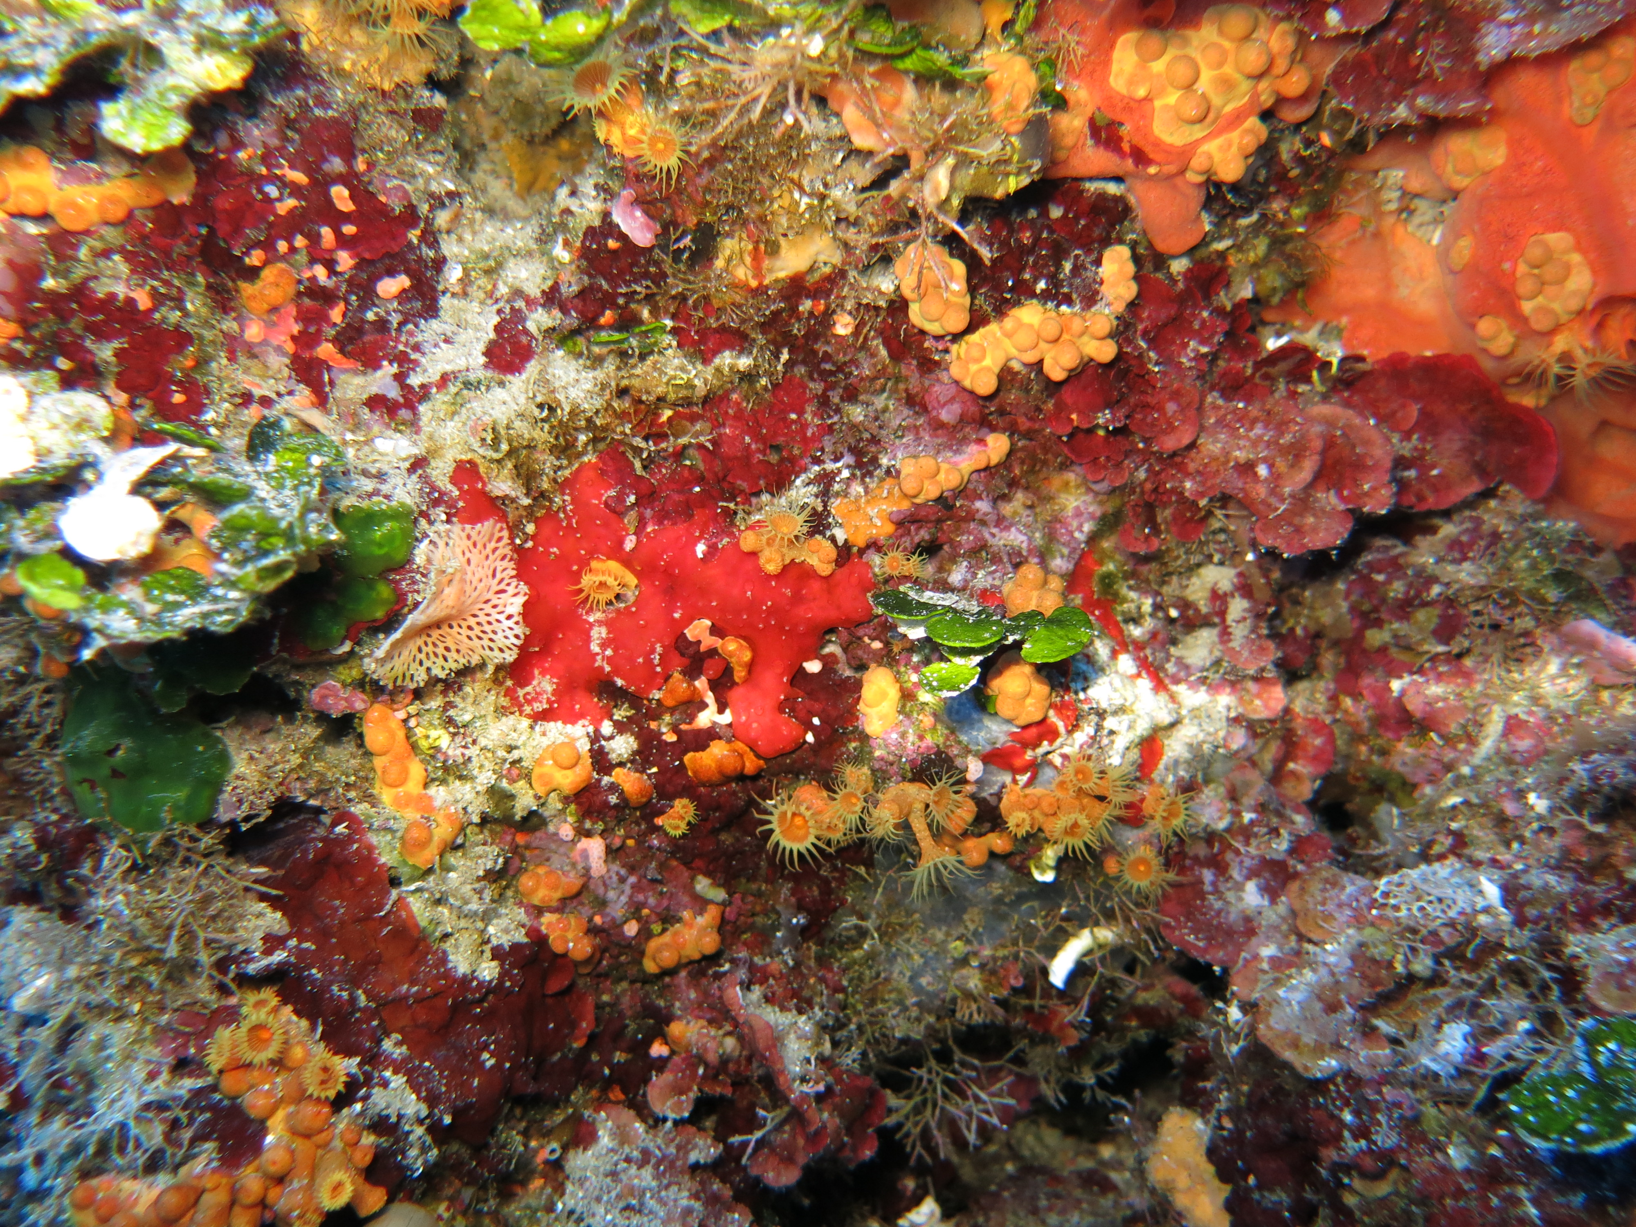
GOOS BioEco Panel and collaborators
http://goosocean.org/
Chairs: Nic Bax and Daniel Dunn
Project Officer: Patricia Miloslavich
Secretariat: Ward Appeltans
Sonia Batten (SAHFOS – Canada), Lisandro Benedetti-Cechi (UP – Italy), Dave Checkley (Scripps – USA), Sanae Chiba (JAMSTEC – Japan), Emmett Duffy (Smithsonian – USA), Albert Fischer (IOC – France), John Gunn (AIMS – Australia), Eduardo Klein (USB – Venezuela), Raphael Kudela (UCSC – USA), Francis Marsac (IRD – France), Frank Muller-Karger (USF – USA), David Obura (CORDIO – Kenya), Yunne Shin (IRD – France), Samantha Simmons (MMC – USA)
Photo credit: Lisandro Benedetti-Cecchi

