Slide 1
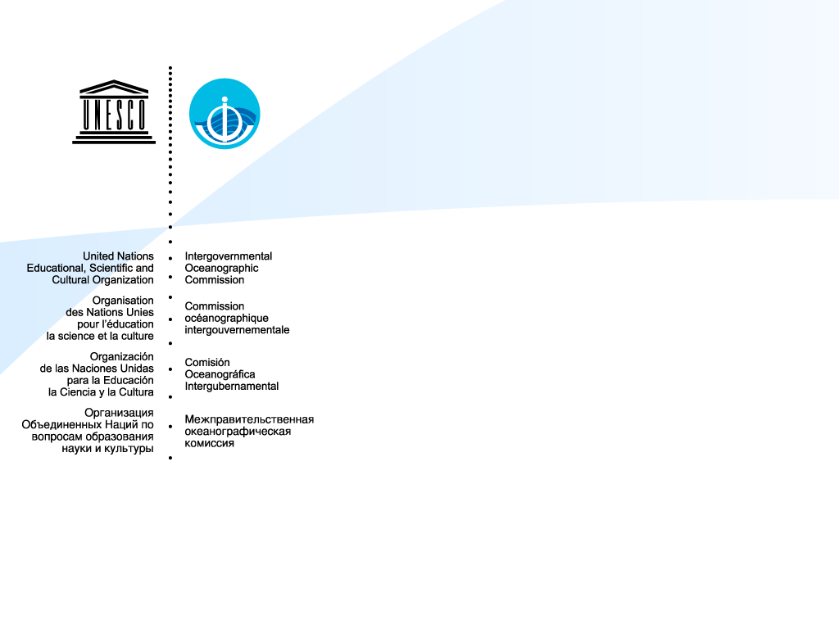
IOC Capacity Development Strategy 2015-2021 and the Role of the OceanTeacher Global Academy (OTGA)
Peter Pissierssens
Head, IOC Project Office for IODE
IODE Programme Manager
IOC Capacity Development Coordinator
Claudia Delgado
IODE Training Coordinator &
OTGA Project Manager

Slide 2
IOC
IODE
OTGA

Slide 3

IOC Medium Term Strategy 2014 - 2021
Vision:
Strong scientific understanding and systematic observation of the changing world climate and ocean ecosystems shall underpin global governance for a healthy ocean, and global, regional and national management of risks and opportunities from the ocean

Slide 4
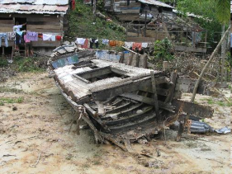
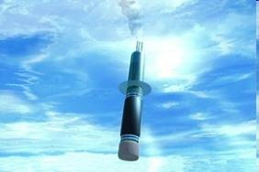
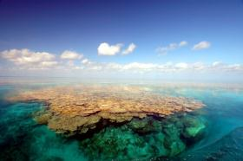
IOC Medium Term Strategy 2014 - 2021
4 High Level Objectives
  Healthy ocean ecosystems
  Early warning for ocean hazards
  Resiliency to climate change and variability
  Enhanced knowledge of emerging issues

Slide 5
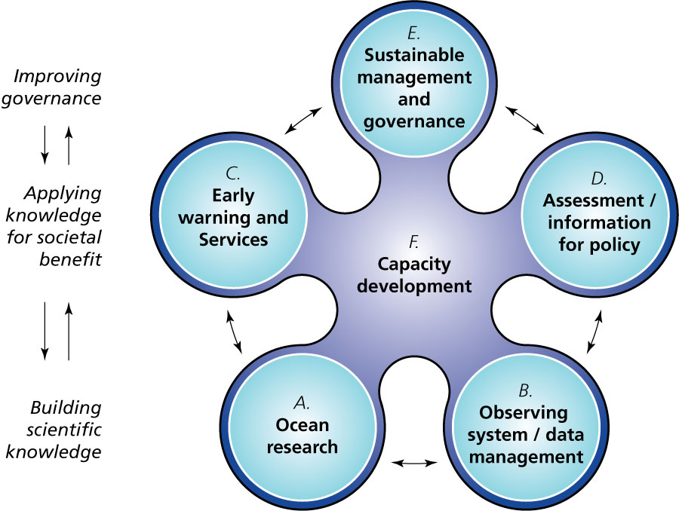
IOC: from vision to execution
Notes:
>50% of our MS are developing countries; One of the main objectives of IOC is there fore to achieve EQUITABLE PARTICIPATION of all IOC Member States in IOC’s global programmes.
The IOC achieves its high level objectives by engaging its Member States and the larger ocean science community in different programmes that fall into the following functions:
A. Fostering research to strengthen knowledge of ocean and coastal processes and human impacts upon them [Ocean research]
B. Maintaining, strengthening and integrating global ocean observing, data and information systems [Observing system / data management]
C. Developing early warning systems, services, and preparedness to mitigate the risks of tsunamis and ocean-related hazards [Early warning and services]
D. Supporting assessments and information to improve the science-policy interface [Assessment and Information for policy]
E. Enhancing ocean governance through a shared knowledge base and improved regional cooperation [Sustainable management and governance], and
F. Developing the institutional capacity in all of the functions above, as a cross-cutting function [Capacity Development]

Slide 6
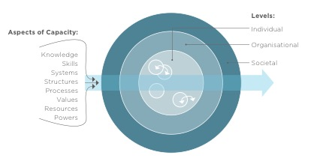
What capacity development?
Levels:
Aspects of Capacity :
Individuals
Knowledge
Skills
Systems
Structures
Processes
Values
Resources
Powers
Organisational
Societal
Source: IASS, 2016

Slide 7
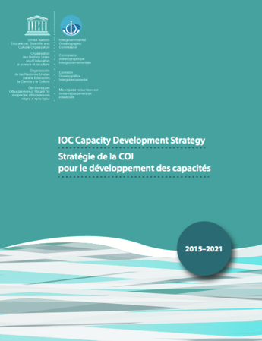
IOC Capacity Development Strategy
Rio+20 Conference (Brazil, 20-22 June 2012):
IOC’s voluntary Commitment on 'Building Global Capacity for Marine Sciences, Observation and Transfer of Marine Technology’.
Vision Statement [where do we want to arrive: desired end-state]
  Through international cooperation, IOC assists its Member States to collectively achieve the IOC’S high-level objectives (HLOs), with particular attention to ensuring that all Member States have the capacity to meet them.
Mission Statement [how shall we reach the end-state]
  The IOC will undertake relevant actions to assist Member States with developing and sustaining the necessary capacity to undertake activities necessary to achieve the IOC vision at the national level as well as at the international cooperation level.
Approved by IOC MS in June 2015

Slide 8
IOC Capacity Development Strategy
Output | Activity
1. Human Resources Developed | 1.1 Academic (higher) education 1.2 Continuous professional development 1.3 Sharing of knowledge and expertise / community building 1.4 Gender balance
2. Access to physical infrastructure established or improved | 2.1 Facilitating access to infrastructure (facilities, instruments, vessels)
3. Global, regional and sub-regional mechanisms strengthened | 3.1 Further strengthening and supporting secretariats of regional commissions 3.2 enhance effective communication between regional sub commission secretariats and global programmes as well as other communities of practice (inc. other organisations)
4. Development of ocean research policies in support of sustainable development objectives promoted | 4.1 Sharing of information on ocean research priorities 4.2 Developing national marine science management procedures and national policies
5. Visibility and awareness increased | 5.1 Public information 5.2 Ocean Literacy
6. Sustained (long-term) resource mobilization reinforced | 6.1 In-kind opportunities 6.2 Financial support by MS to IOC activities

Slide 9
Activities are implemented by actions…
Example: continuous professional development:
Output | Activity | Action
1. Human Resources Developed | 1.2. Continuous Professional Development | 1.2.1. Promote and assist with the organization of training courses, workshops and ‘summer schools’ relevant to the IOC mandate
 |  | 1.2.2 Establish, or collaborate with other organizations on, a internship/fellowship programme (including on-board training)
 |  | 1.2.3 Establish and collaborate with other organizations on, a visiting lecturer programme
 |  | 1.2.4 Promote and assist with the establishment of regional training (and research) centres relevant to the IOC mandate
 |  | 1.2.5 Promote the sharing of the training materials

Slide 10
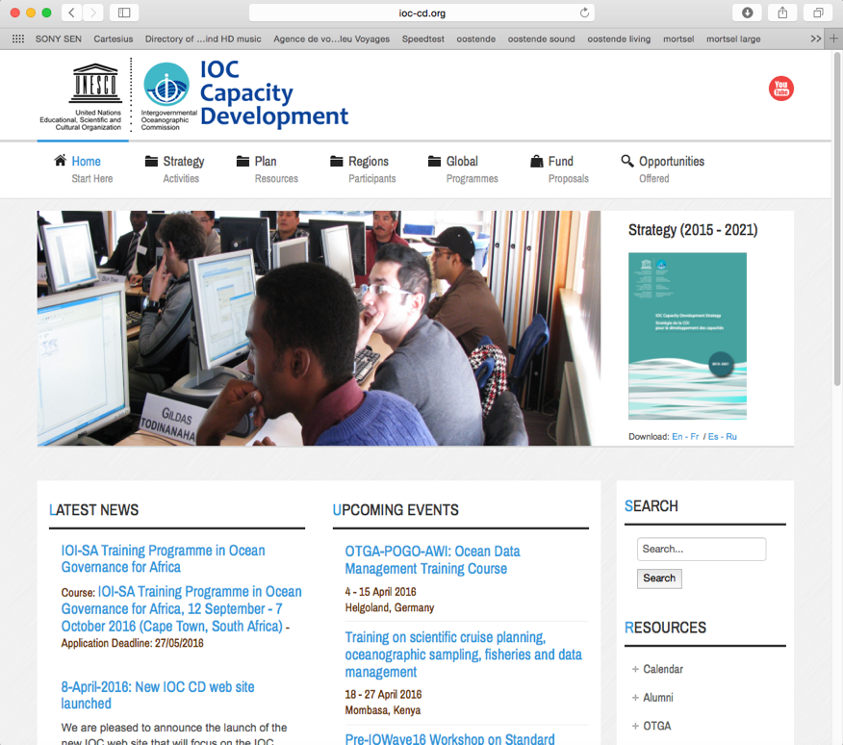
IOC CD website (www.ioc-cd.org)
Information on IOC CD strategy
Information on on the implementation of the strategy
Find CD opportunities (training courses, etc)
Calendar of the IOC CD events
Alumni database
IOC CD Fund: proposals
Mailing list (news)

Slide 11











IOC will not do all by itself: delivering as one
IHO

Slide 12

IODE & Capacity Development
Early
1980’s
1989 ODIN
AFRICA
1991
Ocean PC
1987
IODE Resource Kit
2001 Ocean
Teacher
2009 Ocean
Teacher Academy
2014 Ocean
Teacher Global Academy

Slide 13

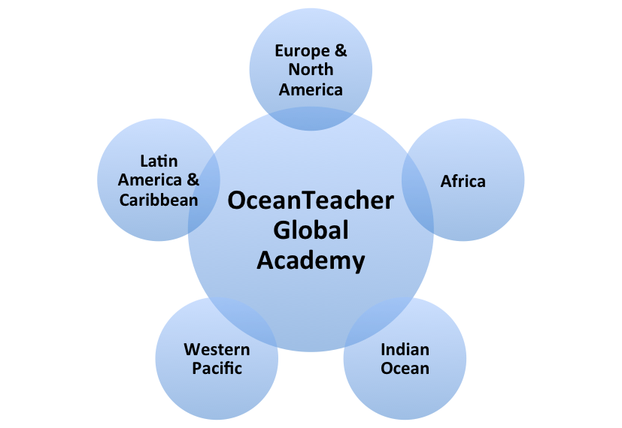
IOC’s Capacity Development tool: OceanTeacher
The OceanTeacher Global Academy builds upon and expands the former OceanTeacher Academy based at the IOC Project Office for IODE in Oostende, Belgium, to a truly worldwide training facility.
It provides a programme of training courses related to IOC programmes, contributing to the sustainable management of oceans and coastal areas worldwide, and relevant to Member States in the regions.

Slide 14
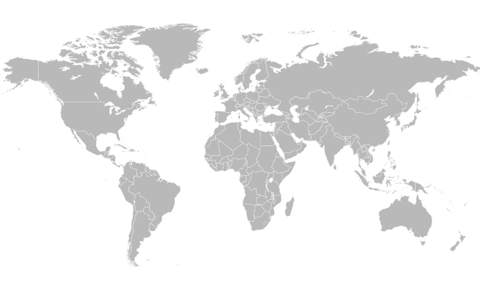
2015: OceanTeacher goes global…
(the OceanTeacher Global Academy)
OTGA Concept:
  At least 1 RTC for each region and language group
  Complementary to existing regional training centres
  Self-driven, based on locally available expertise
  Should be co-located with other ongoing and funded programmes/projects
  Sharing of courses with other RTCs using video conferencing technology
  Inviting of specific expert lectures through video conferencing
  Use of common OceanTeacher e-Learning Platform
OTGA Project funded by FUST (Government of Flanders, Belgium)
RTCs established:
Belgium
Colombia
India
Kenya
Malaysia
Mozambique
Senegal
Candidate RTCs:
China
Iran

Slide 15
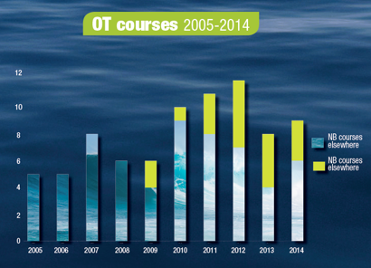
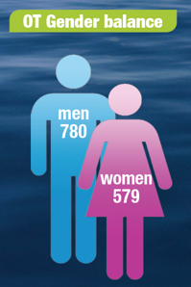
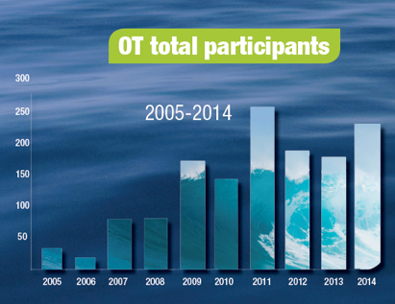
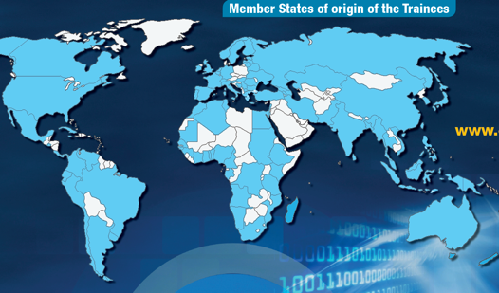
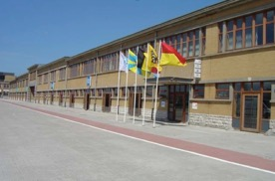
OceanTeacher Facts & Figures
> 2500 trainees F2F
> 130 courses
> 120 countries
4 languages
> 4200 registered users on the OT eLP

Slide 16

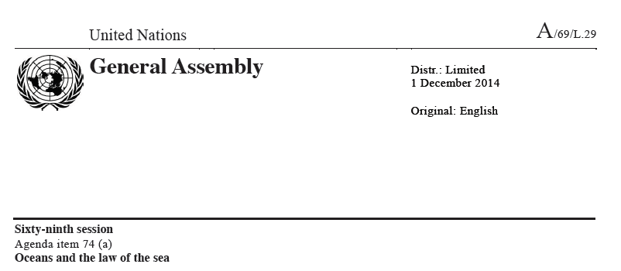
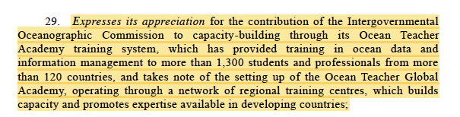
OceanTeacher at the
United Nations General Assembly (UNGA)

Slide 17

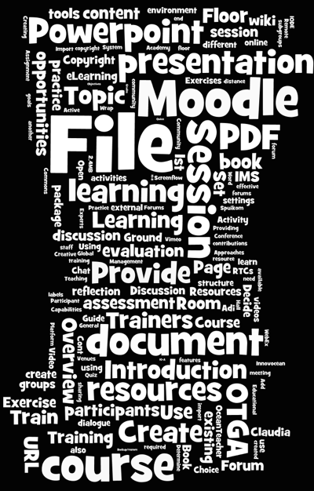
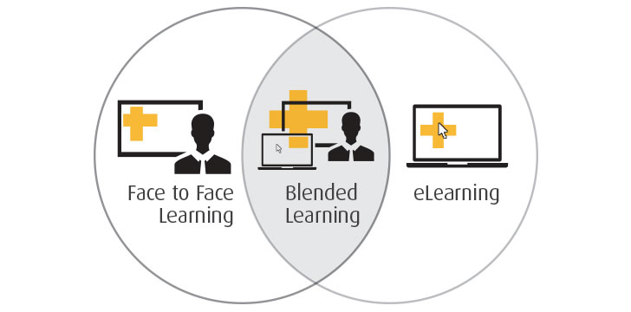
OceanTeacher e-Learning Platform
Modular Object-Oriented Dynamic Learning Environment
Web based Contents Management System
Notes:
Moodle is a learning platform designed to provide educators, administrators and learners with a single robust, secure and integrated system to create personalised learning environments.
Moodle = modular object-oriented dynamic learning environment

Slide 18
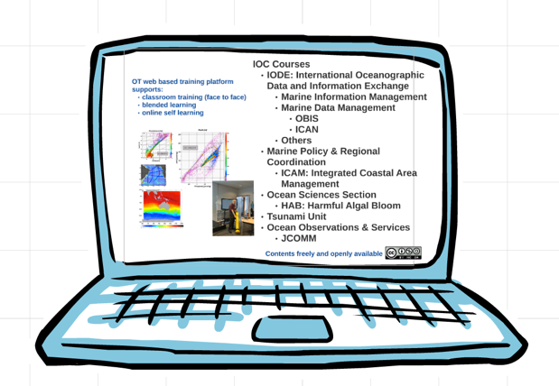
OceanTeacher e-Learning Platform
Course Categories
IODE: marine data and information management, inc. OBIS
MPR / ICAM: Coastal Marine Management and Planning
HAB: Harmful Algal Bloom and Advanced Phytoplankton (APC) Training
Tsunami
MSR/DOALOS: Marine Scientific Research

Slide 19
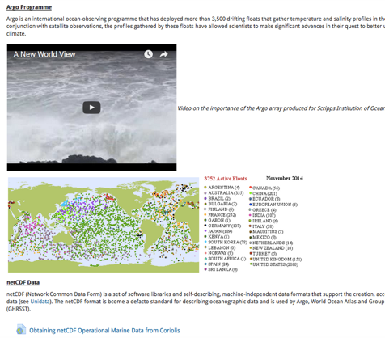
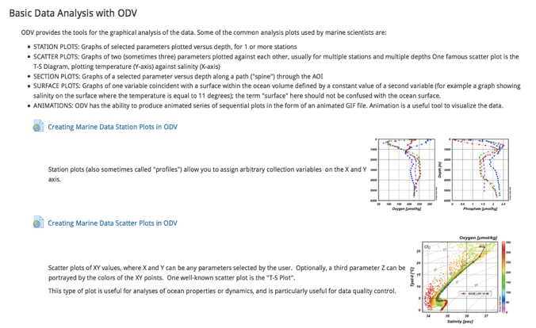
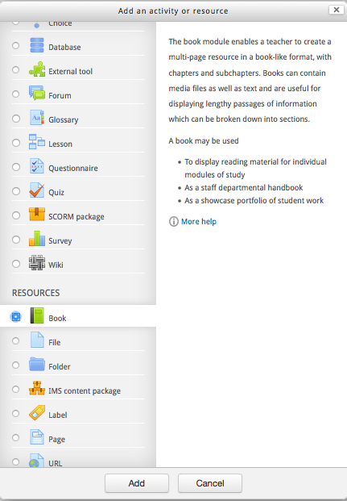
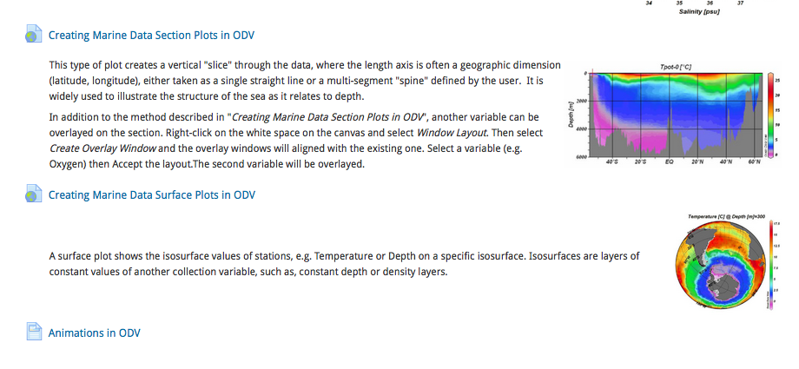
OT e-Learning Platform:
Course Outlines & Contents

Slide 20
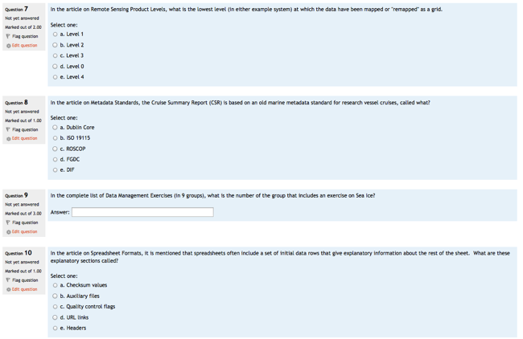
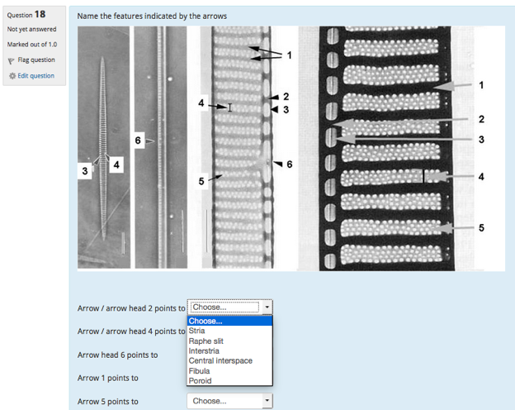
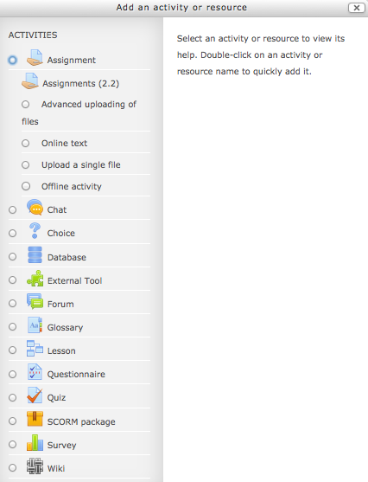
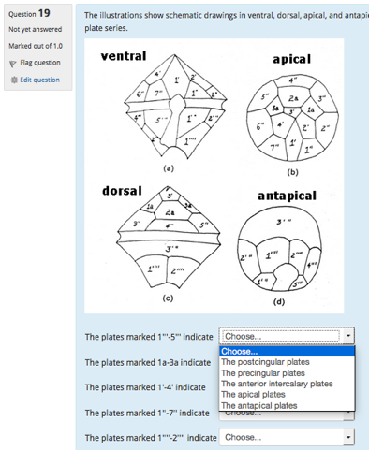
OT e-Learning Platform:
Students Assessment Tools
Assignment, questionnaire, quiz, polls, survey, essay, etc…

Slide 21
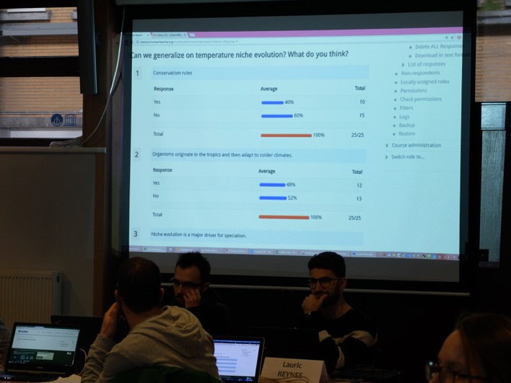

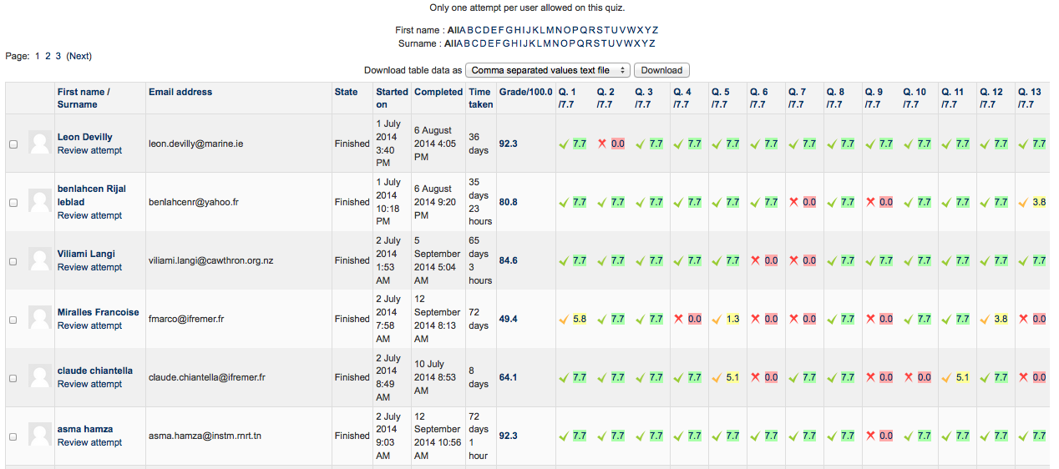
OceanTeacher e-Learning Platform:
Assessment reports
results provided ’real time’ / remotely

Slide 22
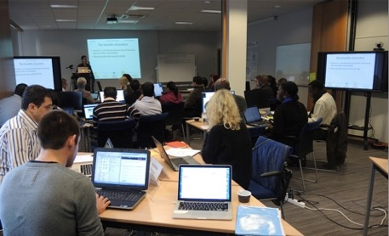
OT e-Learning Platform:
customisable
(Platform environment) Language
RTC logos, others
etc…

Slide 23

OceanTeacher
Online Application Form
Fully online application form (using Wufoo)
Customisable: allows managing mandatory vs optional questions
Allows uploading mandatory files (e.g. endorsement letter, others)
Allows different language interfaces
AF translated into 4 languages:
  English
  French
  Spanish
  Portuguese
Easily exportable output (spreadsheet)
Allows exporting in PDF (individual apps)
Allows setting deadline automatically
Automatic feedback email reply

Slide 24
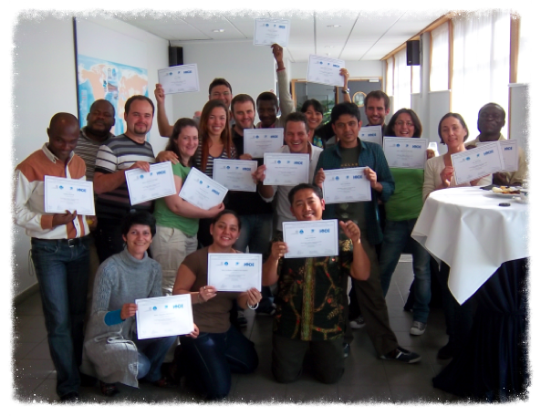
OceanTeacher e-Learning Platform
(online) Certificates

Slide 25
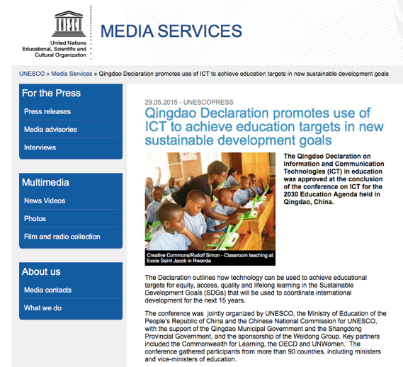
Qingdao Declaration (2015): promoting the use of ICT to achieve education targets
The Qingdao Declaration is the first global declaration on ICT in education. The text, approved unanimously by participants, highlights the different ways in which technology can support the global agenda for education which was suggested at the World Education Forum for the next 15 years.
It states that “the remarkable advances in Information and Communication Technologies (ICT) and the rapid expansion of internet connectivity have made today’s world increasingly interconnected and made the knowledge more accessible for every girl and boy, woman and man. To achieve the goal of Inclusive and Equitable Quality Education and Lifelong Learning by 2030, ICT must be harnessed to strengthen education systems, knowledge dissemination, information access, quality and effective learning, and more efficient service provision”.
The Declaration is a clear statement in favour of the use of ICT to foster access and equity in education as well as to promote the effective pedagogical use of ICT. It highlights in particular the paramount role that teacher development and support will have to play. It stresses that increasing efforts have to be made to promote the culture of open educational resources and the need to ensure quality assurance and recognition of online learning. Finally, it encourages governments, industry partners and all other education stakeholders to join forces and share resources to create equitable, dynamic, accountable, and sustainable learner-centered digital learning ecosystems.

Slide 26
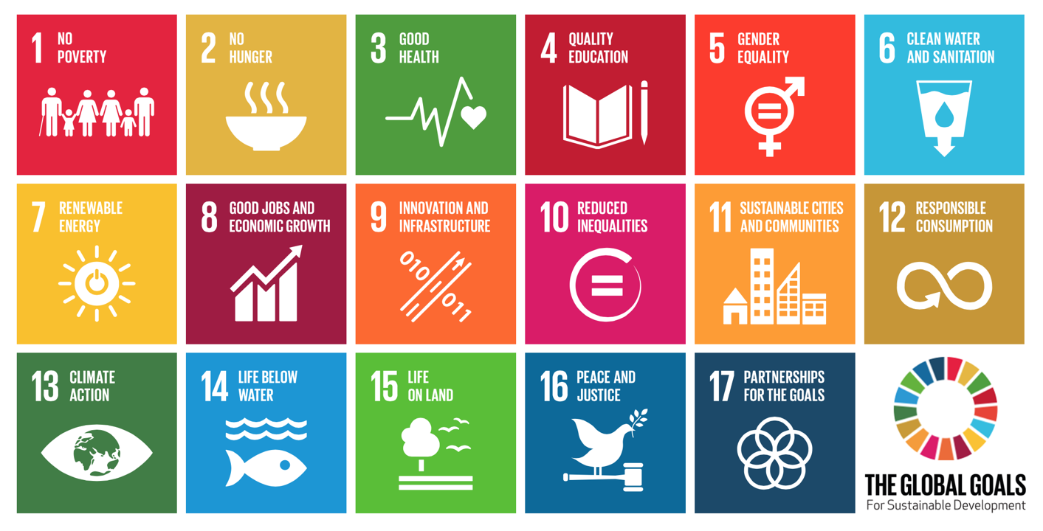
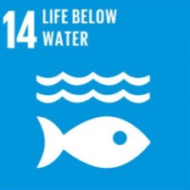
OceanTeacher and the SDG
Notes:
The IOC is involved in monitoring the role of the ocean in the climate system and improving disaster risk reduction, providing a major contribution to implementing SDG 13 on climate change and SDG 11 on sustainable cities. Considering the significant impact of the ocean on several aspects of our daily lives, IOC activities also strengthen efforts to achieve other global goals such as food security (SDG 2), learning opportunities (SDG 4), gender equality (SDG 5), sustainable economic growth (SDG 8), and human health (SDG 3). to support its MS in achieveing these trhough training, indicator based assessment

Slide 27


www.oceanteacher.org
Sharing training resources and
expertise in a coordinated way
With the support of the
Government of Flanders, Belgium

