Slide 1
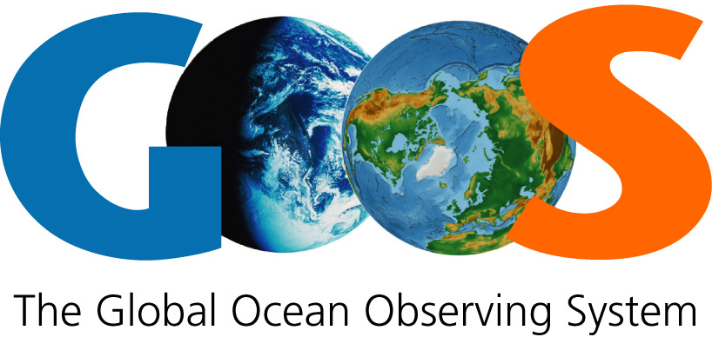
2030 vision
A sustained global ocean observing system, spanning from coasts to open ocean, serving governments, communities and industry by delivering the essential information to improve our safety, sustainability, wellbeing and prosperity
Mission
Provide authoritative guidance and coordination to the global ocean observing community and to end-users who require observational data for operational services and to respond to challenges on climate and ocean health
Principles
User-driven design • sustained observations • regular evaluation • global standards and best practices • open data • capacity development
Themes
Climate • Operational services • Ocean health
2030
Strategic
Objectives
1. Engage with national funders, observing system stakeholders, and key users in the evaluation and design of GOOS, building advocacy | 2. Strengthen partnerships to improve delivery from observations into forecast systems and operational services, and into policy-relevant scientific assessments | 3. Expand understanding and use of information about observing system requirements, including societal drivers, applications, Essential Ocean Variables, and network design
4. Sustain and expand observing network coordination | 5. Ensure ocean observing data are findable, accessible, interoperable, and reusable – the FAIR principles | 6. Promote increasing readiness of new observing technologies and networks
7. Develop capacity to ensure broader participation in and benefit from GOOS | 8. Regularly evaluate the ocean observing system to assess it is fit for purpose | 9. Improve the governance and management of the observing system, strengthening the coordination capability of GOOS and its partners

