Slide 1
The Global Ocean Observing System Harmonizing Phenomena
GOOS Staff Call
7 Dec 2017

Slide 2
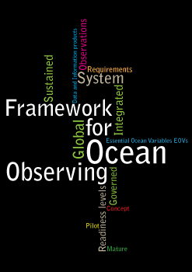
Framework for Ocean Observing A simple system
Input
(Requirements)
Output
(Data &
Products)
Process
(Observations)
Notes:
GOOS at the global level as a program delivers strategic oversight, coordination, and evaluation of the sustained ocean observing system for these three themes: climate, services, and ocean health. The program is helping to coordinate a wide range of efforts by national and regional research and operational agencies, entraining a wide range of voluntary effort.
Since the publication by IOC in 2012 of the Framework for Ocean Observing, a growing community has been working using the same interoperable language of developing observing requirements for societal benefit, identifying Essential Ocean Variables or EOVs based on feasibility and impact, coordinating ocean observing networks through standards and the sharing and promotion of best practices, developing readiness to observe new EOVs in a globally sustained way, and developing coordinated and interoperable data management streams that feed different information generation mechanisms.
We first published this Framework for Ocean Observing in English; we have had it in Chinese thanks to the efforts of the State Oceanic Administration, and we now plan to translate it into other languages to maximize its uptake in the ocean observing community.

Slide 3
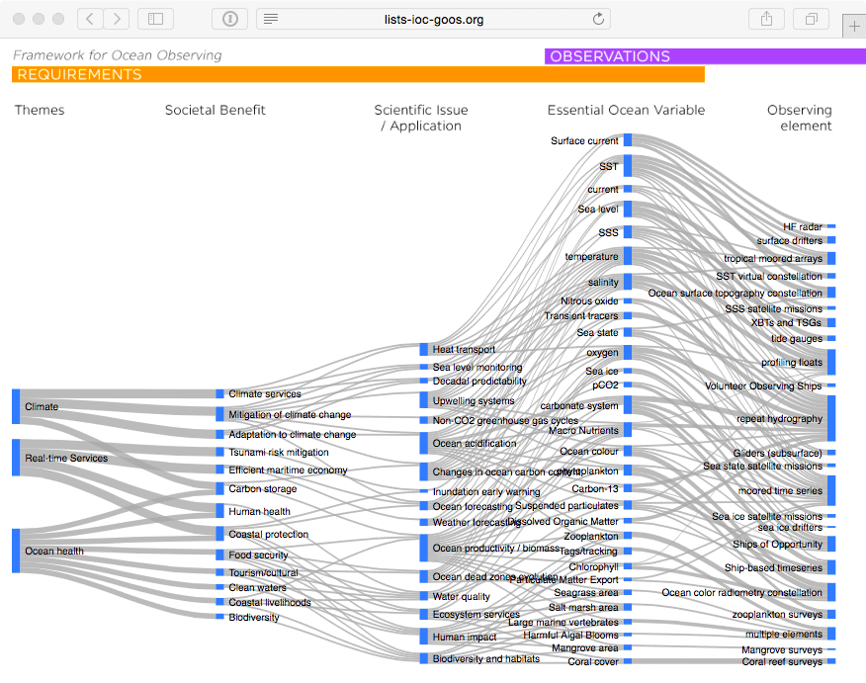
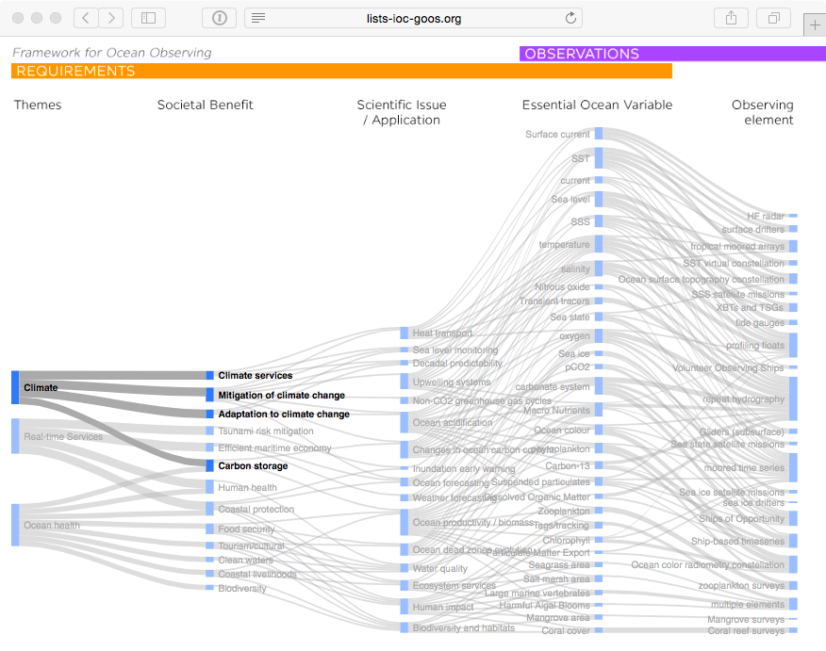
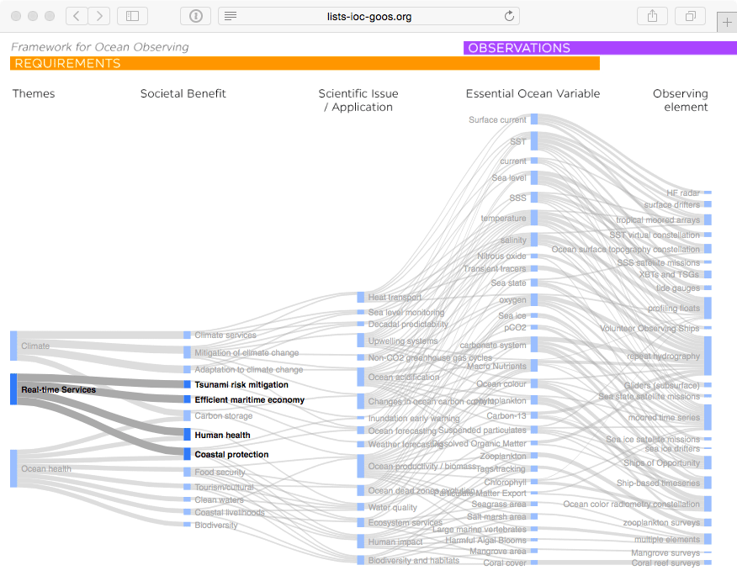
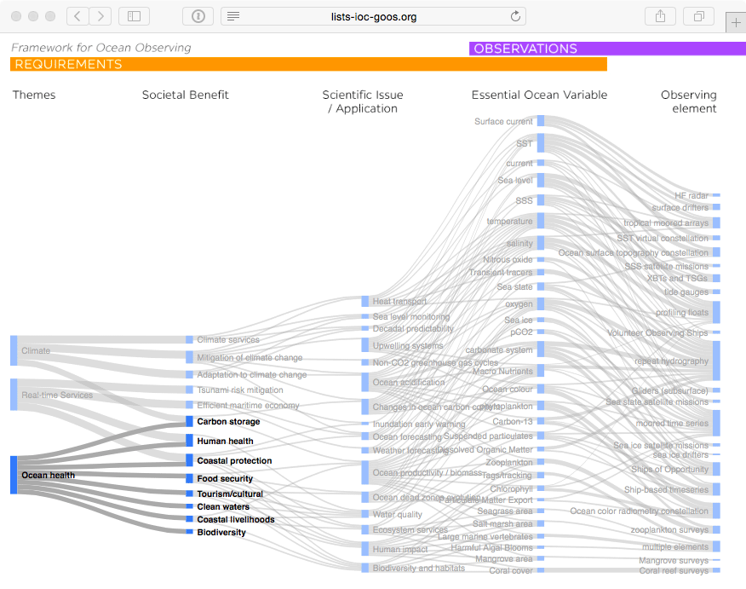
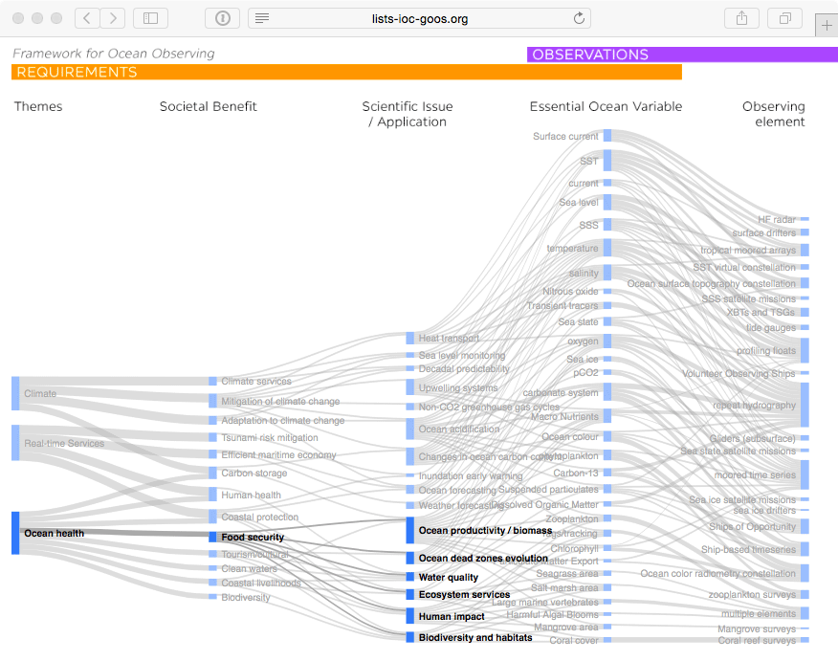
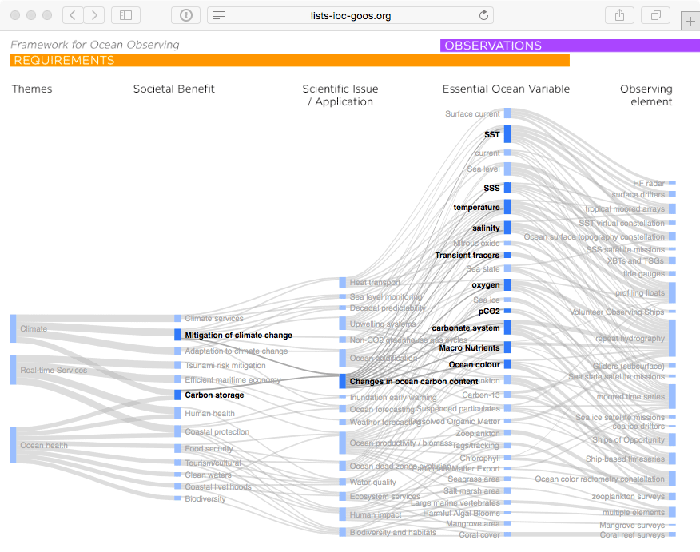
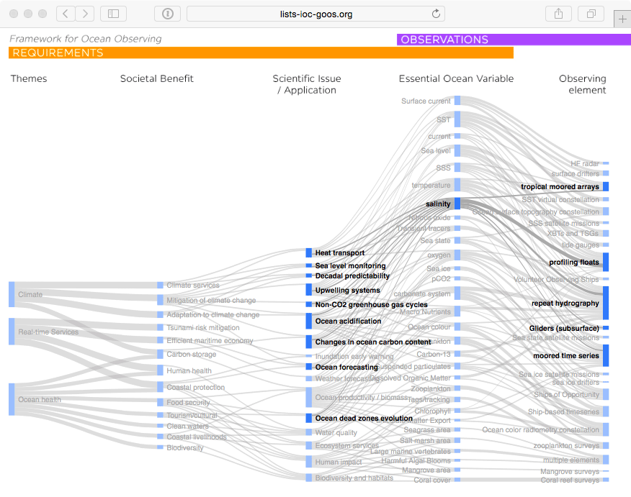
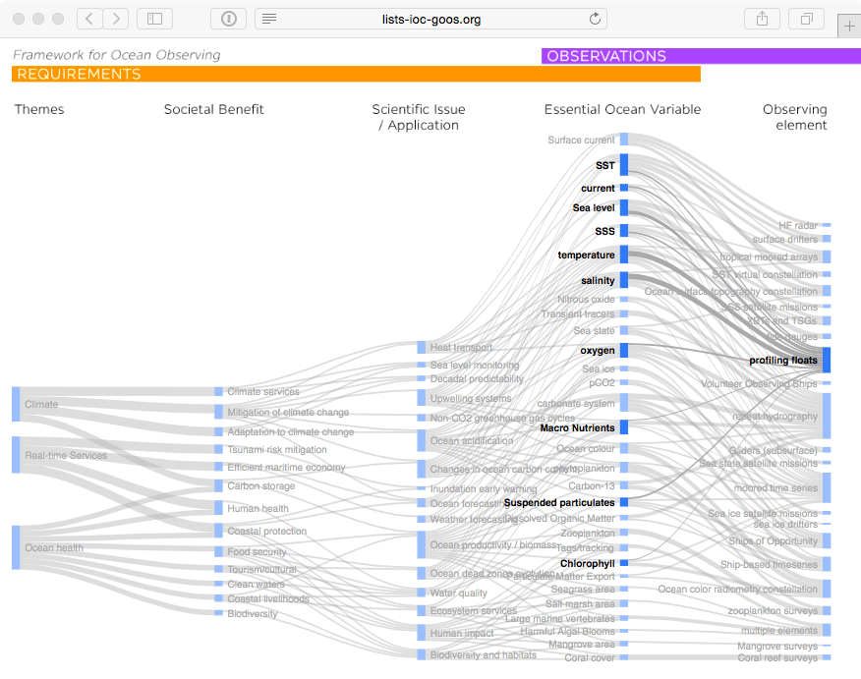
GOOS Strategic Mapping
Notes:
This activity will allow us to improve a Strategic Mapping of GOOS, which is shown here linking the three major societal drivers of GOOS: climate, services, and ocean health; with the societal benefits informed by sustained ocean data; the scientific issue, application, or product needed; the Essential Ocean Variable we need to capture; and the type of observing element contributing to the measure of these variables.
We can track how any particular observing platform measures a number of variables, feeding products and applications that deliver societal benefit.
A major message from this complicated diagram is that there are many interconnections. Many observations have multiple lifetimes – multiple uses. With growing sensor capability we are increasingly building an integrated observing system. And there is a tremendous needs for the coordination activities that make this system as efficient and effective as possible.
Behind each of the nodes in this mapping that we continue to build is a specification sheet with additional information on the global groups and standards and best practices information.
Each GOOS Regional Alliance or national effort will have its own variant of this mapping, based on local priorities and capacities.

Slide 4
What are phenomena:
Dynamic aspects of a system, which vary in space and/or time (i.e. changes / trends / shifts are their inherent properties).
What we need to capture with observations (and models) in order to deliver to key applications and/or answer key scientific questions.
Usually require multiple EOVs (often from more than one discipline) to capture
At 1st Cross-panel meeting in Oostende in 2016 defined as:
‘A GOOS phenomenon is an observed process, event, or property, with characteristic spatial and time scale(s), measured or derived from one or a combination of EOVs, and needed to answer at least one of the GOOS Scientific Questions.’

Slide 5
Why articulate phenomena?
They are what determines our space/time sampling needs/Observing System design; → IMSOO workshop themes built around them.
They are the element of the FOO in which cross-disciplinary synergies must be discussed
i.e. Stratification, Deoxygenation, Primary production, Eutrophication
Will enable us to develop a framework for ongoing evaluation of the observing system
OOPC is scoping a review on observations for capturing changes in ocean heat and freshwater content
(rather than reviewing observations of temperature and salinity against requirements)
AtlantOS: phenomena-based targets for the biogeochemistry observing system → lesson learnt: need to look at ALL EOVs, not just BGC
Harmonized phenomena will be central to the functionality of the Strategic Mapping!

Slide 6
Example physics phenomena

Slide 7
Lessons learnt from BGC EOVs update
Phenomena that appear under BGC EOVs are NOT strictly biogeochemical phenomena. They are ocean phenomena which are being observed through one or more BGC EOV measurements.
Ventilation (water masses) is being observed with Transient Tracers, Oxygen, Nutrients EOVs – but a ‘physical’ phenomenon?
Remineralization is being observed with Oxygen, Nutrients, Particulate Matter, DOC EOVs – but a ‘biological’ phenomenon?
Need to identify those phenomena which are informed by EOVs spanning disciplines, and as GOOS agree on their:
Name
Characteristic spatial and temporal scale
Required EOV measurements
Notes:
I’d like to share with you some of the lessons we in the Biogeochemistry panel have learnt about harmonization or its lack of that became apparent while updating the EOV Spec Sheets earlier this year, also echoing some of the comments from the community. First of all we really need to step away from making our efforts look mostly disciplinary rather than transdisciplinary. Just like we were encouraged not to list EOVs according to their disciplines, even more so we should perhaps not divide the phenomena according to disciplines. While there are some that refer strictly to either physical, chemical or biological procecces, properties or events, many if not most are transdisciplinary. Perhaps this is most obvious for BGC as we are studying the system affected by physics from one side, and biology from the other. Our approach to defining phenomena and populating the EOV Spec Sheets was not focused on identifying biogeochemical phenomena, rather, the focus was on identifying those phenomena, regardless of the discipline, which are being observed through one or more BGC EOV measurements. At first, this might not sound like a big difference, but it is. Take for example the phenomena of ventilation or water masses as it appears currently in the Physics. This is not a BGC phenomenon but there is a handful of measurements that the BGC community is in charge of, and which are key to characterizing this process, as well as interpreting its changes in a holistic context. Similar, or even greater synergies exist or should exist between BGC and BioEco. Take for example Remineralization. It is essentially a biologically mediated process, yet of fundamental importance to observing biogeochemical cycles. While we can describe it using several BGC measurements, changes in this phenomenon cannot be observed or modelled without corresponding BioEco EOV measurements.
It is not feasible to list all of such relevant phenomena, e.g. In the SST spec sheets. But this is possible and i wuld say critical to have it in the Strategic Mapping. At the moment, there is no place to visualzie and explore these links assess the maturity of meeting the requirements.
The challenge is of course for all of us to agree on what the key ocean phenomena are, so that we may later, through the strategic mapping, demonstrate how individual measurements come or should come together to describe the system, and thus enable applications and answers to scientific questions for specific societal benefits.
In our revised Spec Sheets what we have tried to do, was to identify which phenomena, regardless of the disciplines, we should list. In order to do that, we did lots of brain storming, an example of which is this concept map. But this exercise could or should happen collectively.
ALSO note that:
Phenomena can be easier identified when not explicitly called ‘changes’/’trends’/’shifts’ in XXX.
We should assume they’re dynamic by nature.
E.g. in BGC: ‘Biogeographic shifts’, ‘Changes in nutrient distribution’;
E.g. in BioEco: ‘Status and trends’, ‘Ecosystem regime shifts.’

Slide 8
Ventillation / WATER MASSES
Transit times
gas
AIR-SEA FLUXES
aeolian
STORAGE/INVENTORY
freshwater
heat
heat
freshwater
age
CIRCULATION
momentum
chemical
(anthropogenic + other carbon, oxygen, nutrients?)
UPWELLING
PRIMARY PRODUCTION
OCEAN ACIDIFICATION
LAND-SEA FLUXES
NCP
GPP
Riverine + run-off
pH level
Aragonite/calcite saturation states
CONTAMINATION/POLLUTION
freshwater
momentum
CALCIFICATION
organic matter
inorganics
DEOXYGENATION
REMINERALIZATION
Anthropogenic carbon sequestration
Number of OMZs
OMZ area
EUTROPHICATION
nutrient buildup
EXPORT FLUXES
hypoxia
Phyto overgrowth
Oxygen loss
OMZ volume
denitrification
biological pump
solubility pump
organics
inorganics
BENTHIC FLUXES
OPEN OCEAN, SHELF & COASTAL FLUXES
‘BGC Phenomena and what goes in there’ concept map
particulate vs dissolved
Notes:
All the bubbles with solid colour and names in caps are the phenomena which ended up listed in our Spec Sheets. The empy white bubbles describe those processes, properties, events which we identified as belonging to a given phenomenon. You will note that these bubbles also describe elements of the other disciplines and were meant to help us identify synergies, and modify phenomena names so that future near-complete synergy is more probable. For instance, we have introdyced primary prodyction and reminarealizaion, or calficiation instead of some previous names, anticipating that these are more likely to apply to what BioEco has or could have as their phenomena. We added benthic fluxes in anticipation of further recomendations coming from the DOOS community.
We hvae in fact attempted to draw similar concept maps listing just Physics and just BioEco phenomena, adding bubbles to see where exactly the overlaps are now, or where we think they should be.

Slide 9
Physics
BGC
Tides
Water mass
Ventilation
Stratification
Deoxygenation
Circulation
Mixed Layer
Sea level
Heat Storage
Storage / inventory
Ocean Acidification
Sea ice extent
Upwelling
Air-sea fluxes
Contamination
Surface waves
Fronts & eddies
Riverine
Land-sea fluxes
Freshwater cycle
Primary production
Benthic fluxes
Coastal processes / coastal shelf-exhange processes
Carbon sequestration
Calcification
Near-inertial oscillations
Remineralization
Extreme events
Eutrophication
Export fluxes
Ocean productivity
Biodiversity
Phenology/life cycle shifts
Recruitment
Transport/element cycling
Severe decline/mass mortality/bleaching
Resilience
Biogeographical shifts etc.
Possible synergies concept map used to revise the list of phenomena appearing in BGC EOV Spec Sheets.
Status and trends
Ecological regime shift
Recovery/restoration
Functional role of species
Changes in species size
Invasions / HABs
BioEco
Notes:
This slide was our attempt to evaluate the current state of harmonization across the three panels. Some phenomena names are abbreviated down to key words here. The main idea was to place those which are already the same in the respective circle overlaps. Those which represent potential synergies are on the inner edges of these circles and are connected with red lines. For instance, I can easily imagine that Primary Production and Ocean productivity could be harmonized further. Same goes for remineralization, export fluxes and transport/element cycling.
Some phenomena are difficult to understand and perhaps need further rationalization. For example. What coastal processes or ... Mean exactly? Or status and trends? Is this necessary if we assume that a phenomenon includes a change in time and spalce by default? Do all of these have characteristic spatial and temporal scales?
Some apparent synergies might also be misleading/ E.g. Extreme events appear in both Physics and BioEco, but do they refer to the same characteristic spatio-temporal scales?
Going back to why we should harmonize this? To me this is because an integrated observing system must strive towards more efficient co-design of the observing efforts. In order to do that, all three disciplinary comunities must hvae some common frame of reference, some common targets to work towards. Phenomena should provide that common denominator so that temperature, oxygen and plankton can in fact be measured on such scales that enable a complete detection of changes in a given phenomenon. One level above phenomena are scientific questions and applications, which nota bene, are also not harmonized across the panels.
If by a strategic mapping we want to visualizing how multidisciplinary measurements carried out through a global observing network contribute to societal benefits in accordance with GOOS mandates and GOOS vision, we must be able to demonstrate the current as well as missing but need linkages between observing networks and EOVs, phenomena, and higher up.

Slide 10
Current phenomena: Physics & BGC
Lines are some suggested synergies between phenomena
These are now already harmonized WITHIN panel EOVs, and to some extent across the two panels.
Notes:
This is just another look at the phenomena as they currently appear in the Panel Spec Sheets.

Slide 11
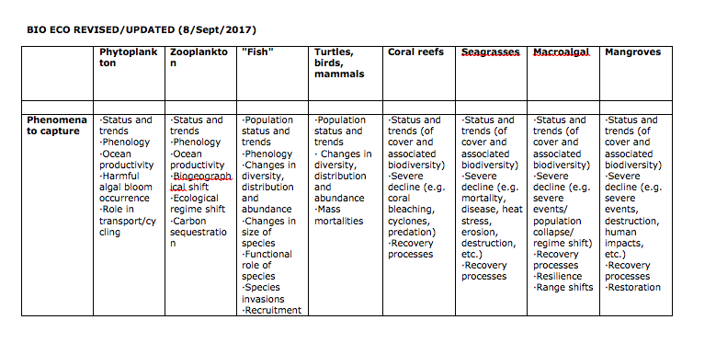
Current phenomena: BioEco

Slide 12
All GOOS phenomena
Bio Eco (a go at synthesising, for discussion!)
Status and Trends species population
Biodiversity (ecosystems/areas)
Severe decline/mass mortalities/Coral bleaching
Resilience
Recovery processes/restoration
Ecological regime shift
Changes in distribution/abundance / Biogeographical shift / Range shifts species
Invasions/HABS occurance,
Ocean Productivity,
Transport/cycling/carbon sequestration
Functional role of species
Recruitment
Phenology/life cycle shifts
Changes in size of species

Slide 13
Points for discussion
Can we find synergies? The more synergies we find, the more functional the Strategic Mapping will be!
Can we rationalise, as far as reasonable, the phenomena?
Do we need to agree on a list of GOOS Scientific Questions and Applications before we can actually harmonize the phenomena?

Slide 15
(optional) Lessons learnt from BGC EOV update cont.
Phenomena need to be distinct from derived products, indices or impacts.
Examples of what were originally listed as phenomena but were deemed inapproirate by the BGC Panel:
Net Community Production – talks about production but is in fact a measurement technique
Removal rates of DOC fractions – derived products describing the phenomenon of DOC export from the euphotic
Transit times – derived measurements, no spatial scale
OA impacts on PIC production – this is more of a science question
Notes:
NCP: it’s a derived measurement describing the net between production and remineralization – it concerns several phenomena such as production, remineralization and export/sinking/vertical transport whatever we call it
Removal rates of DOC fractions: very specific description of a process that in the end talks about Export fluxes and Remineralization
Transit Times: hard to find a characteristic spatial scale in something called transit times…
OA impacts on PIC production: this is more of science question that requires analysis of what drives changes in X and Y. We cannot directly observe those relationships.

