Slide 1






4.1 TWC Operations: Seismic Monitoring in the Caribbean
Regional Training Workshop on Pacific Tsunami Warning Center Enhanced Tsunami Products for ICG/CARIBE EWS
31 October – 02 November, 2017
Cartagena, Colombia
Christa von Hillebrandt-Andrade
NOAA-NWS Caribbean Tsunami Warning Program

Slide 2
CARIBE EWS Recommendations
Minimum seismic network performance requirements for initial earthquake locations:
  1) Earthquake detection within 1 minute
  2) Minimum magnitude threshold M=4.5.
Real Time Data Sharing Recommendations
  MS should share seismic data with US TWC – PTWC (primary TSP) and NTWC (backup for PTWC)
  MS should share data with PRSN, for their operations and relaying to US TWC
  MS should share data with IRIS (Incorporated Research Institutions for Seismology) for tsunami research, also a non guaranteed source of real time data

Slide 3
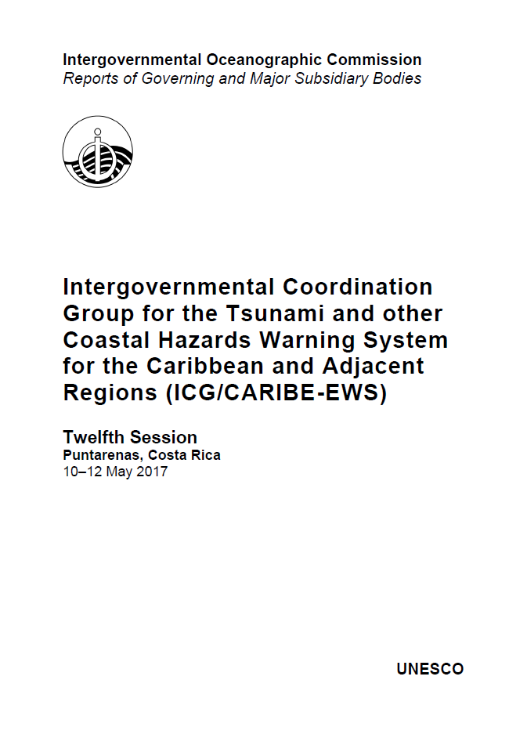
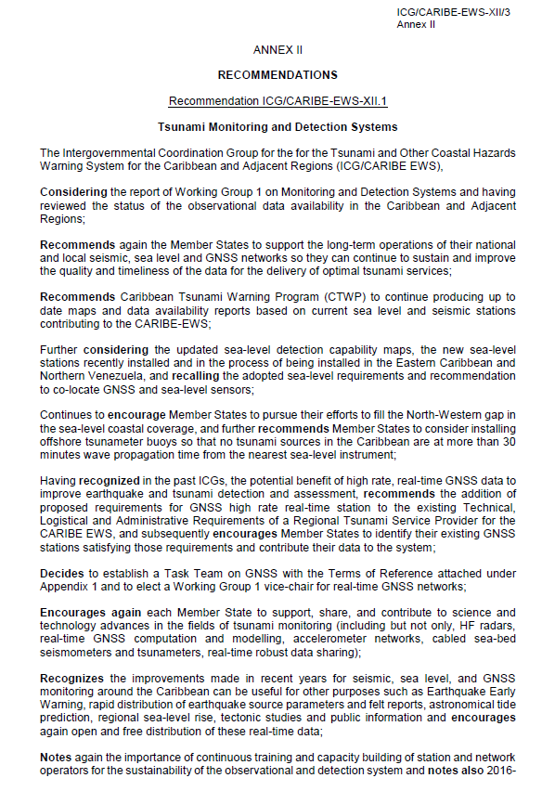

Slide 4
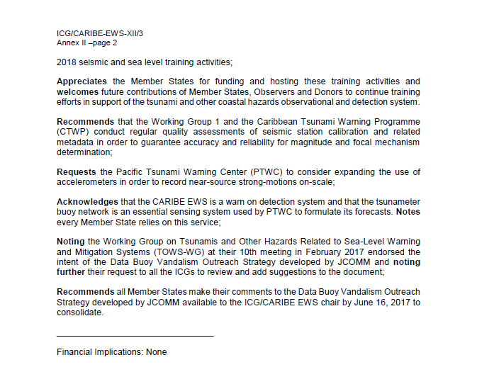
Follow up by CTWP of stations status, data availability and improvements in the number of contributing stations

Slide 5
CARIBE EWS Support
Working Group on Tsunami Monitoring and Detection, Chaired by Nestor Luque
Regional training for seismic network operators – every 2 – 3 years
CTWP produces monthly reports on seismic data availability
CTWP hosts bimonthly virtual meetings of seismic network operators

Slide 6
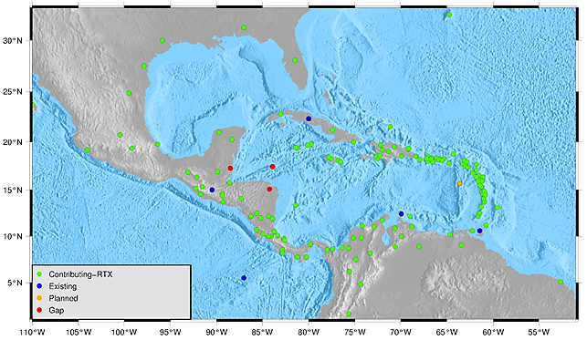
Seismic Stations March 2017
Notes:
Seismic stations in the Caribbean. Status from CTWP.

Slide 7
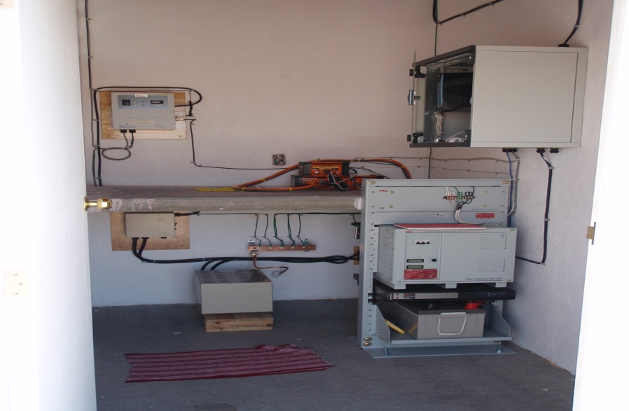
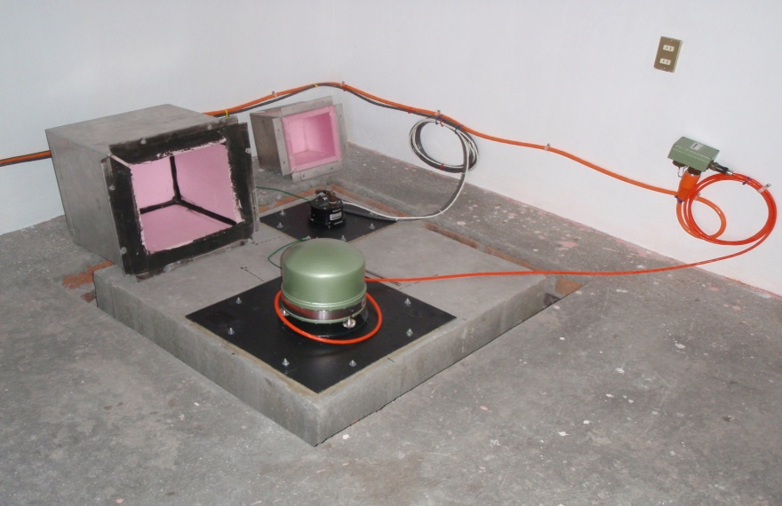
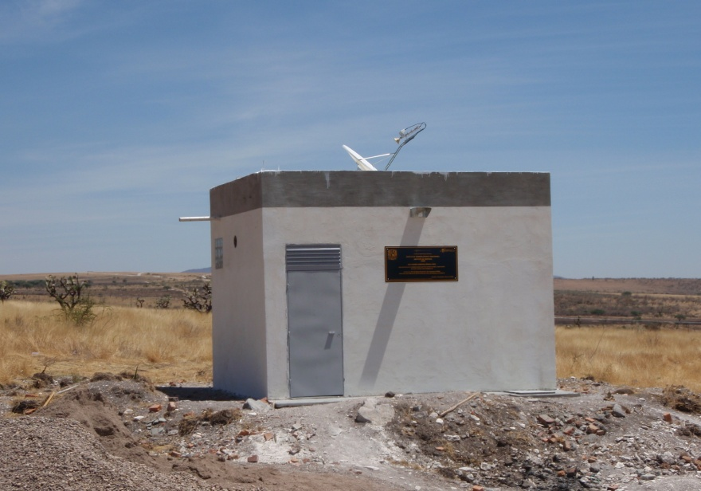
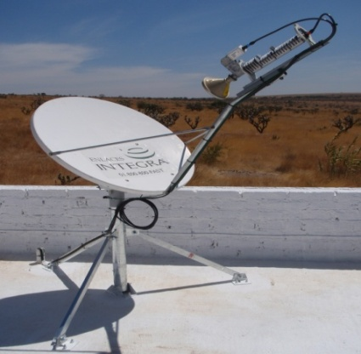

Mexican Seismic Network Station

Slide 8
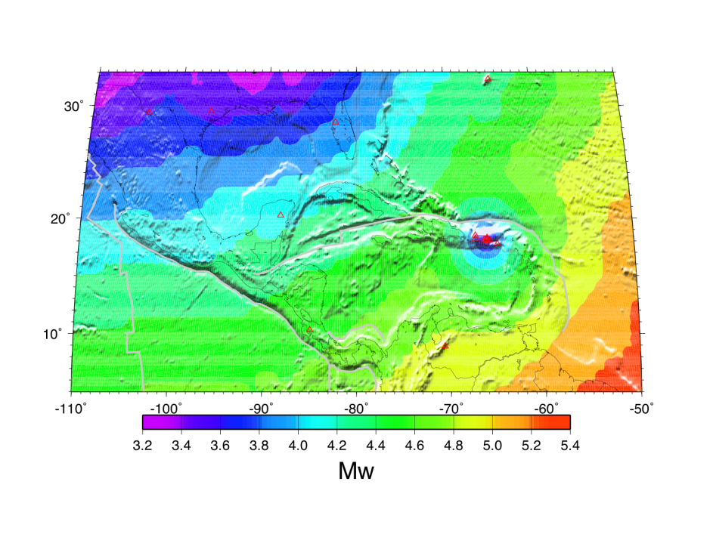
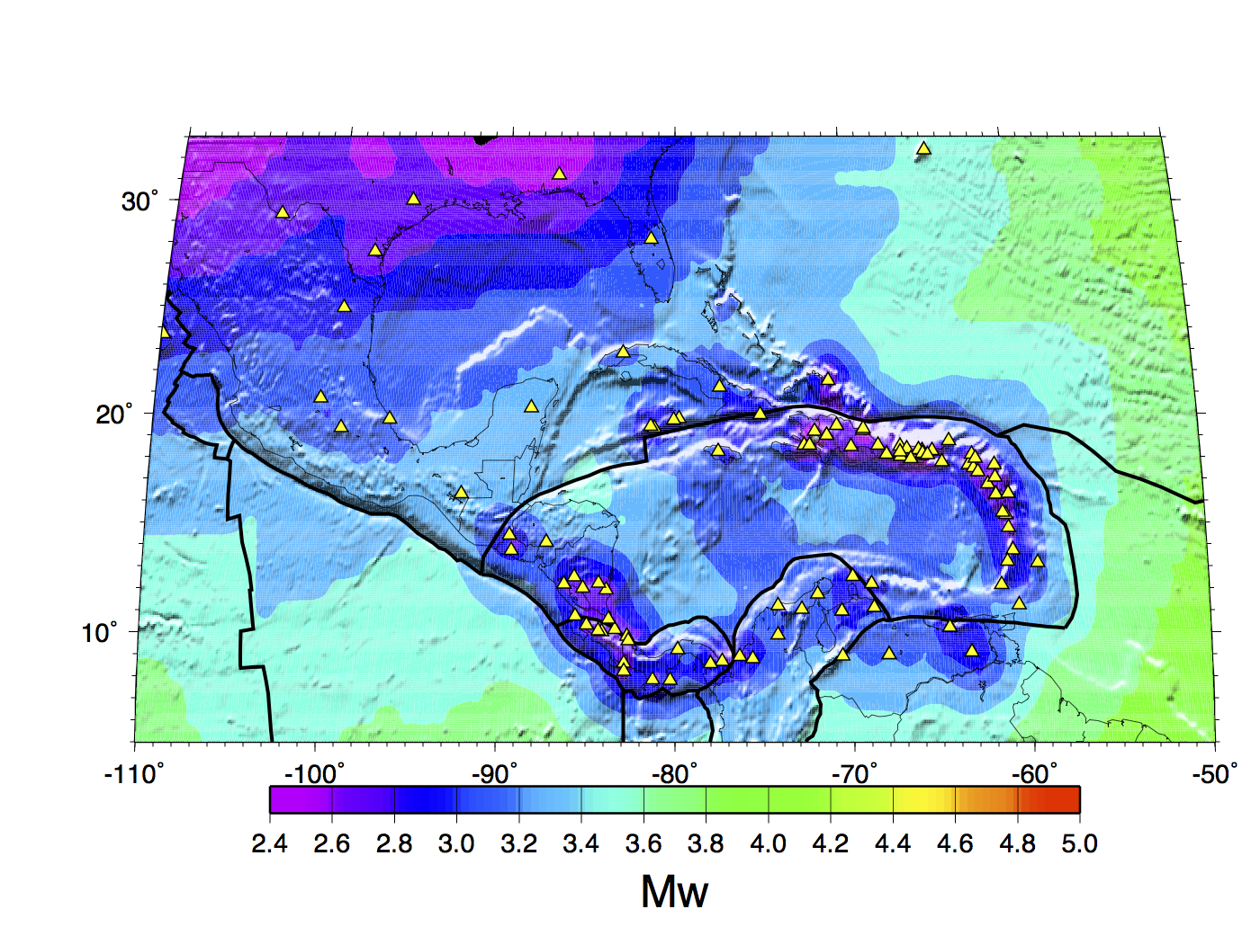
Magnitude threshold : goal 4.5
2006
2017

Slide 9
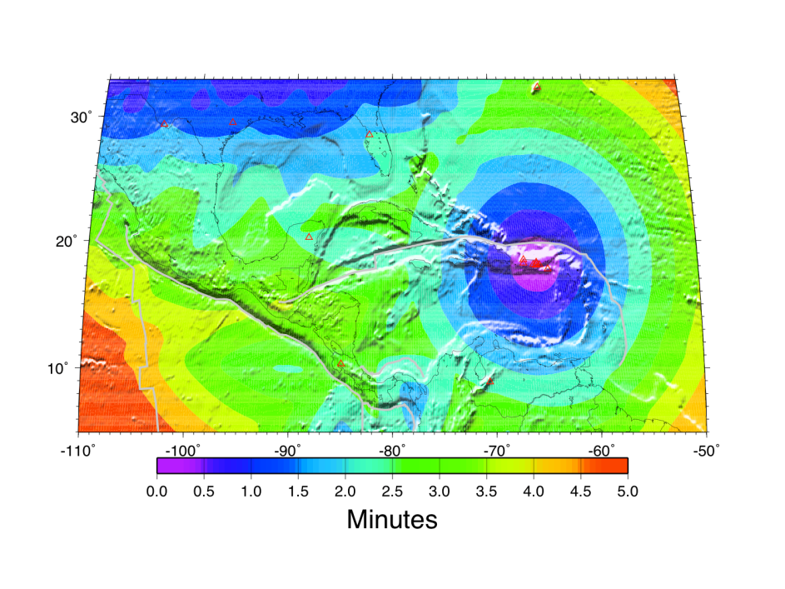
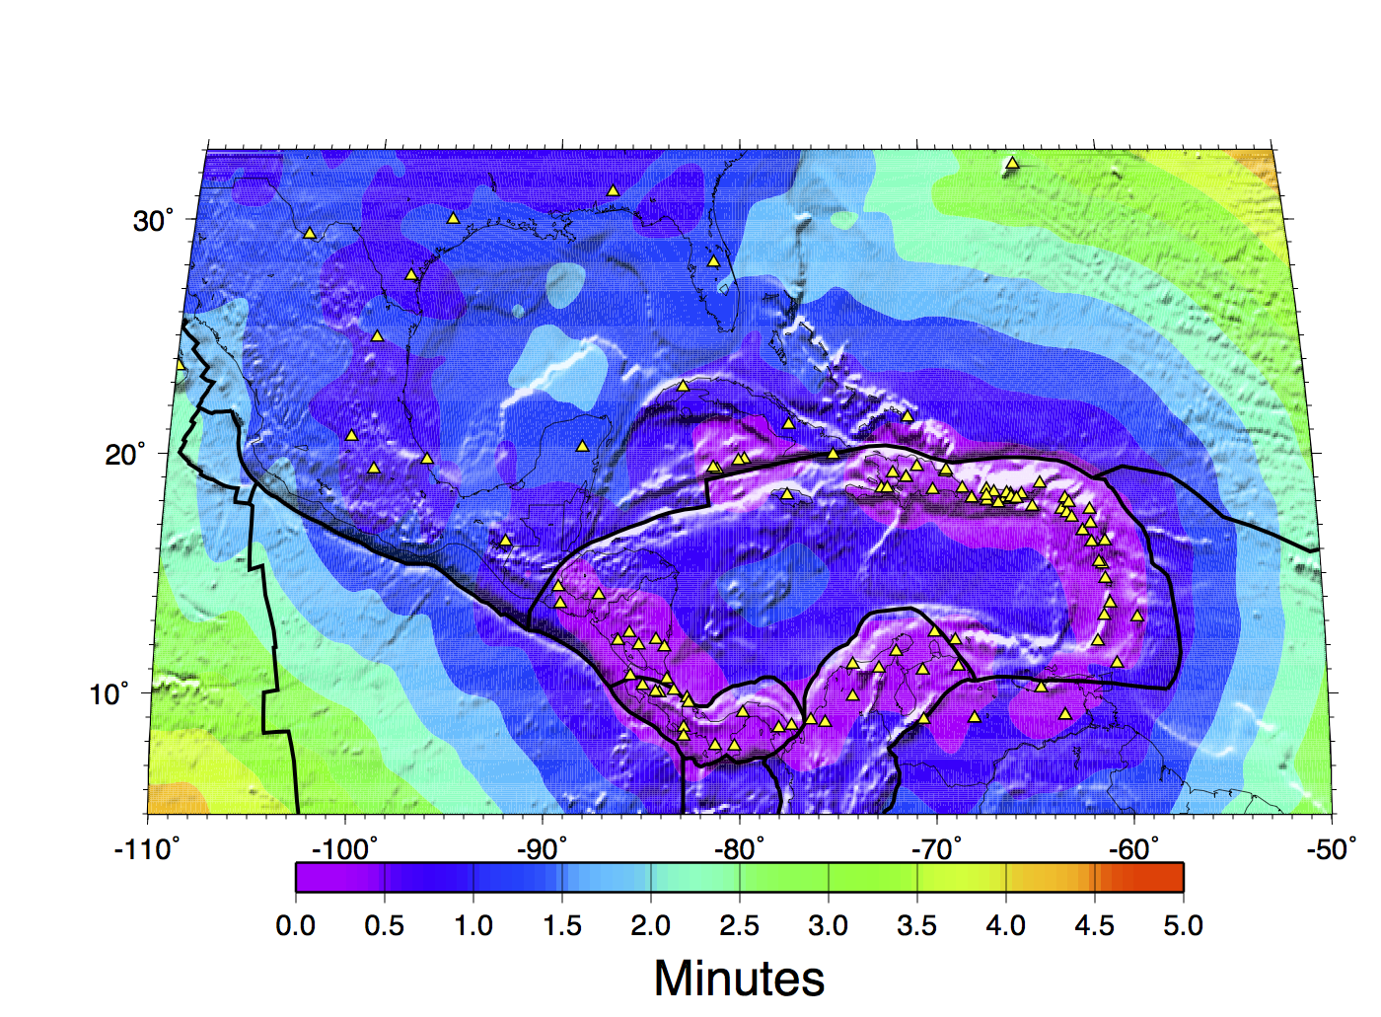
Detection time : goal 1 minute
2006
2017

Slide 10
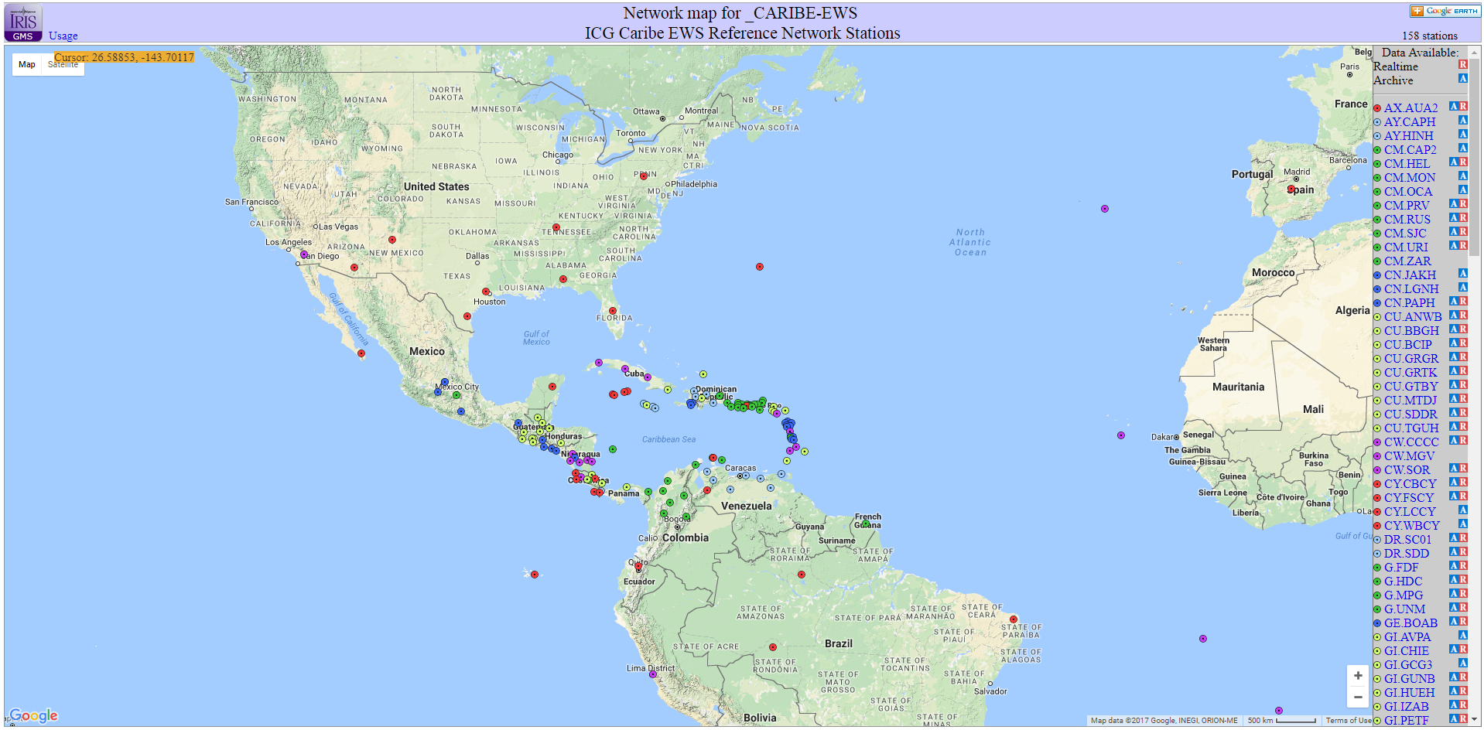
http://www.iris.washington.edu/gmap/_CARIBE-EWS
Notes:
On IRIS a virtual seismic network was established to aggregate all the information from registered Caribbean seismic stations, whether or not data has been archived at the Data Management Center (http://www.iris.edu/gmap/_CARIBE-EWS). Among other services, IRIS offers a webservice to track and follow changes that have occurred in the metadata stored in their facility (http://service.iris.edu/irisws/metadatachange/1/), even if no data are available

Slide 13
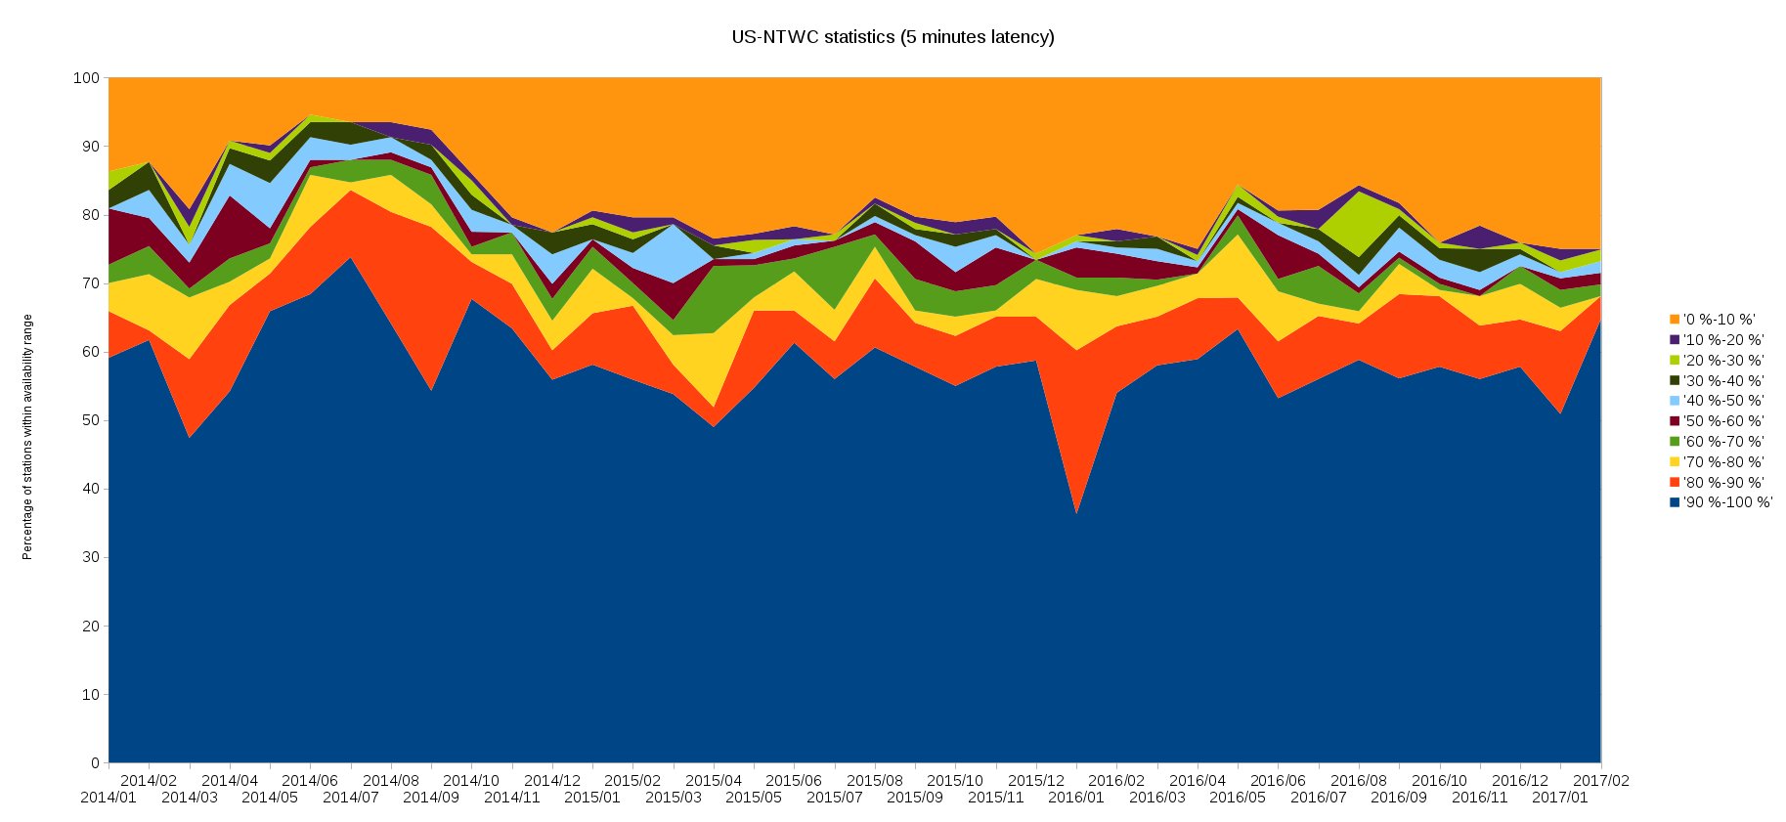
Notes:
Data availability in US-NTWC (March 2017, CTWP). This graph shows only the ratio of available stations over all the contributing stations.

Slide 14
Notes:
Data availability for Contributing-RTX stations at IRIS (May – August 2017)

Slide 15
Notes:
5 minute latency for Contributing-RTX stations at US-NTWC (May – August 2017)

Slide 16
Notes:
Uptime percentage for Contributing-RTX stations at PTWC (May – August 2017)

Slide 17
Notes:
One minute latency for contributing-RTX stations at PRSN (May – August 2017)

Slide 19
Metadata quality check
Seismic metadata is crucial for correct threat level assessment (EQ location and magnitude)
Metadata quality check performed on IRIS and TSPs metadata
Automatic identification of problems using spectral representation
Just a few minor problems identified at IRIS repository
More questions raised by the on-going work on TSPs metadata

Slide 20
Continuous GPS network
COCONet and TLALOCNet projects installations almost completed
1Hz high rate real-time GNSS capabilities for 52 stations in the Caribbean and 15 in Mexico
COCONet community workshop in Punta Cana in May 2016
Real-time GNSS stations requirements proposed

Slide 21
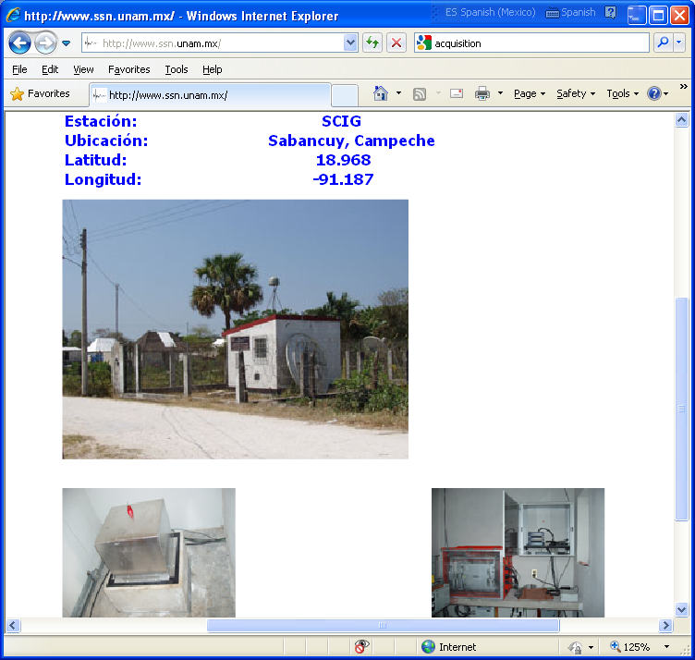
GPS integration into the Mexican Seismic Network

Slide 22
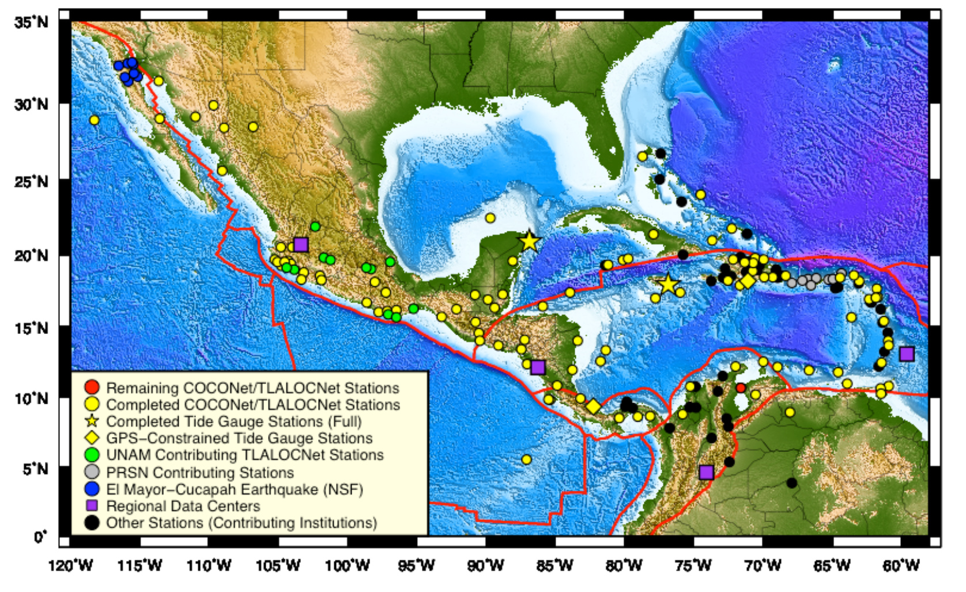
Continuous GNSS stations

Slide 23
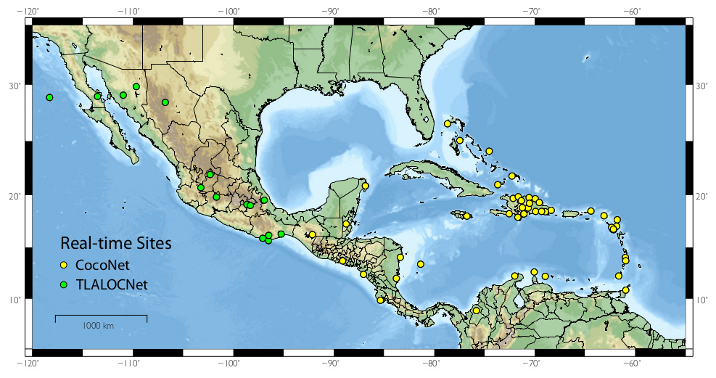
Real-time GNSS network

Slide 24
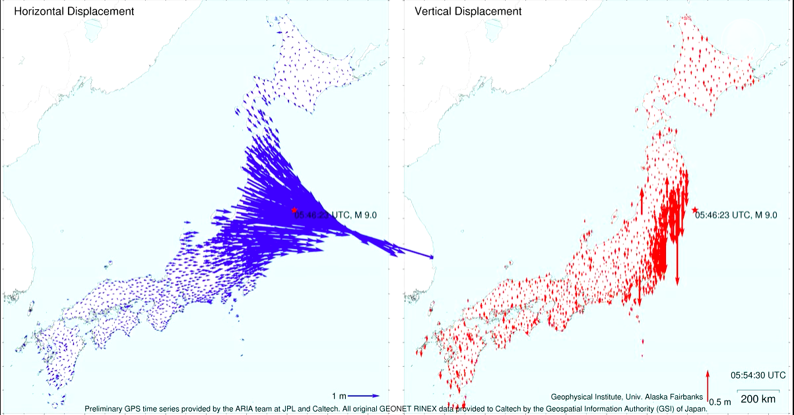
Real-time GNSS applications
Courtesy of Gerald Bawden, NASA

Slide 25
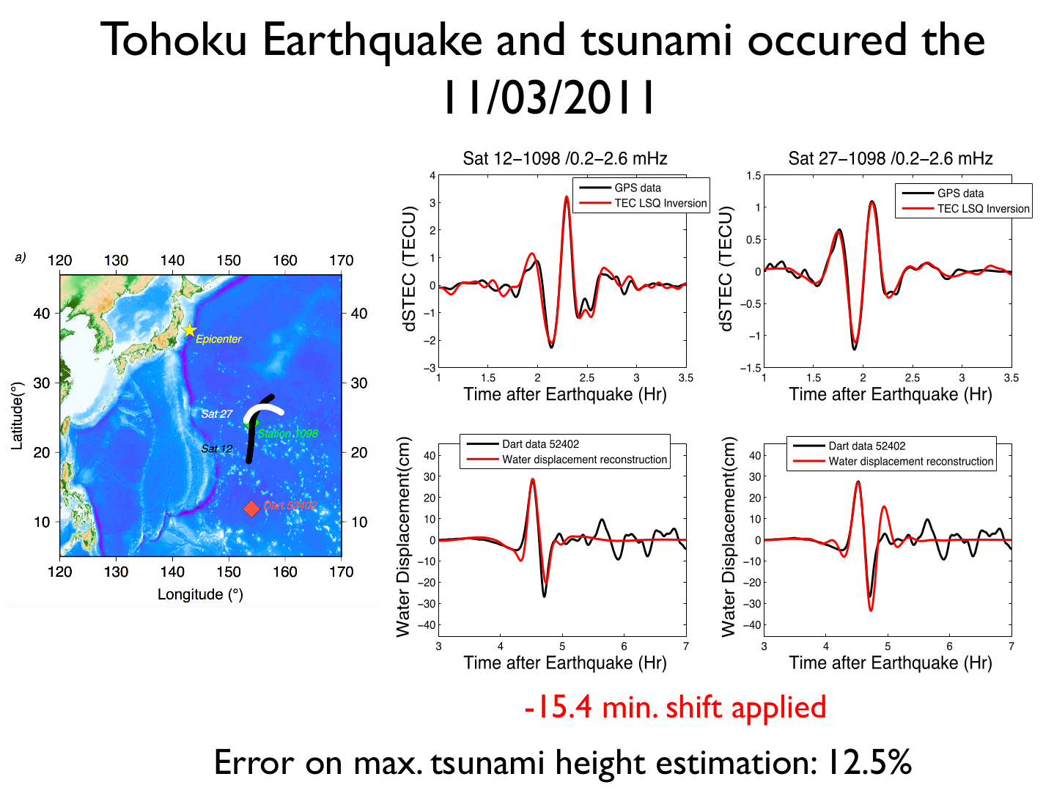
Real-time GNSS applications :
wave heigh estimation (2cm detection threshold)
Courtesy of Giovanni Occhipinti, IPGP

Slide 26
Thanks to all the Seismic Networks that Contribute Data to the CARIBE EWS
Regional Training Workshop on Pacific Tsunami Warning Center Enhanced Tsunami Products for ICG/CARIBE EWS
31 October – 02 November, 2017
Cartagena, Colombia

Slide 27
Thank You
Regional Training Workshop on Pacific Tsunami Warning Center Enhanced Tsunami Products for ICG/CARIBE EWS
31 October – 02 November, 2017
Cartagena, Colombia
Christa von Hillebrandt-Andrade
NOAA-NWS Caribbean Tsunami Warning Program

