Slide 1






1.4 Regional Training Workshop on Pacific Tsunami Warning Center
Enhanced Tsunami Products for ICG/CARIBE EWS:
ICG/CARIBE-EWS XII Outcomes
Regional Training Workshop on Pacific Tsunami Warning Center Enhanced Tsunami Products for ICG/CARIBE EWS
31 October – 02 November, 2017
Cartagena, Colombia
Alison Brome
UNESCO/IOC Caribbean Tsunami Information Centre

Slide 2
International Structure
Why is it Needed?
Tsunamis Cross Oceans and Seas in Hours – Need Rapid Information from Other Countries to Assess
Regional Tsunami Service Providers can do Tsunami Threat Assessment for Many Countries
Tsunamis are Rare – Learn from Experience of Other Countries for Warning and Mitigation
Tsunami Science is Multidisciplinary with Few Scientists – International Exchange of Results
UNESCO/IOC Tsunami Program
Started in 1965 with Pacific System after 1960 Pacific-wide Tsunami from Chile Mw 9.5 Quake
Expanded in 2005 to Indian Ocean, Caribbean, and NE Atlantic – Mediterranean after 2004 Indian Ocean-wide Tsunami from Indonesia

Slide 3
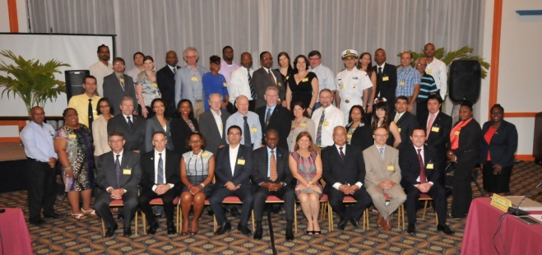
CARIBE EWS
UNESCO/IOC led
12 Sessions held since 2006, most recent in Puntarenas, Costa Rica, from May 2017
48 Members - Member States, UNESCO Associate Member States and 12 Territories, Overseas Territories, States of Member States
Organizations Supporting CARIBE EWS
  Caribbean Tsunami Information Centre
  Pacific Tsunami Warning Center
  Caribbean Tsunami Warning Program

Slide 4
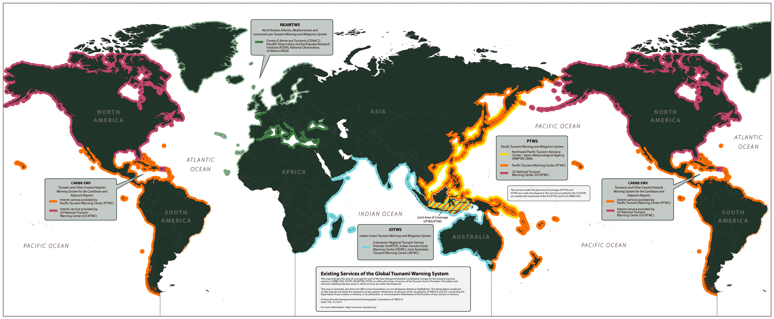
IOC Tsunami Program Coverage

Slide 5
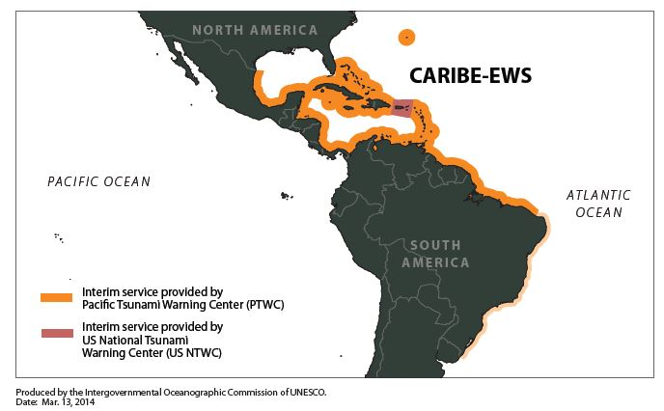
IOC Tsunami Program Coverage

Slide 6
Member State Participation
Countries request to IOC to be a Member State of System(s) through official channels.
Member States designate a Person as their Tsunami National Contact for official communication and to represent country in the system’s Intergovernmental Coordination Group (ICG)
Member States designate a 24x7 office as their Tsunami Warning Focal Point (TWFP) to receive urgent information from regional centers or other contacts during events.
Member States may designate an office as their National Tsunami Warning Center (NTWC) that is responsible for issuing warnings within the country.

Slide 7
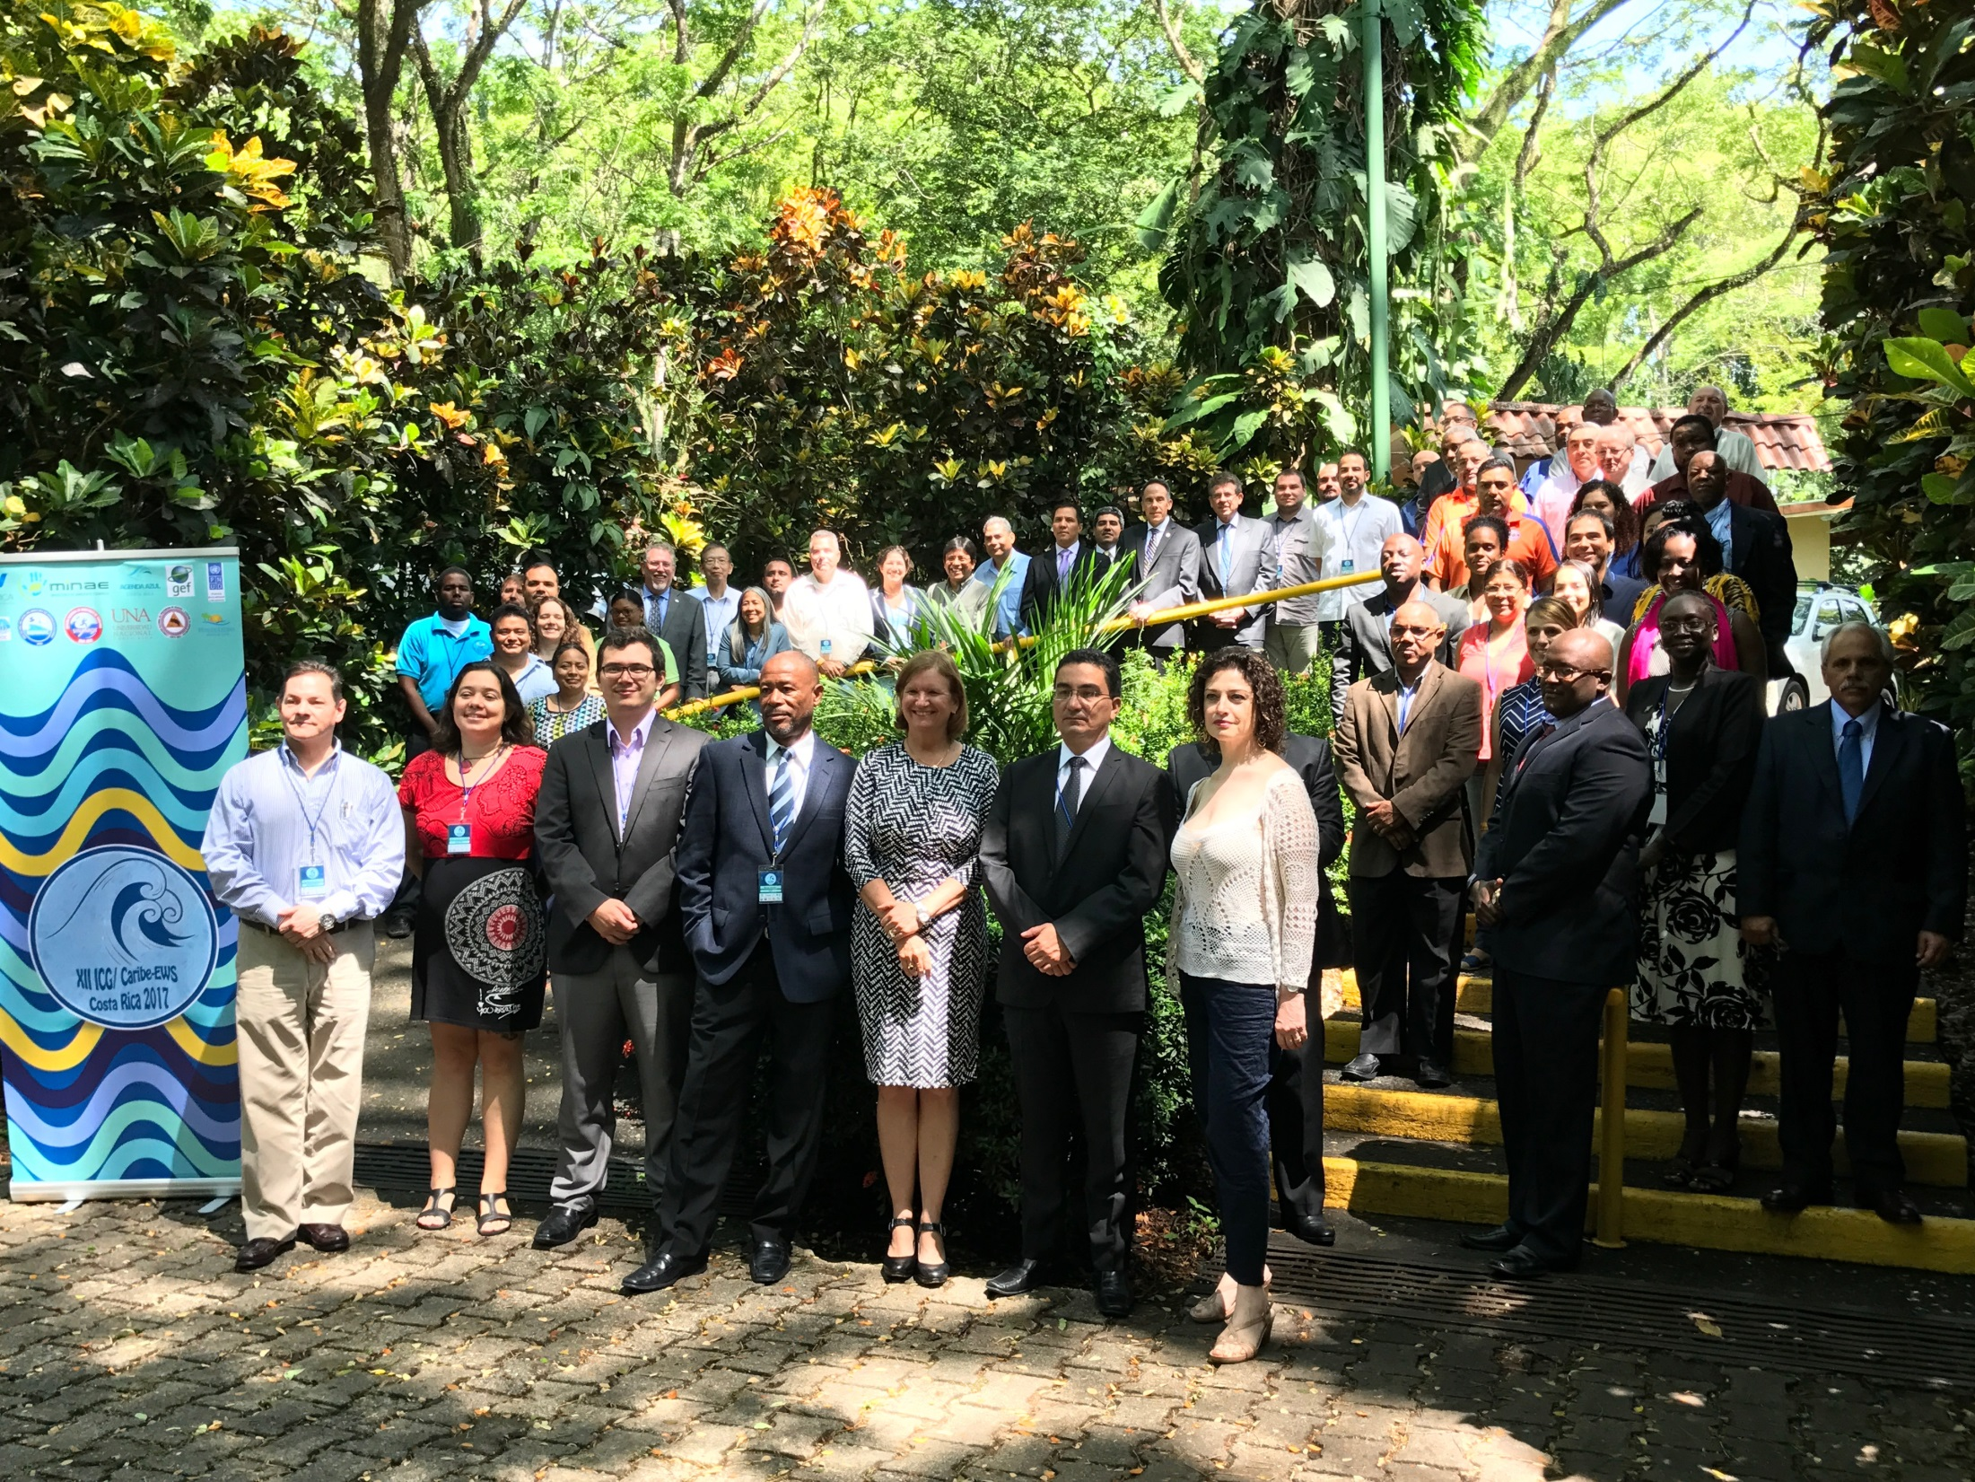

Slide 8
Outcomes from ICG-CARIBE EWS XII
Member States (MS) use as many ways of receiving Tsunami Service Provider (TSP) products as possible and provide updates
MS use of multiple communication methods (including volunteer amateur radio organizations) to disseminate tsunami forecast and warning products in-country
All communication methods to be used be documented in local Standard Operating Procedures (SOPs

Slide 9
Outcomes from ICG-CARIBE EWS XII
To promote good practices in the use of social media for official tsunami warning dissemination, MS review and comment on:
Proposal for a Training Program on Tsunamis Risk for Social Communicators
Proposal for the use of social networks (web 2.0) for the communication of early tsunami warnings, and feedback of information on the impact of tsunamis
to support its adoption at the next ICG Meeting

Slide 10
Outcomes from ICG-CARIBE EWS XII
MS to conduct regular tests of communications methods and to explore web-based teleconferencing platforms with easy access and need for little infrastructure
Communication SOPs to be community centered in order to ensure timely information is conveyed to the populations at risk;

Slide 11
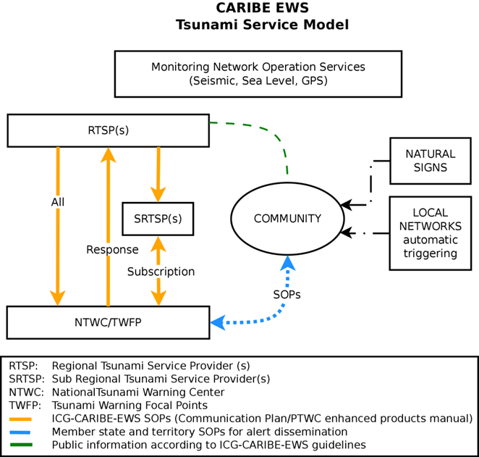
Outcomes of Recent ICG CARIBE EWS
ICG CARIBE EWS Service Model

Slide 12
Outcomes from ICG-CARIBE EWS XII
MS to share their experience using different communication means (problems e.g. false alerts, and solutions) in order to facilitate use of best practices based on actual experience;
Requests PTWC to assess the feasibility of issuing text products in French, and Spanish, in addition to English, and report back to the ICG

Slide 13
Outcomes from ICG-CARIBE EWS XII
PTWC to provide Heads-up SMS service, as a two-year trial project for CARIBE EWS MS
Gov’t of USA to develop a new website (tsunami.gov) = PTWC information and products + US National Tsunami Warning Center including status of tsunami events both nationally and internationally
Caribe Wave18 on Thursday March 15, 2018

Slide 14
Outcomes from ICG-CARIBE EWS XII
Established Tsunami Ready Task to:
Support piloting of the CARIBE EWS Tsunami Ready guidelines
Contribute to the development of consistent global guidelines that are harmonized between the ICGs as recommended by TOWS-X
Develop an evaluation instrument to measure the effectiveness of CARIBE EWS Tsunami Ready Guidelines in the pilot communities

Slide 15
Outcomes from ICG-CARIBE EWS XII
Renewal of CARIBE EWS Tsunami Ready recognition be changed from three to four years

Slide 16
Thank You
Regional Training Workshop on Pacific Tsunami Warning Center Enhanced Tsunami Products for ICG/CARIBE EWS
31 October – 02 November, 2017
Cartagena, Colombia
Alison Brome
UNESCO/IOC Caribbean Tsunami Information Centre

